Slide 1
Topic – 4
Autosar Basic Software (BSW) stack overview

Slide 2
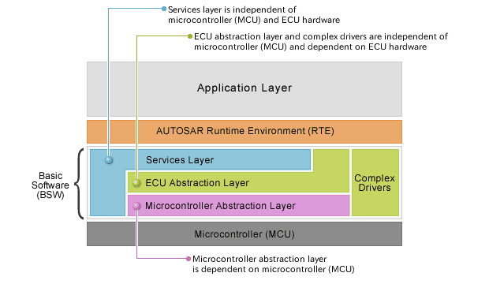
Introduction
Autosar (Automotive Open System Architecture) is a standardized software architecture for automotive systems.
The Autosar BSW stack forms the foundation of the Autosar architecture, providing essential software modules for vehicle functions.
This presentation provides an overview of the Autosar BSW stack.

Slide 3
Components of Autosar BSW Stack
The Autosar BSW stack consists of the following components:
ECU Abstraction Layer (EAL):
Provides an interface between the hardware and higher-level software components.
Handles hardware-specific operations and simplifies software development.
Microcontroller Abstraction Layer (MCAL):
Abstracts the low-level hardware details of microcontrollers.
Offers standardized APIs for accessing hardware features such as ADC, PWM, and CAN.
Services Layer:
Offers a set of services that enable communication and coordination between different software modules.
Includes services like memory management, diagnostics, and communication services (CAN, LIN, FlexRay, Ethernet).
Operating System (OS):
Manages the execution of different software components in a time-controlled manner.
Provides task scheduling, resource management, and inter-task communication services.

Slide 4
Runtime Environment (RTE):
Provides a communication layer between application software components and the BSW stack.
Enables the exchange of data and signals between different software modules.
Diagnostic Stack (UDS):
Implements diagnostic functionality, allowing communication between the vehicle and external diagnostic tools.
Supports diagnostic services such as reading and clearing fault codes, accessing ECU information, etc.
Memory Stack:
Manages the memory resources of the ECU.
Allocates and deallocates memory dynamically to optimize resource utilization.

Slide 5
Benefits of Autosar BSW Stack
Standardization: Enables software components from different suppliers to work together seamlessly.
Reusability: Promotes the reuse of software modules across different vehicle platforms.
Scalability: Supports various hardware configurations, allowing flexibility in ECU selection.
Interoperability: Facilitates the exchange of data and information between different ECUs in a vehicle.

Slide 6
Conclusion
The Autosar Basic Software (BSW) stack serves as the foundation of the Autosar architecture.
It provides essential software components for automotive systems, enabling interoperability and reusability.
By leveraging the Autosar BSW stack, automotive manufacturers can develop complex vehicle functions efficiently and reliably.

