Slide 1
Digital Communication Systems
Harish Chandra Mohanta, CUTM, Bhubaneswar Campus

Slide 2
Information Representation
Communication systems convert information into a form suitable for transmission
Analog systems→Analog signals are modulated (AM, FM radio)
Digital system generate bits and transmit digital signals (Computers)
Analog signals can be converted to digital signals.

Slide 4
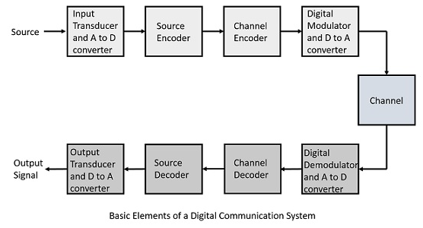
Block Diagram

Slide 5
Digital Data System

Slide 6
Components of Digital Communication
Sampling: If the message is analog, it’s converted to discrete time by sampling.
(What should the sampling rate be ?)
Quantization: Quantized in amplitude.
Discrete in time and amplitude
Encoder:
  Convert message or signals in accordance with a set of rules
  Translate the discrete set of sample values to a signal.
Decoder: Decodes received signals back into original message

Slide 7
Advantages
Stability of components: Analog hardware change due to component aging, heat, etc.
Flexibility:
  Perform encryption
  Compression
  Error correction/detection
Reliable reproduction

Slide 8
Advantages of Digital communication
The greatest advantage of digital communication over analog communication is the viability of regenerative repeaters in the former.
Digital hardware implementation is flexible and permits the use of microprocessors, mini-processors, digital switching, and large scale integrated circuits.
Digital Signals can be coded to yield extremely low error rates and high fidelity as well as privacy.
It is easier and more efficient to multiplex several digital signals.
Digital communication is inherently more efficient than analog in realizing the exchange of SNR for bandwidth.
Digital signal storage is relatively easy and inexpensive.

Slide 9
Applications
Digital Audio Transmission
Telephone channels
Lowpass filter, sample, quantize
32kbps-64kbps (depending on the encoder)
Digital Audio Recording
LP vs. CD
Improve fidelity (How?)
More durable and don’t deteriorate with time

Slide 10
Classification of Digital Communication
Digital communication is classified into two types.
(1) Baseband data transmission
(2) Bandpass data transmission
Baseband data transmissions are of two types
        Pulse analog (PAM, PWM, PPM)
        Pulse digital (PCM, DPCM, DM, ADM)
The fundamental difference between baseband and bandpass data transmission is with respect to channel.
For bandpass, the channel is free space and for baseband, the channel is coaxial cable or fibre optic cable or twisted pair.

Slide 11
Sampling: Time Domain
Many signals originate as continuous-time signals, e.g. conventional music or voice
By sampling a continuous-time signal at isolated, equally-spaced points in time, we obtain a sequence of numbers
  n ∈ {…, -2, -1, 0, 1, 2,…}
  T_{s} is the sampling period.
T_{s}
t
T_{s}
s(t)
Sampled analog waveform
impulse train

Slide 12
Sampling: Frequency Domain
Replicates spectrum of continuous-time signal
  At offsets that are integer multiples of sampling frequency
Fourier series of impulse train where w_{s} = 2 p f_{s}
Example
Modulation by cos(ω_{s} t)
Modulation by cos(2 ω_{s} t)
F(ω)
G(ω)
ω
ω
-2πf_{max}
2πf_{max}
−2ω_{s}
−ω_{s}
ω_{s}
2ω_{s}

Slide 13
Shannon Sampling Theorem
A continuous-time signal x(t) with frequencies no higher than f_{max} can be reconstructed from its samples x[n] = x(n T_{s}) if the samples are taken at a rate f_{s} which is greater than 2 f_{max}.
  Nyquist rate = 2 f_{max}
  Nyquist frequency = f_{s}/2.
What happens if f_{s} = 2f_{max}?
Consider a sinusoid sin(2 p f_{max} t)
  Use a sampling period of T_{s} = 1/f_{s} = 1/2f_{max}.
  Sketch: sinusoid with zeros at t = 0, 1/2f_{max}, 1/f_{max}, …

Slide 14
Shannon Sampling Theorem
Assumption
Continuous-time signal has no frequency content above f_{max}
Sampling time is exactly the same between any two samples
Sequence of numbers obtained by sampling is represented in exact precision
Conversion of sequence to continuous time is ideal
In Practice

Slide 15
Why 44.1 kHz for Audio CDs?
Sound is audible in 20 Hz to 20 kHz range:
  f_{max} = 20 kHz and the Nyquist rate 2 f_{max} = 40 kHz
What is the extra 10% of the bandwidth used?
  Rolloff from passband to stopband in the magnitude response of the anti-aliasing filter
Okay, 44 kHz makes sense. Why 44.1 kHz?
  At the time the choice was made, only recorders capable of storing such high rates were VCRs.
  NTSC: 490 lines/frame, 3 samples/line, 30 frames/s = 44100 samples/s
  PAL: 588 lines/frame, 3 samples/line, 25 frames/s = 44100 samples/s

Slide 16
Sampling
As sampling rate increases, sampled waveform looks more and more like the original
Many applications (e.g. communication systems) care more about frequency content in the waveform and not its shape
Zero crossings: frequency content of a sinusoid
  Distance between two zero crossings: one half period.
  With the sampling theorem satisfied, sampled sinusoid crosses zero at the right times even though its waveform shape may be difficult to recognize

Slide 17
Aliasing
Analog sinusoid
  x(t) = A cos(2πf₀t + φ)
Sample at T_{s} = 1/f_{s}
  x[n] = x(T_{s} n) =
  A cos(2π f₀ T_{s} n + φ)
Keeping the sampling period same, sample
  y(t) = A cos(2π(f₀ + lf_{s})t + φ)
where l is an integer
  y[n] = y(T_{s} n)
  = A cos(2π(f₀ + lf_{s})T_{s}n + φ)
  = A cos(2πf₀T_{s}n + 2π lf_{s}T_{s}n + φ)
  = A cos(2πf₀T_{s}n + 2π l n + φ)
  = A cos(2πf₀T_{s}n + φ)
  = x[n]
  Here, f_{s}T_{s} = 1
  Since l is an integer,
  cos(x + 2πl) = cos(x)
y[n] indistinguishable from x[n]
Frequencies f₀ + l f_{s} for l ≠ 0 are aliases of frequency f₀

Slide 18
ANALOG-TO-DIGITAL CONVERSION
A digital signal is superior to an analog signal because it is more robust to noise and can easily be recovered, corrected and amplified. For this reason, the tendency today is to change an analog signal to digital data. In this section we describe two techniques, pulse code modulation and delta modulation.
Topics discussed in this section:
Pulse Code Modulation (PCM)
Delta Modulation (DM)

Slide 19
PCM
PCM consists of three steps to digitize an analog signal:
  Sampling
  Quantization
  Binary encoding
Before we sample, we have to filter the signal to limit the maximum frequency of the signal as it affects the sampling rate.
Filtering should ensure that we do not distort the signal, ie remove high frequency components that affect the signal shape.

Slide 20
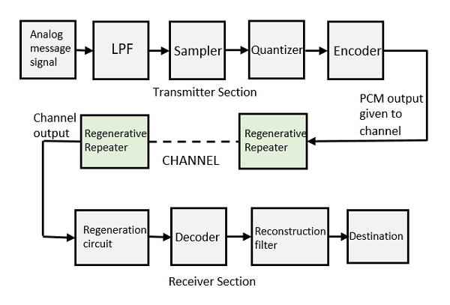
BLOCK DIAGRAM of PCM

Slide 21
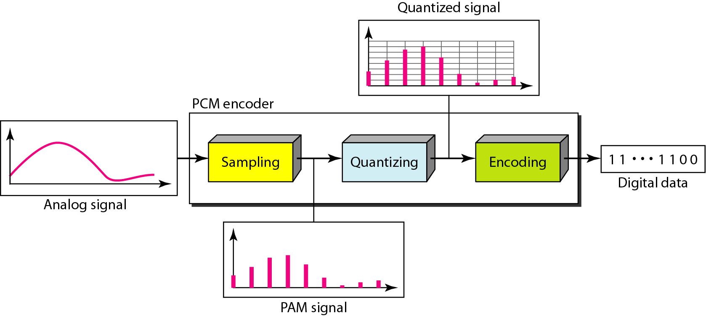
Components of PCM encoder

Slide 22
Sampling
Analog signal is sampled every T_{S} secs.
T_{s} is referred to as the sampling interval.
f_{s} = 1/T_{s} is called the sampling rate or sampling frequency.
There are 3 sampling methods:
  Ideal - an impulse at each sampling instant
  Natural - a pulse of short width with varying amplitude
  Flattop - sample and hold, like natural but with single amplitude value
The process is referred to as pulse amplitude modulation PAM and the outcome is a signal with analog (non integer) values

Slide 23
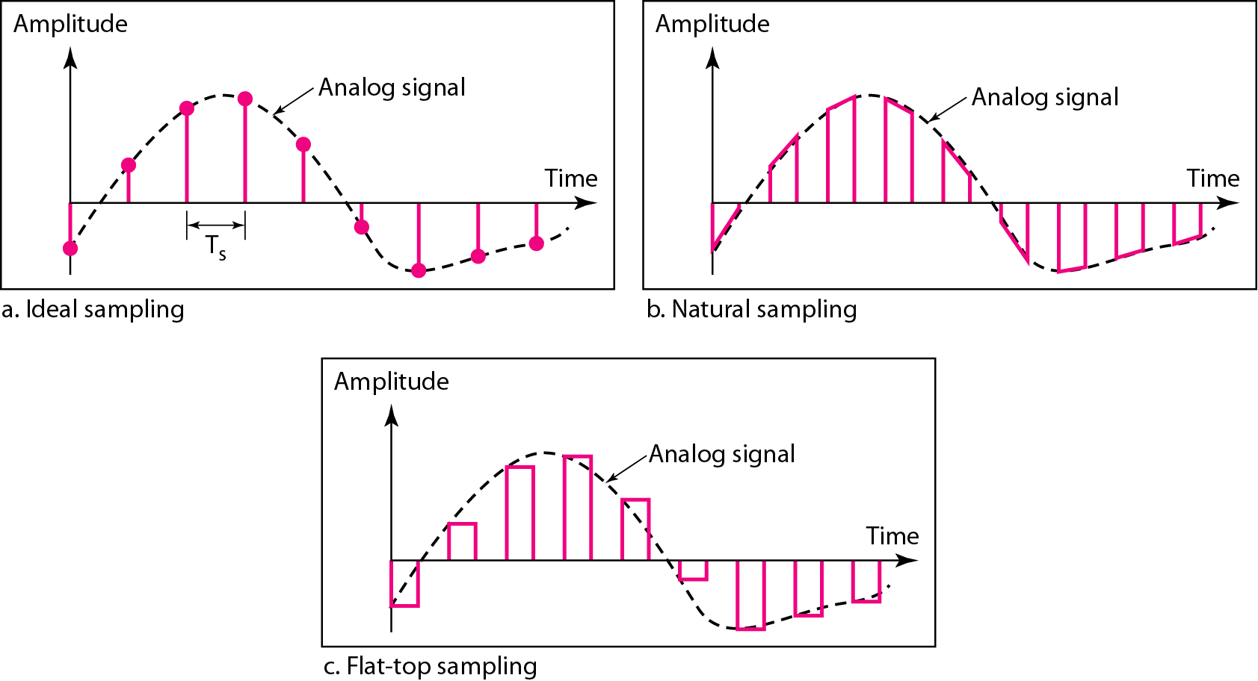
Three different sampling methods for PCM

Slide 24

Note
According to the Nyquist theorem, the sampling rate must be
at least 2 times the highest frequency contained in the signal.

Slide 25
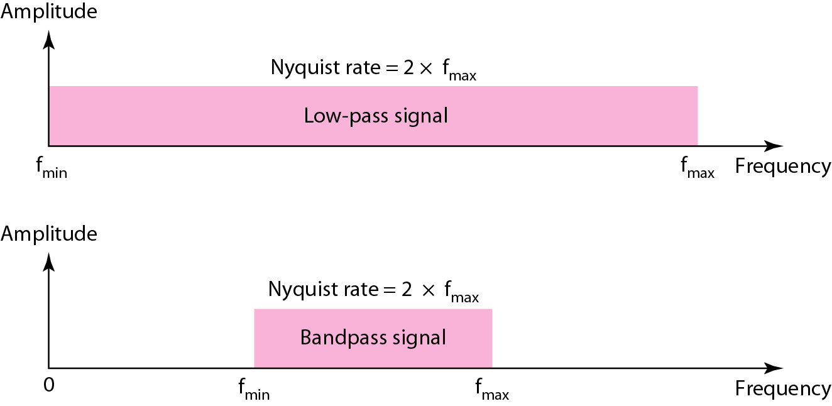
Nyquist sampling rate for low-pass and bandpass signals

Slide 26
Example
For an intuitive example of the Nyquist theorem, let us sample a simple sine wave at three sampling rates: f_{s} = 4f (2 times the Nyquist rate), f_{s} = 2f (Nyquist rate), and
f_{s} = f (one-half the Nyquist rate). Figure 4.24 shows the sampling and the subsequent recovery of the signal.
It can be seen that sampling at the Nyquist rate can create a good approximation of the original sine wave (part a). Oversampling in part b can also create the same approximation, but it is redundant and unnecessary. Sampling below the Nyquist rate (part c) does not produce a signal that looks like the original sine wave.

Slide 27
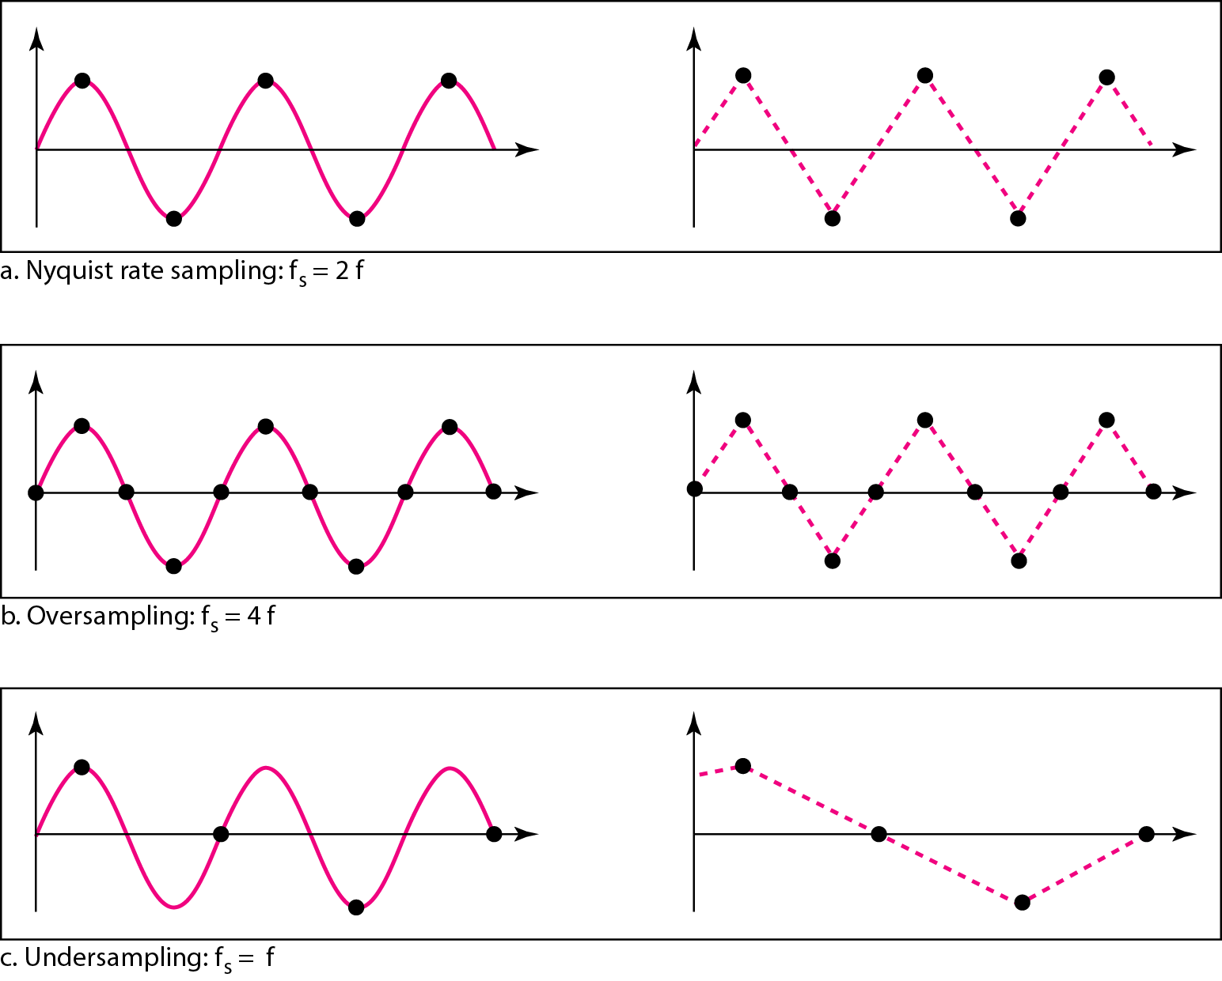
Recovery of a sampled sine wave for different sampling rates

Slide 28
Example
Consider the revolution of a hand of a clock. The second hand of a clock has a period of 60 s. According to the Nyquist theorem, we need to sample the hand every 30 s (T_{s} = T or f_{s} = 2f ). In Figure 4.25a, the sample points, in order, are 12, 6, 12, 6, 12, and 6. The receiver of the samples cannot tell if the clock is moving forward or backward. In part b, we sample at double the Nyquist rate (every 15 s). The sample points are 12, 3, 6, 9, and 12. The clock is moving forward. In part c, we sample below the Nyquist rate (T_{s} = T or f_{s} = f ). The sample points are 12, 9, 6, 3, and 12. Although the clock is moving forward, the receiver thinks that the clock is moving backward.

Slide 29
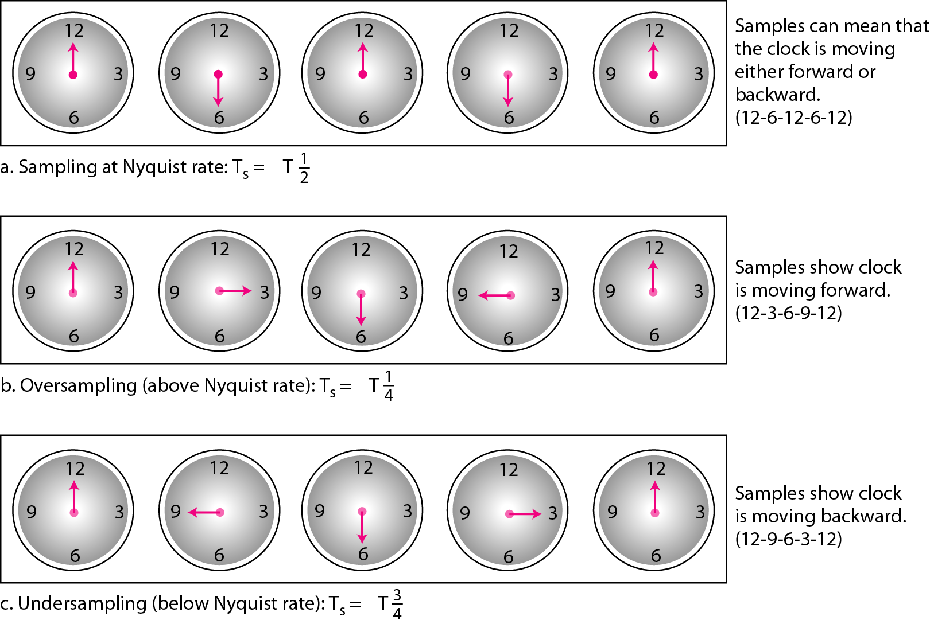
Sampling of a clock with only one hand

Slide 30
Example
An example related to previous example is the seemingly backward rotation of the wheels of a forward-moving car in a movie. This can be explained by under-sampling. A movie is filmed at 24 frames per second. If a wheel is rotating more than 12 times per second, the under-sampling creates the impression of a backward rotation.

Slide 31
Example
Telephone companies digitize voice by assuming a maximum frequency of 4000 Hz. The sampling rate therefore is 8000 samples per second.

Slide 32
Example
A complex low-pass signal has a bandwidth of 200 kHz. What is the minimum sampling rate for this signal?
Solution
The bandwidth of a low-pass signal is between 0 and f, where f is the maximum frequency in the signal. Therefore, we can sample this signal at 2 times the highest frequency (200 kHz). The sampling rate is therefore 400,000 samples per second.

Slide 33
Example
A complex bandpass signal has a bandwidth of 200 kHz. What is the minimum sampling rate for this signal?
Solution
We cannot find the minimum sampling rate in this case because we do not know where the bandwidth starts or ends. We do not know the maximum frequency in the signal.

Slide 34
Quantization
Sampling results in a series of pulses of varying amplitude values ranging between two limits: a min and a max.
The amplitude values are infinite between the two limits.
We need to map the infinite amplitude values onto a finite set of known values.
This is achieved by dividing the distance between min and max into L zones, each of height Δ.
Δ = (max - min)/L

Slide 35
Quantization Levels
The midpoint of each zone is assigned a value from 0 to L-1 (resulting in L values)
Each sample falling in a zone is then approximated to the value of the midpoint.

Slide 36
Quantization Zones
Assume we have a voltage signal with amplitutes V_{min}=-20V and V_{max}=+20V.
We want to use L=8 quantization levels.
Zone width Δ = (20 - -20)/8 = 5
The 8 zones are: -20 to -15, -15 to -10, -10 to -5, -5 to 0, 0 to +5, +5 to +10, +10 to +15, +15 to +20
The midpoints are: -17.5, -12.5, -7.5, -2.5, 2.5, 7.5, 12.5, 17.5

Slide 37
Assigning Codes to Zones
Each zone is then assigned a binary code.
The number of bits required to encode the zones, or the number of bits per sample as it is commonly referred to, is obtained as follows: n_{b} = log₂ L
Given our example, n_{b} = 3
The 8 zone (or level) codes are therefore: 000, 001, 010, 011, 100, 101, 110, and 111
Assigning codes to zones:
  000 will refer to zone -20 to -15
  001 to zone -15 to -10, etc.

Slide 38
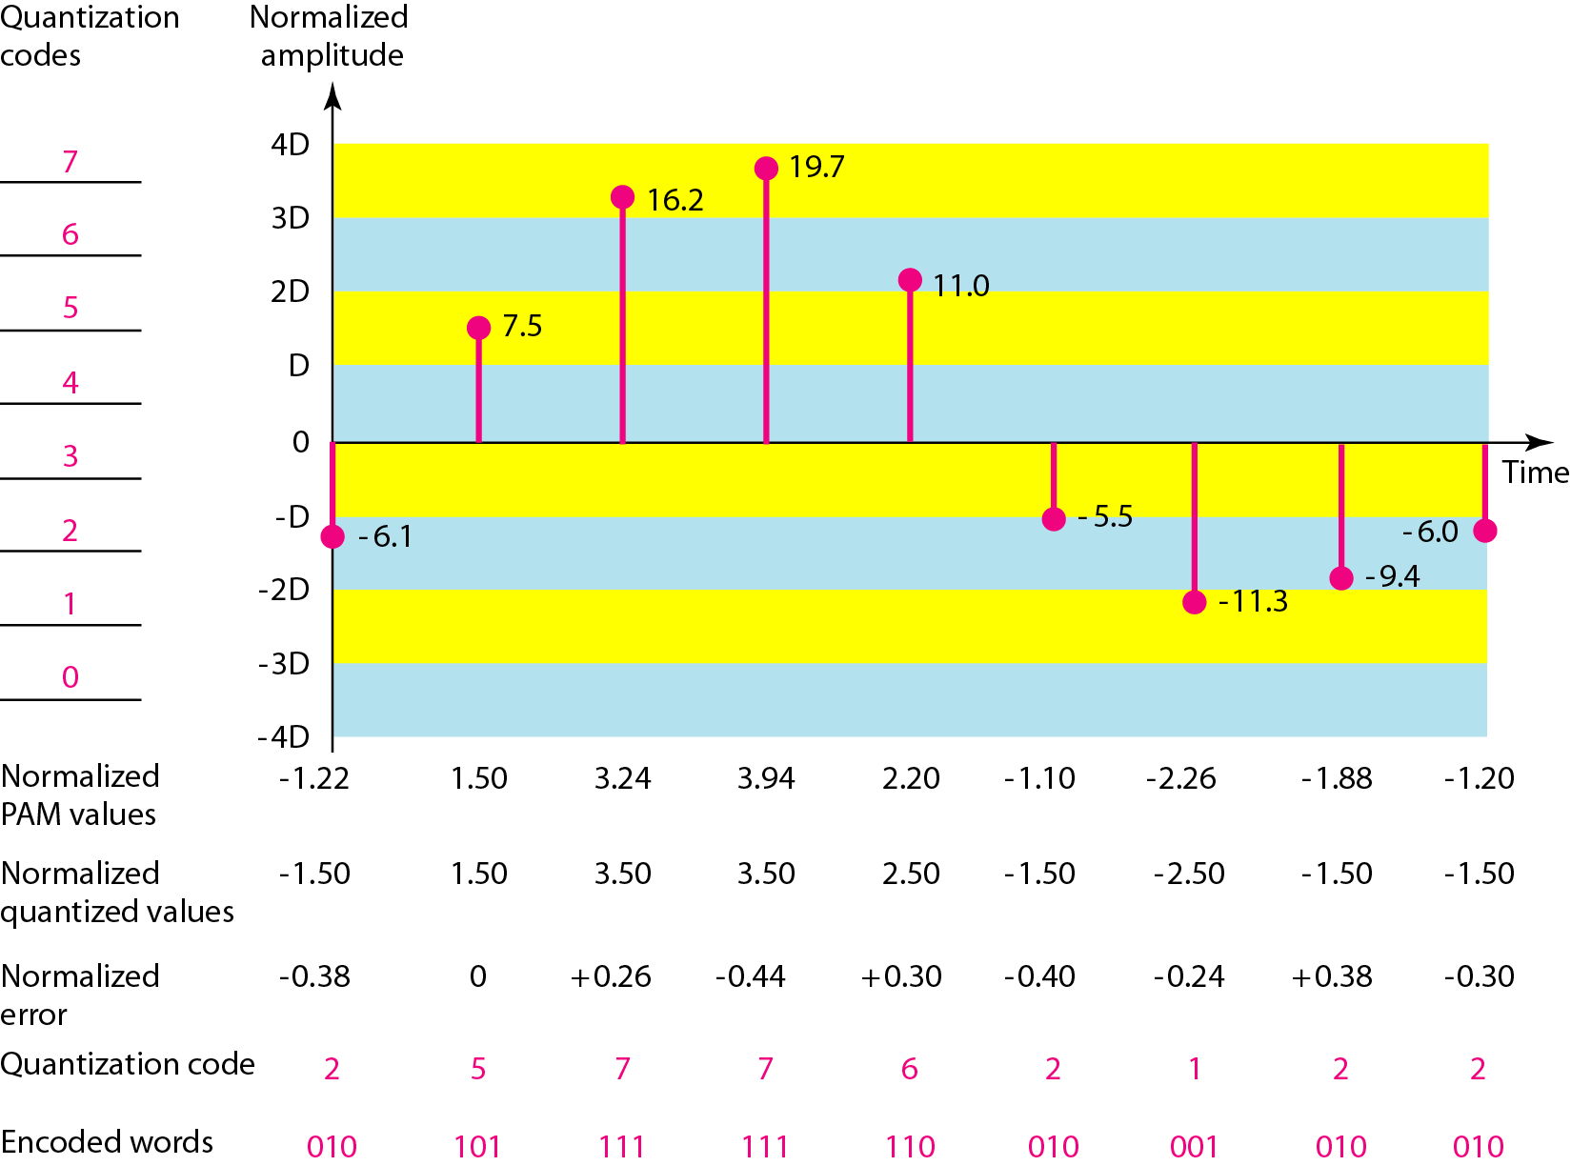
Quantization and encoding of a sampled signal

Slide 39
Quantization Error
When a signal is quantized, we introduce an error - the coded signal is an approximation of the actual amplitude value.
The difference between actual and coded value (midpoint) is referred to as the quantization error.
The more zones, the smaller Δ which results in smaller errors.
BUT, the more zones the more bits required to encode the samples -> higher bit rate

Slide 40
Quantization Error and SNQR
Signals with lower amplitude values will suffer more from quantization error as the error range: Δ/2, is fixed for all signal levels.
Non linear quantization is used to alleviate this problem. Goal is to keep SN_{Q}R fixed for all sample values.
Two approaches:
  The quantization levels follow a logarithmic curve. Smaller Δ’s at lower amplitudes and larger Δ’s at higher amplitudes.
  Companding: The sample values are compressed at the sender into logarithmic zones, and then expanded at the receiver. The zones are fixed in height.

Slide 41
Bit rate and bandwidth requirements of PCM
The bit rate of a PCM signal can be calculated form the number of bits per sample x the sampling rate
Bit rate = n_{b} x f_{s}
The bandwidth required to transmit this signal depends on the type of line encoding used. Refer to previous section for discussion and formulas.
A digitized signal will always need more bandwidth than the original analog signal. Price we pay for robustness and other features of digital transmission.

Slide 42
Example
We want to digitize the human voice. What is the bit rate, assuming 8 bits per sample?
Solution
The human voice normally contains frequencies from 0 to 4000 Hz. So the sampling rate and bit rate are calculated as follows:

Slide 43
PCM Decoder
To recover an analog signal from a digitized signal we follow the following steps:
  We use a hold circuit that holds the amplitude value of a pulse till the next pulse arrives.
  We pass this signal through a low pass filter with a cutoff frequency that is equal to the highest frequency in the pre-sampled signal.
The higher the value of L, the less distorted a signal is recovered.

Slide 44
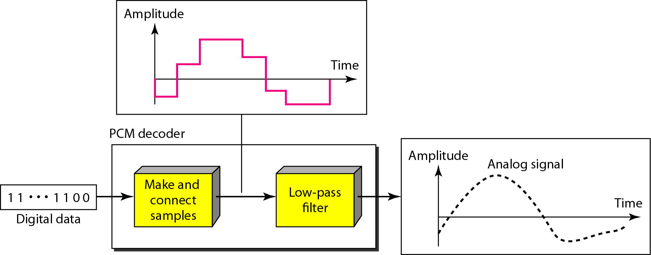
Components of a PCM decoder

Slide 45
Example
We have a low-pass analog signal of 4 kHz. If we send the analog signal, we need a channel with a minimum bandwidth of 4 kHz. If we digitize the signal and send 8 bits per sample, we need a channel with a minimum bandwidth of 8 × 4 kHz = 32 kHz.

Slide 46
Delta Modulation
This scheme sends only the difference between pulses, if the pulse at time t_{n+1} is higher in amplitude value than the pulse at time t_{n}, then a single bit, say a “1”, is used to indicate the positive value.
If the pulse is lower in value, resulting in a negative value, a “0” is used.
This scheme works well for small changes in signal values between samples.
If changes in amplitude are large, this will result in large errors.

Slide 47
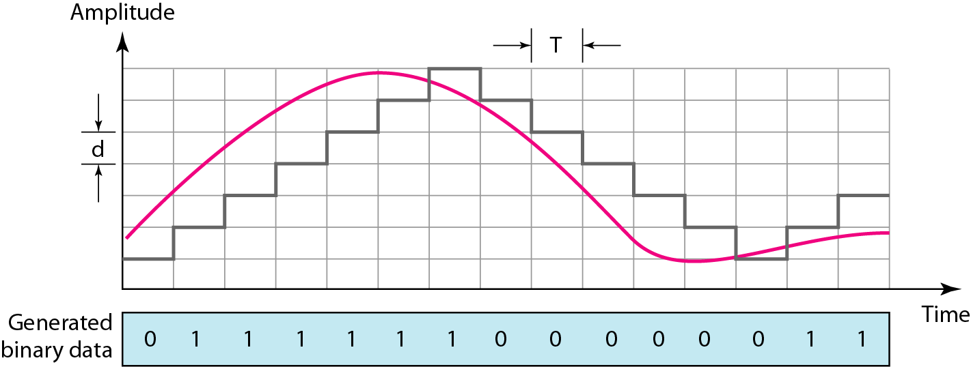
The process of delta modulation

Slide 48
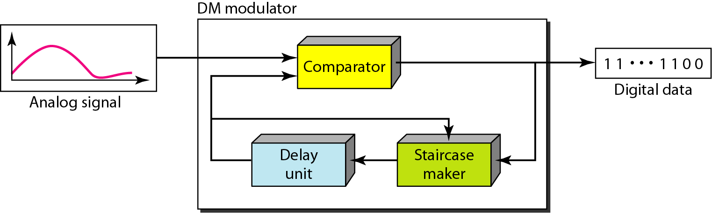
Delta modulation components

Slide 49
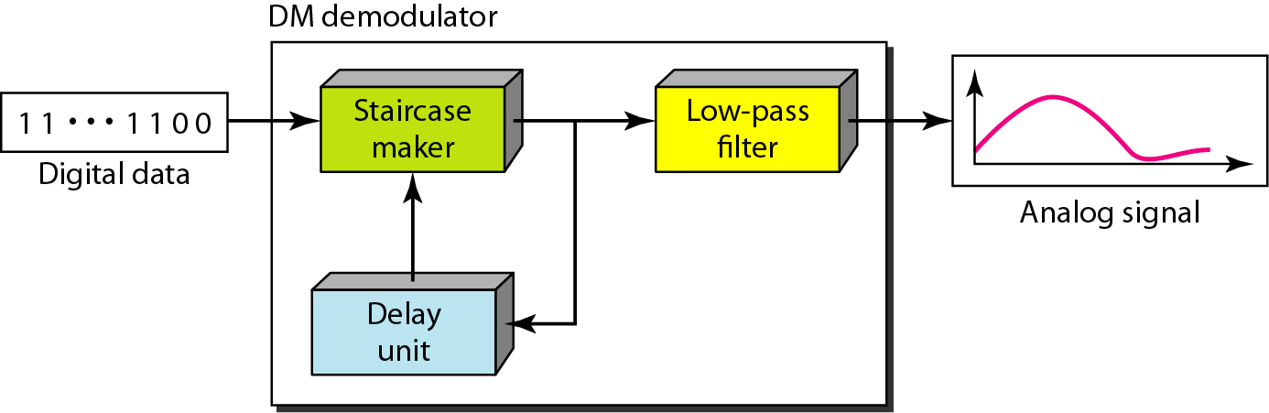
Delta demodulation components

Slide 50
Delta PCM (DPCM)
Instead of using one bit to indicate positive and negative differences, we can use more bits -> quantization of the difference.
Each bit code is used to represent the value of the difference.
The more bits the more levels -> the higher the accuracy.

Slide 51
TRANSMISSION MODES
The transmission of binary data across a link can be accomplished in either parallel or serial mode. In parallel mode, multiple bits are sent with each clock tick. In serial mode, 1 bit is sent with each clock tick. While there is only one way to send parallel data, there are three subclasses of serial transmission: asynchronous, synchronous, and isochronous.
Topics discussed in this section:
Parallel Transmission
Serial Transmission

Slide 52
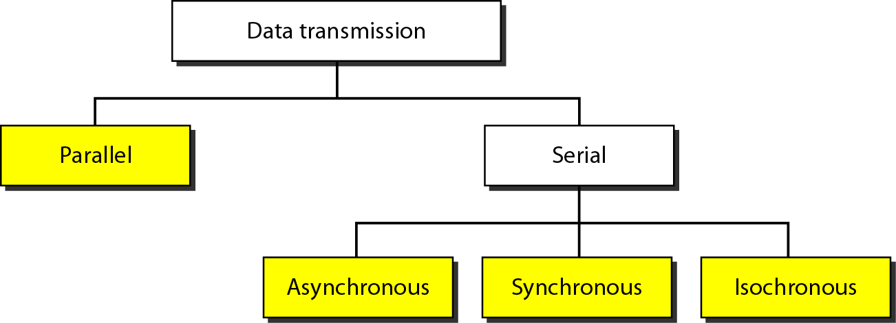
Data transmission and modes

Slide 53
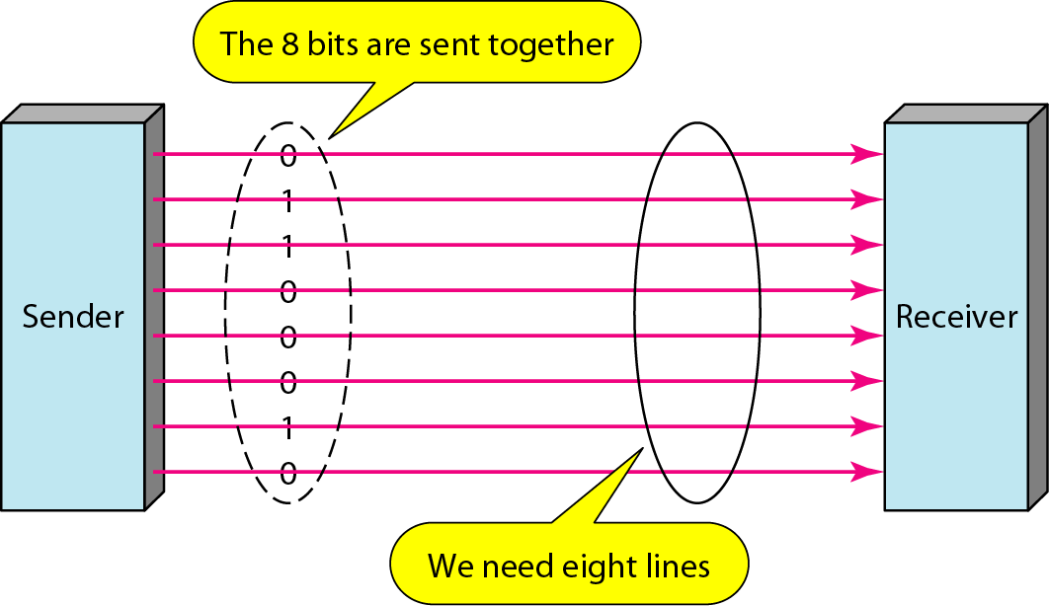
Parallel transmission

Slide 54
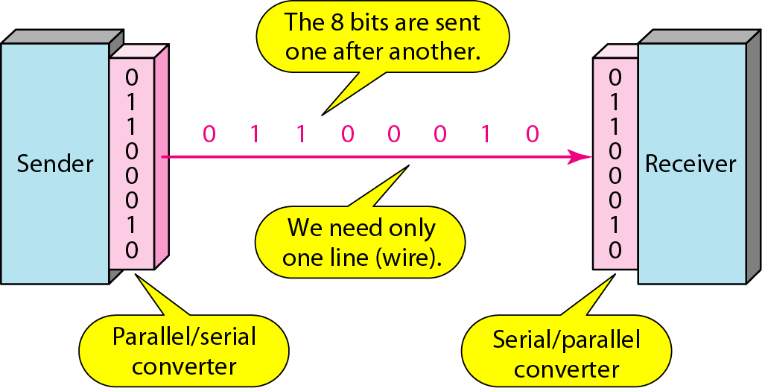
Serial transmission

Slide 55
Note
In asynchronous transmission, we send 1 start bit (0) at the beginning and 1 or more stop bits (1s) at the end of each byte. There may be a gap between
each byte.

Slide 56
Asynchronous here means “asynchronous at the byte level,”
but the bits are still synchronized;
their durations are the same.

Slide 57
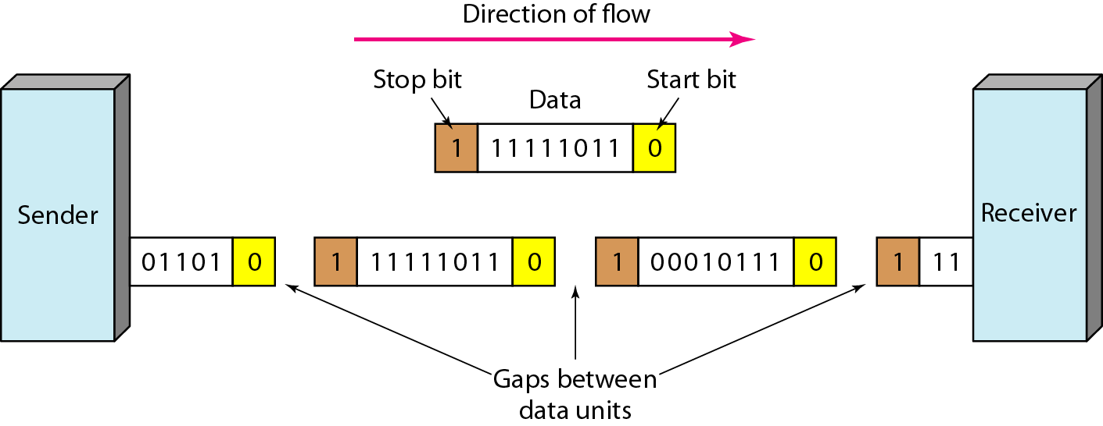
Asynchronous transmission

Slide 58
Note
In synchronous transmission, we send bits one after another without start or stop bits or gaps. It is the responsibility of the receiver to group the bits. The bits are usually sent as bytes and many bytes are grouped in a frame. A frame is identified with a start and an end byte.

Slide 59
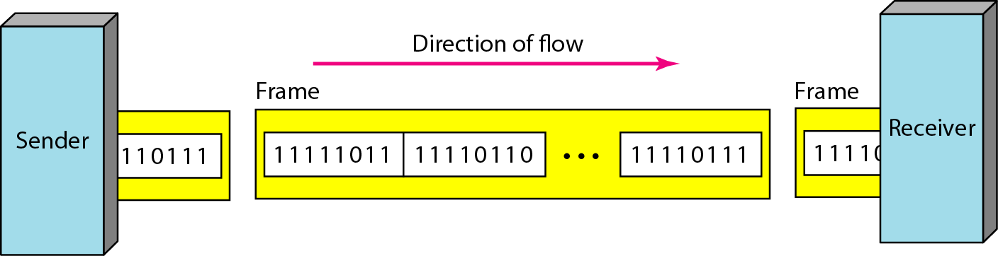
Synchronous transmission

Slide 60
Isochronous
In isochronous transmission we cannot have uneven gaps between frames.
Transmission of bits is fixed with equal gaps.

Slide 61
PULSE CODE MODULATION (PCM) NOISE ANALYSIS
Harish Chandra Mohanta, CUTM, Bhubaneswar Campus

Slide 62
WHAT IS PCM ….??
Pulse-code modulation (PCM) is a method used to digitally represent sampled analog signals.
In a PCM , the amplitude of the analog signal is sampled regularly at uniform intervals, and each sample is quantized to the nearest value within a range of digital steps.
The sampling rate must be greater then twice the highest frequency in the analog signal i.e. f_{s} >=2f_{m}.

Slide 63
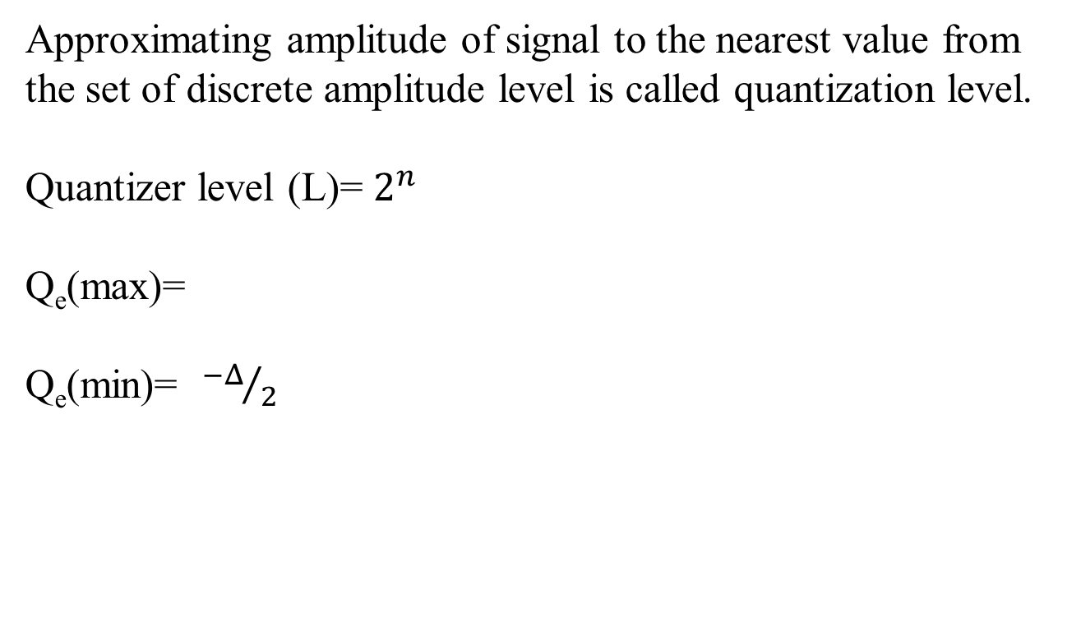
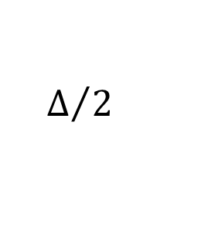
WHAT IS QUANTIZATION..?
It is the process of converting sampled version of analog signal into discrete time and discrete amplitude signal.
WHAT IS QUANTIZATION ERROR…?
Quantization error is the difference between the analog signal and the closest available digital value at each sampling instant from the A/D converter. Quantization error also introduces noise, called quantization noise.
WHAT IS QUANTIZATION LEVEL..?

Slide 64
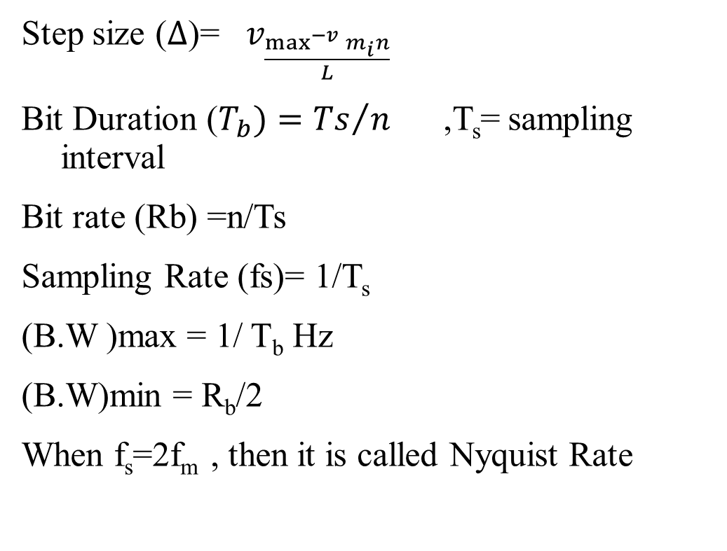
PARAMETERS OF PCM

Slide 65
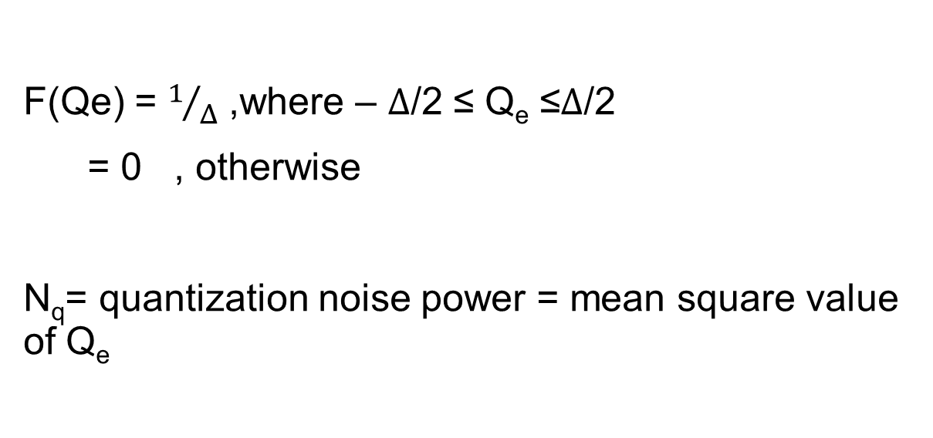
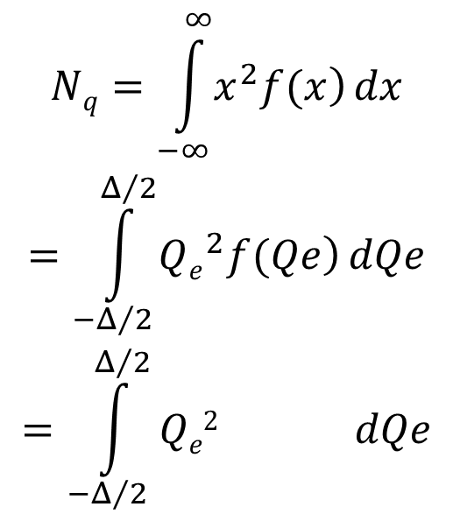

QUANTIZATION NOISE (N_{q})

Slide 66
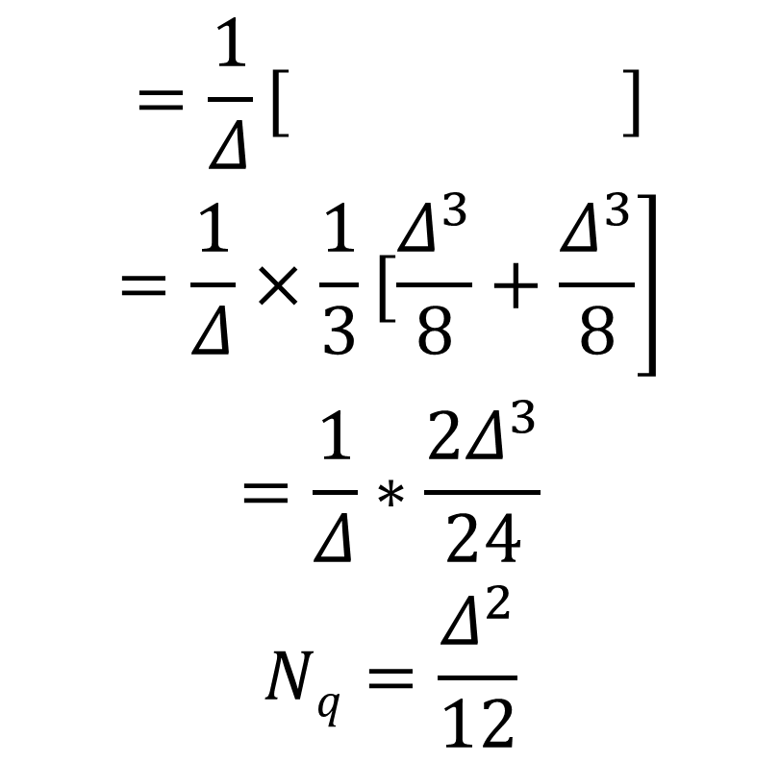

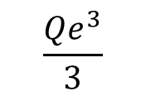


Slide 67
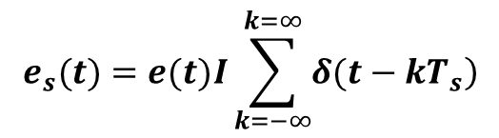
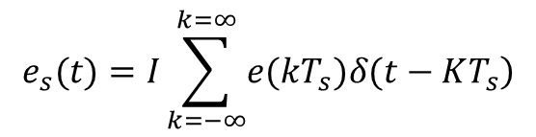
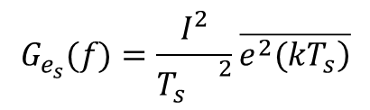
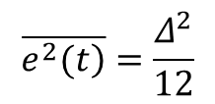
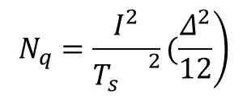
Quantization Noise Power
If the sampled quantization error waveform is represented as
When t=KT_{s}
The power spectral density
Quantization error =
Quantization noise power=

Slide 68
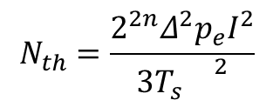

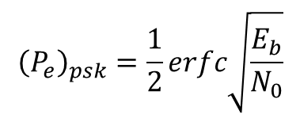
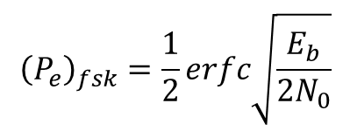
Thermal Noise Power
The thermal noise is white and Gaussian, the probability of an error depends on the ratio E_{b}/N_{0.} Where E_{b} is the signal energy transmitted during a bit and N₀/2 is the two sided power spectral density of the noise.
Thermal noise power = .
Where p_{e} is probability error, I=impulse strength, T_{s}= sampling interval and = quantization step size
Probability error of PSK=
Probability error of FSK=

Slide 69
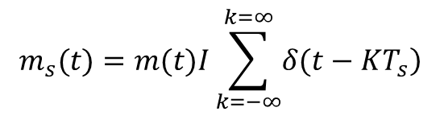
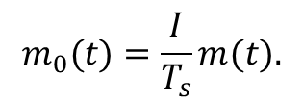
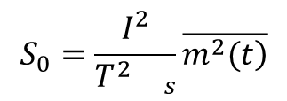
Output Signal Power
The sampled signal which appears at the input to the baseband filter is given by m_{s}(t).
Impulse train is periodic it can be represented by a Fourier series. The impulse trains have a strength (area) I and are separated by a time T_{s}.
Hence the signal m₀(t) at the output of the baseband filter
Output signal power=

Slide 70
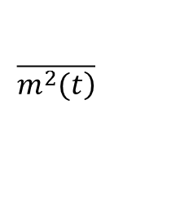

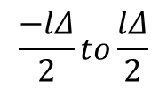

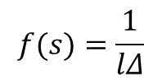
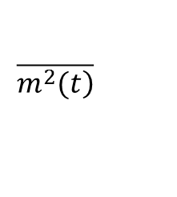
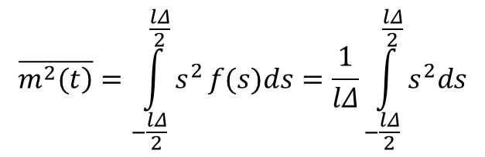
Output Signal Power
In order to calculate the value of , let us assume the number of quantization levels=L=l and step size=
We assume that the signal can vary from .
The instantaneous value of m(t) may fall any where in its allowable range of volts with equal likelihood.
The probability density function of the instantaneous value of s is f(s).
The variance of m(t) is .

Slide 71
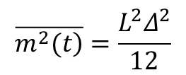
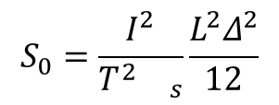
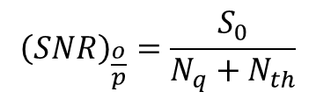
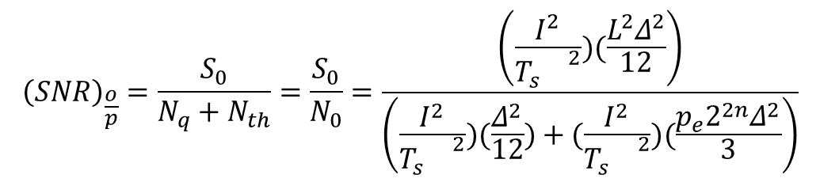
Output Signal Noise Power Ratio
So, the variance of m(t) is
The output signal power=
The output signal to noise ration(SNR) of PCM=
Where N_{q} is quantization noise power and N_{th} is thermal noise power

Slide 72
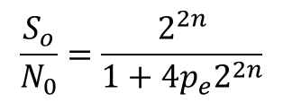
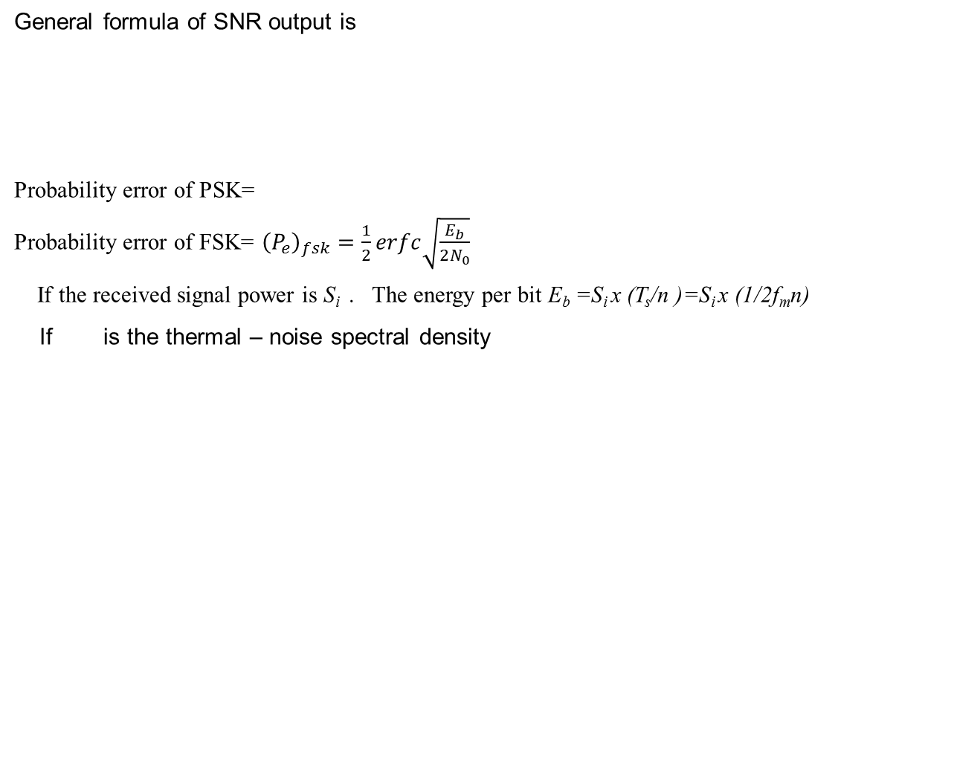
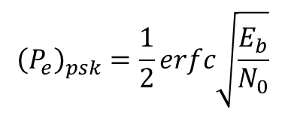
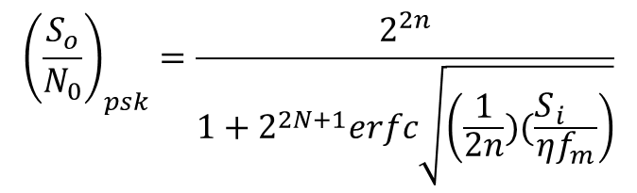

OUTPUT SNR of PCM

Slide 73
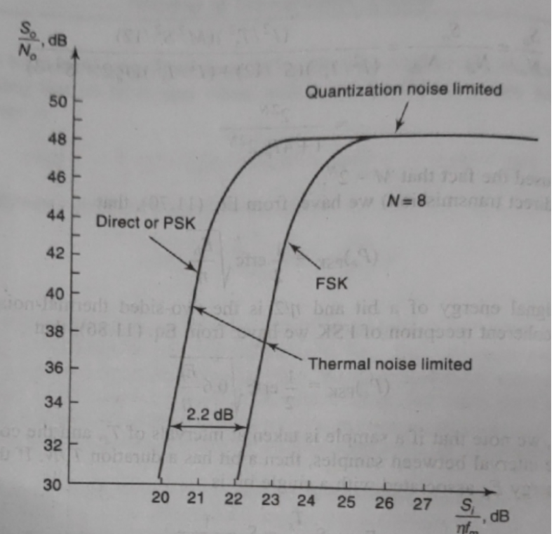
Comparison of PCM Transmission Systems

Slide 74
THANK YOU..

Slide 75
OUTLINE
Overview of PCM
DPCM
DM
ADM

Slide 76
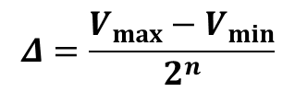

PCM
Pulse digital base band data transmission techniques are PCM, DPCM, DM and ADM.
PCM stands for Pulse Code Modulation.
In n- bit PCM, step size =
Where 2^{n} = no. of quantization levels.
The quantization noise power in PCM =
In order to decrease the quantization error, either we have to increase the value of n or decrease the value of V_{max}-V_{min}.
V_{max}-V_{min} is known as dynamic range of the input message signal.

Slide 77

DPCM
Differential Pulse Code Modulation (DPCM) is the process of converting an analog to digital signal in which the difference between the successive samples are applied to the quantizer.
Block diagram of DPCM transmitter is shown here.

Slide 78

DPCM RECEIVER

Slide 79

Why DPCM?

Slide 80

DM
It is used to reduce the bandwidth of the signal
It has 1-bit encoder.
It is always considered as 1-bit DPCM.

Slide 81

DM TRANSMITTER

Slide 82

DM RECEIVER

Slide 83
Transfer characteristics of Quantizer in DM in terms of step size
+ve
-ve

Slide 84


Slide 85


Slide 86


Slide 87


Slide 88

PROBLEMS
Q1. The i/p to the delta modulator is m(t)=5t and sampling rate is 5000 samples/sec. Determine the step size.
Ans- Here, m(t)=5t. So, dm(t)/dt=5.
Step size=5/5000=5mV.
Q2. The i/p to the delta modulator is m(t)=5cos2π1000t and the pulse rate is 56000 pulses/sec. Determine the step size.
Ans- Here A_{m}=5 V, f_{m}=1000, pulse rate=bit rate=sampling rate=56000.
Step size= V (volt).

Slide 89
ADM :
Stands for adaptive delta modulation
In ADM additional hardware is designed to provide variable step size .
Thereby reducing slope overload effects without increasing the granular noise .

Slide 90

ADM TRANSMITTER

Slide 91
Something More about the practical Approach
Delta Modulation De-merits
SNR Calculation for DM
Comparison of DM, DPCM and PCM
Adaptive delta Modulation

Slide 92

Integrator
Integrator is nothing but a RC Low Pass filter.

Slide 93

Characteristic of Quantizer
If the Difference is positive increase the Voltage by step-size σ, Vice-Versa.
Quantizer is 1 bit Quantizer.
Its simply a Voltage Comparator.

Slide 94

Noise in DM
The key to effective use of DM is proper selection of step size σ and sampling Freq/Sampling Time.
They must be chosen in a such a way that stair-case approximation is close to message signal.
We can know he max frequency at which the signal is changing

Slide 95
Noise in DM
To account fastest possible change we have to increase the sampling frequency as well as step size.
But Sampling Freq ➔ Bandwidth
&
Larger the step Size ➔ Quantization error

Slide 96
Noise in DM
Ideally the slope of both Quantized signal and Message signal must match.
It requires that
………..(7)
Suppose
Hence,
………..(8)
So
………..(9)

Slide 97
Noise in DM
The maximum Amplitude that we can follow for message signal can be given by
*
………..(10)
Where,
This equation is proved by de jagger.
U may see, F. De. Jagger, “ Delta Modulation, a method of PCM transmission by 1 bit code”, Phillips Res. Rep. No 7 pp 442-466, 1952
*

Slide 98

Noise in DM
Thus the maximum Amplitude that we can use without causing the slope overload can be found at frequency 800Hz.
Fortunately, Voice signal spectrum decays with frequency.
Decreases as 1/ω up to 2000 Hz and beyond that by 1/ω²
Hence Single Integration up to 2000Hz and Double for Beyond it
Double Integrator Can be Built By 2 Cascade RC with time constant 1/200Pi (100 Hz to 2KHz) and 1/4000pi(>2KHz) respectively.

Slide 99

Noise in DM
Slope overload
The name slope overload comes due to quantized signals fails to follow the slop of message signal.
The DM With Fixed step size is Linear Delta Modulation (LDM)

Slide 100

Noise in DM
What would happen if we keep the step size larger?
This would results into considerable Overshoot. This is Known as Hunting or Granular Noise.
It is analogous to Quantization Noise.

Slide 101
Signal To Noise Ratio
Granular Noise has Power Spectral Density in the range of well-beyond the fs.
Band-limiting LPF can remove it.
Ideally Noise Power will be well-below the above equation.
To Compute Noise power we assume that PSD is uniform and in the range of 0 to fs Hz. (Experimentally Proved)
σ³/3 is total noise power, which is uniformly distributed over the range of fs, the Power within Signal Bandwidth B is,
And

Slide 102
Signal To Noise Ratio
Suppose m_{p} is the Signal Peak
………..(11)
Hence,
………..(12)
So SNR becomes
………..(13)
Manipulating all equations
*
For Single Integration
For Double Integration
Where,

Slide 103
Signal To Noise Ratio (PCM)
In General,
………..(14)
Where,
Uncompressed
Compressed
………..(15)
But
………..(16)
&
Finally
………..(17)

Slide 104

Comparison Between DM and PCM

Slide 105
Thank You

Slide 106
DPSK
Harish Chandra Mohanta, CUTM, Bhubaneswar Campus

Slide 107
INTRODUCTION
Phase shift keying is a digital modulation scheme that conveys data by changing (modulating) the phase of a reference signal (the carrier wave).
PSK uses a finite number of phases, each assigned a unique pattern of binary digits. Usually, each phase encodes an equal number of bits. Each pattern of bits forms the symbol that is represented by the particular phase.
The demodulator, which is designed specially for the symbol set used by the modulator, determines the phase of received signal and maps it back to the symbol it represents, thus recovering the original data.
Differential phase shift keying (DPSK) is a common form of phase modulation that conveys data by changing the phase of the carrier wave.

Slide 108

DPSK

Slide 109

DPSK

Slide 110

DPSK RECEIVER

Slide 111


Slide 112


Slide 114


Slide 115


Slide 116
Digital Modulation

Slide 117
Change which part of the Carrier?
Carrier: A sin[ωt +ϕ]
  A = const
  ω = const
  ϕ = const
Amplitude modulation (AM)
  A = A(t) – carries information
  ω = const
  ϕ = const
Frequency modulation (FM)
  A = const
  ω = ω(t)– carries information
  ϕ = const
Phase modulation (PM)
  A = const
  ω = const
  ϕ = ϕ(t) – carries information

Slide 118
Amplitude Shift Keying (ASK)
Baseband
Data
1
0
0
1
0
ASK
modulated
signal
Acos(ωt)
Acos(ωt)
Pulse shaping can be employed to remove spectral spreading
ASK demonstrates poor performance, as it is heavily affected by noise, fading, and interference

Slide 119
Frequency Shift Keying (FSK)
Baseband
Data
1
0
0
1
BFSK
modulated
signal
f₁
f₀
f₀
f₁
where f₀ =Acos(ω_{c}-Δω)t and f₁ =Acos(ω_{c}+Δω)t
Example: The ITU-T V.21 modem standard uses FSK
FSK can be expanded to a M-ary scheme, employing multiple frequencies as different states

Slide 120
Phase Shift Keying (PSK)
Baseband
Data
1
0
0
1
BPSK
modulated
signal
s₁
s₀
s₀
s₁
where s₀ =-Acos(ω_{c}t) and s₁ =Acos(ω_{c}t)
Major drawback – rapid amplitude change between symbols due to phase discontinuity, which requires infinite bandwidth. Binary Phase Shift Keying (BPSK) demonstrates better performance than ASK and BFSK
BPSK can be expanded to a M-ary scheme, employing multiple phases and amplitudes as different states

Slide 121


Binary Phase Shift Keying (BPSK)
If the sinusoidal carrier has an amplitude A_{c} and energy per bit E_{b}
Then the transmitted BPSK signal is either:

Slide 122
Linear Modulation Techniques:
Digital modulation can be broadly classified as:
Linear (change Amplitude or phase)
Non linear modulation techniques (change frequency).
Linear Modulation Techniques:
The amplitude /phase of the transmitted signal s(t), varies linearly with the modulating digital signal, m(t).
These are bandwidth efficient (because it doesn’t change frequency) and hence are very attractive for use in wireless communication systems where there is an increasing demand to accommodate more and more users within a limited spectrum.

Slide 123
Linear Modulation schemes have very good spectral efficiency,
However, they must be transmitted using linear RF amplifiers which have poor power efficiency.

Slide 124
Note
“Phase modulation” can be regarded as “amplitude” modulation because it can really change “envelope”;
Thus both of them belong to “linear modulation”!

Slide 125
Differential Modulation
In the transmitter, each symbol is modulated relative to the previous symbol and modulating signal, for instance in BPSK 0 = no change, 1 = +180⁰
In the receiver, the current symbol is demodulated using the previous symbol as a reference. The previous symbol serves as an estimate of the channel. A no-change condition causes the modulated signal to remain at the same 0 or 1 state of the previous symbol.

Slide 126


Slide 127


Slide 128
DPSK
Let {d_{k}} denote the differentially encoded sequence with this added reference bit. We now introduce the following definitions in the generation of this sequence:
If the incoming binary symbol b_{k} is 1, leave the symbol d_{k} unchanged with respect to the previous bit.
If the incoming binary symbol b_{k} is 0, change the symbol d_{k} with respect to the previous bit.

Slide 129
DPSK
to send symbol 0, we advance the phase of the current signal waveform by 180 degrees,
to send symbol 1, we leave the phase of the current signal waveform unchanged.
Generation of DPSK:
The differential encoding process at the transmitter input starts with an arbitrary first bit, serving as reference.

Slide 130
Differential Phase Shift Keying (DPSK):
DPSK is a non coherent form of phase shift keying which avoids the need for a coherent reference signal at the receiver.
Advantage:
Non coherent receivers are easy and cheap to build, hence widely used in wireless communications.
DPSK eliminates the need for a coherent reference signal at the receiver by combining two basic operations at the transmitter:

Slide 131
Pulse Carrier
Carrier:
A train of identical pulses regularly spaced in time

Slide 132
Pulse-Amplitude Modulation (PAM)
Modulation in which the amplitude of pulses is varied in accordance with the modulating signal.
Used e.g. in telephone switching equipment such as a private branch exchange (PBX)

Slide 133
Pulse-Duration Modulation (PDM)
Modulation in which the duration of pulses is varied in accordance with the modulating signal.
Deprecated synonyms: pulse-length modulation, pulse-width modulation.
Used e.g. in telephone switching equipment such as a private branch exchange (PBX)

Slide 134
Demodulation & Detection
Demodulation
  Is process of removing the carrier signal to obtain the original signal waveform
Detection – extracts the symbols from the waveform
  Coherent detection
  Non-coherent detection

Slide 135
Coherent Detection
An estimate of the channel phase and attenuation is recovered. It is then possible to reproduce the transmitted signal and demodulate.
Requires a replica carrier wave of the same frequency and phase at the receiver.
Also known as synchronous detection (I.e. carrier recovery)

Slide 136
Coherent Detection 2
Carrier recovery methods include
  Pilot Tone (such as Transparent Tone in Band)
    Less power in the information bearing signal, High peak-to-mean power ratio
  Carrier recovery from the information signal
    E.g. Costas loop
Applicable to
  Phase Shift Keying (PSK)
  Frequency Shift Keying (FSK)
  Amplitude Shift Keying (ASK)

Slide 137
Non-Coherent Detection
Requires no reference wave; does not exploit phase reference information (envelope detection)
  Differential Phase Shift Keying (DPSK)
  Frequency Shift Keying (FSK)
  Amplitude Shift Keying (ASK)
  Non coherent detection is less complex than coherent detection (easier to implement), but has worse performance.

Slide 138
QPSK
Quadrature Phase Shift Keying (QPSK) can be interpreted as two independent BPSK systems (one on the I-channel and one on Q-channel), and thus the same performance but twice the bandwidth (spectrum) efficiency.

Slide 139
QPSK Constellation Diagram
Q
Q
I
I
Carrier phases
{0, π/2, π, 3π/2}
Carrier phases
{π/4, 3π/4, 5π/4, 7π/4}
Quadrature Phase Shift Keying has twice the bandwidth efficiency of BPSK since 2 bits are transmitted in a single modulation symbol

Slide 140
Types of QPSK
Q
Q
Q
I
I
I
Conventional QPSK
Offset QPSK
π/4 QPSK
Conventional QPSK has transitions through zero (i.e. 180⁰ phase transition). Highly linear amplifiers required.
In Offset QPSK, the phase transitions are limited to 90⁰, the transitions on the I and Q channels are staggered.
In π/4 QPSK the set of constellation points are toggled each symbol, so transitions through zero cannot occur. This scheme produces the lowest envelope variations.
All QPSK schemes require linear power amplifiers

Slide 141


Quadrature Phase Shift Keying (QPSK):
Also a type of linear modulation scheme
Quadrature Phase Shift Keying (QPSK) has twice the bandwidth efficiency of BPSK, since 2 bits are transmitted in a single modulation symbol.
The phase of the carrier takes on 1 of 4 equally spaced values, such as where each value of phase corresponds to a unique pair of message bits.
The QPSK signal for this set of symbol states may be defined as:

Slide 142

QPSK
The striking result is that the bit error probability of QPSK is identical to BPSK, but twice as much data can be sent in the same bandwidth. Thus, when compared to BPSK, QPSK provides twice the spectral efficiency with exactly the same energy efficiency.
Similar to BPSK, QPSK can also be differentially encoded to allow non-coherent detection.

Slide 143


Slide 144
Multi-level (M-ary) Phase and Amplitude Modulation
16 QAM
16 PSK
16 APSK
Amplitude and phase shift keying can be combined to transmit several bits per symbol.
  Often referred to as linear as they require linear amplification.
  More bandwidth-efficient, but more susceptible to noise.
For M=4, 16QAM has the largest distance between points, but requires very linear amplification. 16PSK has less stringent linearity requirements, but has less spacing between constellation points, and is therefore more affected by noise.

Slide 145
Distortions
Perfect channel
White noise
Phase jitter

Slide 146
Bandwidth Efficiency
Notes:
From Shannon Theorem

Slide 147
Comparison of Modulation Types
Modulation Format | Bandwidth efficiency C/B | Log2(C/B) | Error-free Eb/N0
16 PSK | 4 | 2 | 18dB
16 QAM | 4 | 2 | 15dB
8 PSK | 3 | 1.6 | 14.5dB
4 PSK | 2 | 1 | 10dB
4 QAM | 2 | 1 | 10dB
BFSK | 1 | 0 | 13dB
BPSK | 1 | 0 | 10.5dB

Slide 148
Spectral Efficiencies - Examples
GSM Europe Digital Cellular
  Data Rate = 270kb/s; Bandwidth = 200kHz
  Bandwidth efficiency = 270/200 = 1.35bits/sec/Hz
IS-95 North American Digital Cellular
  Data Rate = 48kb/s; Bandwidth = 30kHz
  Bandwidth efficiency = 48/30 = 1.6bits/sec/Hz

Slide 149

BFSK Transmitter

Slide 150

Coherent Detection Of BFSK

Slide 151

FSK Spectrum

Slide 152
Minimum Shift Keying (MSK)
MSK is a continuous phase-frequency shift keying;
Why MSK?
-- Exploitation of Phase Information besides frequency.

Slide 153


Representation of a MSK signal

Slide 154


Slide 155

MSK Transmitter

Slide 156

MSK Receiver

Slide 157
M-ary
Combined Linear and nonlinear (Constant Envelope)
Modulation Techniques

Slide 158
Topics :
What is M-ary modulation?
Various M-ary modulation Techniques:
M-ary Phase Shift Keying (MPSK)
M-ary Quadrature Amplitude Modulation
(QAM)
M-ary Frequency Shift Keying (MFSK)

Slide 159
Definition:
In this modulation Technique the digital data is sent by varying both the envelope and phase(or frequency) of an RF carrier.
These modulation techniques map base band data into four or more possible RF carrier signals. Hence, these modulation techniques are called M-ary modulation.

Slide 160
M-ary signaling scheme:
In this signaling scheme 2 or more bits are grouped
together to form a symbol.
One of the M possible signals
s₁(t) ,s₂(t),s₃(t),……s_{M}(t)
is transmitted during each symbol period
of duration T_{s}.
The number of possible signals = M = 2^{n},
where n is an integer.

Slide 161
The symbol values of M for a given value of n:
n | M = 2^{n} | Symbol
1 | 2 | 0, 1
2 | 4 | 00, 01, 10, 11
3 | 8 | 000, 001, 010,011,...
4 | 16 | 0000, 0001, 0010,0011,….
…. | …… | ……….

Slide 162

Depending on the variation of amplitude, phase or frequency of the carrier, the modulation scheme is called as M-ary ASK, M-ary PSK and M-ary FSK.
Fig: waveforms of (a) ASK (b) PSK (c)FSK

Slide 163

Fig: 4-ary Multiamplitude signal

Slide 164
M-ary Phase Shift Keying(MPSK)
In M-ary PSK, the carrier phase takes on one of the M possible values, namely θ_{i} = 2 * (i - 1)π / M
where i = 1, 2, 3, …..M.
The modulated waveform can be expressed as
where E_{s} is energy per symbol = (log₂ M) E_{b}
T_{s} is symbol period = (log₂ M) T_{b.}

Slide 165

The above equation in the Quadrature form is
By choosing orthogonal basis signals
defined over the interval 0 ≤ t ≤ T_{s}

Slide 166
M-ary signal set can be expressed as
Since there are only two basis signals, the constellation of M-ary PSK is two dimensional.
The M-ary message points are equally spaced on a circle of radius √E_{s}, centered at the origin.
The constellation diagram of an 8-ary PSK signal set is shown in fig.

Slide 167

Fig: Constellation diagram of an M-ary PSK system(m=8)

Slide 168

Derivation of symbol error probability:
Decision Rule:
Fig: Constellation diagram for M=2 (Binary PSK)

Slide 169
If a symbol (0,0,0) is transmitted, it is clear
that if an error occurs, the transmitted signal is most
likely to be mistaken for (0,0,1) and (1,1,1) and the
signal being mistaken for (1,1,0) is remote.
The decision pertaining to (0,0,0) is bounded by θ = -
π/8(below φ₁(t)- axis) to θ = + π/8 ( above φ₂(t)- axis)
The probability of correct reception is…

Slide 170

Fig: Probability density function of Phase θ.

Slide 171

The average symbol error probability of an coherent M-ary PSK system in AWGN channel is given by
Similarly, The symbol error Probability of a differential M-ary PSK system in AWGN channel is given by

Slide 172

Fig: The performance of symbol error probability for
-different values of M

Slide 173


Power Efficiency and Bandwidth :
Fig: MPSK signal sets for M=2,4,8,16

Slide 174
Power efficiency:
Increasing M implies that the constellation is more densely packed, and hence the power efficiency (noise tolerance) is increased.
Bandwidth Efficiency:
The first null bandwidth of M-ary PSK signals decrease as M increases while R_{b} is held constant.
Therefore, as the value of M increases, the bandwidth efficiency also increases.

Slide 175
M-ary Quadrature Amplitude Modulation (QAM)
It’s a Hybrid modulation
As we allow the amplitude to also vary with the phase, a new modulation scheme called quadrature amplitude modulation (QAM) is obtained.
The constellation diagram of 16-ary QAM consists of a square lattice of signal points.

Slide 176

Fig: signal Constellation of M-ary QAM for M=16

Slide 177

Fig: Decomposition of signal Constellation of M-ary QAM

Slide 178

The general form of an M-ary QAM signal can be defined as
where
E_{min} is the energy of the signal with the lowest amplitude and
a_{i} and b_{i} are a pair of independent integers chosen according to the location of the particular signal point.
In M-ary QAM energy per symbol and also distance between possible symbol states is not a constant.

Slide 179


It reasons that particular values of S_{i} (t) will be detected with higher probability than others.
The signal S_{i} (t) may be expanded in terms of a pair of basis functions defined as
The coordinates of the i th message point are a_{i} √Emin and b_{i}√Emin where (a_{i}, b_{i}) is an element of the L by L matrix given by
Where L = √M.

Slide 180


For the example M=16- QAM the L by L matrix is
Derivation of symbol error probability:
The average probability of error in an AWGN channel is given by

Slide 181

In terms of average signal energy,E_{avg}
Power Efficiency and Bandwidth :
Power efficiency of QAM is superior to M-ary PSK.
Bandwidth efficiency of QAM is identical to M-ary PSK.

Slide 182


Fig: signal constellation of M-ary QPSK and M-ary QAM(M=16)

Slide 183

Fig: QAM for M = 16

Slide 184

M-ary Frequency Shift Keying(MFSK)
In M-ary FSK modulation the transmitted signals are defined by:
where fc = nc/2Ts, for some fixed integer n.
The M transmitted signals are of equal energy and equal duration, and the signal frequencies are separated by 1/2Ts Hertz, making the signals orthogonal to one another.

Slide 185


The average probability of error based on the union bound is given by
Using only the leading terms of the binomial expansion:

Slide 186


Power Efficiency and Bandwidth :
Bandwidth:
The channel bandwidth of a M-ary FSK signal is :

Slide 187

The channel bandwidth of a noncohorent MFSK is :
This implies that the bandwidth efficiency of an M-ary FSK signal decreases with increasing M. Therefore, unlike M-PSK signals, M-FSK signals are bandwidth inefficient.

Slide 188
Noise in DM
The error d(t) caused by Hunting Lies in the range of (-σ,+σ).
where,
σ=Step-Size.
So Finding the Granular Noise Power,

Slide 189
Different Codes

Slide 190
Performance Metrics
In analog communications we want,
Digital communication systems:
  Data rate (R bps) (Limited) Channel Capacity
  Probability of error
  Without noise, we don’t make bit errors
  Bit Error Rate (BER): Number of bit errors that occur for a given number of bits transmitted.
What’s BER if P_{e}=10⁻⁶ and 10⁷ bits are transmitted?

Slide 191
Baseband Data Transmission

Slide 192
Each T-second pulse is a bit.
Receiver has to decide whether it’s a 1 or 0
( A or –A)
Integrate-and-dump detector
Possible different signaling schemes?

Slide 193
DIGITAL-TO-DIGITAL CONVERSION
In this section, we see how we can represent digital data by using digital signals. The conversion involves three techniques: line coding, block coding, and scrambling. Line coding is always needed; block coding and scrambling may or may not be needed.
Topics discussed in this section:
Line Coding
Line Coding Schemes
Block Coding
Scrambling

Slide 194
Line Coding
Converting a string of 1’s and 0’s (digital data) into a sequence of signals that denote the 1’s and 0’s.
For example a high voltage level (+V) could represent a “1” and a low voltage level (0 or -V) could represent a “0”.

Slide 195

Line coding and decoding

Slide 196
Mapping Data symbols onto Signal levels
A data symbol (or element) can consist of a number of data bits:
  1 , 0 or
  11, 10, 01, ……
A data symbol can be coded into a single signal element or multiple signal elements
  1 -> +V, 0 -> -V
  1 -> +V and -V, 0 -> -V and +V
The ratio ‘r’ is the number of data elements carried by a signal element.

Slide 197
Relationship between data rate and signal rate
The data rate defines the number of bits sent per sec - bps. It is often referred to the bit rate.
The signal rate is the number of signal elements sent in a second and is measured in bauds. It is also referred to as the modulation rate.
Goal is to increase the data rate whilst reducing the baud rate.

Slide 198

Signal element versus data element

Slide 199
Data rate and Baud rate
The baud or signal rate can be expressed as:
S = c x N x 1/r bauds
where N is data rate
c is the case factor (worst, best & avg.)
r is the ratio between data element & signal element

Slide 200

Example
A signal is carrying data in which one data element is encoded as one signal element ( r = 1). If the bit rate is 100 kbps, what is the average value of the baud rate if c is between 0 and 1?
Solution
We assume that the average value of c is 1/2 . The baud rate is then

Slide 201
Note
Although the actual bandwidth of a digital signal is infinite, the effective bandwidth is finite.

Slide 202
Example
The maximum data rate of a channel (see Chapter 3) is Nmax = 2 × B × log₂ L (defined by the Nyquist formula). Does this agree with the previous formula for N_{max}?
Solution
A signal with L levels actually can carry log₂L bits per level. If each level corresponds to one signal element and we assume the average case (c = 1/2), then we have

Slide 203
Considerations for choosing a good signal element referred to as line encoding
Baseline wandering - a receiver will evaluate the average power of the received signal (called the baseline) and use that to determine the value of the incoming data elements. If the incoming signal does not vary over a long period of time, the baseline will drift and thus cause errors in detection of incoming data elements.
A good line encoding scheme will prevent long runs of fixed amplitude.

Slide 204
Line encoding C/Cs
DC components - when the voltage level remains constant for long periods of time, there is an increase in the low frequencies of the signal. Most channels are bandpass and may not support the low frequencies.
This will require the removal of the dc component of a transmitted signal.

Slide 205
Line encoding C/Cs
Self synchronization - the clocks at the sender and the receiver must have the same bit interval.
If the receiver clock is faster or slower it will misinterpret the incoming bit stream.

Slide 206

Effect of lack of synchronization

Slide 207
Example
In a digital transmission, the receiver clock is 0.1 percent faster than the sender clock. How many extra bits per second does the receiver receive if the data rate is
1 kbps? How many if the data rate is 1 Mbps?
Solution
At 1 kbps, the receiver receives 1001 bps instead of 1000 bps.
At 1 Mbps, the receiver receives 1,001,000 bps instead of 1,000,000 bps.

Slide 208
Line encoding C/Cs
Error detection - errors occur during transmission due to line impairments.
Some codes are constructed such that when an error occurs it can be detected. For example: a particular signal transition is not part of the code. When it occurs, the receiver will know that a symbol error has occurred.

Slide 209
Line encoding C/Cs
Noise and interference - there are line encoding techniques that make the transmitted signal “immune” to noise and interference.
This means that the signal cannot be corrupted, it is stronger than error detection.

Slide 210
Line encoding C/Cs
Complexity - the more robust and resilient the code, the more complex it is to implement and the price is often paid in baud rate or required bandwidth.

Slide 211

Line coding schemes

Slide 212
Unipolar
All signal levels are on one side of the time axis - either above or below
NRZ - Non Return to Zero scheme is an example of this code. The signal level does not return to zero during a symbol transmission.
Scheme is prone to baseline wandering and DC components. It has no synchronization or any error detection. It is simple but costly in power consumption.

Slide 213

Unipolar NRZ scheme

Slide 214
Polar - NRZ
The voltages are on both sides of the time axis.
Polar NRZ scheme can be implemented with two voltages. E.g. +V for 1 and -V for 0.
There are two versions:
  NZR - Level (NRZ-L) - positive voltage for one symbol and negative for the other
  NRZ - Inversion (NRZ-I) - the change or lack of change in polarity determines the value of a symbol. E.g. a “1” symbol inverts the polarity a “0” does not.

Slide 215

Polar NRZ-L and NRZ-I schemes

Slide 216
Note
In NRZ-L the level of the voltage determines the value of the bit.
In NRZ-I the inversion
or the lack of inversion
determines the value of the bit.

Slide 217
Note
NRZ-L and NRZ-I both have an average signal rate of N/2 Bd.

Slide 218
Note
NRZ-L and NRZ-I both have a DC component problem and baseline wandering, it is worse for NRZ-L. Both have no self synchronization &no error detection. Both are relatively simple to implement.

Slide 219
Example
A system is using NRZ-I to transfer 1-Mbps data. What are the average signal rate and minimum bandwidth?
Solution
The average signal rate is S= c x N x R = 1/2 x N x 1 = 500 kbaud. The minimum bandwidth for this average baud rate is Bmin = S = 500 kHz.
Note c = 1/2 for the avg. case as worst case is 1 and best case is 0

Slide 220
Polar - RZ
The Return to Zero (RZ) scheme uses three voltage values. +, 0, -.
Each symbol has a transition in the middle. Either from high to zero or from low to zero.
This scheme has more signal transitions (two per symbol) and therefore requires a wider bandwidth.
No DC components or baseline wandering.
Self synchronization - transition indicates symbol value.
More complex as it uses three voltage level. It has no error detection capability.

Slide 221

Polar RZ scheme

Slide 222
Polar - Biphase: Manchester and Differential Manchester
Manchester coding consists of combining the NRZ-L and RZ schemes.
  Every symbol has a level transition in the middle: from high to low or low to high. Uses only two voltage levels.
Differential Manchester coding consists of combining the NRZ-I and RZ schemes.
  Every symbol has a level transition in the middle. But the level at the beginning of the symbol is determined by the symbol value. One symbol causes a level change the other does not.

Slide 223

Polar biphase: Manchester and differential Manchester schemes

Slide 224
Note
In Manchester and differential Manchester encoding, the transition
at the middle of the bit is used for synchronization.

Slide 225
Note
The minimum bandwidth of Manchester and differential Manchester is 2 times that of NRZ. The is no DC component and no baseline wandering. None of these codes has error detection.

Slide 226
Bipolar - AMI and Pseudoternary
Code uses 3 voltage levels: - +, 0, -, to represent the symbols (note not transitions to zero as in RZ).
Voltage level for one symbol is at “0” and the other alternates between + & -.
Bipolar Alternate Mark Inversion (AMI) - the “0” symbol is represented by zero voltage and the “1” symbol alternates between +V and -V.
Pseudoternary is the reverse of AMI.

Slide 227

Bipolar schemes: AMI and pseudoternary

Slide 228
Bipolar C/Cs
It is a better alternative to NRZ.
Has no DC component or baseline wandering.
Has no self synchronization because long runs of “0”s results in no signal transitions.
No error detection.

Slide 229
Multilevel Schemes
In these schemes we increase the number of data bits per symbol thereby increasing the bit rate.
Since we are dealing with binary data we only have 2 types of data element a 1 or a 0.
We can combine the 2 data elements into a pattern of “m” elements to create “2^{m}” symbols.
If we have L signal levels, we can use “n” signal elements to create L^{n} signal elements.

Slide 230
Code C/Cs
Now we have 2^{m} symbols and L^{n} signals.
If 2^{m} > L^{n} then we cannot represent the data elements, we don’t have enough signals.
If 2^{m} = L^{n} then we have an exact mapping of one symbol on one signal.
If 2^{m} < L^{n} then we have more signals than symbols and we can choose the signals that are more distinct to represent the symbols and therefore have better noise immunity and error detection as some signals are not valid.

Slide 231
Note
In mBnL schemes, a pattern of m data elements is encoded as a pattern of n signal elements in which 2^{m} ≤ L^{n}.

Slide 232
Representing Multilevel Codes
We use the notation mBnL, where m is the length of the binary pattern, B represents binary data, n represents the length of the signal pattern and L the number of levels.
L = B binary, L = T for 3 ternary, L = Q for 4 quaternary.

Slide 233

Multilevel: 2B1Q scheme

Slide 234
Redundancy
In the 2B1Q scheme we have no redundancy and we see that a DC component is present.
If we use a code with redundancy we can decide to use only “0” or “+” weighted codes (more +’s than -’s in the signal element) and invert any code that would create a DC component. E.g. ‘+00++-’ -> ‘-00--+’
Receiver will know when it receives a “-” weighted code that it should invert it as it doesn’t represent any valid symbol.

Slide 235

Multilevel: 8B6T scheme

Slide 236
Multilevel using multiple channels
In some cases, we split the signal transmission up and distribute it over several links.
The separate segments are transmitted simultaneously. This reduces the signalling rate per link -> lower bandwidth.
This requires all bits for a code to be stored.
xD: means that we use ‘x’ links
YYYz: We use ‘z’ levels of modulation where YYY represents the type of modulation (e.g. pulse ampl. mod. PAM).
Codes are represented as: xD-YYYz

Slide 237

Multilevel: 4D-PAM5 scheme

Slide 238
Multitransition Coding
Because of synchronization requirements we force transitions. This can result in very high bandwidth requirements -> more transitions than are bits (e.g. mid bit transition with inversion).
Codes can be created that are differential at the bit level forcing transitions at bit boundaries. This results in a bandwidth requirement that is equivalent to the bit rate.
In some instances, the bandwidth requirement may even be lower, due to repetitive patterns resulting in a periodic signal.

Slide 239

Multitransition: MLT-3 scheme

Slide 240
MLT-3
Signal rate is same as NRZ-I
But because of the resulting bit pattern, we have a periodic signal for worst case bit pattern: 1111
This can be approximated as an analog signal a frequency 1/4 the bit rate!

Slide 241

Summary of line coding schemes

Slide 242
Block Coding
For a code to be capable of error detection, we need to add redundancy, i.e., extra bits to the data bits.
Synchronization also requires redundancy - transitions are important in the signal flow and must occur frequently.
Block coding is done in three steps: division, substitution and combination.
It is distinguished from multilevel coding by use of the slash - xB/yB.
The resulting bit stream prevents certain bit combinations that when used with line encoding would result in DC components or poor sync. quality.

Slide 243
Note
Block coding is normally referred to as mB/nB coding;
it replaces each m-bit group with an
n-bit group.

Slide 244

Block coding concept

Slide 245

Using block coding 4B/5B with NRZ-I line coding scheme

Slide 246

4B/5B mapping codes

Slide 247

Substitution in 4B/5B block coding

Slide 248
Redundancy
A 4 bit data word can have 24 combinations.
A 5 bit word can have 25=32 combinations.
We therefore have 32 - 26 = 16 extra words.
Some of the extra words are used for control/signalling purposes.

Slide 249
Example
We need to send data at a 1-Mbps rate. What is the minimum required bandwidth, using a combination of 4B/5B and NRZ-I or Manchester coding?
Solution
First 4B/5B block coding increases the bit rate to 1.25 Mbps. The minimum bandwidth using NRZ-I is N/2 or 625 kHz. The Manchester scheme needs a minimum bandwidth of 1.25 MHz. The first choice needs a lower bandwidth, but has a DC component problem; the second choice needs a higher bandwidth, but does not have a DC component problem.

Slide 250

8B/10B block encoding

Slide 251
More bits - better error detection
The 8B10B block code adds more redundant bits and can thereby choose code words that would prevent a long run of a voltage level that would cause DC components.

Slide 252
Scrambling
The best code is one that does not increase the bandwidth for synchronization and has no DC components.
Scrambling is a technique used to create a sequence of bits that has the required c/c’s for transmission - self clocking, no low frequencies, no wide bandwidth.
It is implemented at the same time as encoding, the bit stream is created on the fly.
It replaces ‘unfriendly’ runs of bits with a violation code that is easy to recognize and removes the unfriendly c/c.

Slide 253

AMI used with scrambling

Slide 254
For example: B8ZS substitutes eight consecutive zeros with 000VB0VB.
The V stands for violation, it violates the line encoding rule
B stands for bipolar, it implements the bipolar line encoding rule

Slide 255

Two cases of B8ZS scrambling technique

Slide 256
HDB3 substitutes four consecutive zeros with 000V or B00V depending
on the number of nonzero pulses after the last substitution.
If # of non zero pulses is even the substitution is B00V to make total # of non zero pulse even.
If # of non zero pulses is odd the substitution is 000V to make total # of non zero pulses even.

Slide 257

Different situations in HDB3 scrambling technique

Slide 258
Receiver Structure

Slide 259
Receiver Preformance
The output of the integrator:
is a random variable.
N is Gaussian. Why?

Slide 260
Analysis
Key Point
  White noise is uncorrelated

Slide 261
Error Analysis
Therefore, the pdf of N is:
In how many different ways, can an error occur?

Slide 262
Error Analysis
Two ways in which errors occur:
  A is transmitted, AT+N<0 (0 received,1 sent)
  -A is transmitted, -AT+N>0 (1 received,0 sent)

Slide 263
Similarly,
The average probability of error:

Slide 264
Energy per bit:
Therefore, the error can be written in terms of the energy.
Define

Slide 265
Recall: Rectangular pulse of duration T seconds has magnitude spectrum
Effective Bandwidth:
Therefore,
What’s the physical meaning of this quantity?

Slide 266
Probability of Error vs. SNR

Slide 267
Error Approximation
Use the approximation

Slide 268
Example
Digital data is transmitted through a baseband system with , the received pulse amplitude A=20mV.
a)If 1 kbps is the transmission rate, what is probability of error?

Slide 269
b) If 10 kbps are transmitted, what must be the value of A to attain the same probability of error?
Conclusion:
Transmission power vs. Bit rate

Slide 270
Binary Signaling Techniques

Slide 272
Amplitude Shift Keying (ASK)
0→0
1→Acos(w_{c}t)
What is the structure of the optimum receiver?

Slide 273
Receiver for binary signals in noise

Slide 274
Error Analysis
0→s1(t), 1→s2(t) in general.
The received signal:
Noise is white and Gaussian.
Find P_{E}
In how many different ways can an error occur?

Slide 275
Error Analysis (general case)
Two ways for error:
        Receive 1→ Send 0
        Receive 0→Send 1
Decision:
        The received signal is filtered. (How does this compare to baseband transmission?)
        Filter output is sampled every T seconds
        Threshold k
        Error occurs when:

Slide 276
are filtered signal and noise terms.
Noise term: is the filtered white Gaussian noise.
Therefore, it’s Gaussian (why?)
Has PSD:
Mean zero, variance?
Recall: Variance is equal to average power of the noise process

Slide 277
The pdf of noise term is:
Note that we still don’t know what the filter is.
Will any filter work? Or is there an optimal one?
Recall that in baseband case (no modulation), we had the integrator which is equivalent to filtering with

Slide 278
The input to the thresholder is:
These are also Gaussian random variables; why?
Mean:
Variance: Same as the variance of N

Slide 279
Distribution of V
The distribution of V, the input to the threshold device is:

Slide 280
Probability of Error
Two types of errors:
The average probability of error:

Slide 281
Goal: Minimize the average probability of errror
Choose the optimal threshold
What should the optimal threshold, k_{opt} be?
K_{opt}=0.5[s₀₁(T)+s₀₂(T)]

Slide 282
Observations
P_{E} is a function of the difference between the two signals.
Recall: Q-function decreases with increasing argument. (Why?)
Therefore, P_{E} will decrease with increasing distance between the two output signals
Should choose the filter h(t) such that P_{E} is a minimum→maximize the difference between the two signals at the output of the filter

Slide 283
Matched Filter
Goal: Given , choose H(f) such that is maximized.
The solution to this problem is known as the matched filter and is given by:
Therefore, the optimum filter depends on the input signals.

Slide 284
Matched filter receiver

Slide 285
Error Probability for Matched Filter Receiver
Recall
The maximum value of the distance,
E₁ is the energy of the first signal.
E₂ is the energy of the second signal.

Slide 286
Therefore,
Probability of error depends on the signal energies (just as in baseband case), noise power, and the similarity between the signals.
If we make the transmitted signals as dissimilar as possible, then the probability of error will decrease ( )

Slide 287
ASK
The matched filter:
Optimum Threshold:
Similarity between signals?
Therefore,
3dB worse than baseband.

Slide 288
PSK
Modulation index: m (determines the phase jump)
Matched Filter:
Threshold: 0
Therefore,
For m=0, 3dB better than ASK.

Slide 289
Matched Filter for PSK

Slide 290
FSK
Probability of Error:
Same as ASK

Slide 291
Applications
Modems: FSK
RF based security and access control systems
Cellular phones

Slide 292
INTER SYMBOL INTERFERENCE (ISI)
Harish Chandra Mohanta, CUTM, Bhubaneswar Campus

Slide 293
INTERSYMBOL INTERFERENCE (ISI)
Intersymbol Interference
ISI on Eye Patterns
Combatting ISI
Nyquist’s First Method for zero ISI
Raised Cosine-Rolloff Pulse Shape
Nyquist Filter

Slide 294
Inter-symbol Interference
Inter symbol interference (ISI) occurs when a pulse spreads out in such a way that it interferes with adjacent pulses at the sample instant.
Example: assume polar NRZ line code. The channel outputs are shown as spreaded (width T_{b} becomes 2T_{b}) pulses shown (Spreading due to band limited channel characteristics).
Channel Input
Pulse width T_{b}
Channel Output
Pulse width T_{b}
Data 1
Data 0

Slide 295
Intersymbol Interference
For the input data stream:
The channel output is the superposition of each bit’s output:
1
0
1
1
0
1
Resultant Channel Output Waveform
1
0
1
1
0
1

Slide 296

ISI on Eye Patterns
The amount of ISI can be seen on an oscilloscope using an Eye Diagram or Eye pattern.
Distortion
Noise
Margin
Amplitude
Extension Beyond T_{b} is ISI
Time (T_{b})

Slide 297

Intersymbol Interference
If the rectangular multilevel pulses are filtered improperly as they pass through a communications system, they will spread in time, and the pulse for each symbol may be smeared into adjacent time slots and cause Intersymbol Interference.
How can we restrict BW and at the same time not introduce ISI? 3 Techniques.

Slide 298

Intersymbol Interference
Flat-topped multilevel input signal having pulse shape h(t) and values a_{k}:
h_{e}(t) is the pulse shape that will appear at the output of the receiver filter.

Slide 299
Intersymbol Interference
Equivalent Impulse Response h_{e}(t) :
Equivalent transfer function:
Receiving filter can be designed to produce a needed H_{e}(f) in terms of H_{T}(f) and H_{C}(f):
Output signal can be rewritten as:
H_{e}(f), chosen such to minimize ISI is called EQUALIZING FILTER)

Slide 300
Combating ISI
Three strategies for eliminating ISI:
  Use a line code that is absolutely band limited.
    Would require Sinc pulse shape.
    Can’t actually do this (but can approximate).
  Use a line code that is zero during adjacent sample instants.
    It’s okay for pulses to overlap somewhat, as long as there is no overlap at the sample instants.
    Can come up with pulse shapes that don’t overlap during adjacent sample instants.
      Raised-Cosine Roll-off pulse shaping
  Use a filter at the receiver to “undo” the distortion introduced by the channel.
    Equalizer.

Slide 301
Nyquist’s First Method for Zero ISI
ISI can be eliminated by using an equivalent transfer function, H_{e}(f), such that the impulse response satisfies the condition:
Sampling Instants
ISI occurs but,
NO ISI is present at the sampling instants

Slide 302
Nyquist’s First Method for Zero ISI
There will be NO ISI and the bandwidth requirement will be minimum (Optimum Filtering) if the transmit and receive filters are designed so that the overall transfer function H_{e}(f) is:
This type of pulse will allow signalling at a baud rate of D=1/T_{s}=2B (for Binary R=1/T_{s}=2B) where B is the absolute bandwidth of the system.
H_{e}(f)
1/f_{s}
-f_{s}/2
f_{s}/2

Slide 303

Nyquist’s First Method for Zero ISI

Slide 304
Nyquist’s First Method for Zero ISI
h_{e}(t)
H_{e}(f)
1/f_{s}
Zero crossings at non-zero integer multiples of the bit period
-f_{s}/2
f_{s}/2
Since pulses are not possible to create due to:
  Infinite time duration.
  Sharp transition band in the frequency domain.
The Sinc pulse shape can cause significant ISI in the presence of timing errors.
  If the received signal is not sampled at exactly the bit instant (Synchronization Errors), then ISI will occur.
We seek a pulse shape that:
  Has a more gradual transition in the frequency domain.
  Is more robust to timing errors.
  Yet still satisfies Nyquist’s first method for zero ISI.

Slide 305
Raised Cosine-Rolloff Nyquist Filtering
Because of the difficulties caused by the Sa type pulse shape, consider other pulse shapes which require more bandwidth such as the Raised Cosine-rolloff Nyquist filter but they are less affected by synchrfonization errors.
The Raised Cosine Nyquist filter is defined by its rollof factor number r=f_{Δ}/f_{o.}

Slide 306

Raised Cosine-Rolloff Nyquist Filtering
Now filtering requirements are relaxed because absolute bandwidth is increased.
Clock timing requirements are also relaxed.
The r=0 case corresponds to the previous Minimum bandwidth case.

Slide 307

Raised Cosine-Rolloff Nyquist Filtering
Impulse response is given by:
The tails of h_{e}(t) are now decreasing much faster than the Sa function (As a function of t²).
ISI due to synchronization errors will be much lower.

Slide 308

Raised Cosine-Rolloff Nyquist Filtering
Frequency response and impulse responses of Raised Cosine pulses for various values of the roll off parameter.

Slide 309


Raised Cosine-Rolloff Nyquist Filtering
Illustrating the received bit stream of Raised Cosine pulse shaped transmission corresponding to the binary stream of 1 0 0 1 0 for 3 different values of r=0, 0.5, 1.
1 0 0 1 0
1 0 0 1 0

Slide 310
Bandwidth for Raised Cosine Nyquist Filtering
The bandwidth of a Raised-cosine (RC) rolloff pulse shape is a function of the bit rate and the rolloff factor:
Or solving for bit rate yields the expression:
This is the maximum transmitted bit rate when a RC-rolloff pulse shape with Rolloff factor r is transmitted over a baseband channel with bandwidth B.

Slide 311
Nyquist Filter
Raised Cosine Filter is also called a NYQUIST FILTER.
NYQUIST FILTERS refer to a general class of filters that satisfy the NYQUIST’s First Criterion.
Theorem: A filter is said to be a Nyquist filter if the effective transfer function is :
There will be no intersymbol interference at the system output if the symbol rate is

Slide 312

Nyquist Filter Characteristics

Slide 313
EYE DIADRAM

Slide 314
INTRODUCTION
Eye diagram is an operation tool for evaluating the effects of inter symbol interference (ISI) in an insightful manner.
It carries lot of information about the quality of the incoming pulse and state of the channel which is useful for the detection of the digital input.
The eye diagram is defined as the synchronized superposition of all possible realizations of the signal of interest (e.g. received signal, receiver output) viewed within a particular signalling interval.
The eye pattern/diagram derives its name from the fact that it resembles the human eye for binary waves.

Slide 315

EYE Diagram Test setup

Slide 316

EYE Pattern

Slide 317

Simplified EYE Diagram

Slide 318

EYE Diagram

Slide 319

EYE Diagram is a statistical representation

Slide 320

Jitter

Slide 321

EYE JITTER

Slide 322

Comparison

Slide 323

Unfiltered EYE

Slide 324

Filtered EYE

Slide 325
THANK YOU

Slide 326
Huffman Coding

Slide 327
Contents
A simple example
Definitions
Huffman Coding Algorithm
Image Compression

Slide 328

A simple example
Suppose we have a message consisting of 5 symbols, e.g. [►♣♣♠☻►♣☼►☻]
How can we code this message using 0/1 so the coded message will have minimum length (for transmission or saving!)
5 symbols → at least 3 bits
For a simple encoding,
length of code is 10*3=30 bits

Slide 329

A simple example – cont.
Intuition: Those symbols that are more frequent should have smaller codes, yet since their length is not the same, there must be a way of distinguishing each code
For Huffman code,
length of encoded message
will be ►♣♣♠☻►♣☼►☻
=3*2 +3*2+2*2+3+3=24bits

Slide 330
Definitions
An ensemble X is a triple (x, A_{x}, P_{x})
  x: value of a random variable
  A_{x}: set of possible values for x , A_{x}={a₁, a₂, …, a_{I}}
  P_{x}: probability for each value , P_{x}={p₁, p₂, …, p_{I}}
  where P(x)=P(x=a_{i})=p_{i}, p_{i}>0,
Shannon information content of x
  h(x) = log₂(1/P(x))
Entropy of x
i | a_{i} | p_{i} | h(p_{i})
1 | a | .0575 | 4.1
2 | b | .0128 | 6.3
3 | c | .0263 | 5.2
.. |  | .. | ..
26 | z | .0007 | 10.4

Slide 331
Source Coding Theorem
There exists a variable-length encoding C of an ensemble X such that the average length of an encoded symbol, L(C,X), satisfies
  L(C,X)∈[H(X), H(X)+1)
The Huffman coding algorithm produces optimal symbol codes

Slide 332
Symbol Codes
Notations:
  A^{N}: all strings of length N
  A⁺: all strings of finite length
  {0,1}³={000,001,010,…,111}
  {0,1}⁺={0,1,00,01,10,11,000,001,…}
A symbol code C for an ensemble X is a mapping from A_{x} (range of x values) to {0,1}⁺
c(x): codeword for x, l(x): length of codeword

Slide 333
Example
Ensemble X:
  A_{x}= { a , b , c , d }
  P_{x}= {1/2 , 1/4 , 1/8 , 1/8}
c(a)= 1000
c⁺(acd)=
  100000100001
  (called the extended code)
a_{i}
c(a_{i})
l_{i}
a
1000
4
C₀:
b
0100
4
c
0010
4
d
0001
4

Slide 334
Any encoded string must have a unique decoding
A code C(X) is uniquely decodable if, under the extended code C⁺, no two distinct strings have the same encoding, i.e.

Slide 335
The symbol code must be easy to decode
If possible to identify end of a codeword as soon as it arrives
→no codeword can be a prefix of another codeword
A symbol code is called a prefix code if no code word is a prefix of any other codeword
  (also called prefix-free code, instantaneous code or self-punctuating code)

Slide 336
The code should achieve as much compression as possible
The expected length L(C,X) of symbol code C for X is

Slide 337
Example
Ensemble X:
  A_{x}= { a , b , c , d }
  P_{x}= {1/2 , 1/4 , 1/8 , 1/8}
c⁺(acd)=
  0110111
  (9 bits compared with 12)
prefix code?
a_{i}
c(a_{i})
l_{i}
a
0
1
C₁:
b
10
2
c
110
3
d
111
3

Slide 338
The Huffman Coding algorithm- History
In 1951, David Huffman and his MIT information theory classmates given the choice of a term paper or a final exam
Huffman hit upon the idea of using a frequency-sorted binary tree and quickly proved this method the most efficient.
In doing so, the student outdid his professor, who had worked with information theory inventor Claude Shannon to develop a similar code.
Huffman built the tree from the bottom up instead of from the top down

Slide 339
Huffman Coding Algorithm
Take the two least probable symbols in the alphabet
  (longest codewords, equal length, differing in last digit)
Combine these two symbols into a single symbol, and repeat.

Slide 340


Example
A_{x}={ a , b , c , d , e }
P_{x}={0.25, 0.25, 0.2, 0.15, 0.15}
1.0
0
0.55
1
1
0
0.45
0.3
0
1
0
1
a
0.25
b
0.25
c
0.2
d
0.15
e
0.15
00
10
11
010
011

Slide 341
Statements
Lower bound on expected length is H(X)
There is no better symbol code for a source than the Huffman code
Constructing a binary tree top-down is suboptimal

Slide 342
Disadvantages of the Huffman Code
Changing ensemble
  If the ensemble changes→ the frequencies and probabilities change → the optimal coding changes
  e.g. in text compression symbol frequencies vary with context
  Re-computing the Huffman code by running through the entire file in advance?!
  Saving/ transmitting the code too?!
Does not consider ‘blocks of symbols’
  ‘strings_of_ch’ →the next nine symbols are predictable ‘aracters_’ , but bits are used without conveying any new information

Slide 343
Variations
n-ary Huffman coding
  Uses {0, 1, .., n-1} (not just {0,1})
Adaptive Huffman coding
  Calculates frequencies dynamically based on recent actual frequencies
Huffman template algorithm
  Generalizing
    probabilities → any weight
    Combining methods (addition) → any function
  Can solve other min. problems e.g. max [w_{i}+length(c_{i})]

Slide 344
Image Compression
2-stage Coding technique
  A linear predictor such as DPCM, or some linear predicting function → Decorrelate the raw image data
  A standard coding technique, such as Huffman coding, arithmetic coding, …
  Lossless JPEG:
  - version 1: DPCM with arithmetic coding
  - version 2: DPCM with Huffman coding

Slide 345
DPCM
Differential Pulse Code Modulation
DPCM is an efficient way to encode highly correlated analog signals into binary form suitable for digital transmission, storage, or input to a digital computer
Patent by Cutler (1952)

Slide 346

DPCM

Slide 347
Huffman Coding Algorithm for Image Compression
Step 1. Build a Huffman tree by sorting the histogram and successively combine the two bins of the lowest value until only one bin remains.
Step 2. Encode the Huffman tree and save the Huffman tree with the coded value.
Step 3. Encode the residual image.

Slide 348
Huffman Coding of the most-likely magnitude
MLM Method
Compute the residual histogram H
  H(x)= # of pixels having residual magnitude x
Compute the symmetry histogram S
  S(y)= H(y) + H(-y), y>0
Find the range threshold R
  for N: # of pixels , P: desired proportion of most-likely magnitudes

Slide 349
Shannon – Fano Coding
Arrange the messages in order of decreasing probability.
In column 1, divide the messages into two partitions such that the sum of the probabilities of each group are the same.
Assign the bit 0 to the message in one partition and assign the bit 1 to allthe messages in the other partiton.
This process of dividing groups in the same partition into two groups partitions each with equal sums of probabilities is continued, until each message finds itself alone in a partition.

Slide 350

Hamming CODE
Harish Chandra Mohanta, CUTM, Bhubaneswar CaMPUS

Slide 351
INTRODUCTION
A code is said to be linear if any two code words in the code can be added in modulo-2 arithmetic to produce a third codeword in the code.
A codeword is divided into two parts, one of which occupied by the message bits and other by the parity bits.
For an (n, k) linear block code, k bits of the n bits are message bits and n-k bits are parity bits.
Structure of codeword
b₀, b₁, b₂,……….., b_{n-k-1} (parity bits) | m₀, m₁, m₂, …………….., m_{k-1} (message bits)

Slide 352
Hamming distance and hamming weight
Consider a pair of code vectors c₁and c₂ that have the same number of elements.
The Hamming distance d(c₁, c₂) between such a pair of code vectors is defined as the number of locations in which their respective elements differ.
The Hamming weight w(c) of a code vector c is defined as the number of nonzero elements in the code vector. We may state that the Hamming weight of a code vector is the distance between the code vector and the all-zero code vector.
The minimum distance d_{min} of a linear block code is defined as the smallest Hamming distance between any pair of code vectors in the code.
We may state that the minimum distance of a linear block code is the smallest Hamming weight of the nonzero code vectors in the code.

Slide 353

Hamming Codes
Hamming code is a set of error-correction codes that can be used to detect and correct the errors that can occur when the data is moved or stored from the transmitter to the receiver.
This technique was developed by R.W. Hamming for error correction.
Parity bits are extra binary bits that are generated and added to the information-carrying (message) bits of data transfer to ensure that no bits were lost during the data transfer.
The number of parity bits can be calculated using the following formula:
Where p is the no. of parity bits and m is the no. of message bits
Here, P ≥ 3, block length=n= 2^{p}-1, no. of message bits=m=k=2^{p}-p-1, no. of parity bits=p=n-k for block code of (n , k).

Slide 354
Hamming Codes
Hamming codes are single-error correcting binary perfect codes.
No. of parity bits calculation formula
2^{p} ≥ p + m +1
Where p is the no. of parity bits and m is the no. of message bits
All bit positions that are power of 2 are marked as parity bits (1, 2, 4, 8,…….., 2^{n}), other bits are message bits.
So block code C(7,4) means total no. of bits in the codeword is 7. The no. of message bits=4 and no. of parity bits=7-4=3. message=m₁m₂m₃m₄ and parity bits are p₁, p₂, p₃.
Hamming code format is p₁ p₂ m₁ p₃ m₂ m₃ m_{4.}
Bit positions are 1 , 2, 3, 4, 5, 6, 7.

Slide 355
Generation of Hamming Code
Generate the hamming code for the message 1110.
Here, message bits=m=4.
To calculate no. of parity bits p, we have to use the formula 2^{p} ≥ p + m +1
To satisfy above condition, the minimum value of p is 3. So, the no. of parity bits=p=3
Parity bits are p₁, p₂, p_{3.}
Hamming code is p₁ p₂ m₁ p₃ m₂ m₃ m_{4 .} i.e. p₁ p₂ 1 p₃ 1 1 0.
Now we have to find the value of parity bits i.e. p₁ value, p₂ value and p₃ value.
p₁ value, p₂ value and p₃ value must satisfy even parity or odd parity.

Slide 356
Hamming code generation
P₁→ 1, 3, 5, 7→P₁ 1 1,0. To make even parity P₁=0. Because for even parity , the total of 1’s present must be even.
P₂→ 2, 3, 6, 7→P₂ 11 0. To make even parity P₂=0. Because for even parity , the total of 1’s present must be even.
P₃→ 4, 5, 6, 7→P₃ 11 0. To make even parity P₃=0. Because for even parity , the total of 1’s present must be even.
So, all parity bits are 0.
Hence , Hamming code is 0 0 1 0 1 1 0 for even parity transmission.
For odd parity transmission , Hamming code is 1111110.
Since 3 parity bits are there, so total combination values, we have 000, 001, 010, 011, 100, 101, 110, 111.
For P₁, we have taken which have 1 in 1st place in above combinations i.e. 1, 3, 5, 7.
For P₂, we have taken which have 1 in 2nd place in above combinations i.e. 2, 3, 6, 7.
For P₃, we have taken which have 1 in 3rd place in above combinations i.e. 4, 5, 6, 7.

Slide 357
ERROR CORRECTION IN HAMMING CODING
C(7,4) hamming code is received as 1010111. Determine the correct code when even parity is there.
Here, no. message bits=4, no. of parity bits=7-4=3.
Error place depends on the no. of parity bits. So , here error place=E₃ E₂ E_{1.}
E₁→ 1, 3, 5,7→ 1 1 1 1, To make even parity, here E₁=0 , as four 1’s are present.
E₂→ 2, 3, 6,7→ 0 1 1 1, To make even parity, here E₂=1 , as three 1’s are present.
E₃→ 4, 5, 6,7→ 0 1 1 1, To make even parity, here E₂=1 , as three 1’s are present.
1 | 0 | 1 | 0 | 1 | 1 | 1

Slide 358
CORRECT HAMMING CODE
Here, error place can be defined as E₃ E₂ E₁ i.e. 1 1 0 whose decimal equivalent is 6.
So, in 6th bit there is an error. Since ‘1’ is received in 6th bit, the corrected bit value in 6th bit is 0.
Hence, the corrected Hamming code is 1 0 1 0 1 0 1.

Slide 359
THANK YOU

