Slide 1
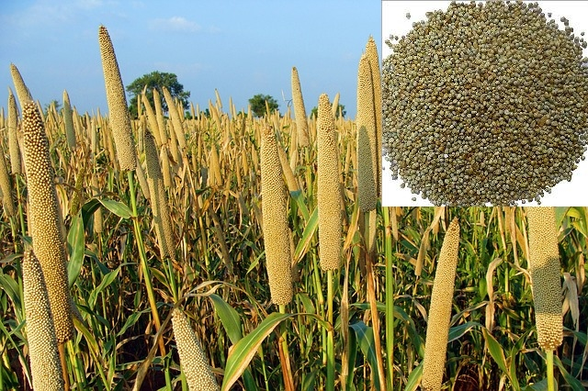
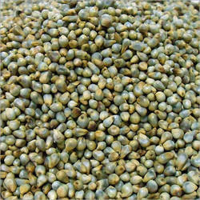
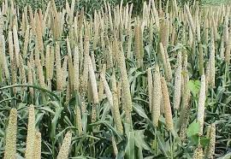
DISEASES OF BAJRA OR PEARL MILLET (PENNISETUM TYPHOIDES)
DFCM
CREDIT HOUR:2+1

Slide 2
MAJOR DISEASES OF BAJRA
FUNGAL DISEASES
ERGOT OR SUGARY DISEASE | Claviceps fusiformis or C. microcephala
DOWNY MILDEW OR GREEN EAR | Sclerospora graminicola
RUST | Puccinia penniseti
SMUT | Tolyposporium penicillariae
MINOR DISEASES
GRAIN MOULD | Fungal complex
BLAST | Pyricularia setariae.
ZONATE LEAF SPOT | Gloeocercospora spp.
BANDED LEAF SPOT | Rhizoctonia spp

Slide 3
ERGOT OR SUGARY DISEASE OF BAJRA
ECONOMIC IMPORTANCE
During 1967-78, the disease broke out in epidemic proportions on newly introduced hybrid Bajra varieties.
On HB-1 and HB-2 hybrids, the disease occurred in epidemic form and caused 25% losses in Maharastra and Karnataka.
The pathogen produce mycotoxin known as ergotoxin ,which cause disease in human and animal known as ergotism by consuming the infected grain .
In severe infections, 41 to 70% yield losses are also reported.
SYMPTOMS
The symptom is seen by exudation of small droplets of light pinkish or brownish sticky fluid (honey dew) from the infected spikelets.
Under severe infection many such spikelets exude plenty of honey dew which trickles along the earhead onto the upper leaves making them sticky.
This attracts several insects.
In the later stages, the infected ovary turns into small dark brown sclerotial bodies larger than the seed and with a pointed apex which protrude from the florets in place of grain.

Slide 4
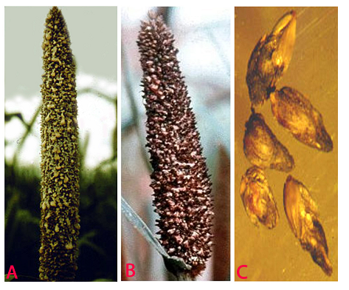
ERGOT OR SUGARY DISEASE OF BAJRA
A.HONEY DEW STAGE,B. SCLEROTIAL STAGE ,C. SLEROTIA

Slide 5
ETIOLOGY
Claviceps fusiformis or C. Microcephala
(Sub-division-Ascomycotina,Order-Hypocreales,Family-Hypocreaceae)
The fungus attacks the ovary and grows profusely producing masses of hyphae which form sclerotial bodies.
The pathogen produces septate mycelium which produces conidiophores which are closely arranged.
Conidia are hyaline and one celled.
The honey dew –like droplets in the affected ears are full of conidia,which germinate and produce secondary small conidia.
The sclerotia are small and dark grey but white inside. Sclerotia are 3-8 mm long and 0.3-15 mm broad.
The sclerotia contain mycotoxin i.e .Ergotoxin.
DISEASE CYCLE
Sclerotia are viable in soil for 6-8 months.
The primary infection takes place by germinating sclerotia present in the soil.
Secondary spread is by insects or air-borne conidia and ascospores.
The role of collateral hosts like Cenchrus ciliaris and C. Setigerus in perpetuation of fungus is significant.
The fungus also infects other species of Pennisetum.

Slide 6
FAVOURABLE CONDITIONS
Flowers are susceptible to the infection only after stigma emergence and before pollination and fertilization.
Overcast sky, drizzling rain with a temperature of 20-300C during flowering period, favour the disease development.
MANAGEMENT
Adjust the sowing date so that the crop does not flower during September when high rainfall and high relative humidity favour the disease spread.
Immerse the seeds in 10 per cent common salt solution and remove the floating sclerotia.
Eradication of collateral hosts
Grow resistant varieties like PHB 10, 14; Co 2, 3 and Bajra 24.
Spray with Ziram@0.2% or Carbendazim@0.1% or Mancozeb@0.2% at boot leaf and flowering stage

Slide 7
DOWNY MILDEW OR GREEN EAR
ECONOMIC IMPORTANCE
It occurs in many parts of Africa, as well as in India, where it was first reported by Butler in 1907.
Disease is severe in ill drained and low lying areas.
Losses due to the disease may be as high as 30-45 per cent in the high yielding varieties.
SYMPTOMS
Infection is mainly systemic and symptoms appear on the leaves and the earhead.
The first symptoms can appear in seedlings at three to four leaf stage.
The affected leaves show patches of light green to light yellow colour on the upper surface of leaves and the corresponding lower surface bears white downy growth of the fungus.
The downy growth seen on infected leaves consists of sporangiophores and sporangia.
The yellow discolouration often turns to streaks along veins.
The infected plants tiller excessively and are dwarfed.
As the disease advances, the streaks turn brown and the leaves shred at the tips only.
In affected plants, ears fail to form or if formed, they are completely or partially malformed into twisted green leafy structures; hence the name green ear disease.
The infection converts the various floral parts, including glumes, palea, stamens and pistil into green linear leafy structures of variable length.
As the disease advances, the green leafy structures become brown and dry bearing masses of oospores.

Slide 8
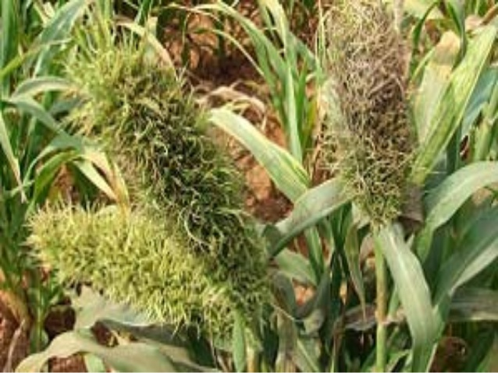
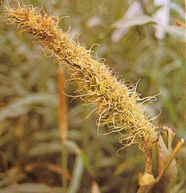
EARS MALFORMED INTO GREEN LEAFY STRUCTURES

Slide 9
ETIOLOGY
PATHOGEN:Sclerospora graminicola
(CLASS-Oomycetes,Order-Peronosporales,Family-Peronosporaceae)
The mycelium is systemic, non-septate and intercellular in the parenchymatous tissues.
Short, stout, hyaline sporangiophores arise through stomata and branch irregularly to produce sterigmata bearing the sporangia.
Sporangia are hyaline, thin walled and elliptical, and bear prominent papilla.
Oospores are round in shape, surrounded by a smooth, thick and yellowish brown wall.
DISEASE CYCLE
The oospores remain viable in soil for five years or longer giving rise to the primary infection on the host seedling.
Oospores attached to the seed also cause primary and systemic infection of seedlings.
Secondary spread is through sporangia, which are active during rainy season, disseminated by air and water.
Secondary infection may not develop into systemic infection, but leads to local infection.
The pathogen readily infects teosinte (Euchlaena mexicana) and Setaria italica.

Slide 10
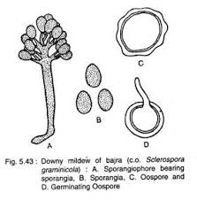
PATHOGEN

Slide 11
FAVOURABLE CONDITIONS
Formation of sporangiophores and sporangia is favoured by very high humidity (90 per cent), presence of water on the leaves and low temperature of 15-25OC.
MANAGEMENT
Selection of seed from healthy crop
Collect diseased plants, especially before oospores are formed, and burn them.
Summer deep ploughing
Rogue out infected plants.
Prolonged crop rotation
Grow resistant varities like WCC 75, PHB 10, ICMH 451 ICTP 8203, Mallikarjuna, HB-1, HB 5 and PHB 14.
Grow tolerant varieties like MBH 118, CM 46, Balaji composite, Nagarjuna composite, Visakha composite, New vijaya composite, RBS 2, etc.
Treat the seeds with Metalaxyl (Apron 35SD)@6g/kg or Thiram or Captan@4g/kg.
Spray Mancozeb@0.25% or Metalaxyl (Ridomil MZ)@0.2% starting from 30 days after sowing in the field.

