Slide 1
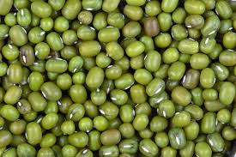
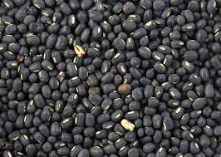
DISEASES OF BLACK GRAM (Vigna mungo) AND GREEN GRAM (Vigna radiata)

Slide 2
MAJOR DISEASES BLACK GRAM AND GREEN GRAM
FUNGAL DISEASE
POWDERY MILDEW | Erysiphe polygoni
RUST | Uromyces phaseoli typica (Syn: U.appendiculatus)
CERCOSPORA LEAF SPOT | Cercospora canescens
WEB BLIGHT | Rhizoctonia bataticola
ANTHRACNOSE | Colletotrichum lindemuthianum Glomerella lindemuthiana
VIRAL DISEASE
LEAF CRINKLE | Leaf crinkle virus
YELLOW MOSAIC | Mungbean yellow mosaic virus

Slide 3
CERCOSPORA LEAF SPOT
ECONOMIC IMPORTANCE
This is an important disease of black gram and green gram and it usually occurs in a severe form, causing heavy losses in yield particularly when humidity is high.
SYMPTOMS
Small, circular spots develop on the leaves with grey centre and reddish brown margin.
The several spots coalesce to form brown irregular lesions.
Under favourable environmental conditions, severe leaf spotting and defoliation occurs at the time of flowering and pod formation.
The brown lesions may be seen on petioles, branches and pods in severe cases.
Powdery growth of the fungus may be seen on the centre of the spots.
PATHOGEN Cercospora canescens
The fungus produces clusters of dark brown septate conidiophores.
The conidia are linear, hyaline, thin walled and 5-6 septate.
DISEASE CYCLE
The fungus survives on diseased plant debris in soil and on seeds.
The secondary spread is by air-borne conidia.
FAVOURABLE CONDITIONS
Humid weather and dense plant population favour disease development.
MANAGEMENT
Remove and burn infected plant debris.
Spray Mancozeb@0.25% or Carbendazim@0.1%
Grow tolerant black gram varieties like UG 135, TPU 4, TPU 5, TPU 11, TPU 12, AKU 4 and SP 21.

Slide 4
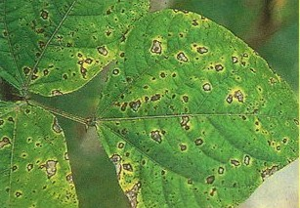
CERCOSPORA LEAF SPOT

Slide 5
ANTHRACNOSE SYMPTOM
SYMPTOMS
The symptom can be observed in all aerial parts of the plants and at any stage of crop growth.
The fungus produces dark brown to black sunken lesions on the hypocotyl area and cause death of the seedlings.
Small angular brown lesions appear on leaves, mostly adjacent to veins, which later become greyish white centre with dark brown or reddish margin.
The lesions may be seen on the petioles and stem.
The prominent symptom is seen on the pods.
Minute water soaked lesion appears on the pods initially and becomes brown and enlarges to form circular, depressed spot with dark centre with bright red or yellow margin.
Several spots join to cause necrotic areas with black dots (Acervuli).
The infected pods have discolored seeds.

Slide 6
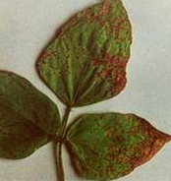
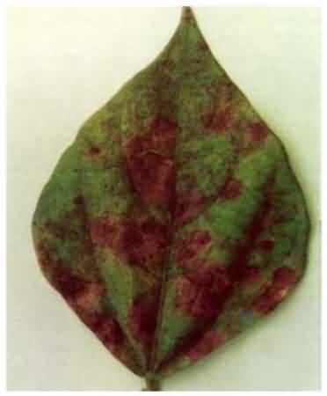
ANTHRACNOSE

Slide 7
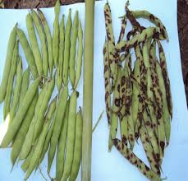

Slide 8
PATHOGEN: Colletotrichum lindemuthianum (Sexual stage : Glomerella lindemuthianum)
The fungus mycelium is septate, hyaline and branched.
Conidia are produced in acervuli, arise from the stroma beneath the epidermis and later rupture to become erumpent.
A few dark coloured, septate setae are seen in the acervulus.
The conidiophores are hyaline and short and bear oblong or cylindrical, hyaline, thinwalled, single celled conidia with oil globules.
The perfect stage of the fungus produces perithecia with limited number of asci, which contain typically 8 ascospores which are one or two celled with a central oil globule.
FAVOURABLE CONDITIONS
High relative humidity (Above 90 per cent), low temperature (15-20OC) and cool rainy days.
MODE OF SPREAD AND SURVIVAL
The fungus is seed-borne and cause primary infection.
It also lives in the infected plant tissues in soil.
The secondary spread by air borne conidia produced on infected plant parts.
Rain splash also helps in dissemination.
MANAGEMENT
Remove and destroy infected plant debris in soil.
Treat the seeds with Carbendazim at 2 g/kg. Spray Carbendazim 500g or Mancozeb 1 kg/ha soon after the appearance of disease and repeat after 15 days.

Slide 9
RHIZOCTONIA ROOT ROT (WEB BLIGHT) DRY ROOT ROT
SYMPTOMS
The disease symptom starts initially with yellowing and drooping of the leaves.
The leaves later fall off and the plant dies with in week.
Dark brown lesions are seen on the stem at ground level and bark shows shredding symptom.
The affected plants can be easily pulled out leaving dried, rotten root portions in the ground.
The rotten tissues of stem and root contain a large number of black minute sclerotia.
PATHOGEN: Rhizoctonia bataticola
(Pycnidial stage : Macrophomina phaseolina)
The fungus produces dark brown, septate mycelium with constrictions at hyphal branches.
Minute, dark, round sclerotia are produced in abundance.
The fungus also produces dark brown, globose ostiolated pycnidia on the host tissues.
They pycnidiospores (conidia) are thin walled, hyaline, single celled and elliptical.
DISEASE CYCLE
The fungus survives in the infected debris and also as facultative parasite in soil.
The primary spread is through seed-borne and soil-borne sclerotia.
The secondary spread is through seed-borne and soil-borne sclerotia.
The secondary spreads is through pycnidiospores which are air-borne.
FAVOURABLE CONDITIONS
Day temperature of 300C and above and prolonged dry season followed by irrigation.
MANAGEMENT
Treat the seeds with Carbendazim or Thiram at 4 g/kg or pellet the seeds with Trichoderma viride at 4 g/kg or Pseudonomas fluorescens @ 10g/kg of seed.
Apply farm yard manure or green leaf manure (Gliricidia maculate) at 10 t/ha or neemcake at 250 kg/ha.

Slide 10
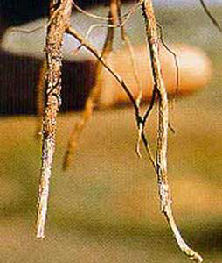
DRY ROOT ROT

Slide 11
YELLOW MOSAIC MUNGBEAN YELLOW MOSAIC VIRUS
ECONOMIC IMPORTANCE
The disease is prevalent in black gram and green gram in Andhra Pradesh, T.N., U.P., M.P., Bihar, Punjab, Haryana, Himachal Pradesh, Rajasthan and Orissa.
SYMPTOMS
Initially small yellow patches or spots appear on young leaves.
The next trifoliate leaves emerging from the growing apex show irregular yellow and green patches alternating with each other.
The yellow discoloration slowly increases and newly formed leaves may completely turn yellow.
Infected leaves also show necrotic symptoms.
The infected plants normally mature late and bear a very few flowers and pods.
The pods are small and distorted.
The early infection causes death of the plant before seed set.
PATHOGEN: Mungbean yellow mosaic virus (MYMV)(CONTAIN SSDNA) (genus: Begomovirus, family: Geminiviridae)
DISEASE CYCLE
The virus survives in the weed hosts and other legume crops. The disease spreads through white fly, Bemisia tabaci.

Slide 12
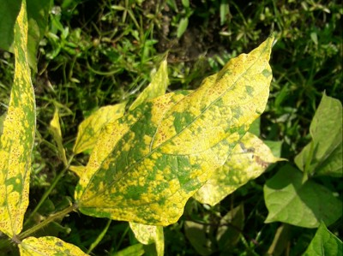
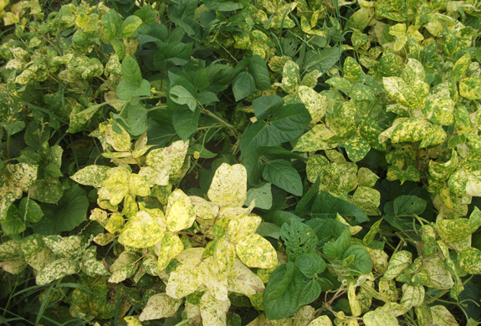
YELLOW MOSAIC SYMPTOM

Slide 13
FAVOURABLE CONDITIONS
Summer sown crops are highly susceptible. The presence of weed hosts viz., Croton sparsiflorus, Acalypha indica, Eclipta alba and Cosmos pinnatus and legume hosts.
MANAGEMENT
Rogue out the diseased plants upto 40 days after sowing.
Remove the weed hosts peiodically.
Increase the seed rate (25 kg/ha).
Grow resistant black gram varieties like Teja, LBG 752, Pant-30 and Pant-90.
Grow resistant green gram varieties like LGG 407 and ML 267.
Cultivate the crop during rabi season.
Follow mixed cropping by growing two rows of maize (60 x 30 cm) or sorghum (45 x15 cm) for every 15 rows of black gram or green gram.
Grow seven rows of sorghum as border crop
Treat seeds with Imidacloprid 70 Wetable Sulphure @ 5ml/kg to control vector.
Give one foliar spray of systemic insecticide (Dimethoate @ 750 ml/ha) on 30 days after sowing.

