Slide 1
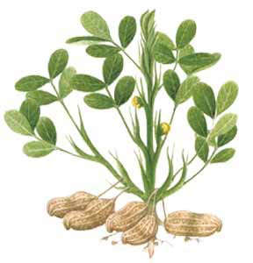
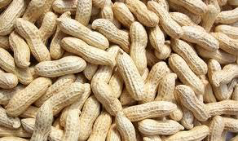
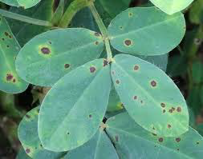
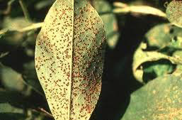
DISEASES OF GROUNDNUT(PEANUT)
COURSE-DFHCM-I
CREDIT HOUR-2+1

Slide 2
MAJOR DISEASES OF GROUNDNUT
FUNGAL DISEASE
TIKKA DISEASE OF GROUNDNUT | Early leaf spot: Cercopora arachidicola. (Sexual Stage: Mycosphaerella arachidis). Late leaf spot:Phaeoisariopsis personata. (Syn: Cercosporidium personatum) (Sexual stage :Mycosphaerella berkeleyii)
RUST | Puccinia arachidis.
COLLAR ROT OR SEEDLING BLIGHT OR CROWN ROT | Aspergillus niger and A. pulverulentum.
STEM ROT | Sclerotium rolfsii.
FUNGAL WILT OF GROUNDNUT | Fusarium oxysporum
BACTERIAL DISEASE
BACTERIAL WILT OF GROUNDNUT | Pseudomonas solanacearum
VIRAL DISEASE
GROUNDNUT/PEANUT BUD NECROSIS | Peanut bud necrosis virus.

Slide 3
TIKKA DISEASE OF GROUNDNUT
INTRODUCTION:
Tikka disease is the major disease of groundnut in India.
It occurs in every state in India and in every groundnut growing country of the world, including USA, most countries of Africa, the Philippines, Indonesia, SriLanka, China, Malaysia and Australia.
The late leafspot symptoms are common in our state than the early leafspots.
The loss in pod production may be sometimes as high as50%.
SYMPTOMS: The tikka disease occurs as two distinct types of leafspots , Caused by two species of Cercospora.
EARLY LEAF SPOT:
Early Infection leads to circular to irregular reddish brown or dark brown spots with some yellow halo on upper surface of leaves.
Symptoms may also appear on rachis, petioles, stipules and stalks etc, as elongated, elliptical spots with definite border.
The disease usually appears early (before35DAS) than the Cercosporidium personatum and hence is known as early spot.

Slide 4
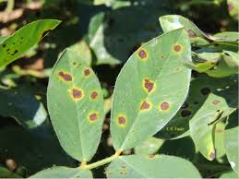
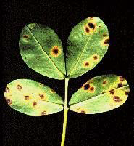
EARLY LEAF SPOT

Slide 5
LATE LEAF SPOT
Leaf spots due to C.personatum appear (after 35DAS) later than those due to Cercospora arachidicola and hence the symptoms are called late spots.
The spots on leaves are small dark spots, usually darker than early leaf spots and irregular in shape which enlarge about 3-8mm in dia.
Yellow halo is absent.
The spots are deep black in colour with clusters of conidiophores bearing conidia, arranged in concentric manner.
Severe disease attack leads to shedding of leaflets resulting in premature ageing of the crop.
The disease severe between flowering and harvest period.

Slide 6
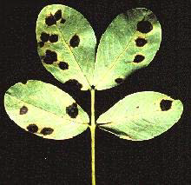
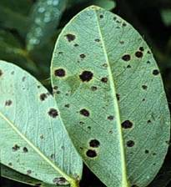
LATE LEAF SPOT

Slide 7
ETIOLOGY
EARLY LEAF SPOT
CAUSAL ORGANISIM: Cercospora arachidicola (Asexual stage)
[Subdivision-Deuteromycotina,Order-Moniliales,Family-Dematiaceae]
Mycosphaerella arachidis (Sexual stage)
[Subdivision-Ascomycotina,Order-Sphaeriales,Family-Mycosphaerellaceae]
The mycelium first intercellular but later become intracellular when host cells die.
No haustoria are found.
The fungus produces abundant sporulation on the upper surface of the leaves.
Conidiophores are olivaceous brown or yellowish brown in colour, short, 1or2 septate.
Conidia are subhyaline or pale yellow, obclavate,often curved,3-12septate and 35-110x2.5-5.4μm in size.
The perfect stage of the fungus produces perithecia as ascostromata which are globose with papillate ostiole.
Asci are cylindrical to clavate and contain 8 ascospores.
Ascospores are hyaline, slightly curved and 2celled, apical cell larger than the lower cell.

Slide 8
LATE LEAF SPOT
CAUSAL ORGANISIM: Phaeoisariopsis personata (Asexual stage)
(Syn: Cercosporidium personatum)
Mycosphaerella berkeleyii(Sexual stage)
The mycelium is septate and intercellular.
The haustoria are found in pellisade and mesophyll cells.
The conidiophores develop on dense,oval,brown to black and1-2 septate.
The conidia are cylindrical or obclavate,short,measure18-60x6-10μm, hyaline to olive brown, usually straight or slightly curved and with 1-7 septa.
The fungus in its perfect stage produces perithecia as ascostromata which are globose or broadly ovate with papillate ostiole.
Asci are cylindrical to ovate, contain 8 ascospores.
Ascospores are 2celled and constricted at septum and hyaline.

Slide 9
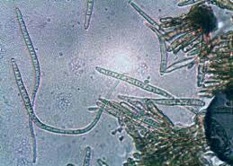
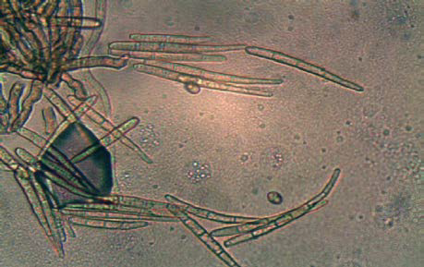
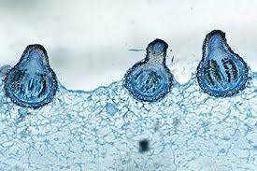
PATHOGEN

Slide 10
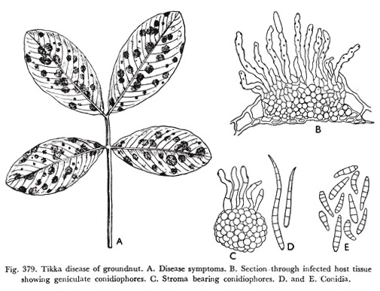
CONT...

Slide 11
Typical distinguish between Cercospora arachidicola and Cercosporidium Personatum
Cercospora arachidicola
Cercosporidium Personatum
The pathogen cause early spot in the plant.
The spot appear on the leaf surrounded by yellow halo.
Conidia are 4-12 sepated.
The conidia usually develop on the upper surface of the leaf but rarely on the lower surface. They are not formed in concentric rings.
The pathogen cause late spot in plant.
The spot not surrounded by yellow halo.
Conidia are 2-7 septated.
The conidia are restricted to the lower surface and the conidiophores develop in cocentric spots.

Slide 12
EPIDEMIOLOGY
Favourable conditions:
Wet weather‐High relative humidity (>85 %).
Heavy rainfall.
Leaf wetness.
Moderate temperature of 22‐250C.
Disease cycle:
The primary infection is by ascospores or conidia from infected plant debris or infectd seeds.
The secondary spread is by wind blown conidia.
Rains plash also helps in the spread of conidia.

Slide 13
DISEASE MANAGEMENT
Remove and destory the infected plant debris.
Eradicate the volunteer groundnut plants.
Keep weeds under control.
Treat the seeds with Carboxin + Thiram (Vitavax power) at 2g/kg.
Spray Carbendazim +mancozeb @ 0.2 % or Chlorothalonil @ 0.2% and if necessary, repeat after 15 days.
Grow moderately resistant varieties like ALR 1.

Slide 14
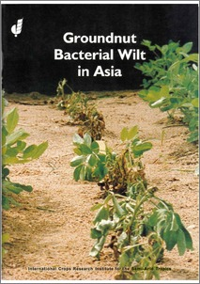
WILT OF GROUNDNUT
BACTERIAL WILT
FUNGAL WILT
C.O-Fusarium oxysporum
Symptom: In two months old plant, the yellowing of leaves, followed by wilting and drying occur. Roots turn brown and brittle. Vascular browning can be seen.
Disease cycle
Primary infection – Chlamydospores
Secondary infection – Conidia
Management
Select disease free seeds for planting.
Rogue out and burn disease affected plants and crop debris regularly.
Follow crop rotation for 2-3 years with non-host plants like pearl millet, finger millet or other cereals.
Seed treatment with Trichoderma viride@4g/kg and Thiram@3g/kg seed or carbendazim@2g/kg seed.
C.O-Pseudomonas solanacearum
Symptom: Infected plants appear unhealthy, chlorotic and wilt under water stress. Dark brown discolouration of xylem is seen. Grey slimy liquid ooze out of the vascular bundles.
Disease cycle
Primary infection – Soil
Secondary infection – Oozes spread by water
Management
Seed treatment with Streptocycline @ 0.01%.
Spray Streptocycline @ 0.01% and copper oxychoride @0.3%.

