Slide 1
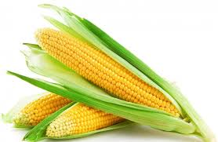
DISEASES OF MAIZE
(ZEA MAYS)
DFHCM-I
CREDIT HOUR:2+1

Slide 2
MAJOR DISEASES OF MAIZE
FUNGAL DISEASES
DOWNY MILDEW OR CRAZY TOP OF MAIZE | Peronosclerospora sorghi
TURCICUM LEAF BLIGHT/LEAF SPOT | Helminthosporium turcicum (Syn : H. maydis) PERFECT STAGE:Trichometasphaeria turcica
COMMON SMUT | Ustilago maydis
HEAD SMUT | Sphacelotheca reiliana
BROWN SPOT | Physcoderma zeae-maydis
RUST | Puccinia sorghi
CHARCOAL ROT | Macrophomina phaseolina (Sclerotial stage: Rhizoctonia bataticola)
STALK ROT OF MAIZE | Cephalosporium acremonium/C.maydis

Slide 3
MAJOR DISEASES OF MAIZE
BACTERIAL DISEASES
SHOOT AND EAR ROT OF MAIZE | Erwinia carotovora
BACTERIAL LEAF SPOT | Xanthomonas campestris pv.maydis
VIRAL DISEASES
MAIZE LEAF STREAK | Maize streak virus (MSV)
MAIZE DWARF MOSAIC | Maize dwarf mosaic virus (MDMV)
MOSAIC OF MAIZE | Sugarcane mosaic virus

Slide 4
DOWNY MILDEW OR CRAZY TOP OF MAIZE
INTRODUCTION
The disease is restricted to India and severe outbreaks have occurred in several states.
The disease was 1st reported in Panthnagar, UP, by Payakand Renfro (1967).
The disease causes considerable loss of the crop yield.
SYMPTOMS
  The most characteristic symptoms is the development of long, rather broad and chlorotic stripes on the leaf.
  White downey growth of the fungus can be seen on the lower surface of the leaf.
  Proleferation of axillary buds on the stalk of tassel and top (crazy top) takes place.
  Plant exhibit stunted and bushy appearance.

Slide 5
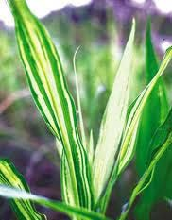
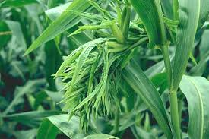
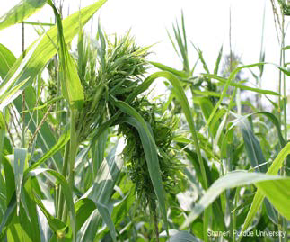
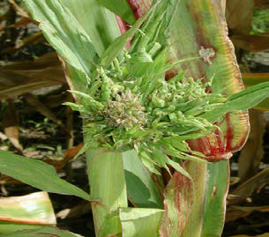
SYMPTOM OF DOWNY MILDEW OR CRAZY TOP OF MAIZE

Slide 6
CAUSAL ORGANISM
The pathogen is responsible for downy mildew of maize is Peronosclerospora sorghi
Sporangiophores are massive, wedge-shaped, short, dichotomously branched.
Sporangiophores are profusely into series of pointed sterigmata which bear hyaline, oblong or ovoid sporangia (conidia).
FAVOURABLE CONDITIONS
  High relative humidity(90%).
  Water logging condition.
  Light drizzles with at emperature of 20-250C.
  Young plants are highly susceptible.
DISEASECYCLE
The primary source of infection is through oospores in soil and also dormant mycelium present in the infected maize seeds.
Secondary spread is through airborne sporangia (conidia).

Slide 7
DISEASE MANAGEMENT
Do not grow maize in low, wet fields.
Provide adequate soil drainage (where this is a problem).
Control grass weeds in or around the maize fields.
Deep ploughing.
Crop rotation with pulses.
Treat the seeds with Metalaxyl at 4 g / kg.
Spray the crop with Metalaxyl + Mancozeb @ 1 kg on 20thday after sowing.
Grow resistant varieties like CO 1, Hybrids-COH 1, 2.

Slide 8
LEAF SPOT OF MAIZE
ECONOMIC IMPORTANCE
In Andhra Pradesh, it is severe in the districts of Warangal, Karimnagar, Medak,Nizamabad, Adilabad and Ranga Reddy.
SYMPTOMS
Disease is characterized by long elliptical grayish green or tan lesions on the leaves measuring 2.5 to 25 cm in length and upto 4 cm in width.
The fungus affects the maize plant at young stage. Small yellowish round to oval spots are seen on the leaves.
The spots gradually increase in area into bigger elliptical spots and are straw to grayish brown colour in the centre with dark brown margins.
The spots coalesce to form bigger spots and gives blighted appearance.
The surface is covered with olive green velvety masses of conidia and conidiophores.
Under high humidity the whole leaf area becomes necrotic and plant appears as dead. Lesions may be extended to husk.

Slide 9
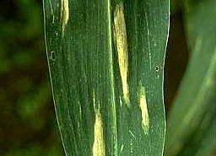
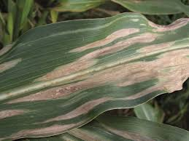
LEAF SPOT OF MAIZE

Slide 10
PATHOGEN: IMPERFECT STAGE: Helminthosporium turcicum (Syn : H. Maydis)
(Sub-division-Deuteromycotina,Order-Moniliales,Family-Moniliaceae)
PERFECT STAGE:Trichometasphaeria turcica
Conidiophores are in group, geniculate, mid dark brown, pale near the apex and smooth.
Conidia are distinctly curved, fusiform, and pale to golden brown with 5-11 pseudosepta.
DISEASE CYCLE
Fungus survives in plant debris, seed and collateral hosts.
The fungus is externally seed borne.
It also infects Sudan grass, Johnson grass, sorghum, wheat, barley, oats, sugarcane and spores of the fungus are also found to associate with seeds of green gram, black gram, cowpea.
Secondary spread is through wind borne conidia.
FAVOURABLE CONDITIONS
Optimum temperature for the germination of conidia is 18 to 27OC provided with free water on the leaf.
Infection takes place early in the wet season.
MANAGEMENT
Crop rotation
Grow resistant hybrids like DHM-1
Treat the seeds with Captan or Thiram at 4 g/kg
Spray Mancozeb@0.25%

Slide 11
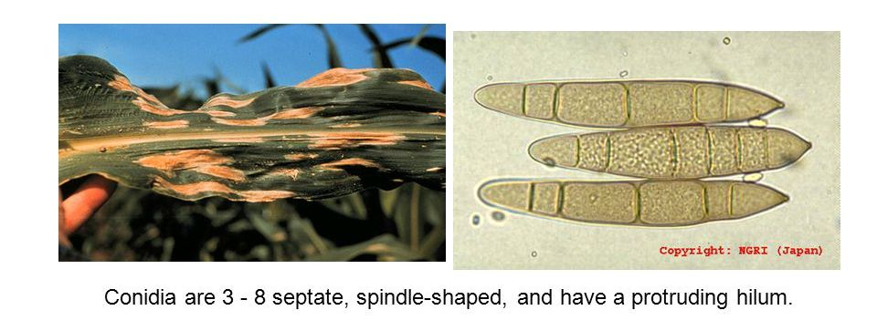
SYMPTOM AND CONIDIA OF HELMINTHOSPORIUM TURCICUM

Slide 12
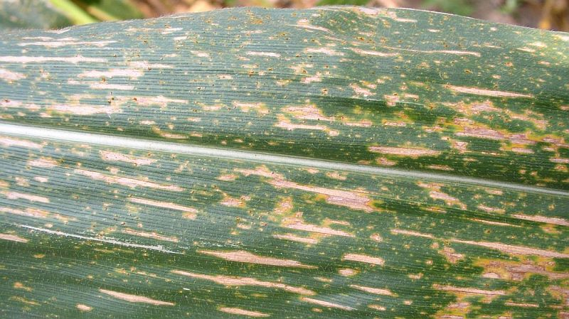
SOURTHEN LEAF SPOT

Slide 13
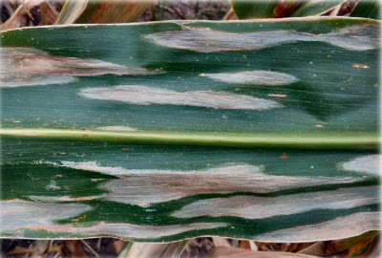
NORTHEN LEAF SPOT

Slide 14
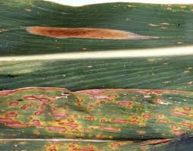
COMPARISION SOURTHEN AND NORTHEN LEAF BLIGHT OF MAIZE

Slide 15
STALK ROT OF MAIZE
Cephalosporium wilt (Black bundle disease and late wilt)
Symptoms
By Cephalosporium acremonium
The diseases prominent when maize has reached the dough stage.
One of the first symptoms is the purpling of leaves and stalks.
The most characteristic symptom is the restricted blackening of vascular bundles in the stalk with shredding of the intermodal pith region.
Blackening of the vascular bundles extends through several internodes.
Barren plants, excessive tillering and multiple ears are the other diagnostic symtoms.
By Cephalosporium maydis
Symptoms appear only after flowering stage .
plants start wilting basipetally giving a dull green appearance of the leaves which later dry up.
The lower internode turns discoloured, become reddish brown, shrunken and soft, and subsequently becomes dry and hollow.
When diseased stalks are split open, reddish brown vascular bundles are seen.

Slide 16
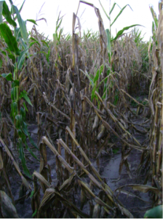
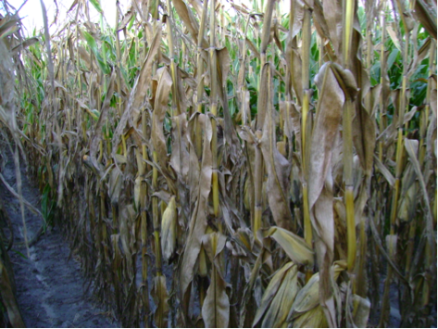
STALK ROT OF MAIZE

Slide 17
Pathogen
Conidiophores swollen or slender; conidia are one celled, hyaline and are produced successively at the tip and usually embedded in a slimy drop.
Disease cycle
Primary infection – Soil, Plant debris and seed
Secondary infection – Conidia
Favourable Conditions
High temperature and low soil moisture (drought) favour the disease.
Management
Crop sanitation.
Crop rotation.
Avoid water stress at flowering.
Seed treatment with Carboxin + Thiram (Vitavax Power) @ 2g/kg of seed.
Grow resistant varieties like DHM-103, DHM 105, Hi-Starch and Ganga Safed-2.
Soil drenching and foliar spray of carbendazim + Mancozeb @ 0.2%.

