Slide 1
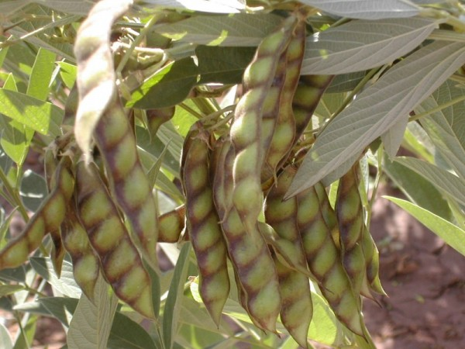
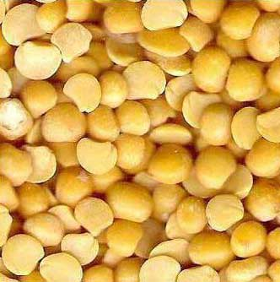
DISEASES OF RED GRAM (Cajanus cajan)

Slide 2
MAJOR DISEASES OF RED GRAM (Cajanus cajan)
FUNGAL DISEASES
PHYTOPHTHORA BLIGHT / STEM BLIGHT | Phytophthora drechsleri f. sp. cajani
WILT | Fusarium oxysporum f. sp. udum
CANKER | Diplodia cajani
LEAF SPOT | Cercospora indica
POWDERY MILDEW | Leveillula taurica
BACTERIAL DISEASE
BACTERIAL LEAF SPOT AND STEM CANKER | Xanthomonas campestris pv. cajani
VIRAL DISEASE
STERILITY MOSAIC | Sterility mosaic virus

Slide 3
WILT
ECONOMIC IMPORTANCE
The annual losses due to wilt have been estimated at US $ 71 million in India.
It is prevalent in A.P., Maharashtra, M.P., U.P and Bihar. In A.P.
SYMPTOMS
The diseases may appear from early stages of plant growth (4-6 week old plant) up to flowering and podding.
The leaves of affected plants turn yellow droop prematurely and within 3-4 days the plant wilt.
In 6-week all the ages of plant wilt ,the disease spread in concentric circle to near by plant.
In sever condition death of more than 50% plant occur.
Black lesions of varying size but mostly linear with irregular margin seen on the stem and tap root.
Vascular tissues exhibit brown to black discolouration.
Partial wilting of the plant is a definite indication of Fusarium wilt and distinguishes from Phytophthora blight that kills the whole plant.
Partial wilt is associated with lateral root infection, while total wilt is due to tap root infection.

Slide 4
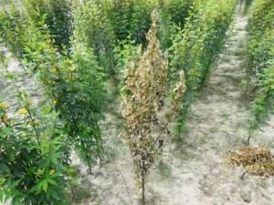
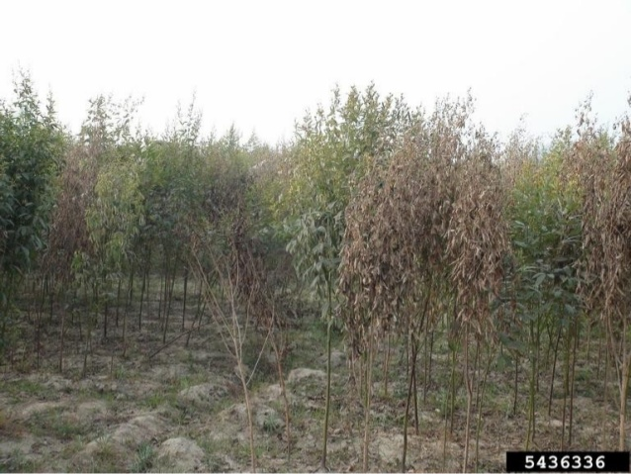
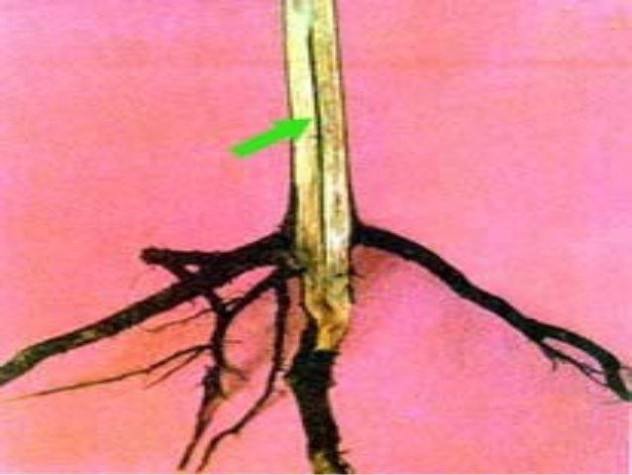
WILT SYMPTOM IN PIGEON PEA
Wilt infected plant in field
Blackening of vascular bundle

Slide 5
PATHOGEN: Fusarium oxysporum f. sp. Udum
[Subdivision-Deuteromycotina,order-Moniliales,Family-Tuberculariaceae]
The fungus produces hyaline, septate mycelium.
Microconidia are hyaline, small, elliptical or curved, single celled or two celled.
Macroconidia are also hyaline, thin walled, linear, curved or fusoid, pointed at both ends with 3-4 septa.
The fungus also produces thick walled, spherical or oval, terminal or intercalary chlamydospores singly or in chains of 2 to 3.
FAVOURABLE CONDITIONS
Long and medium duration types suffer more wilt than short duration types.
Monocropping and ratooning pre-disposes the plant to wilt.
Disease incidence is more severe in Vertisols than in Alfisols.
Early sowing, good weed management and good crop growth encourage wilt development.
Soil temperatures of 17 to 250C favour the pathogen development.

Slide 6
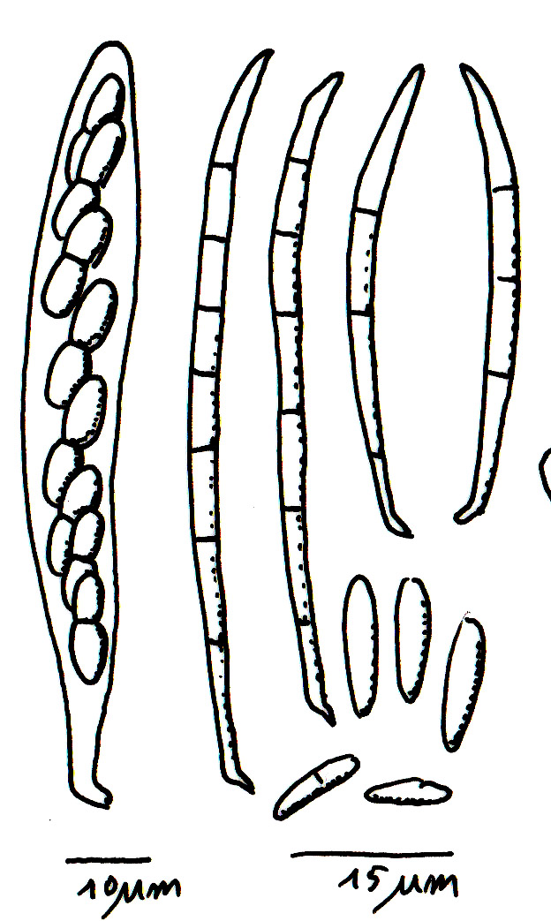
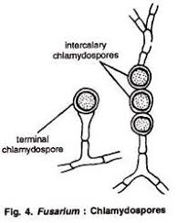
PATHOGEN
MACROCONIDIA
MICROCONIDIA

Slide 7
MODE OF SPREAD AND SURVIVAL
The disease is seed and soil borne.
The fungus survives in the infected stubbles in the field for about 3 years.
The primary spread is by soil-borne chlamydospores and also by seed contaminant.
Chlamydospores remain viable in soil for 8-20 years.
The secondary spread in the field is through irrigation water and implements.
MANAGEMENT
CULTURAL:
Follow long crop rotation with tobacco, sorghum or castor.
Avoid successive cultivation of redgram in the same field.
Adopt mixed cropping of sorghum in the field.
Soil solarization in summer to reduce the inoculum of pathogen.
Collect and destroy the diseased stubbles.
HPR:
Grow resistant / tolerant varieties like Asha (ICPL 87119), Maruti (ICP 8863), Lakshmi (ICPL 85063), Durga (ICPL 84031), PRG 100, PRG 158, Muktha, Prabhat and Sharada.
CHEMICAL:
Seed treatment with Thiram @0.3% or Carbendazim @0.2%
BIO-CONTROL:
Treat the seeds with Trichoderma viride at 4 g/kg.
Multiply 2 Kg T. viride formulation in 50 kg of Farm Yard Manure and apply to soil.

Slide 8
PHYTOPHTHORA BLIGHT / STEM BLIGHT
ECONOMIC IMPORTANCE
A devastating disease that kills young (1 to 7 week old) plants, leaving large gaps in plant stands.
Yield losses are usually higher in short duration pigeonpeas than in medium and long duration types.
SYMPTOMS
Phytophthora blight resembles damping off in that it causes seedlings to die suddenly.
Infected plants have water soaked lesions on their leaves and brown to black, slightly sunken lesions on their stems and petioles.
Infected leaves loose turgidity, and become desiccated.
Lesions girdle the affected main stems or branches which break at this point and foliage above the lesion dries up.
When conditions favour the pathogen, it is common for many plants to die.
Pigeonpea plants that are infected by blight, but not killed often produce large galls on their stems especially at the edges of the lesions.
The pathogen infects the foliage and stems but not the root system.

Slide 9
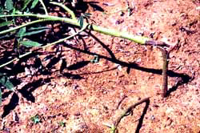
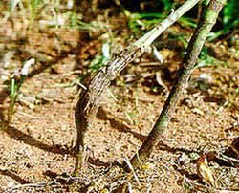
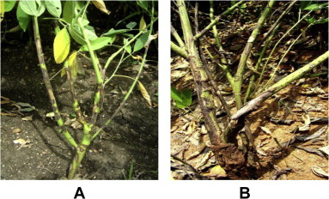
PHYTOPHTHORA BLIGHT SYMPTOM

Slide 10
PATHOGEN: Phytophthora drechsleri f. sp. cajani
Fungus produces hyaline, coenocytic mycelium.
The sporangiophores are hypha-like with a swelling on the tip bearing hyaline, ovate or pyriform, non-papillate sporangia.
Each sporangium produces 8-20 zoospores. Oospores are globose, light brown, smooth and thick walled.
FAVOURABLE CONDITIONS
Cloudy weather and drizzling rain with temperatures around 250C favour infection .
It requires continuous leaf wetness for 8 hours to occur.
Warm and humid weather following infection results in rapid disease development and plant death.
Soils with poor drainage, low lying areas, heavy rain during the months of July-September favours the disease.
Pigeonpeas are usually not infected after they are 60 days old.

Slide 11
DISEASE CYCLE
The fungus survives in the soil and plant debris in the form of oospores, and dormant mycelium.
Primary infection is from oospores and secondary spread by zoospores from sporangia.
Rain splash and irrigation water help for the movement of zoospores.
Cajanus scarabaeoides var. scarabaeoides, a wild relative of pigeonpea is also a host of the blight pathogen.
MANAGEMENT
Avoid sowing redgram in fields with low-lying patches that are prone to water logging.
Adjust the sowing time so that crop growth should not coincide with heavy rainfall.
Grow resistant varieties like BDN 1, ICPL 150, ICPL 288, ICPL 304, KPBR 80-1-4.
Seed treatment with 4g Trichoderma viride formulation + 6g metalaxyl (Apron 35SD) per kg of seed.
Spray Metalaxyl (Ridomyl MZ) at 0.2%.

Slide 12
STERILITY MOSAIC
ECONOMIC IMPORTANCE
A serious problem in India and Nepal where it is estimated to cause annual pigeonpea grain losses worth US $ 282 million.
SYMPTOMS
The disease attack can be seen in all stages of crop growth.
In the field, the diseased plants appear as bushy, pale green plants without flowers or pods.
Leaves of these plants are small and show typical light and dark green mosaic pattern.
Symptoms initially appear as vein-clearing on young leaves.
In severe cases, leaves become smaller and cluster near tip because of shortened internodes and stimulation of auxillary buds.
The plants are generally stunted and do not produce pod.
Plants infected at early stages (upto 45 days) of crop growth show near complete sterility and yield loss upto 95 per cent.
As plants become older (after 45 days), their susceptibility to the disease decreases and such plants show partial sterility.
If pods develop, the seeds may be small, shrivelled and immature. Some pigeonpea varieties exhibit ring spot leaf symptoms.
Ring spot leaf symptoms indicate localized sites of infection of the pathogen, and such plants produce normal flowers and pods.

Slide 13
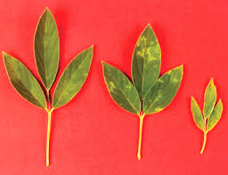
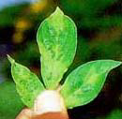
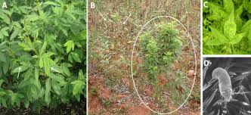
STERILITY MOSAIC SYMPTOM

Slide 14
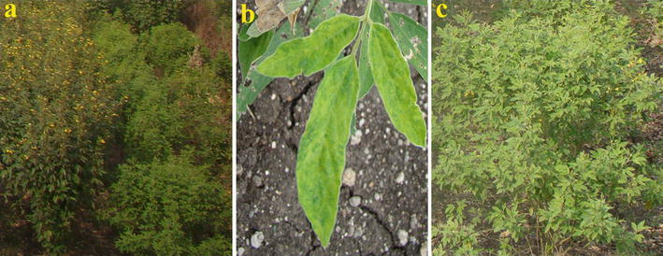
STERILITY MOSAIC SYMPTOM

Slide 15
PATHOGEN :Pigeon pea Sterility mosaic virus(PPSMV)
The causal agent of the disease is PPSMV, a virus with a segmented, negative-sense, single-stranded RNA genome, transmitted in a semi-persistent manner by an eriophyid mite Aceria cajani .
DiSEASE CYCLE
The disease is transmitted by an Eriophyid mite Aceria cajani.
The self-sown redgram plants, perennial types of redgram (Cajanus scarabaeoides var. scarabaeoides) and the rationed growth of harvested plants serve as sources of infection.
FAVOURABLE CONDITIONS
Disease incidence is high when pigeonpeas are inter- or mixed cropped with sorghum or millets.
Shade and humidity encourage mite multiplication, especially in hot summer weather.
MANAGEMENT
Rogue out infected plants in early stages of disease development.
Grow tolerant genotypes like ICPL 87119 (Asha), ICPL 227, Jagruti and Bahar.
Spray Dicofol 3ml or Sulphur 3g in one liter of water to control mite vector in early stages of disease development

