Slide 1
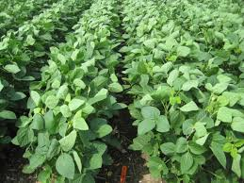
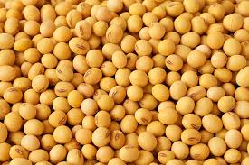
DISEASES OF SOYBEAN
(Glycine max)

Slide 2
MAJOR DISEASES SOYBEAN (Glycine max)
FUNGAL DISEASE
RUST | Phakopsora pachyrhizi
RHIZOCTONIA BLIGHT | Rhizoctonia solani
SEED AND SEEDLING ROT | Fusarium, Rhizoctonia, Phytophthora, and Pythium
BACTERIAL DISEASE
BACTERIAL PUSTULES/SPOTS | Xanthomonas axonopodis pv. glycines
VIRAL DISEASE
SOYBEAN MOSAIC | Soybean mosaic virus

Slide 3
RHIZOCTONIA BLIGHT
SYMPTOMS :
The infection is common during the late vegetative stages.
Initially circular to irregular green water soaked spots with reddish - brown margin appear on older leaves, sometimes on older leaflets.
At the later stage of disease the spot turns tan or brown colour and the spots start to appear on the petioles, stem and young pod.
Brown protrusion grows on stems and petioles. Agglutinations of leaves with cottony fungal growth are also common.
Severe infection cause pod blight and defoliation.
PATHOGEN:
Rhizoctonia solani(Sub-division: Deuteromycotina)

Slide 4
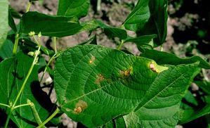
RHIZOCTONIA BLIGHT

Slide 5
Disease Cycle
Primary infection – Sclerotia in soil
Secondary infection – Water
Favourable condition
Warm temperature and high humidity favours disease development.
Management
Soil drenching with Validamycin @ 0.2%.

Slide 6
BACTERIAL PUSTULES/SPOTS
SYMPTOMS
Symptoms are evident as tiny, light green spots with elevated centers that later on turn into raised light coloured pustules , typically without exudates.
Infection is more frequent on the lower ones.
Spots may vary from minute specks to large, irregular, mottled brown areas.
Severely affected portions of leaves are torn away by wind imparting a ragged appearance to plants, and results in premature defoliation.
PATHOGEN
Xanthomonas axonopodis pv. glycines

Slide 7
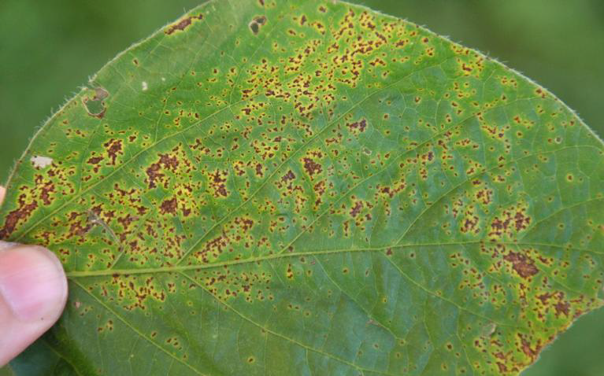
BACTERIAL PUSTULES/SPOTS

Slide 8
Disease cycle
Primary infection – Seed and plant debris
Secondary infection – Ooze spread by water
Favourable condition
The disease appears in a severe form when warm temperatures and frequent showers prevail during growing season.
Management
Remove and burn infected plant debris.
Crop rotation with grain crop is recommended
Two sprays at 45and 55 DAS with a mixture of Streptocycline @ 0.01% + Copper oxychloride @ 0.3%.

Slide 9
SEED AND SEEDLING ROT
Causal organisim:Fusarium, Rhizoctonia, Phytophthora, and Pythium

Slide 10
SYMPTOMS
Phytophthora can attack and rot seeds prior to emergence, and can cause pre- and post- emergence damping off. It produces tan-brown, soft, rotted tissue. At the primary leaf stage (V1), infected stems appear bruised and soft, secondary roots are rotted, the leaves turn yellow, and plants frequently wilt and die.
Pythium can attack and rot seeds and seedlings prior to emergence and can cause post-emergence damping-off under wet conditions. The characteristic symptom of most Pythium infections is soft, brownish-colored, rotting tissue.
Rhizoctonia can damage seeds and plants prior to or after emergence. In seedlings and older plants, a firm, rusty-brown decay or sunken lesion on the root or on the lower stem is a characteristic symptom.
Fusarium is also a common pathogen that can damage seeds and seedlings. It causes light to dark brown lesions on roots that may spread over much of the root system and may appear shrunken. Fusarium may attack the tap root and promote adventitious root growth near the soil surface and may degrade lateral roots.

Slide 11
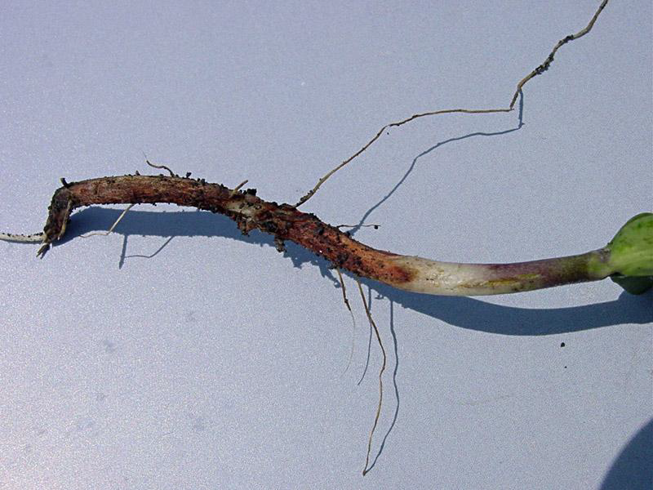
SEED AND SEEDLING ROT

Slide 12
Disease Cycle
Primary infection – Soil
Secondary infection – Air and water
Management
For Pythium and Phytophthora spray Metalaxyl @ 0.2%
For Fusarium spray Carbendazim + Mancozeb @ 0.1%.
For Rhizoctonia spray Validamycin @ 0.2%.

Slide 13
SOYBEAN MOSAIC
SYMPTOMS
Infected plants can be recognized by their stunted growth, distorted and puckered leaves.
The leaves are dwarfed, crinkled and narrow with their margins turned downwards.
In severe cases, dark green blister like puckering along the veins takes place.
Pod setting is drastically reduced.
Infected plants produce distorted pods and fewer seeds.
Seed discolouration can be seen under severe infection.
The infected plants remain green even at the end of the growing season.
PATHOGEN:Soybean mosaic virus Soybean mosaic virus (SMV) is a member of the plant virus genus Potyvirus (family Potyviridae) contain ssRNA.
DISEASE CYCLE
The virus is seed borne and is transmitted by aphids.
MANAGEMENT
Use virus free seed from healthy crop.
Rogue out infected plants and burn them.
Spray dimethoate@2ml/lt to control the vector

Slide 14
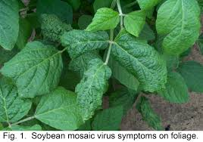
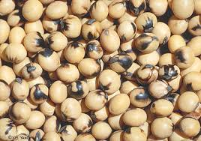
SOYBEAN MOSAIC SYMPTOM
Seed discolouration

