Slide 1
EMBEDDED SYSTEM DOMAIN
Presented by
Mrs. Swarna Prabha Jena

Slide 2
OUTLINE
Introduction
Domain Objectives
Domain Outcomes
Future Scope
Training Partner
Companies for Placements
Carrier Opportunities
Course structure
Evaluation System

Slide 3
INTRODUCTION
An Embedded System is an electronic/electro-mechanical system designed to perform a specific function and is a combination of both hardware and firmware(software).
It has three components:1) Hardware, 2) Application software, 3) Real Time Operating System

Slide 6
Washing machine has an Embedded System

Slide 7
An Air conditioner for controlling room temperature
Embedded system with control functionalities impose control over some variables according to the input variables.
A system with control functionality contains both sensors and actuators.

Slide 8
Application Specific User Interface
These are embedded systems with application specific user interfaces like buttons, switches, keypad, lights, bells, display units, etc..
Mobile phone is an example for this, in mobile phone the user interface is provided through the keyboard, graphic LCD module, system speaker, vibration alert, etc…

Slide 9
Automatic Traffic Light System

Slide 10
Automated Parking System

Slide 11
Fits a windscreen to a Mercedes-Benz Automobile at a factory in Germany.

Slide 12
Smart Agriculture

Slide 13
Smart Home

Slide 14
DOMAIN OBJECTIVES
To know the concepts, structure and function of Embedded System.
Familiar with software tools & hardware to develop an Embedded System.
Learning debugging techniques for Embedded System.

Slide 15
DOMAIN OUTCOMES
Students will able to execute Real Time Projects.
Students will be able to apply the knowledge, techniques, skill and modern tool of discipline to broadly defined Engineering Technology activities.
Students with this knowledge will be able to satisfy the need of industry.

Slide 16
FUTURE SCOPE OF EMBEDDED SYSTEMS
Scope is always evergreen in present, future and also never ever end for Embedded System.

Slide 17
OUR INDUSTRY TRAINING PARTNER

Slide 18
TIE-UPS WITH LEADING COMPANY FOR PLACEMENT PROGRAMS

Slide 19
WHO CAN REGISTER FOR THIS DOMAIN?
Anyone who wants to learn the Technology

Slide 20
WHAT SKILLS STUDENTS SHOULD HAVE ?
Software Skills
Embedded C Programming on Microcontrollers (AVR, PIC, ARM)
Interfacing microcontrollers with different sensors and peripherals
Kernel Programming
Device Drivers
Real Time Operating Systems (RTOS)
Innovative Thinking
Hardware Skills
Electronic Circuit Designing
Power Supply Circuit Designing
PCB Designing
Troubleshooting Skills
Other Skills
Learning new microcontroller interfacing
Learning new hardware
Reading Datasheets

Slide 21
CAREER OPPORTUNITIES IN EMBEDDED SYSTEMS
Embedded FPGA Engineer
Embedded Robotics Engineer
Firmware Developer for Embedded Systems
Embedded System Manager
Embedded Developer
Embedded System IT Security
Embedded Systems Engineer
Embedded Software Engineer
Developer - Embedded Software/firmware
Embedded Linux Application Developer
Embedded Design Engineer
Embedded Graphics Developer
IoT Developer and Embedded R D Engineer

Slide 22
SECTORS IN WHICH STUDENTS WILL GET EMBEDDED SYSTEMS JOBS
Medical Electronics
Aerospace
Automobiles
Defence
Toys
Consumer Electronics
Food industry
Telecommunication
Industrial machines
Space
Agriculture
Construction

Slide 23
STUDENTS GOT PLACED(2016-2017)
Company Name | No. of Students | Package per Annum
Harman International Pvt. Ltd | 4 | 4.5 Lac
Mymo Wireless | 1 | 3.5 Lac
Robert Bosch | 1 | 4 Lac
Tech Mahindra | 3 | 3.5 Lac
UX Reacter | 1 | 3 Lac

Slide 24
STUDENTS GOT PLACED(2017-2018)
Company Name | No. of Students | Package per Annum
Mahindra Electric | 2 | 4.6 Lac
HCL | 9 | 3.5 Lac
MindTree | 2 | 3.5 Lac
VEDA IIT ( Soctronics ) | 1 | 4 Lac
MPS | 1 | 3 Lac
Etech Global services | 2 | 3 Lac
Robot Bosch | 2 | 3 Lac

Slide 25
Advanced C Programming and Data Structure | Theory + Practice | 5 | Basket V
Embedded C Programming | Theory + Practice | 3 | Basket V
ARM Processor Based System Design | Theory + Practice | 5 | Basket IV
Real Time Operating System & VxWorks | Theory + Practice | 5 | Basket V
Linux for Embedded System | Practice +Project | 2 | Basket IV
Linux kernel programming & Device Driver | Theory + Practice | 5 | Basket V
Model Based System Design | Theory + Practice | 3 | Basket V
Internet Of Things | Theory + Practice | 5
Basket V

Slide 26
MICROCONTROLLERS AVAILALABE
8051 Microcontrollers Boards (AT89s52)
AVR Microcontrollers Boards(ATmega 16)
PIC Microcontrollers Boards(PIC16f877)
Arduino Microcontrollers Boards (Uno & Mega)
ARM 7 Microcontrollers Boards(LPC2148)
Raspberry Pi Microcontrollers Boards (ARM Cortex A5)
Beagle Bone Black boards (ARM Cortex A8)

Slide 27
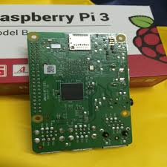
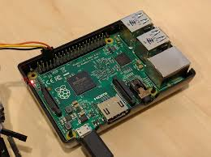
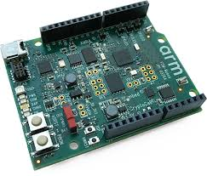
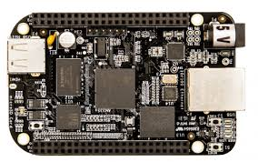
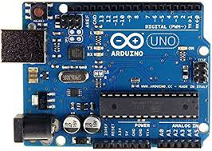
Different Controller Boards

Slide 28
SENSORS AVAILABLE
IR sensors ,Light sensor, Pressure sensor, Load sensor, .
Alcohol sensor, Flex sensor, Accelerometer.
Force sensor, Temperature sensor, Distance sensor.
Humidity sensor, Gas sensors, Moisture sensor.
Sound sensor, Direction sensor, Laser sensor.
Vibration sensor, piezoelectric sensor,

Slide 29
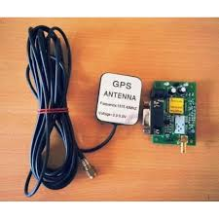
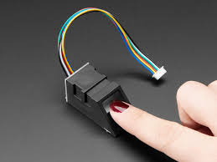
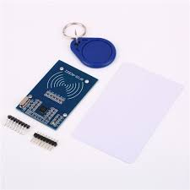
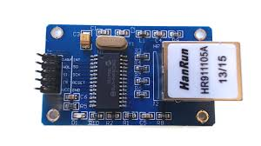
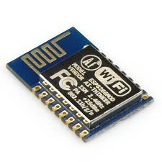
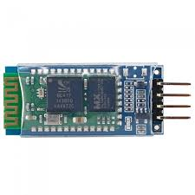
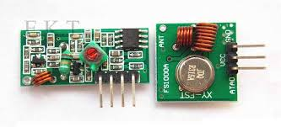
Interfacing Modules

Slide 30
INTERFACING MODULES
LCD, LED, Dot Matrix, Touch Screen ,Seven Segment Display, RTC, EEPROM, SD cards.
Types of Switches, Keypads, Types of Motors.
Wifi Modules, Ethernet Modules.
Bluetooth Modules, RF Modules, Zig-bee Modules.
Finger Print modules, RFID Modules, Web Camera.
GSM modules, GPS modules, .

Slide 31
SOFTWARE AVAILABLE
Keil uVision IDE for 8051 & ARM Processors.
MATLAB 2016 for Model Based System Design,
Tornado for Vxworks,freeRTOS for Real Time Operating System.
AVR Studio for ATMEGA Microcontrollers.
Arduino IDE for Arduino Microcontroller.
MicroC Pro for PIC Microcontroller,
Multisim12 for PCB Designing,
Proteus Professional for simulation purpose.

Slide 32
THANK YOU

