Slide 1
Euphorbiaceae
By
Dr. Gyanranjan Mahalik
Asst. Prof.
Dept. of Botany; SoAS
Centurion University of Technology and Management

Slide 2
Euphorbiaceae
Systematic position Class: Dicotyledonae Sub-class: Monochlamydeae Series: Unisexuales Family: Euphorbiaceae
General characters of Euphorbiaceae Distribution
Euphorbiaceae includes more than 300 genera and about 7,500 species.
It is world wide in distribution, but particularly well represented in Africa and South America.
In India, it is represented by more than 70 genera and about 450 species.
Habit
This family includes a large number of annual herbs (eg. Phyllanthus amarus) or shrubs (eg. Ricinus communis) or trees (eg. Phyllanthus emblica).

Slide 3
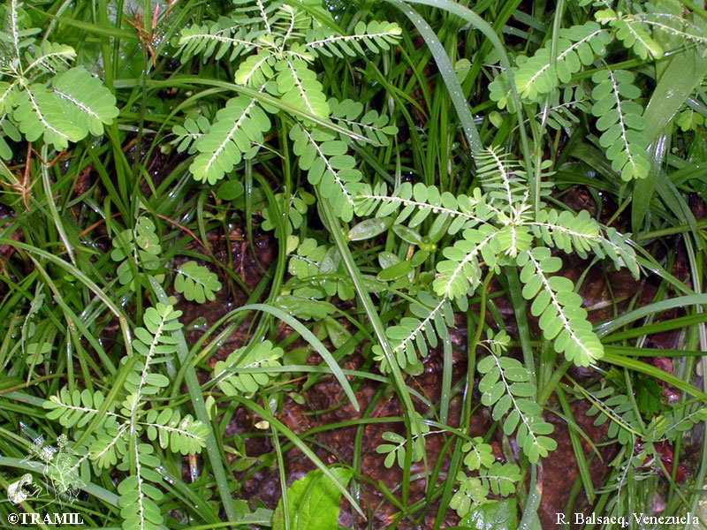
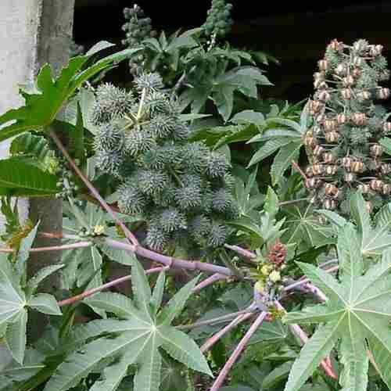
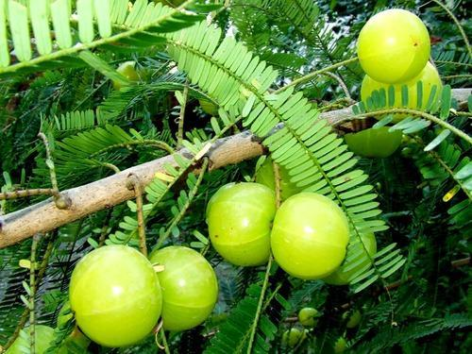
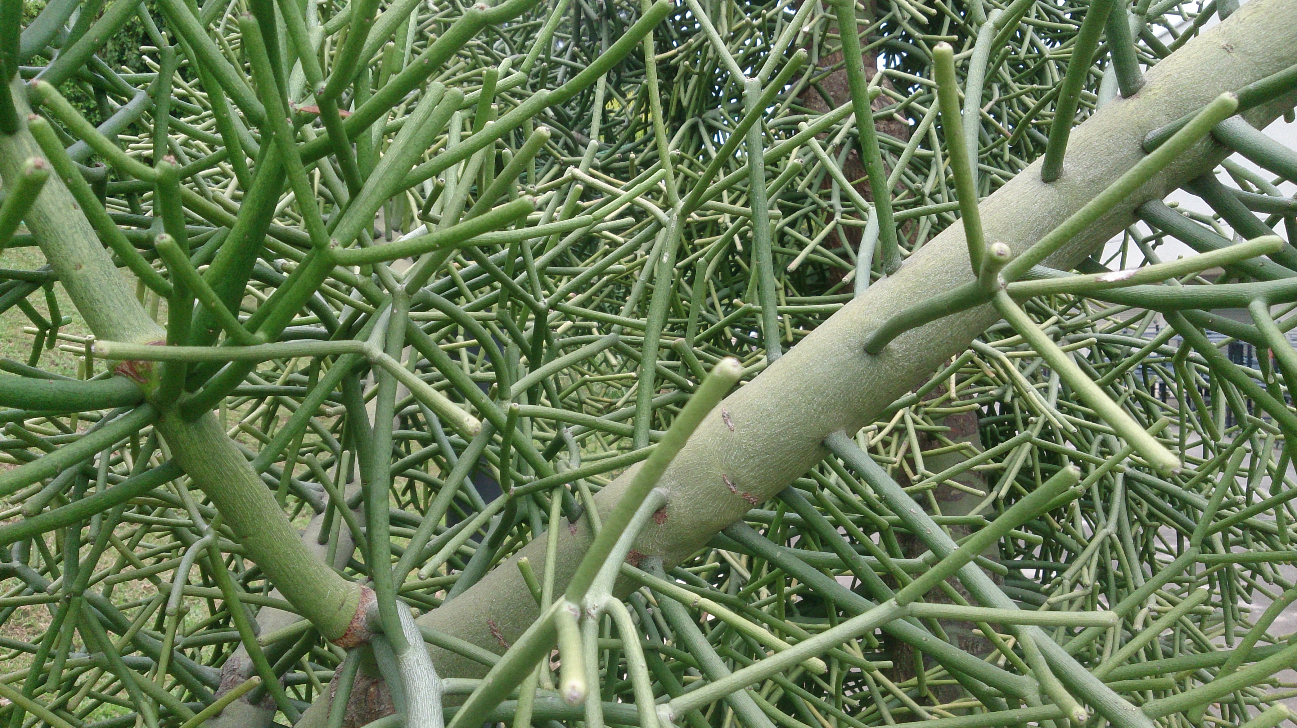
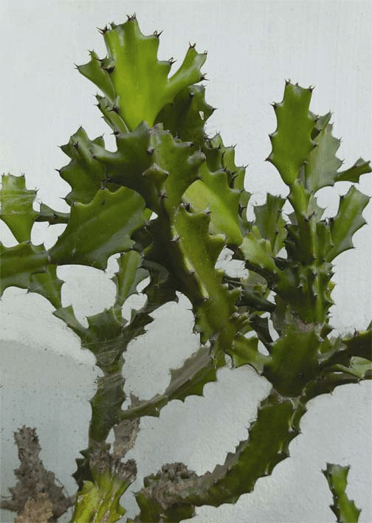
In several species of Euphorbia, the stem is modified to perform photosynthesis. This modified stem is called cladode and it resembles cactus. eg. E. tirucalli and E. antiquorum. Almost all the plants have latex which is either milky or watery.
Phyllanthus amarus Ricinus communis Phyllanthus emblica
E. tirucalli
E. antiquorum

Slide 4
Roots: Branched tap root system.
Stem: Aerial, erect, herbaceaous but woody below, branched and hollow. Young branches are covered with hair like outgrowth. Latex is present.
Leaf: Sessile or petiolate; alternate; simple; there is general tendency of reduction in leaves. Sometimes, leaves are reduced to scales or spines.
Inflorescence: Compound raceme or panicle and terminal. Male flowers are seen below and female flowers near the apex.
Male Flower: Bracteate, ebracteolate, pedicellate, actinomorphic, monoecious and incomplete.

Slide 5
Perianth: Tepals 5, arranged in single whorl, gamophyllous, valvate aestivation and odd tepal is posterior in position.

Slide 6
Androecium: Stamens many, polyadelphous, filaments branched and united to form five branches. Anthers are dithecous, globose, basifixed, introrse and dehiscing by longitudinal slits.
Gynoecium: Absent but pistillode is present.
Floral formula and Diagram of male flower:

Slide 7
Female Flower:
Bracteate, ebracteolate, pedicellate, actinomorphic, incomplete and hypogynous.
Perianth: Calyx 3 to few or more, Caducous, Spathaceous, and gamophyllous showing valvate aestivation.
Caducous:- falling of calyx before usual time
Androecium: Absent but staminode is present.
Gynoecium: Ovary superior, 3 carpels (tricarpellary) and syncarpous. Ovary trilocular with one ovule in each locule on axile placentation. Styles 3, deep red and long, 3 bifid stigma
Fruit: Fruit is called regma. It is covered by spinous outgrowths. The fruit splits into three one seeded cocci.
Seed: Endospermous.

Slide 8
Floral formula and Diagram of female flower:

