Slide 1
2. GENERAL CHARACTERISTICS OF FUNGI:
FUNGI: Fungi are eukaryotic, spore bearing, achlorophyllous, heterotrophic organisms that generally reproduce sexually and asexually and whose filamentous, branched somatic structures are typically surrounded by cell walls containing chitin or cellulose or both with many organic molecules and exhibiting absorptive nutrition.
Somatic structures:
Thallus/ Soma :Commonly called as vegetative body or fungal body. A thallus( pl. thalli) is a simple, entire body of the fungus devoid of chlorophyll with no differentiation into stem, roots and leaves lacking vascular system.
Hypha (hypha=web) ( pl. hyphae) : Hypha is a thin, transparent, tubular filament filled with protoplasm.It is the unit of a filamentous thallus and grows by apical elongation.
Mycelium( pl. mycelia): A net work of hyphae ( aggregation of hyphae) constituting the filamentous thallus of a fungus.It may be colourless i.e., hyaline or coloured due to presence of pigments in cell wall.The mycelium may be ectophytic or endophytic.
Lecture 16&17
Mycelium

Slide 2
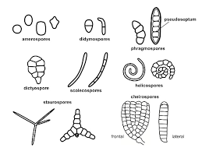
Fungal mycelium
Different fungal spores

Slide 3
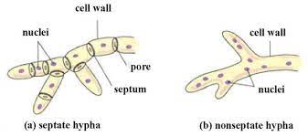
Septation in Fungi :(septum=hedge/partition) ( pl.septa)
Some fungal hyphae are provided with partitions or cross walls which divide the fungus into a number of compartments /cells. These cross walls are called septa.
Aseptate hypha/coenocytic hypha: ( Koinos=common,kytos=hollow vessel): A hypha with out septa is called aseptate /non-septate/ coenocytic hypha wherein the nuclei are embedded in cytoplasm.Eg. lower fungi like Oomycetes and Zygomycetes.
Septate hypha: A hypha with septa or cross walls is called septate hypha.
Eg.common in higher fungi like Ascomycotina, Basidiomycotina and Deuteromycotina

