Slide 1
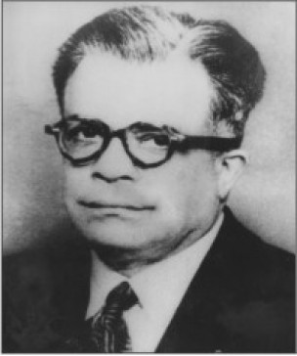
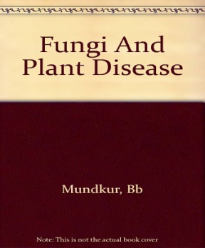
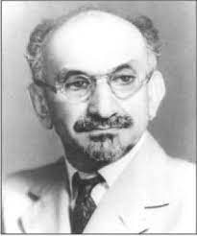
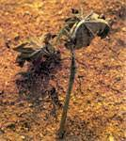
INDIAN SCIENTISTS
B.B MUNDKUR:
Extensively worked on Indian smut fungi
Book: Fungi and plant disease
Established Indian Phytopathological society (IPS) – 1948
worked on the control of cotton wilt diseases
J.F.DASTUR:
First Indian plant pathologist who studied in detail on fungi
and plant diseases
ii) He is the first president of IPS
iii) Established Phytophthora parasitica from Castor seedling blight

Slide 2
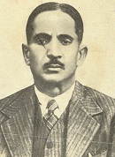
INDIAN SCIENTISTS
K.C. MEHTA:
1. Life cycle of cereal rusts in India
2. Father of cereal rust in India
3. Monograph: Further studies on cereal rust in India
T.S. SADASIVAN
1. Studied on bio-chemistry of host-parasite relationship
2. Gave Vivotoxin concept while working on the cotton fusarium wilt
3. Studied on mechanism of wilting in cotton due to production of fusaric acid

