Slide 1
National Intellectual Property Awareness Mission (NIPAM)
Pritish Ranjan Pradhan
Examiner of Patents and Designs
IPO Kolkata
Dhiren Pattanayak
Examiner of Patents and Designs
IPO Kolkata
nipam-kolkata@gov.in
https://ipindia.gov.in/

Slide 2


INTELLECTUAL PROPERTY
Intellectual property is a property that arises from human intellect.
It is a product of human creation
(“PRODUCT OF MIND”)

Slide 3
Background of Intellectual Property
Property
Tangible
(Measure)
Intangible
(not measure)
Movable
Eg. : Car
Immovable
Eg.: Building
Intellectual Property
Industrial Property
Copyrights
Patents, Designs, Trademarks, GIs

Slide 4
Intellectual Property Rights
Brain
Resources
Labor
Property

Slide 5
Importance and Significance
Utilize
Commercialize
Earn
Exclude others
Protect

Slide 6
Intellectual Property
Patents
Designs
Trade Marks
Geographical Indications
Copyrights
Semiconductor Integrated Circuits Layout-Designs

Slide 7


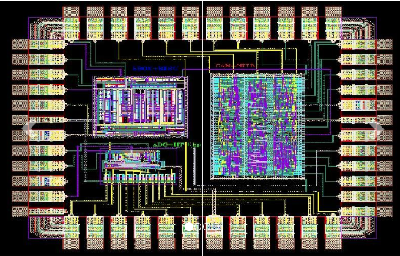
Different IPs in a Single Product
LED display- Patent
Body of laptop- Design
Apple sign- Trade Mark
User Manual- Copyright
layout of IC- SICL Design

Slide 8
Academics
Pride
Businessman
Earn and Invest
Brand Value
Common Person
Commercialize

Slide 9
Patents

Slide 10
What is Patent
Patent is a grant by sovereign or state to a person
giving exclusive right to stop others from “making, using, exercising, vending and importing”
AN INVENTION FOR A LIMITED PERIOD,
IN EXCHANGE FOR DISCLOSING IT IN A PATENT SPECIFICATION such that any one having average skill in the art can reproduce the invention.
Right to exclude others from using your invention
Owner has a qualified right to use the invention

Slide 11
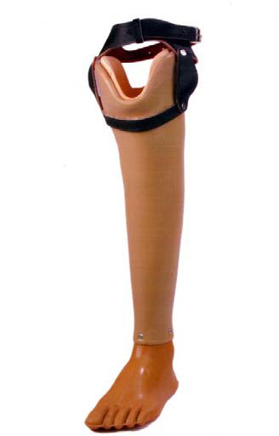
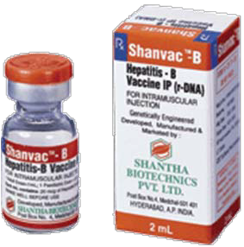
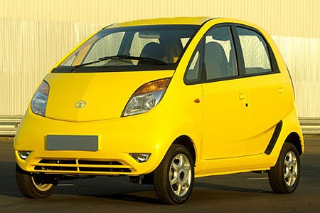
Famous Indian inventions
Jaipur foot: Affordable
prosthetics
@US
$ 28
Hepatitis Vaccine:
40 cents a dose product giving health care access to large number of people with low purchasing power
Nano Car:
2500 US $ from Tatas
for providing an
opportunity for middle income families

Slide 12
Patent Application Filing

Slide 13
SEARCHING FOR PATENTS
Searching indian patent database INPASS https://ipindiaservices.gov.in/publicsearch
Google Patents
https://patents.google.com/
Notes:
202121006402
201921031911

Slide 14
Want to file Patent Application in India what to do? What forms should I fill? How much is the fee?
Form-1:- Details of Application, Applicant Fees need to be paid
Form-2:- Details of Invention (Title, Background of Invention, Particular of Drawings, Brief description of Drawing, Brief Description of the Invention, Claims, Abstract, Drawings) Fees not required (30 pages, 10 Claims)
Form-3:- Details of foreign Filing of Similar Invention Fees not required
Form-5 :- Declaration as to inventorship Fees not required
Form-18:- Request for Examination (shall be filed within 48 months from the earliest priority date / filing date, if not filed, application deemed to be withdrawn) Fees need to be paid

Slide 15
Fees e-filing in INR
Forms | Natural Person or startup or Small Entity Or Educational Institute | Other than natural (E.g Company)
Form-1 | 1600/- | 8000/-
Form-2 | No Fees up to 30 pages and 10 claims | No Fees up to 30 pages and 10 claims
Form-3 | ---- | ----
Form-5 | ---- | ----
Form-18 | 4000 | 20000
Total** | 5600/- | 28000/-
**Refer First Schedule of The Patents Rule, 2003 (As amended) for more details.

Slide 16
Filing Procedure
Submission of hard copy in The appropriate patent office. (Not available for Patent agents)
Online filing
  E-comprehensive file through portal
  https://ipindiaonline.gov.in/epatentfiling/goForLogin/doLogin
  Require digital signature of Class-II/III

Slide 17
Basic Timelines
Particulars | Time
Provisional to Complete specification | 12 Months
Request for Examination | 48 Months
Reply to FER | 6 Months
Form-3 | 6 Months
Form-5 | 1 Month
Withdrawal of Application | 15 Months
Hearing Submission | 15 days
Pre-grant Opposition | Before Grant
Post-grant Opposition | One Year

Slide 18
Expedited Examination
Start Up
Small entity
Applicant is a female (or Joint applicant with other natural persons)
Department of the Government and other Govt. Establishments…(Refer Rule 24C(1) )
India as a ISA/IPEA in PCT
An agreement between Indian Patent Office and a foreign Patent Office
**Refer provisions of The Patents Rule, 2003 (As amended) for further details.

Slide 19
provisional specification
A provisional patent application must be followed by a complete specification within 12 months from the date of filing the provisional specification.
Enables a domestic inventor to protect his/her invention.
Analogous to learner license and driver license

Slide 20
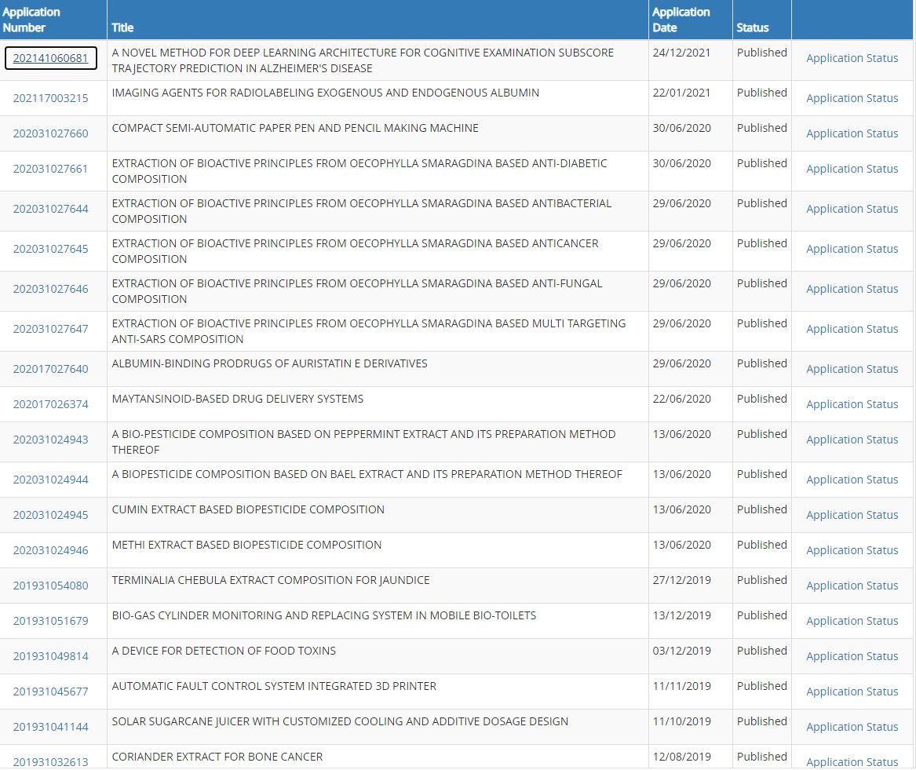
SEARCH RESULTS USING CENTURION

Slide 21
Patent Application Contents

Slide 22
PATENT DATA
80% of available technical information is published in patents
A patent is a structured techno legal document and contains all technical information
Publishing of a patent is needed which can impact patenting process around the world

Slide 23
understanding patent applications
What to look in a patent application
What is the problem statement being discussed
What is the solution available previously
Drawbacks of the previous solution
The new solution being proposed
Notes:
202121006402
201921031911

Slide 24
PARTS OF FORM 2 (TECHNICAL SPECIFICATION)
ABSTRACT
CLAIMS (IMPORTANT)
BACKGROUND
SUMMARY
COMPLETE SPECIFICATION

Slide 25
TYPES OF CLAIMS
METHOD CLAIMS
DEVICE CLAIMS
INDEPENDENT CLAIMS
DEPENDENT CLAIMS

Slide 26
DRAFTING CLAIMS(RESOURCES)
SELF STUDY 1
https://www.youtube.com/results?search_query=draft+patent+claims
https://www.wipo.int/edocs/mdocs/aspac/en/wipo_ip_mnl_3_18/wipo_ip_mnl_3_18_p_10.pdf
https://www.uspto.gov/sites/default/files/documents/Claim%20drafting.pdf

Slide 27
POPULAR AREAS OF PATENT FILING
Medical image processing (detecting cancer, corona, heart disease, sporiasis through NN/DL/CNN)
Platforms, web 3.0, blockchain, smart contracts, NFT
Reinforcement learning techniques in video games, robots
Sensor technologies(smart gloves, smart glasses) for physically challenged
Green technologies (smart metering, waste management through AI)
Time series analysis, forecasting

Slide 28
Detection - objects, faces, vehicles and use in crowd management, traffic prediction and surveillance
Biometric enabled applications and financial transactions
                ...... and so on...

Slide 29
CASE STUDY 1
Company name: Qzense Labs Private Limited
Application number: 202141040699

Slide 30
CASE STUDY 2
SELF STUDY 2
Company name: Sunfox Technologies Private Limited
Application number: 202011040621

Slide 31
SOME GRANTED APPLICATIONS
SELF STUDY 3
202121006402 (Dr. Jayashri V. Bagade)
201921031911 (VIVEK TIWARI)
202011017319
201921031911

Slide 32
Patent Office
Journal

Slide 33
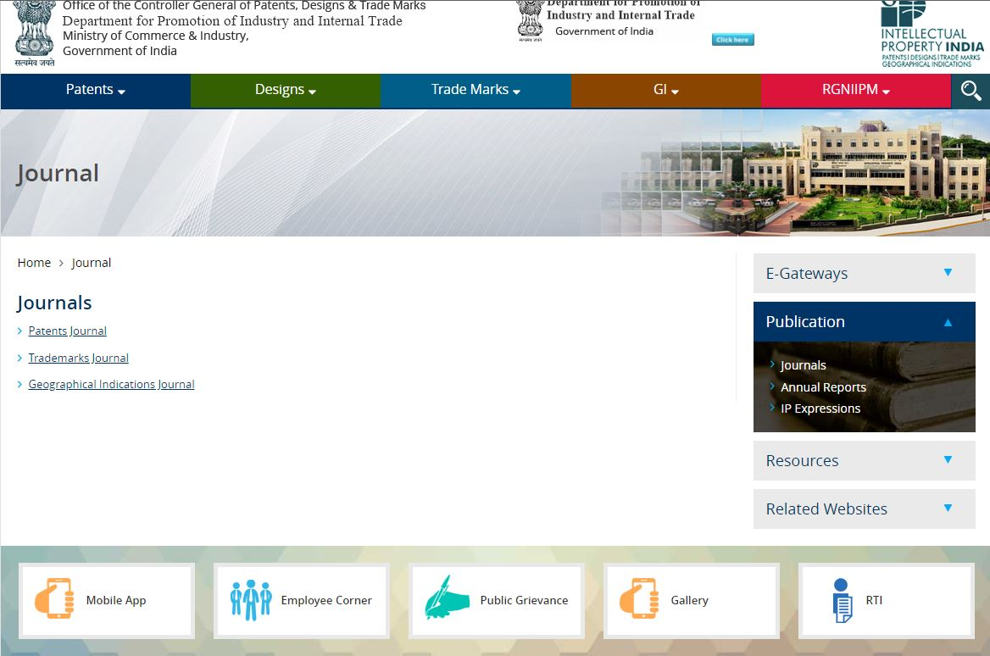

Slide 34
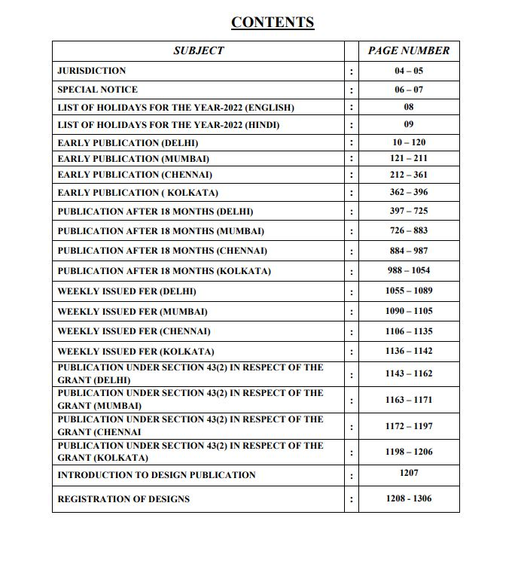

Slide 35
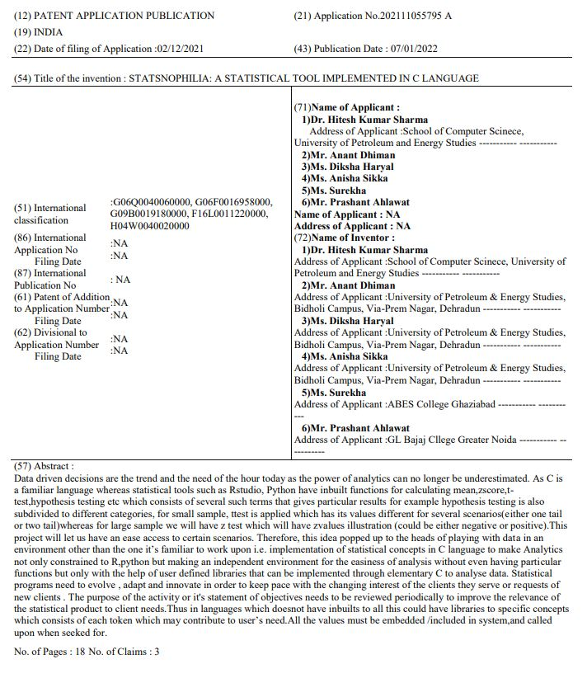

Slide 36
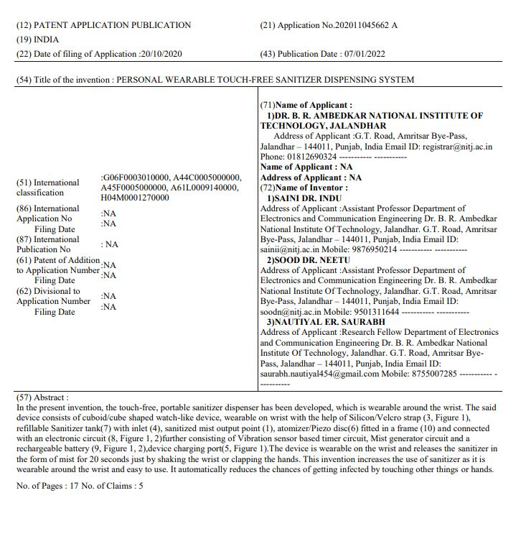

Slide 37
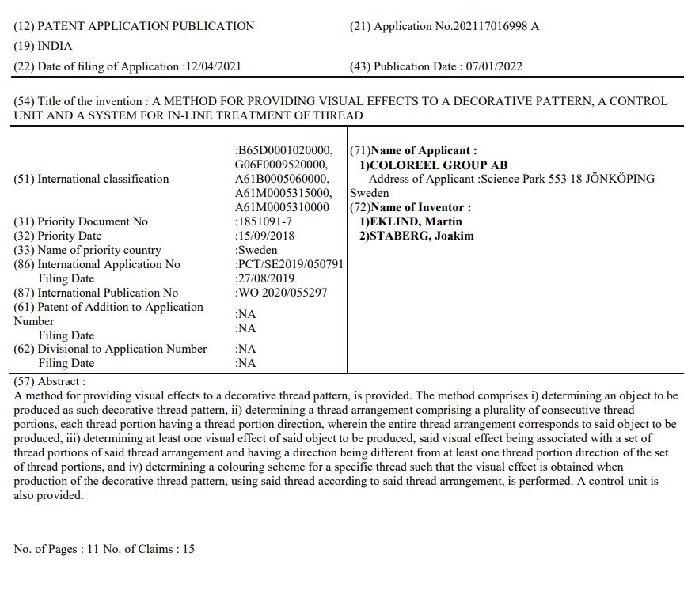

Slide 38
What protects the advanced disk brake for bike developed by the inventors?
    Copyright
    Geographical indications
    Patents
    Designs
    Trademarks

Slide 39
How long can a patent last?
    10 years
    20 years
    40 years
    60 years

Slide 40
Designs

Slide 41
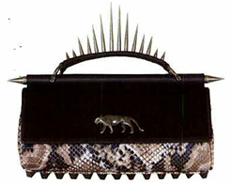
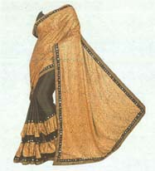

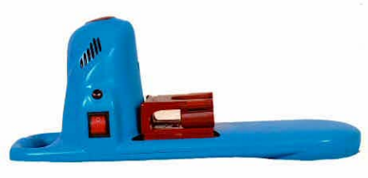
DESIGNS
Designs (ornamental or aesthetic aspects on an article)- features of shape, configuration, pattern, ornament or composition of lines or colours applied to any article whether in two dimensional or three dimensional or in both forms, by any industrial process or means, whether manual, mechanical or chemical, separate or combined, which in the finished article appeal to and are judged solely by the eye
Term of Design – 10 Years
(Extendable to 15 Years)
Portable Washing
Machine

Slide 42
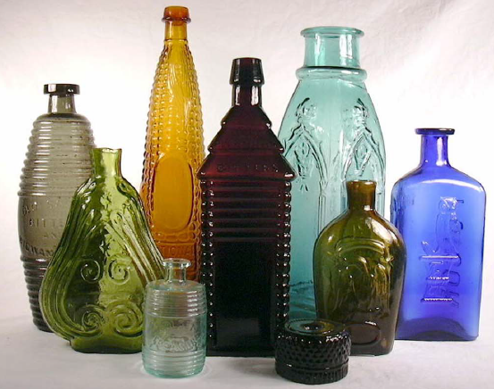
Shape, Configuration & Surface Pattern of Bottles

Slide 43

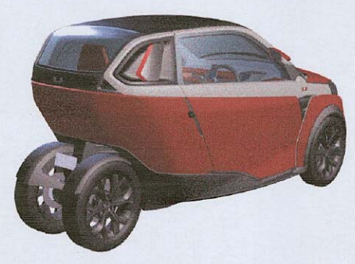



Design of an article
Table Lamp
Inhaler

Slide 44
What protects the intellectual property created by fashion designers?
    Copyright
    Geographical indications
    Patents
    Designs
    Trademarks

Slide 45
Trade Marks

Slide 46
Trade Marks
Concept:
  A trade mark is any word, name, symbol or device (or any combination thereof)
  Identifies and distinguishes the source of the goods or services of one trader from those of others.
Function/ Importance:
  Provides exclusive monopoly over a class of goods or services.
  Allows a business entity to build public goodwill and brand reputation.
  Identifies the source / origin of goods or services
  Assures customers about quality of goods or services

Slide 47









Subject matter of Trade Marks
Trade Marks (including Service Marks)
Trade Names
Collective Marks
Certification Marks
Tagline / Slogans
Shapes
Sound Marks

Slide 48


How to indicate your Trade Mark
Registered/Unregistered/Application Pending
Only when Registered

Slide 49
How to protect your Trade Mark?
Trade Marks registration is optional. However, registration has certain advantages.
Registration available at the national, regional or international level.
Initially registered for 10 years. Can be further renewed indefinitely (10 years each time and so on).
In case of non-use, non-renewal or no policing, trade mark rights are lost.
The existing trade marks registration is governed by The Trade Mars Act, 1999 & The Trade Marks Rules, 2017.
For more information, please visit:
https://ipindia.gov.in

Slide 50
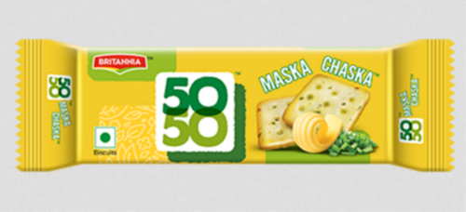
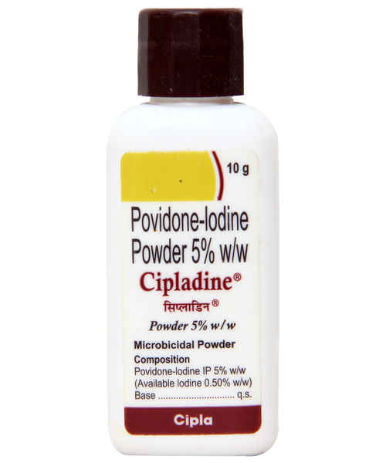
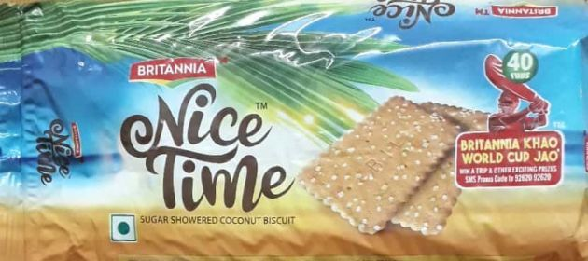
FUN ACTIVITY
Find out if your product (medicine, biscuit etc) has a registered trademark or not

Slide 51
What does a trademark protect?
    An invention
    A work of art
    Logos, names and brands
    A secret formula

Slide 52
Imagine a cricketer sets up his own company to sell his own range of clothes. What type of intellectual property can he use to show that the clothes are made by his company?
    Copyright
    Geographical indications
    Patents
    Designs
    Trademarks

Slide 53
Copyrights

Slide 54

What is Copyright?
- Bundle of Rights
- Automatic Right
-Exclusive Right given to creators of original work of authorship
Allows the owner to:
Choose the ways his/her copyrighted works are made available to the public.
Prevent unauthorized copying/reproduction
Section 2(y) defines “Works” and Section 13 of the Copyright Act, 1957 provides for the “Works in which copyright subsists”

Slide 55
Criteria for the work to be copyrighted
Creativity (Minimum Modicum)
Originality
Fixation

Slide 56
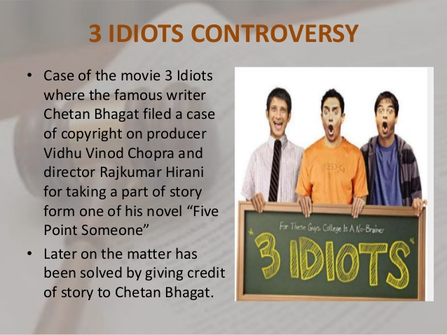

Slide 57


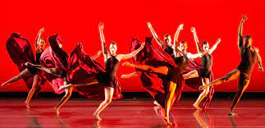
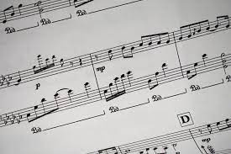


Subject matter of copyright
Literary works
[S. 2 (o)]
Dramatic works
[S. 2 (h)
Sound Recording Works
[S. 2 (xx)]
Artistic works
[S. 2 (c)]
Musical works
[S. 2 (p)]
Cinematographic Films
[S. 2 (f)]

Slide 58

Term of Protection (S. 22)
Published literary/ Dramatic, Artistic and Musical work | Life of author + 60 years
Cinematographic Film and Sound Recording | 60 years from date of publication
Broadcast Reproduction Rights | 25 years from the year following the year of broadcast
Performance Right | 50 years from the year following the year in which performance is made

Slide 59





Slide 60


Slide 61
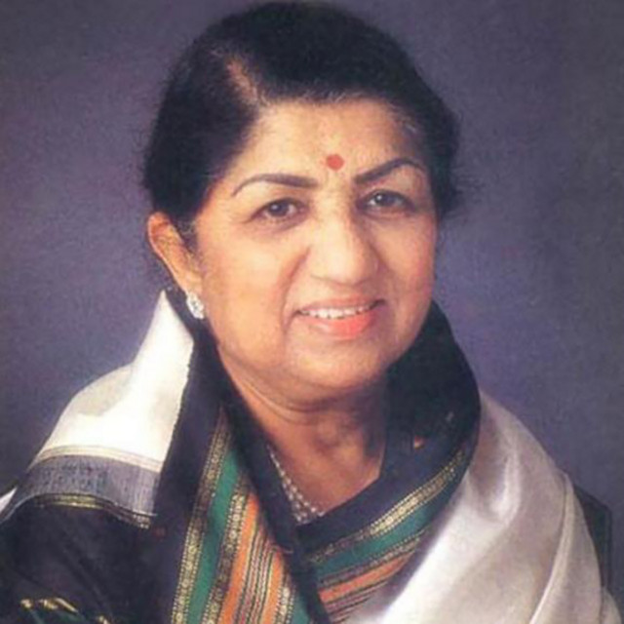
Lag Jaa Gale (1964)
Tujhe Dekha To Yeh Jaana Sanam (1995)
Aye mere watan ke logon (1963)

Slide 62
MAHATMA GANDHI
MAHATMA GANDHI WAS ASSASSINATED IN 1949.
ALL HIS BOOKS AND LITERATURE ARE NOW IN PUBLIC DOMAIN SINCE 2009 ( 1949 +60).

Slide 63
Which type of IP protects the painting painted by artists?
    Copyright
    Geographical indications
    Patents
    Designs
    Trademarks

Slide 64
SICLD
Semiconductor Integrated Circuits Layout-Design

Slide 65
Introduction of SICLD
"Semiconductor Integrated Circuit (SIC)" means a product having transistors and other circuitry elements, inseparably formed on or inside a semiconductor or insulating material, designed to perform an electronic circuitry function.
“Layout-Design" means a layout of transistors and other circuitry elements and includes lead wires connecting such elements and expressed in a manner in SICs.
Semiconductor Integrated Circuits Layout-Design (SICLD) Registry, Delhi is the office where the applications on Layout-Designs of integrated circuits are filed for registration of created IPR.
SICLD is an important IPR for protection of products with fast changing technologies, such as electronic gadgets, computers etc.
The registration of a layout-design is for a period of 10 years from the date of application filing or first commercial exploitation, whichever is earlier.

Slide 66

Geographical Indication

Slide 67












Geographic Indications (GI)
A Geographical indication (GI) is an indication that identifies a product that have a specific geographical origin and possess qualities or a reputation that are due to that origin.
Courtesy: GI Registry

Slide 68

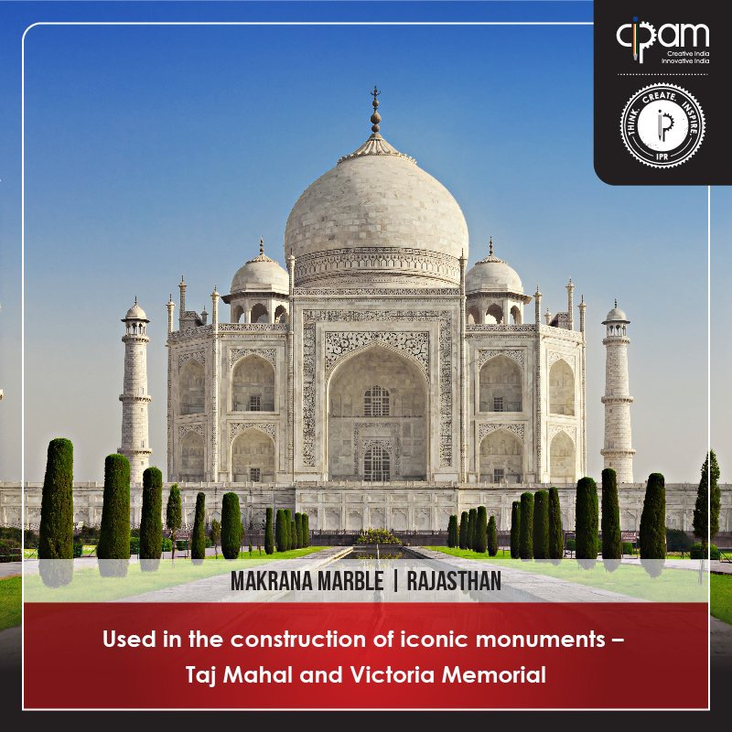


Darjeeling tea
Makrana marble
Ratlami Sev
Kancheepuram silk
Courtesy: CIPAM

Slide 69

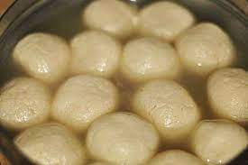
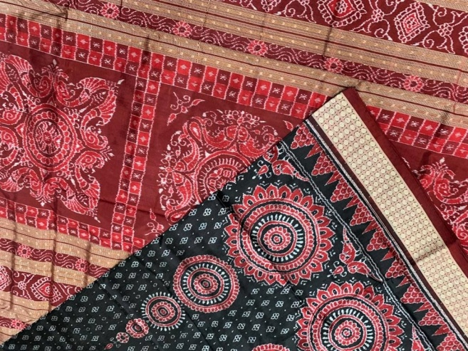
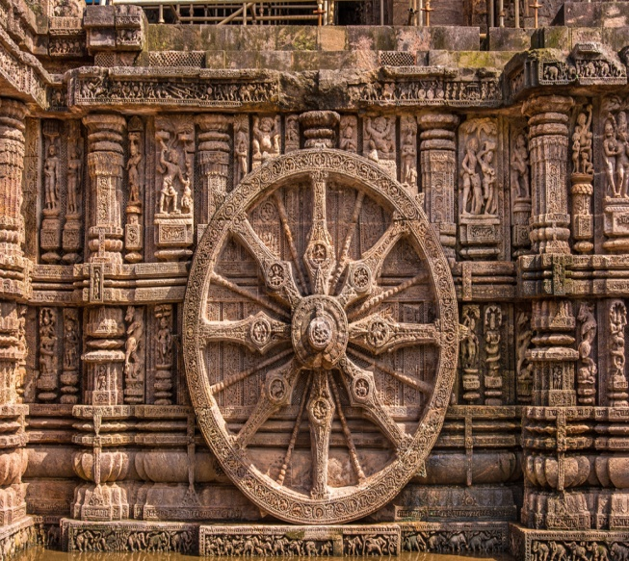
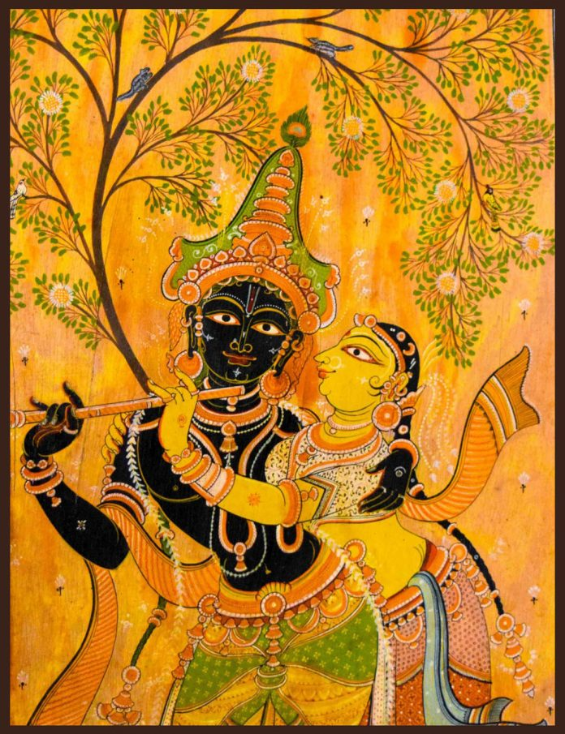
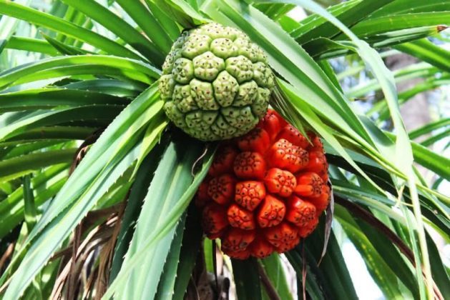
PIPILI APPLIQUE
ODISHA RASAGOLA
Sambalpuri Bandha Saree
Konark Stone Carving
Odisha Pattachitra
Ganjam Kewda flower
Courtesy: GI Registry

Slide 70
Which of these is a geographical indication?
    BMW
    Nagpur Orange
    Ironing machine with stem
    Playstation
    World Wide Web

Slide 71
Validity
Patents- 20 years term
There is nothing called global / international patent
Designs- 10 years + 5 years
Trade Marks- Indefinitely subject to renewal (initially for 10 years)
GI-Indefinitely subject to renewal (initially for 10 years)
Copyright (Published literary/ Dramatic, Artistic and Musical work)- lifetime of the author + sixty years
Who can Apply:- Person (Individual not for GI) or legal representative
Person includes:- Firm, partnership, small entity and a body corporate
All IP rights are territorial in nature

Slide 72
IP Everywhere

Slide 73

Courtesy-CIPAM
Video-2

Slide 74
Points to remember
First protect then Publish
Rights are Territorial (Limited to boundary of Country/ sovereign authority), registration is required (in each country)*
Registration is done by sovereign authority (i.e. Government of India)
Rights for limited period of time
No automatic relief.(Need to file infringement suit)
Renewal fees to be paid for some IPRs*
Appointment of Patent Agent is not Compulsory; applicant can sign the documents and file himself.
* - Except Copyright and Trade secret

Slide 75
contact details for further training
Rajiv Gandhi National Institute of Intellectual Property Management (RGNIIPM),
03, Hislop College Road, Civil lines, Near Nagpur University, Nagpur,
Maharashtra - 440001
Phone: 0712 –2542961 / 2542979 / 2540913 / 2540922
Email: rgniipm.ipo@nic.in
Website: https://ipindia.gov.in

Slide 76
Career opportunities
Government Job
  Examiner of Patents and Designs
  Examiner of Trademark and GI
  Examiner of Copyrights
Others
  Patent Agent
  Trademark Agent
  JRF/SRF in Patent Facilitation Centers
  Patent Litigation and other opportunities in private sector

Slide 77
Sree Chitra Tirunal Institute for Medical Sciences and Technology, Trivandrum
https://www.sctimst.ac.in/Academic%20and%20Research/Research/Intellectual%20Property%20Rights/

Slide 78
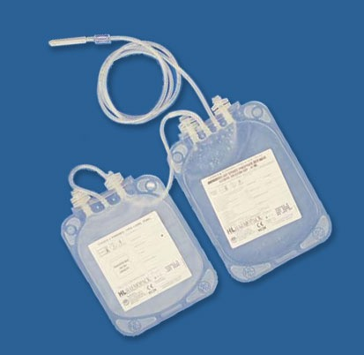
Disposable blood bag system – Sree Chitra Tirunal Institute of Medical Science and Technology

Slide 79
Disposable blood bag system – Sree Chitra Tirunal Institute of Medical Science and Technology
Product manufactured and marketed by Hindustan Latex Limited.
Widely used in the country and exported to several countries including UK, USA earning valuable foreign exchange.

Slide 80
“EVERYTHING IS THEORETICALLY IMPOSSIBLE UNTIL IT IS DONE”
(Quote from Rocket Boys, Sony Liv, 2022)
Thank You
www.ipindia.gov.in

Slide 81
What protects the advanced disk brake for bike developed by the inventors?
    Copyright
    Geographical indications
    Patents
    Designs
    Trademarks

Slide 82
What does a trademark protect?
    An invention
    A work of art
    Logos, names and brands
    A secret formula

Slide 83
If you write an original story, what type of intellectual property gives you the right to decide who can make and sell copies of your work?
    Copyright
    Geographical indications
    Patents
    Designs
    Trademarks

Slide 84
If a company develops a new technology that improves its main product, what type of intellectual property can they use to stop others from copying their invention?
    Copyright
    Geographical indications
    Patents
    Designs
    Trademarks

Slide 85
Numbers

Slide 86
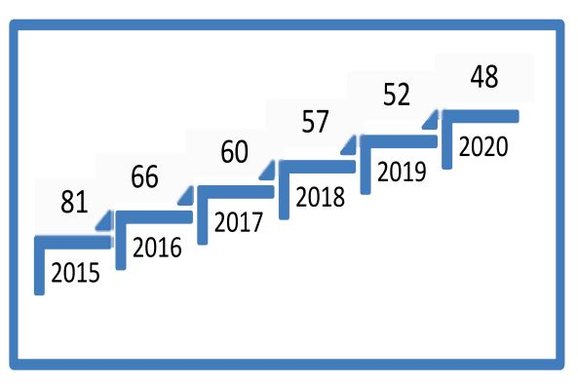
GLOBAL INNOVATION INDEX
In the past 5 years, India’s rank in the Global Innovation Index has improved from the 81st rank in 2015 to the present 48th rank in GII 2020 report.

Slide 87
IP Filings (Resident + Abroad, Including Regional) and Economy
Year | Patent | Trademark (class count) | Industrial Design (design count) | GDP (Constant 2017 US$)
2011 | 15,914 | 194,796 | 8,180 | 5,501.13
2012 | 18,250 | 197,877 | 7,139 | 5,801.29
2013 | 20,945 | 204,982 | 7,010 | 6,171.77
2014 | 22,476 | 237,484 | 8,032 | 6,629.11
2015 | 24,018 | 283,493 | 9,264 | 7,159.19
2016 | 25,887 | 294,412 | 7,885 | 7,750.27
2017 | 28,010 | 272,765 | 10,382 | 8,276.93
2018 | 30,035 | 333,443 | 15,216 | 8,817.67
2019 | 34,051 | 369,903 | 12,753 | 9,174.04
2020 | 37,880 | 418,560 | 11,849 | 8,443.36
Source: WIPO

Slide 88
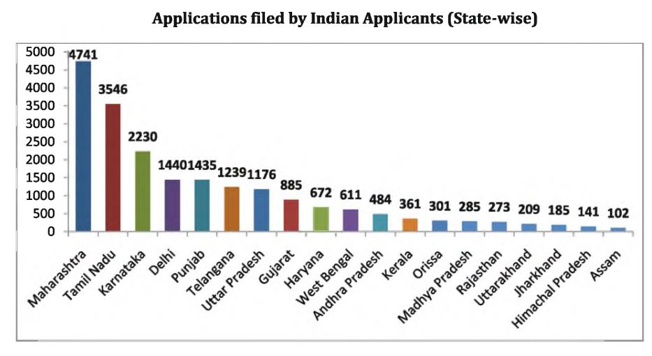
STATE WISE PATENT FILING

Slide 89
TOP INDIAN APPLICANTS FOR PATENTS IN IT
Sl. No. | Name of the company | No of applications
1 | MESBRO TECHNOLOGIES PRIVATE LIMITED | 425
2 | LOVELY PROFESSIONAL UNIVERSITY | 175
3 | TCS | 162
4 | IIT (collectively) | 156
5 | WIPRO | 110

Slide 90
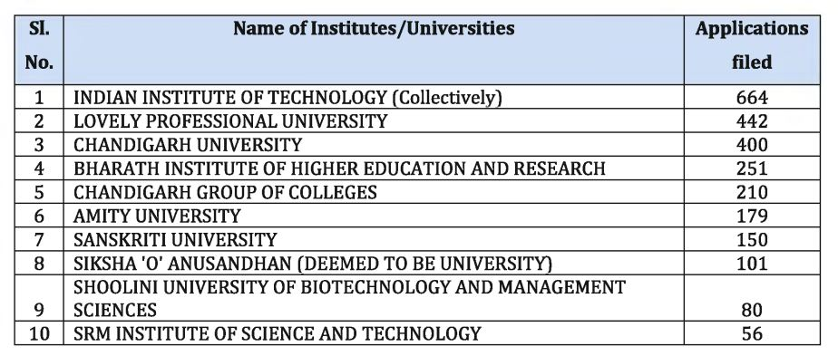
TOP INDIAN APPLICANTS FOR PATENTS FROM ACADEMICS

Slide 91
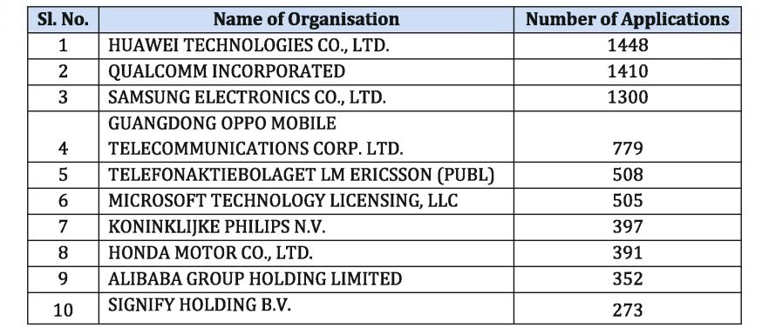
TOP 10 FOREIGN RESIDENT APPLICATIONS

