Slide 1
Bravais lattice, primitive vectors, primitive unit cell, conventional unit cell,

Slide 2
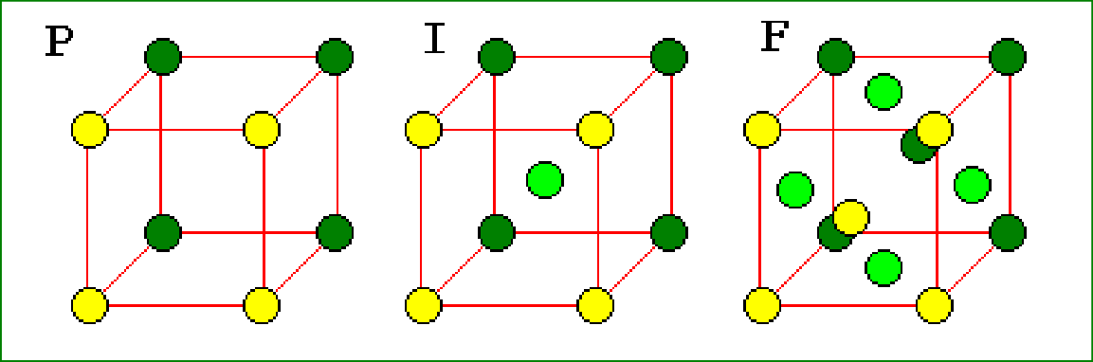
STRUCTURE OF SOLID MATERIALS

Slide 3
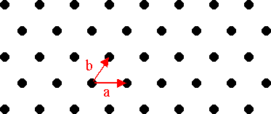
Plane Lattice
Consider an array of points in such a way that the
environment about any point is identical with the
environment about any other point. Such an array of
points in two dimensions is shown in Fig. and is called a
plane lattice.
For constructing a two dimensional lattice, choose any two convenient axis such that the points lie at equal intervals a and b along these axis as shown in the Fig. There are generally 5 lattices in two dimensions: Oblique, Square, Hexagonal, Rectangular and Centered Rectangular lattice.

Slide 4
Space Lattice
If this array of points is extended to three dimensions then the array of points is called space lattice. For constructing the space lattice the points are arranged at equal intervals c in the third direction also. There are 14 space lattices in total, called Bravais Lattice.
Thus a lattice may also be defined as a parallel net like arrangement of points such that the environment about any point is identical with the environment about any other point.

Slide 5
Basis
A basis is defined as an assembly of atoms, ions or
molecules identical in composition, arrangement and orientation.
Basis consists of the simplest arrangement of atoms which is repeated at every point in the lattice to build up the crystal structure.
The number of atoms in a basis may be one as in case of
many metals and inert gases, but could be as large as 1000 in many structures.
In ionic crystals, a basis is composed of two distinct types of ions. For example, Na⁺ and Cl⁻ in a NaCl crystal.

Slide 6
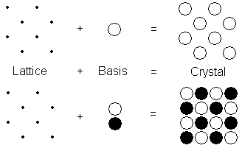
When basis is attached identically to each lattice point, the actual crystal structure is formed as shown in the Fig.
The relation can be written as
Lattice + Basis = Crystal Structure

Slide 7
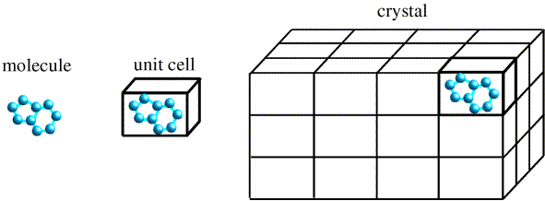
UNIT CELL
A unit cell is a region of space which when repeated
by primitive translation vectors fills all space. Thus a
unit cell is defined as the smallest geometrical figure, the repetitions of which give the actual crystal structure.
The choice of the unit cell is not unique. It can be
constructed in a number of ways, but the unit cell should
be chosen in such a way that it conveys all the symmetry
of a crystal lattice, by having shortest possible size, which makes the mathematical calculations easy.
Each atom or molecule in a unit cell is considered as a
lattice point. The distance between the two atoms or ions of the same type is the ‘length of the unit cell’.

Slide 8
Primitive and Non - primitive unit cell
A unit cell which contain just one lattice point is called primitive unit cell. This cell is the smallest part of the lattice which when repeated would reconstruct the entire crystal structure. It is a minimum volume unit cell and is denoted by the letter p. A unit cell which contain more than one lattice point is called non - primitive unit cell. These two cells are shown in the Fig.

Slide 9
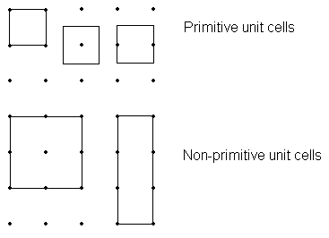

Slide 10
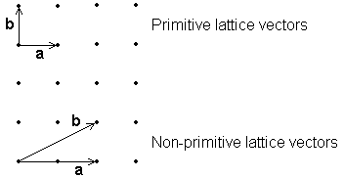

Slide 11
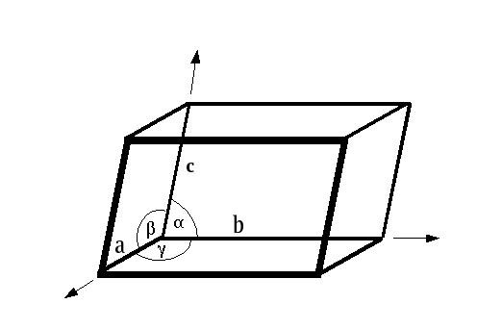
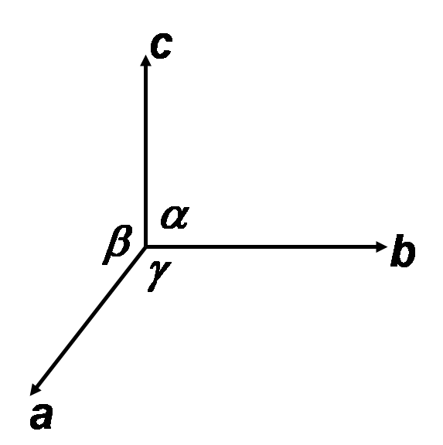
For a three dimensional case, the unit cell is a parallelopiped
formed by basic vectors a, b and c as
concurrent edges and the angles α, β and γ, between (b, c), (c, a), and (a, b) respectively as explained in the following Figures.

Slide 12
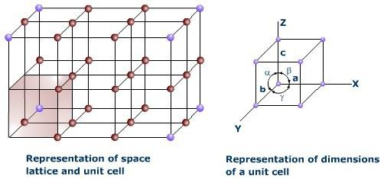
Thus, in general, a unit cell may be defined as the smallest volume of a solid from which the entire crystal may be constructed by translational repetitions in 3-dimension and which represent fully all the characteristics of a particular crystal. In Fig. a three dimensional unit cell is shown by the shaded portion.

Slide 13
Lattice Parameters
In a unit cell the vectors a, b and c are called translation vectors or primitive basis vectors. In two dimensionsn the area of the unit cell is (a x b) while in three dimension the volume of the unit cell is ⎢(a x b).c ⎪. In Fig. the direction of the primitive basis vectors defines the crystallographic axis. The angles between these axis are called interfacial angles, which are α, β and γ, between (b, c), (c, a), and (a, b) respectively. Primitive vectors and interfacial angles together are called lattice parameters.

Slide 14
CRYSTAL SYSTEMS AND BRAVAIS LATTICES
Crystals of different substances have similar shapes and
hence the crystals are classified into the so called crystal systems depending upon their axial ratio and the interfacial
angles α, β and γ. In three-dimension, there are 7 crystal
systems. Bravais showed that throughout the seven crystal
systems there are fourteen unique lattice types possible.
These are known as Bravais or space lattices. These seven crystal systems with examples are :
Cubic(CsCl, NaCl, Cu)
Tetragonal(SnO2)
Orthorhombic(PbSO4, MgSO4)
Monoclinic(FeSO4, LiSO4 ⋅ H2O)
Triclinic(FeSO4 ⋅ 5H2O, K2Cr2O7)
Trigonal (Rhombohedral)(Sb, As, CaCO3)
Hexagonal(Zn, Cd, Ni, As, SiO2)
The characteristics features of these crystal systems and the corresponding Bravais lattices are as follows:

Slide 15
No. | Crystal class | Intercepts on Axes | Angles between Axes | Bravais space lattice
1 | Cubic | a = b = c | α = β = γ = 90⁰ | Simple, body-centred, face-centred
2 | Tetragonal | a = b ≠ c | α = β = γ = 90⁰ | Simple, body-centred
3 | Orthorhombic | a ≠ b ≠ c | α = β = γ = 90⁰ | Simple, body-centred,
 |  |  |  | face-centred,
 |  |  |  | Base(side)-centred
4 | Trigonal | a = b = c | α = β = γ ≠ 90⁰ | Simple
5 | Hexagonal | a = b ≠ c | α = β = 90⁰, | Simple
 |  |  | γ = 120⁰
6 | Monoclinic | a ≠ b ≠ c | α = γ = 90⁰ ≠ β | Simple, base-centred
7 | Triclinic | a ≠ b ≠ c | α ≠ β ≠ γ | Simple

Slide 16
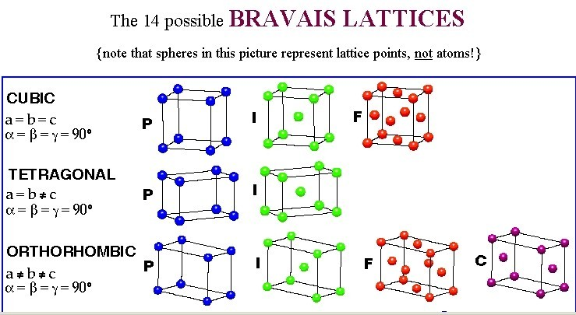

Slide 17
