Slide 1
Deep Eutectic Solvents: Classification, Synthesis and Application
Dr. Pratap Chhotaray

Slide 2
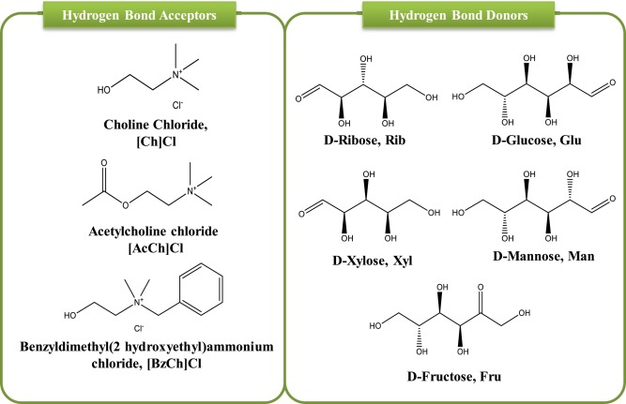
Deep Eutectic Solvent (DES)
Systems formed by mixing Lewis or Bronsted acids and bases
One component is known as hydrogen bond acceptor (HBA) and other hydrogen bond donor (HBD)
DES is composed of neutral as well as ionic species

Slide 3
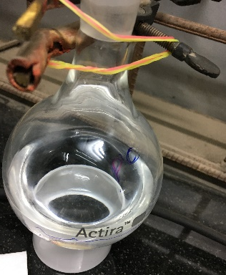
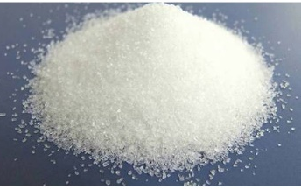
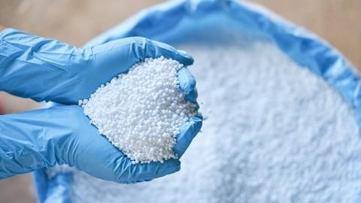
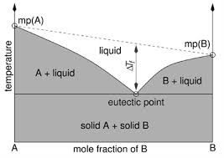
Synthesis of DES
Generally, M.P of DES is lower than individual components
The parent components of DES engage in a complex hydrogen bonding network which results in significant freezing point depression as compared to the parent compounds
1:2 molar ratio @ 50 ℃
+
Choline
Urea
Reline DES
MP: 302 ℃ 133 ℃ 12 ℃
Professor Andrew P Abbott
University of Leicester, UK

Slide 4
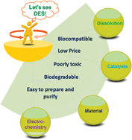
Advantages of DES

Slide 5
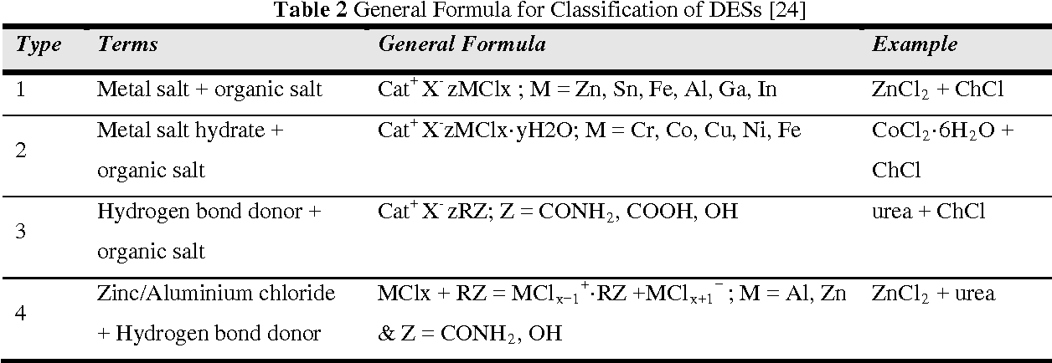
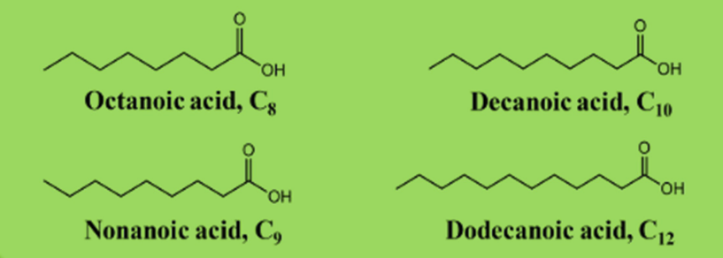
Classification of DES
DES are of four types
Hydrophobic DES
Hydrophilic DES

Slide 6
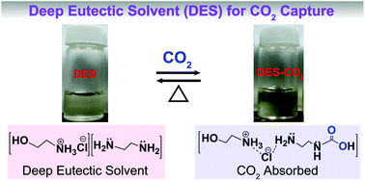
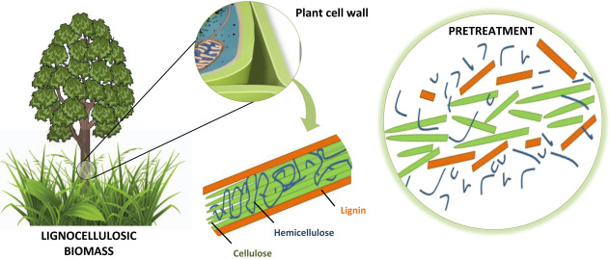
Applications of DES
Extraction
Bio-catalysis
Gas Absorption
DES
Biomass
Pretreatment
Electrochemical
Detection
Nano-
materials
Pharma-
ceuticals

Slide 7
Thank You
Any Queries ??...

