Slide 1

Sprinkler Irrigation – Adaptability, Problems and Prospects
Sprinkler and Micro irrigation Systems
[BTAI 31]

Slide 2
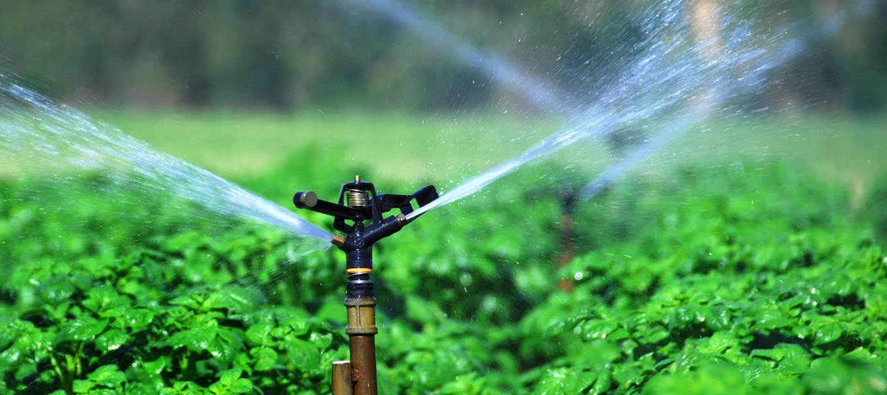
Sprinkler Irrigation
It is a method of overhead irrigation that imitate natural rainfall.
Water is pumped and sprayed into air through sprinklers.
Water breaks up into small water drops, which fall to the ground.

Slide 3
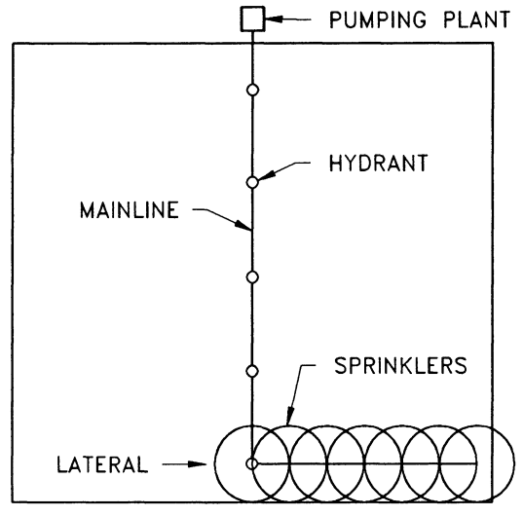
Adaptability of Sprinkler Irrigation System
It is suitable for most row, field and tree crops.
Water can be sprayed over and under the crop canopy.
Adaptable to any farmable slope whether uniform or undulating, which only subject to limitations imposed by land use capability and economics.
Periodic–move systems are well suited for irrigation in areas where crop-soil-climate situation doesn’t require irrigations more often than every 5 – 6 days.

Slide 4
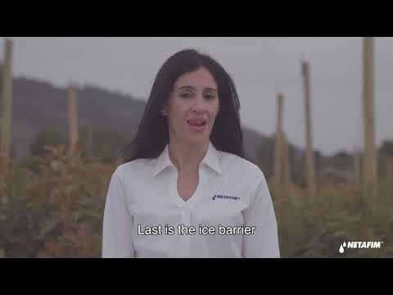
Adaptability of Sprinkler Irrigation System
Soils with low WHC and shallow rooted crops require light and frequent irrigation. For these fixed or continuously moving systems are suitable.
Fixed systems can also be designed and operated for frost and freeze protection, blossom delay and crop cooling.
An application of sprinkler for frost control

Slide 5
Problems of Sprinkler Irrigation System
Salinity Problems: under low humidity crops may absorb toxic amount of salts from irrigation water falling on the leaves.
Certain water are corrosive to metal pipes typically used in many sprinkle irrigation system.
Sprinkling is not well adapted to soils having an intake rate of less than 3 mm hour⁻¹.
Extremely high temperature and windy conditions are unfavourable for sprinkle irrigation system.
Both initial and pumping costs for sprinkle irrigation system are higher than for surface irrigation system.

Slide 6
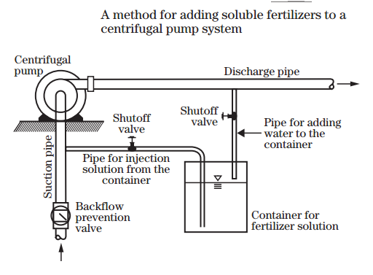
Special Uses:
Application of fertilizers and soil amendments:
Many liquid, dry and liquid suspension materials are suitable, subject to convenience and cost of desired nutrients.
Commonly used materials for sprinkler system: urea- ammonium nitrate solution, ammonium nitrate, calcium and potassium nitrate.
Fertilizers should be applied in batch methods.
Order of metal susceptibility to corrosion.
Galvanized steel
Phosphobronze
Yellow brass
Aluminium
Stainless steel

Slide 7
Special Uses:
Frost Protection
Bloom Delay:
In early spring, when temperatures are cool, blossoming is delayed; however, in above normal spring temperature bud development accelerates and trees blossom early.
An early bud development, followed by cold spell has serious freeze damage potential.
So, by sprinkling water blossoming can be delayed by evaporative cooling (up to 80% of the damage from early spring freezes can be prevented).

Slide 8
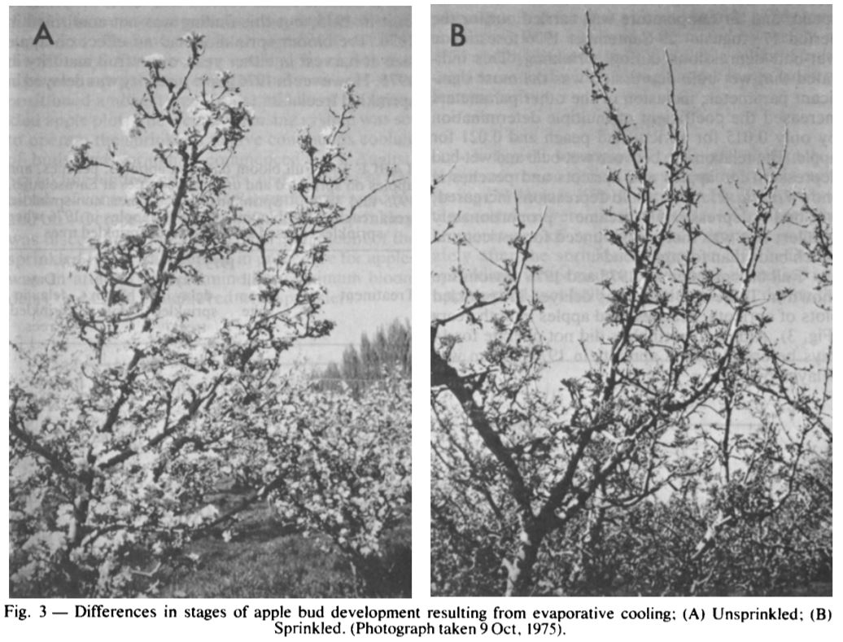

Slide 9
Special Uses:
Microclimate Control:
Crop and soil cooling can be provided by sprinkler irrigation.
Small amount of water applied intermittently to cool air and plant to raise the humidity and in theory, to improve production quality and yield.
Water sprayed on plant surfaces reduce the transpiration rate, thus by letting the plant to function normally even on a hot afternoon.

Slide 10
!!!-Thank You-!!!

