Slide 1

Sprinkler Irrigation – Types
Sprinkler and Micro irrigation Systems
[BTAI 31]

Slide 2
Types of Sprinkler Irrigation System
There are several types of sprinkler irrigation system, broadly divided into two groups
Set system operate with the sprinklers set in a fixed position.
Continuous move system operate while sprinkler is moving through the field.
Set systems may be further divided according to whether or not sprinklers must be moved through a series of positions during the course of irrigating a field
Periodic move system: those systems must be moved.
Fixed system: those not requiring any movement.

Slide 3
“Periodic move” Sprinkler Irrigation Systems
These are further classified into
Hand move
End tow
Side-roll laterals
Side-move laterals
Gun and Boom sprinklers

Slide 4
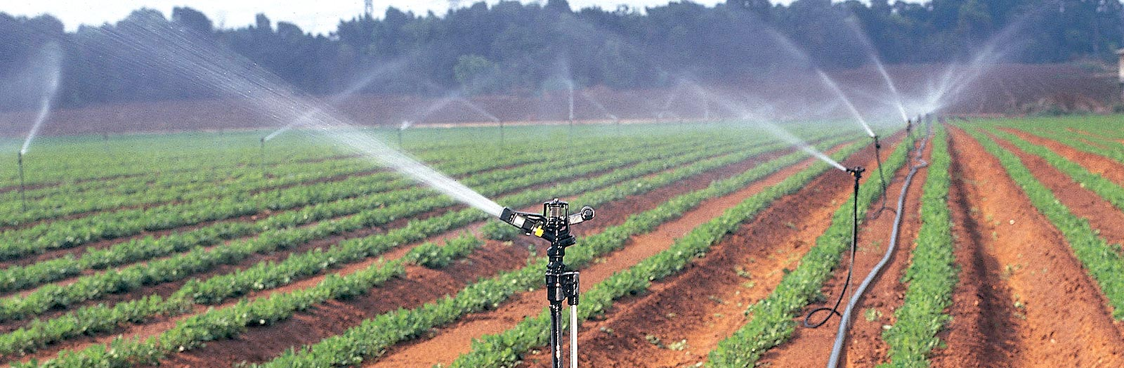
Hand Move Lateral System
Consists of either portable or buried pipeline with valve outlets at intervals for attaching the portable laterals.
Each pipe section has either centre mounted or end mounted riser pipe supporting a sprinkler head.
Can be used for variety of crops on all types of topography.
Requires high labour.

Slide 5
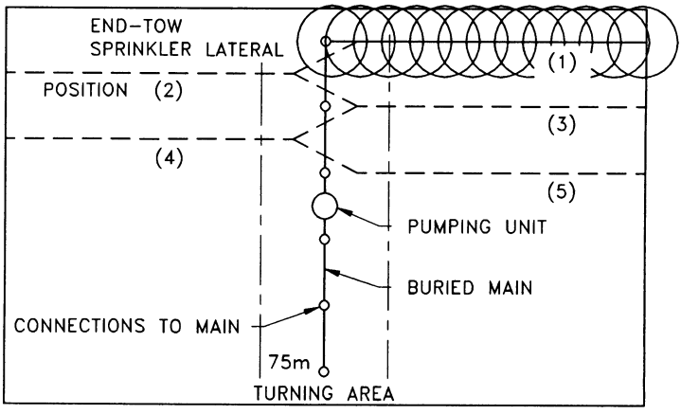
End Tow Lateral System
Similar to hand-move lateral system, except that the main line is buried in centre and laterals are rigidly coupled.
Laterals are towed lengthwise over the mainline from one side to the other in an S fashion.
20 to 30 hp tractor can tow 400m long lateral of 100mm ø lateral.

Slide 6
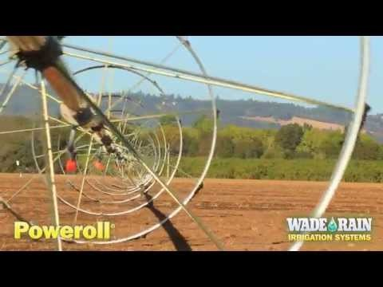
Side Roll Lateral System
Similar to hand-move lateral system.
Lateral pipes are rigidly coupled, and each joint of pipe is supported by a large wheel.
Lateral line form the axle of the wheel; rolls sideways when twisted.
Best adapted to rectangular fields with uniform topography for low growing crops.

Slide 7
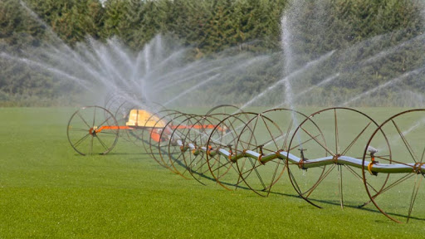
Side Roll Lateral System
All sprinkler provided with a self leveller to keep the sprinkler upright regardless of the position at which lateral pipe is stopped
Laterals provided with at least two wind braces, one on either side of the power mover, as well as a flexible or telescopic section to connect the lateral to the main line hydrant valves.

Slide 8
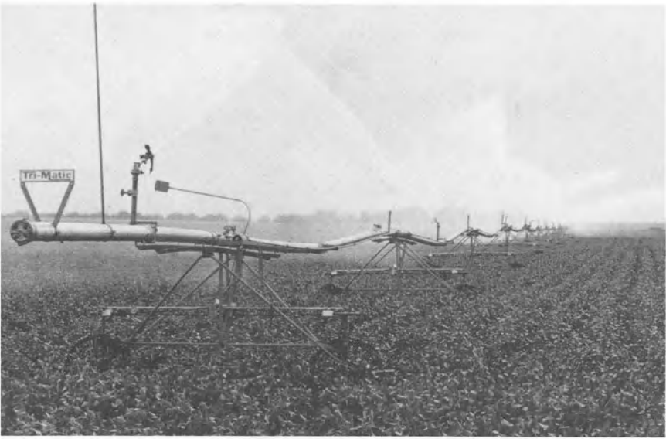
Side Move Lateral System
Periodically moved across field in a similar manner to side roll systems.
Difference being the pipeline is carried over wheels on small ‘A’ frame instead of serving as axle.
Suitable for most field and vegetable crops.

Slide 9
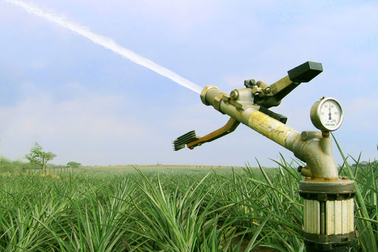
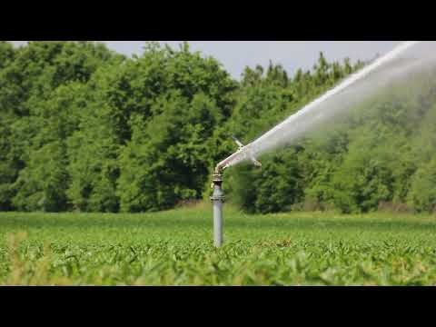
Gun or Boom Sprinkler
Gun or giant sprinkler has larger range nozzles attached to long discharge tubes.
Most gun sprinkler are rotated by means of a rocker arm drive.
It can be set to irrigate a part circle also.

Slide 10
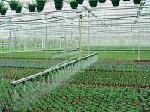
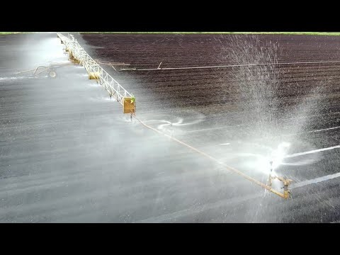
Gun or Boom Sprinkler
Boom sprinklers have rotating arms 18 to 36m in length.
Water is discharged through nozzle strategically positioned along the arms.
The arms or booms are supported by a cable suspension system and mounted on a four wheel trailer.

Slide 11
Gun or Boom Sprinkler
Both gun and boom sprinkler systems are both well – adapted to supplemental irrigation and to use on irregularly shaped fields or fields or fields with obstructions.
Boom sprinklers provide a more uniform water application and somewhat smaller droplets than gun sprinkler.
These sprinklers produce relatively high application rates and large water drops that tend to compact the soil surface and to create runoff problems.
Therefore, these sprinklers are most suitable for coarse-textured soil with high infiltration rates and for relatively mature crops that need only supplemental irrigation.

Slide 12
Fixed Sprinkler System
Has enough lateral pipe and sprinkler heads so that none of the laterals need to be moved for irrigation purposes after being placed in the field.
To irrigate field, sprinkler need to be cycled on or off.
Three main types of fixed system
Hand-move laterals
Buried, or permanent laterals
Sequencing-valve laterals.
Hand-move laterals can be moved from field to field as crop rotation or irrigation plan for farm is changed.
Permanent buried laterals are placed underground 40 to 75 cm deep, with only riser pipe and sprinkler head above the field.

Slide 13
Fixed Sprinkler System
The sequencing valve laterals may be buried, placed on the soil-surface, or suspended on cables above the crop. A valve on each sprinkler riser turns the sprinkler on and off when a control signal is received. Most sequencing-valve systems with small sprinklers use pressure change in the water supply to activate the valves.
http://www.freepatentsonline.com/4497333.pdf

Slide 14
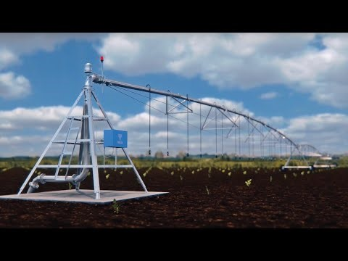
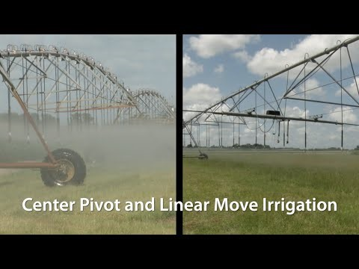
Continuous Move Sprinkler Irrigation System
Assignment
Describe the use advantage and dis-advantage of different types of continuous move sprinkler irrigation system.

Slide 15
!!!-Thank You-!!!

