Slide 1

Sprinkler Irrigation – Design Steps
Sprinkler and Micro irrigation Systems
[BTAI 31]

Slide 2
Checklist of Design Procedure
Make inventory of available resources (i.e., information on soil, topography, water supply, source of power, crops, farm operation)
Estimate depth or quantity of water to be applied at each irrigation.
From daily consumptive use rate and water requirement of crop, determine frequency of irrigation and irrigation period.
Determine the capacity requirement of the system
Make a selection from several alternative types of sprinkler system.

Slide 3
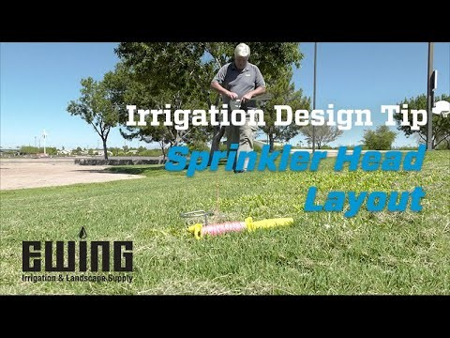
Checklist of Design Procedure
For periodic move and fixed sprinkler system, determine
Sprinkler spacing, discharge, nozzle size, and operating pressure for optimum water application
The number of sprinklers that must be operated simultaneously to meet the system capacity requirement.
The best layout of main and lateral pipelines for simultaneous operation of sprinklers
Required size of lateral line pipe.
Total max pressure required for individual lateral line.

Slide 4

Checklist of Design Procedure
Determine size of main pipe line
Determine max and minimum operating condition (Pressure and Discharge condition).
Select pump for max efficiency within range of operating condition.
Prepare plans schedules and instructions for proper layout.

Slide 5
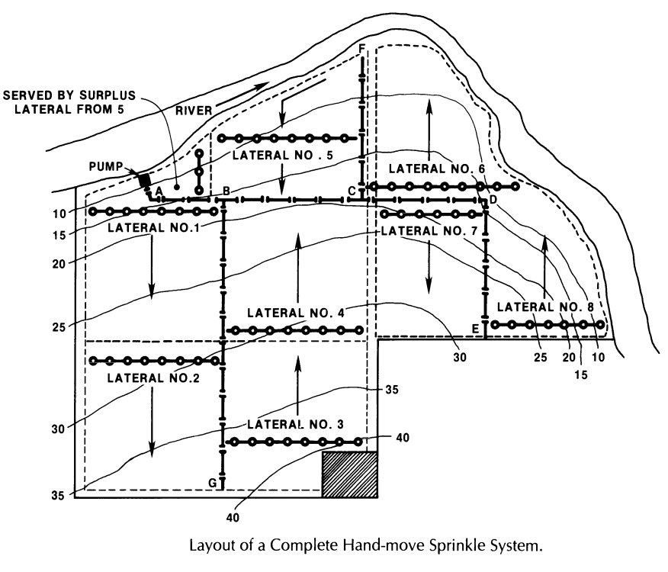
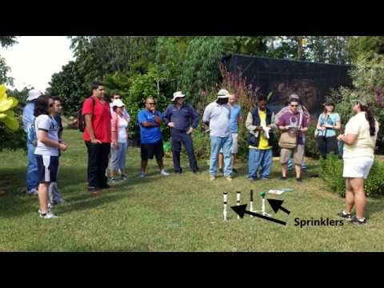

Slide 6
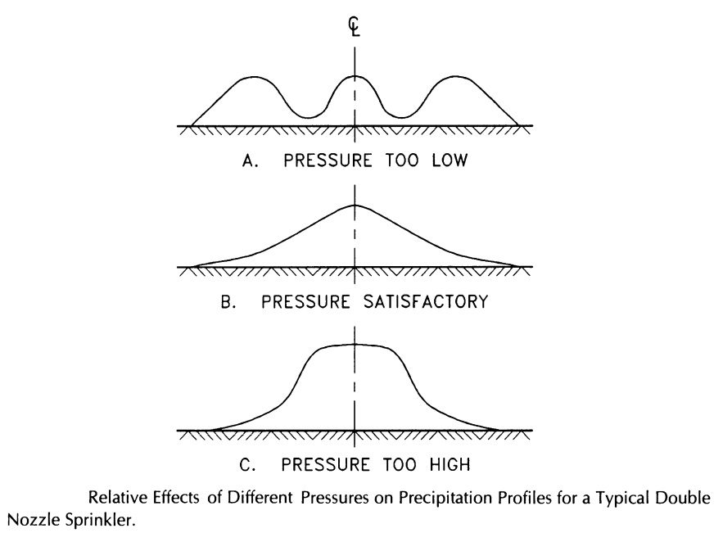
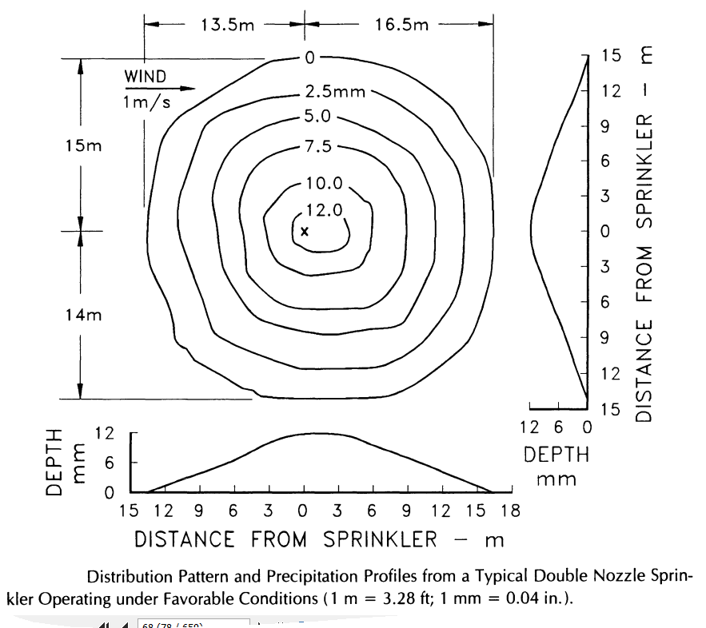
Precipitation Profile and Recommended Spacing
Degree of uniformity depends upon water distribution pattern and spacing of sprinklers.
Precipitation profile characteristics vary with nozzle size and operating pressure.

Slide 7
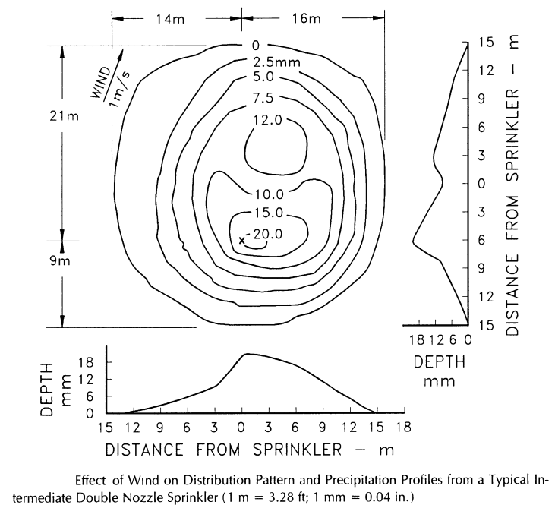
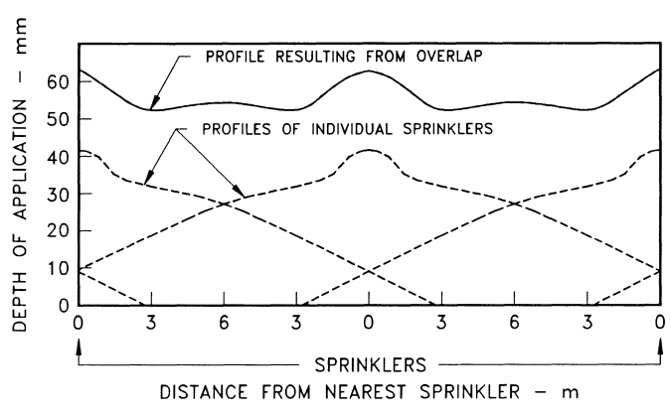
Precipitation Profile and Recommended Spacing
Wind distorts the application pattern. Higher the wind velocity, greater the distortion.
The depth of water applied to an area surrounding a revolving sprinkler varies as the distance from the sprinkler increases.
To obtain a reasonably high degree of uniformity of application, water from adjacent sprinkler must be added.

Slide 8
Precipitation Profile and Recommended Spacing
Manufacturers specify a wetted diameter for all nozzle size and operating pressure combination.
The sprinkler spacing recommendations to be made on the basis of these diameters.
As a general recommendation, moderate and intermediate pressured sprinkler should be spaced as follows:
40 – 67% of the effective diameter for rectangular spacing
50% of the effective diameter for square spacing
62% of the effective diameter for equilateral triangle spacing

Slide 9
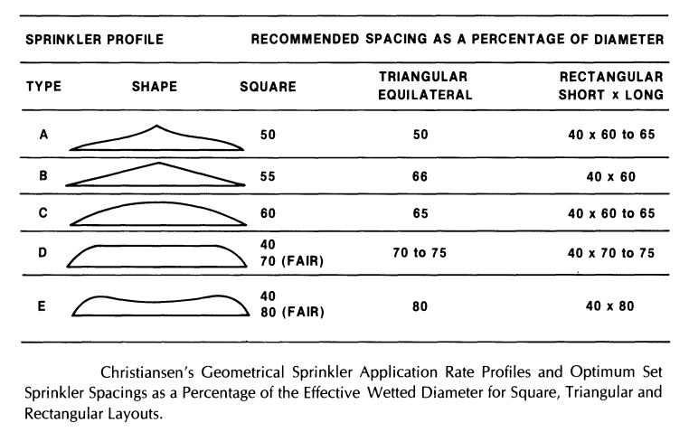
Precipitation Profile and Recommended Spacing
Profile A & B: Characteristics of sprinklers having two or more nozzles
Profile C and D: Characteristics of single nozzle sprinkler
Profile E: Characteristics of Gun sprinkler

Slide 10
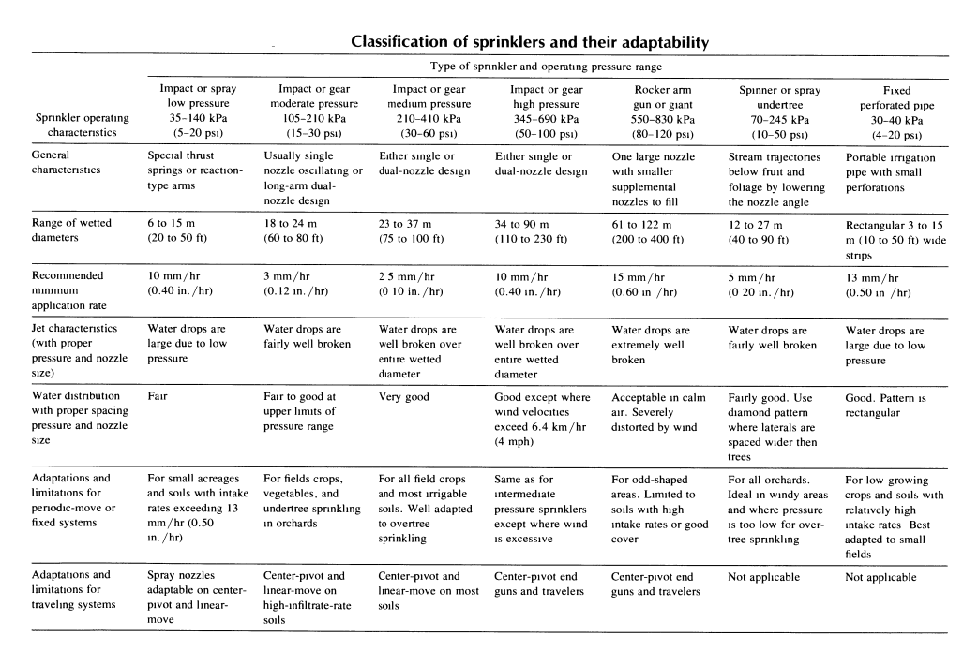
Precipitation Profile and Recommended Spacing

Slide 11
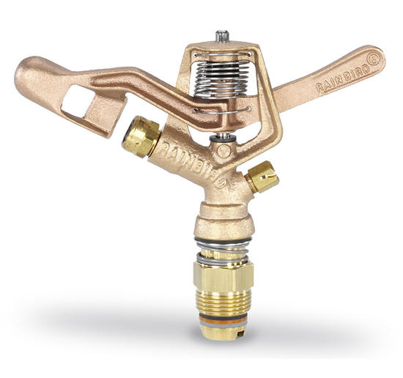
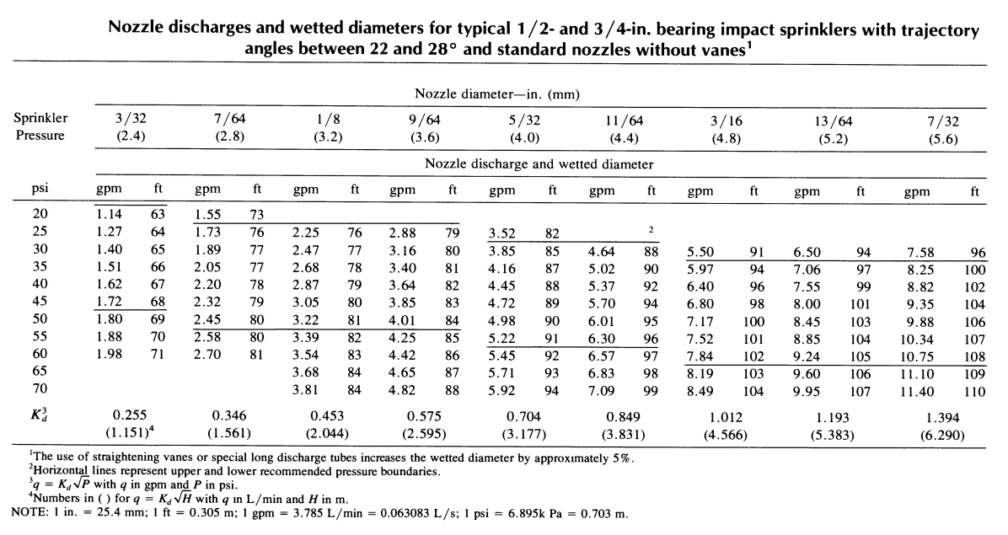
Nozzle Size and Pressure

Slide 12
!!!-Thank You-!!!

