Slide 1

Sprinkler Irrigation – Preliminary Design
Sprinkler and Micro irrigation Systems
[BTAI 31]

Slide 2
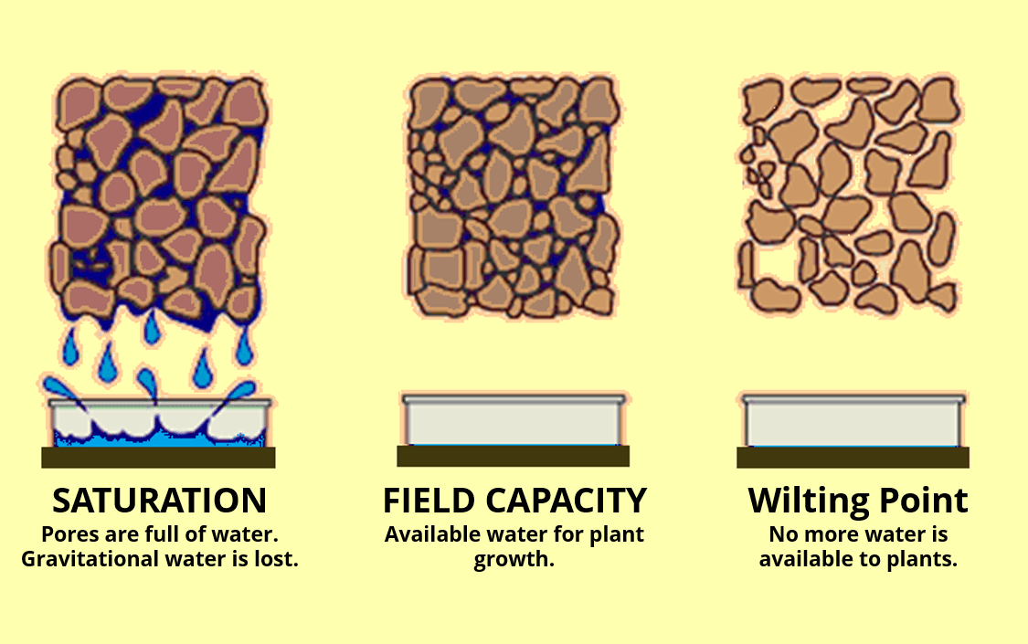
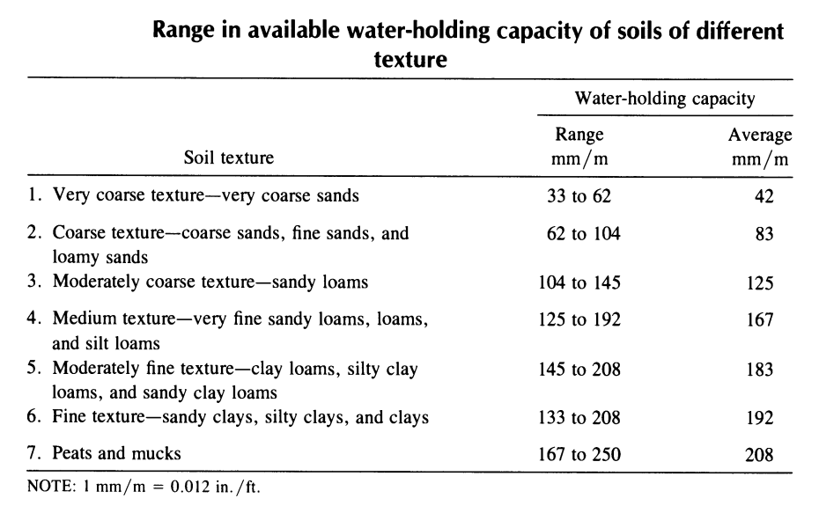
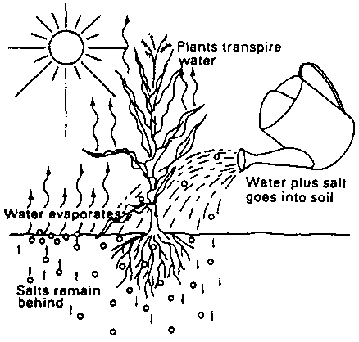
Soil Water
Water Holding Capacity
Soils of various texture have varying abilities to retain water.
Apart from leaching requirement, any irrigation beyond field capacity is an economic loss.

Slide 3
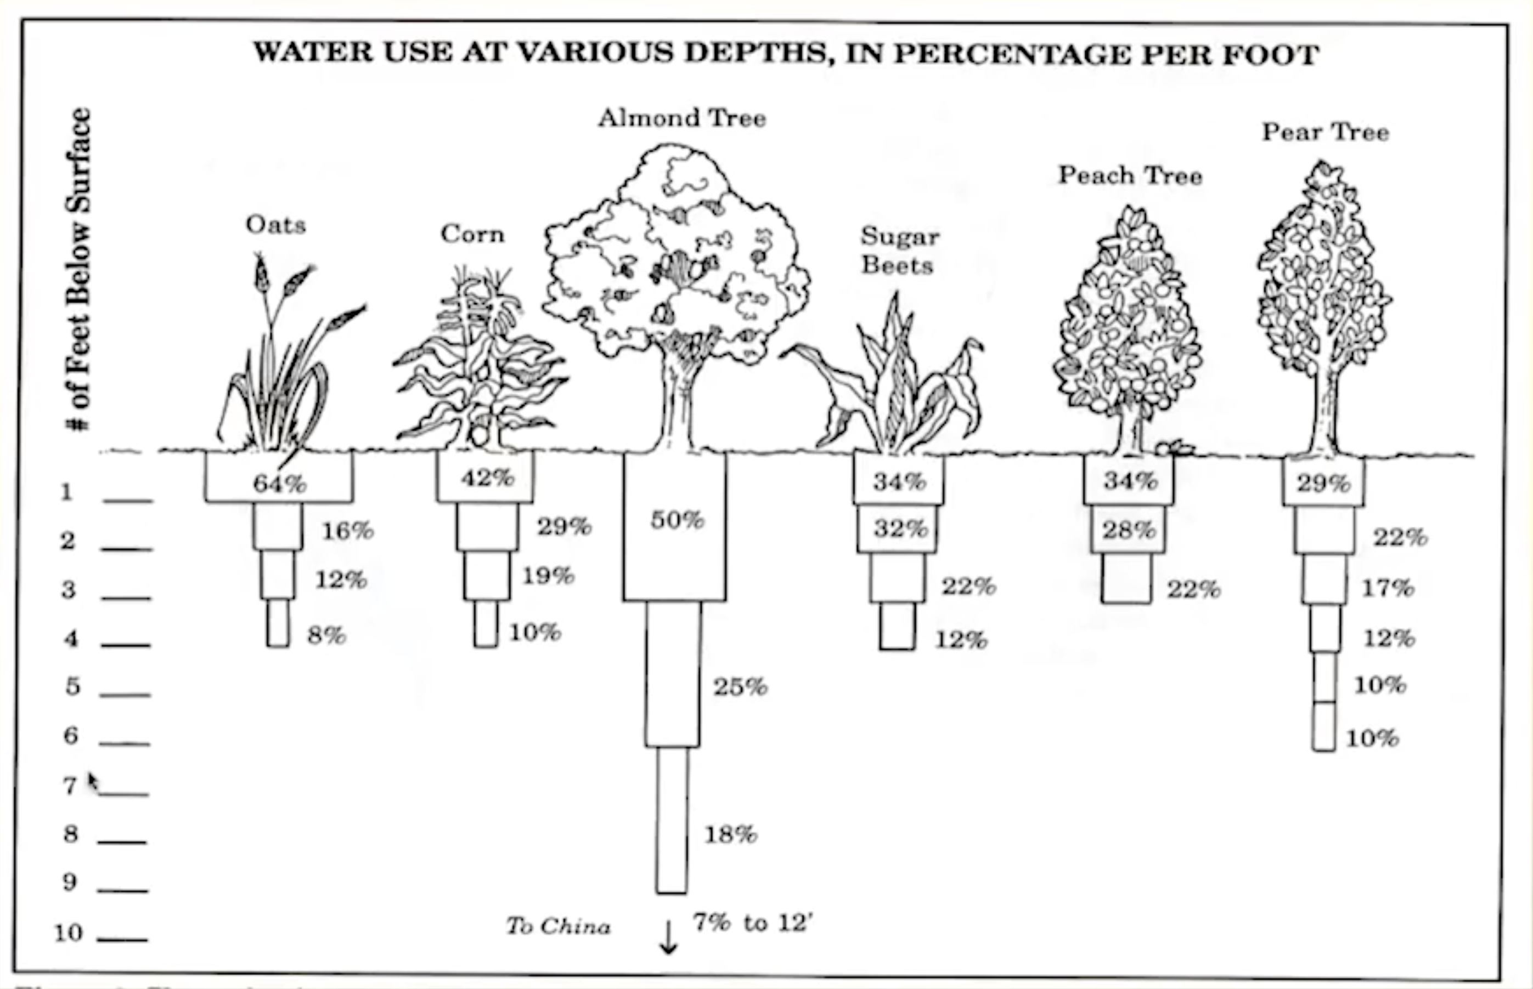
Soil Water
Root Depth
The soil water available for plant is sum of available WHCs of all horizons occupied by plant roots.
The actual depth of rooting of various crops are affected by soil conditions.
Therefore, actual depth at any site should be checked.
Where local data isn’t available and there are no root restrictions, data from other sources of standard reference can be used.

Slide 4
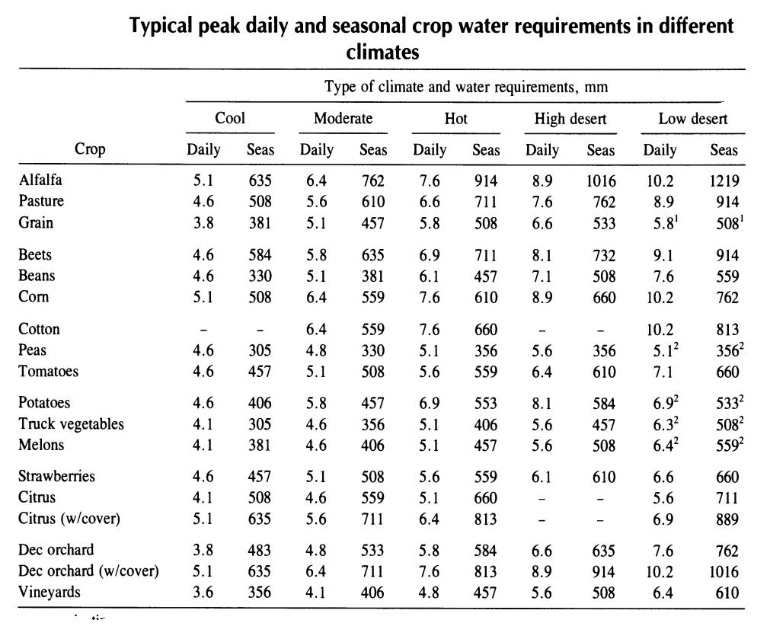
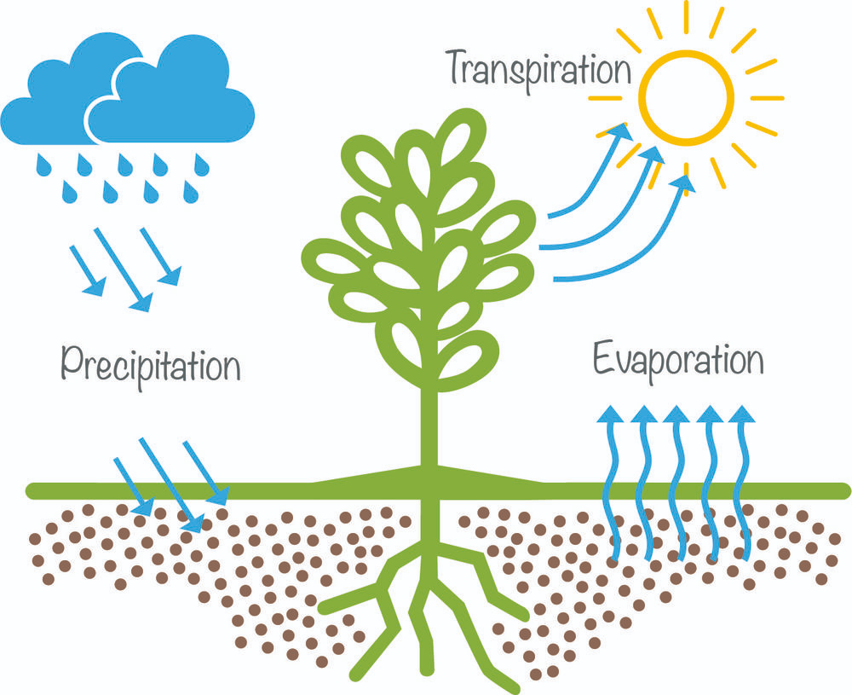
Consumptive Use and Design
To address the design capacity of an irrigation system, the data on consumptive use is important.
The rate of water use during peak consumptive use should be the basis of determining rate for designing system capacity.

Slide 5
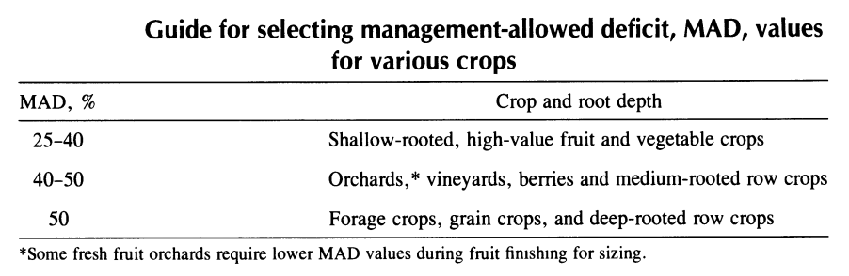
Soil Moisture Management
As a general rule of thumb, the soil moisture deficit should not fall below 50% (i.e., Management Allowable Deficit (MAD) = 50%).
The depth and duration of irrigation is constant throughout the growing period.
However, the frequency of application changes as the rate of water use changes in the growing period.

Slide 6
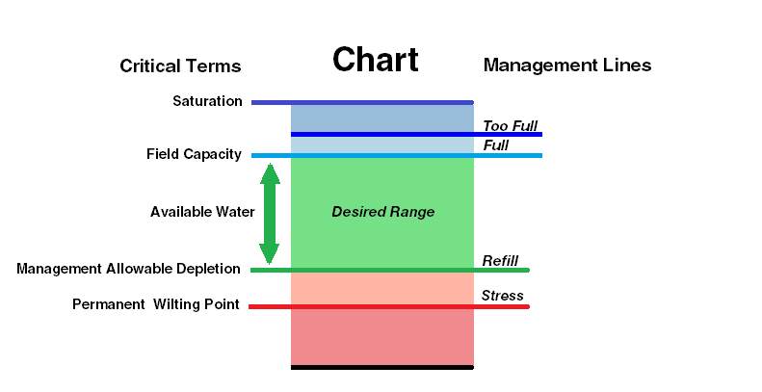
Soil Moisture Management
Irrigation Depth
The maximum net depth of water per irrigation (d_{x}) = maximum allowable depletion of soil water between irrigations.
d_{x} = maximum net depth of water to be applied per irrigation (mm).
MAD = management allowed deficit (in %)
W_{a} = available WHC of soil (mm/m).
Z = effective root zone depth (mm).

Slide 7
Soil Moisture Management
Irrigation Interval
The irrigation interval, i.e., the time elapsed between beginning of two successive irrigations, is determined by:
f’ = irrigation interval or frequency (days)
d_{n} = net depth of water application per irrigation, to meet the consumptive use requirements (mm)
U_{d} = average daily crop water requirement, or use rate, during the peak use month (mm/day).

Slide 8
Soil Moisture Management
Leaching Requirement
All irrigation water contain some dissolved salts, that are pushed downward by sprinkling and rainfall.
Application of more water than the plant consume, push (or leach) most of the salts below root zone.
The leaching requirement can be determined as:
LR = leaching requirement ratio
EC_{w} = electrical conductivity of irrigation water, (dS/m)
EC_{e} = electrical conductivity of saturation extract of soil root zone for an appropriate yield reduction(≈10%) (dS/m)

Slide 9
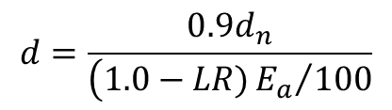
Soil Moisture Management
Leaching Requirement
When LR ≤ 0.1, the annual deep percolation losses, will be sufficient to provide necessary leaching.
When LR > 0.1, water in addition to consumptive use should be applied.
d = gross depth of irrigation application (mm)
E_{a} = application efficiency (%)
$$d=\frac{0.9d_{n}}{\left(1.0−LR){E_{a}}/{100}\right.}$$

Slide 10

System Capacity Requirement
The required capacity of sprinkler system depends on
the size of the area irrigated
the gross depth of water applied at each irrigation and
the net operating time allowed to apply this depth
Q_{s} = system discharge capacity (lps)
K = conversion constant (2.78 for metric units)
A = design area (ha)
d = gross depth of application (mm)
f = operating time allowed for completion of one irrigation (days)
T = average actual operating time per day (hr/day)
$$Q_{s}=K\frac{Ad}{fT}$$

Slide 11
Intake and Optimum Application Rate
The rate at which water should be applied depends on the following
Infiltration characteristics of soil, the field slope and the crop cover
The minimum application rate that will produce a uniform sprinkler distribution pattern and satisfactory efficiency under prevalent wind and evaporative demand conditions;
The coordination of the lateral moves for periodic move system with other operation on the farm
Q. How surface sealing is occurred in case of impact problem and what are the problems related with it ?

Slide 12
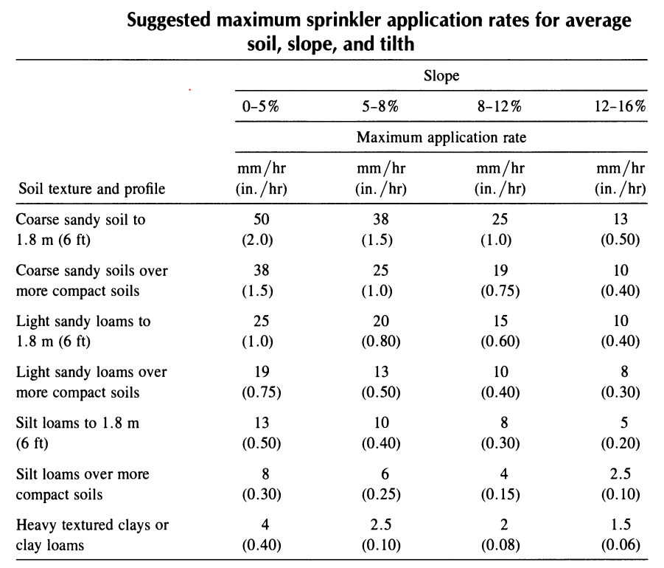
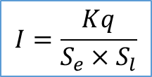
Intake and Optimum Application Rate
This table can be suggested for maximum application rate for periodic move system.
Average Application Rate from Sprinkler
$$I=\frac{Kq}{S_{e}×S_{l}}$$
I = average application rate (mm/hr)
K = Conversion factor (60)
q = Sprinkler discharge (lpm)
S_{e} = Sprinkler spacing along laterals (m)
S_{l} = Sprinkler spacing along mains (m)

Slide 13
!!!-Thank You-!!!

