Slide 1

Sprinkler Irrigation – Uniformity, Efficiency, and Layout
Sprinkler and Micro irrigation Systems
[BTAI 31]

Slide 2
Factors Affecting Sprinkler Application Efficiency
Variation of individual sprinkler discharge throughout the lateral line.
Variation of water distribution efficiency within the sprinkler-spacing area, primarily by wind.
Loss of water by direct evaporation from the spray.
Evaporation from soil surface before the water is used by the plants.
Q. How to deal with all these factors?

Slide 3
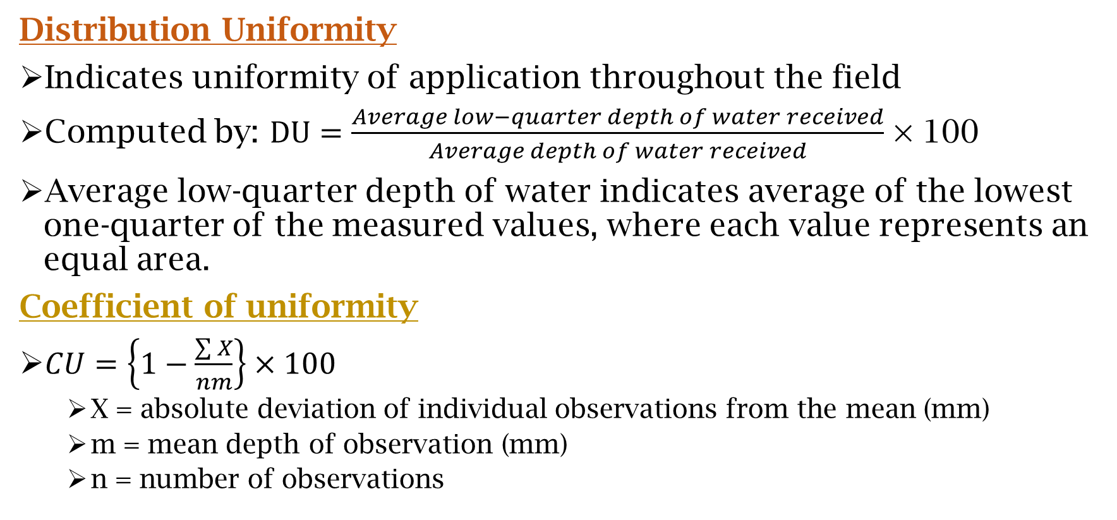
Uniformity
Distribution Uniformity
Indicates uniformity of application throughout the field
Computed by: $DU=\frac{Average low−quarter depth of water received}{Average depth of water received}$ × 100
Average low-quarter depth of water indicates average of the lowest one-quarter of the measured values, where each value represents an equal area.
Coefficient of uniformity
$CU=\left\{1−\frac{\sum{X}}{nm}\right\}×100$
X = absolute deviation of individual observations from the mean (mm)
m = mean depth of observation (mm)
n = number of observations

Slide 4

Uniformity
System CU = CU × $\frac{1+{\left({P_{n}}/{P_{a}}\right)}^{0.5}}{2}$
System DU = DU × $\frac{1+{\left({P_{n}}/{P_{a}}\right)}^{0.5}}{4}$
P_{n} = minimum sprinkler pressure (kPa)
P_{a} = average sprinkler pressure (kPa)

Slide 5
Design Criteria
Date generated by independent testing agencies regarding sprinklers operating under various simulated and actual field conditions.
These data can be used for selecting various combination of spacing, discharge, nozzle size, and operating pressure that will result in highest practical DU or CU for the anticipated operating conditions.

Slide 6
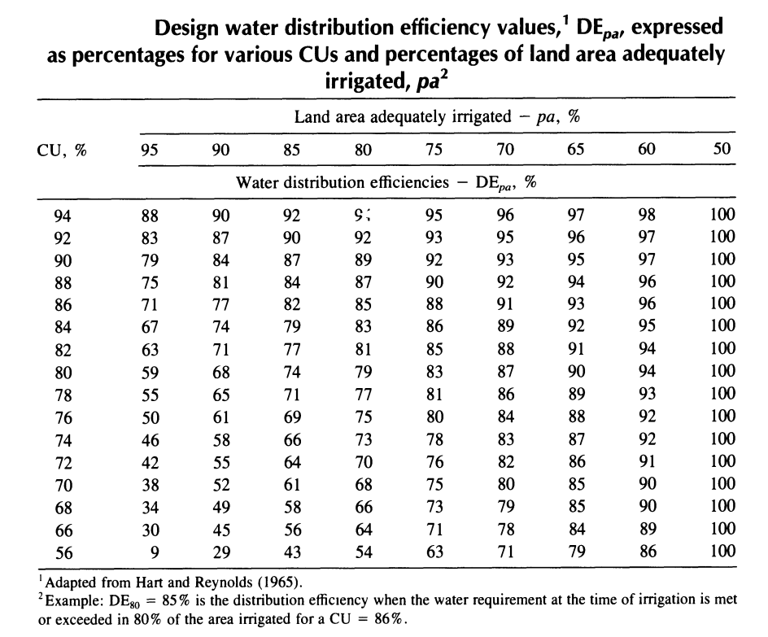
Interpretation of CU
The water distribution efficiency given in table represent values of different CUs assuming water requirement at the time of irrigation is met on 95, 90, 85, …. , 50% of the irrigated area.
If a sprinkler system has a CU of 86%, then, from table, DE₈₀ = 85%.
i.e., for each unit of average application of water received by the crop or soil, 80% of area would receive 85% of the average application or more.

Slide 7
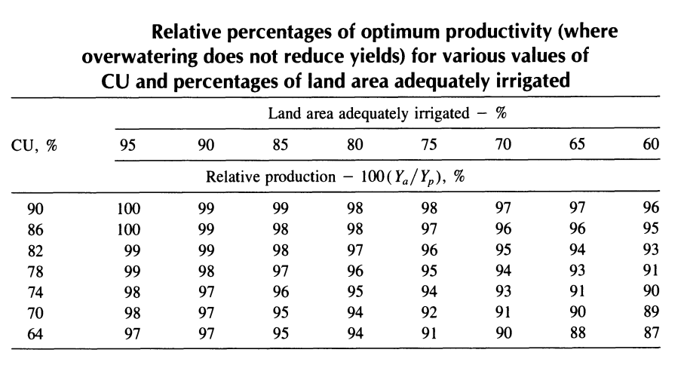
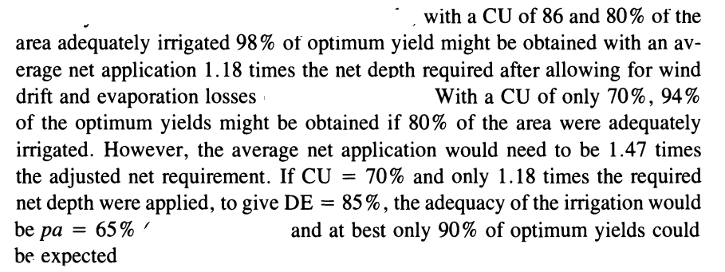
Interpretation of CU
This gives an understanding of CU to give a feel of relative productivity of forage and other vegetative crops.
For these crops, the yield must be a linear function of available water, and overwatering doesn’t reduce yield.

Slide 8
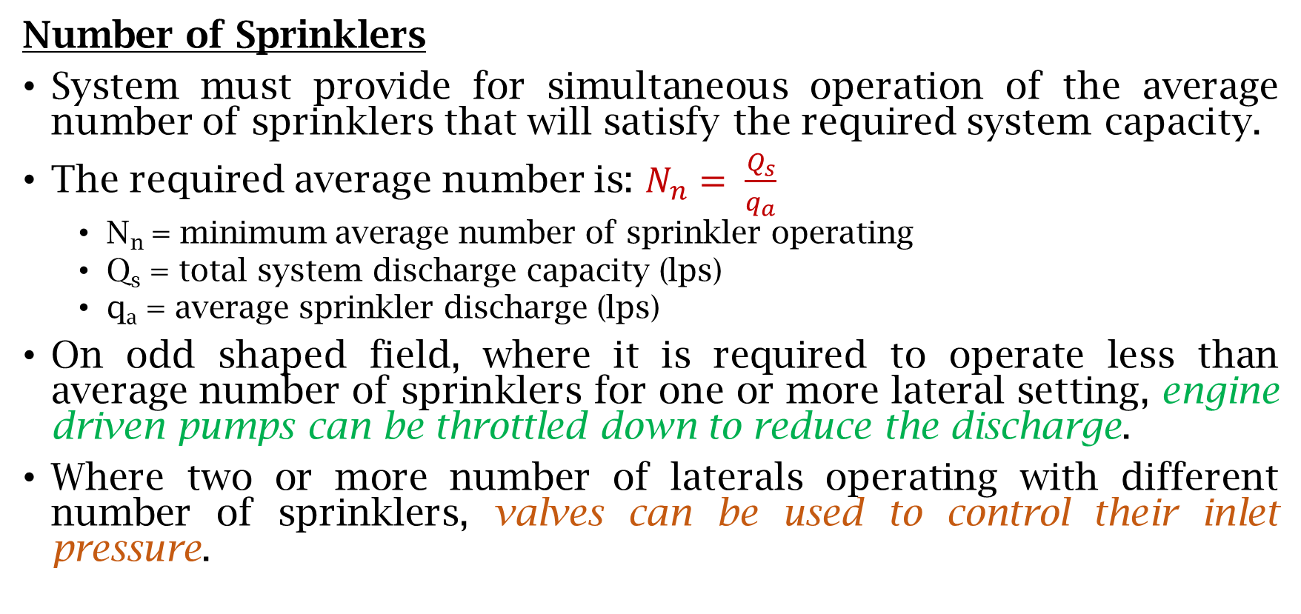
Layout of Set Sprinkler Systems
Number of Sprinklers
System must provide for simultaneous operation of the average number of sprinklers that will satisfy the required system capacity.
The required average number is: $N_{n}= \frac{Q_{s}}{q_{a}}$
N_{n} = minimum average number of sprinkler operating
Q_{s} = total system discharge capacity (lps)
q_{a} = average sprinkler discharge (lps)
On odd shaped field, where it is required to operate less than average number of sprinklers for one or more lateral setting, engine driven pumps can be throttled down to reduce the discharge.
Where two or more number of laterals operating with different number of sprinklers, valves can be used to control their inlet pressure.

Slide 9
Layout of Set Sprinkler Systems
Number of Lateral Position
Number of position of that each periodic-move lateral can handle depends on the
Number of moves per day
Number of operating days allowed for completing one irrigation cycle during the peak use period, f.
The required number of positions per lateral must not exceed the product of these two factors.

Slide 10
Topographic Effects (lateral layout)
For uniform application along the lateral, the pipe diameter, length and alignment must be so selected to result in minimum variation in discharge (variation shouldn’t exceed 10%).
The pipe sizes and layout should be so selected that the pressure variation along the lateral will not exceed 20% of average design operating pressure.
To meet the pressure variation criterion the laterals should be preferred to be laid on contours or across prominent land slopes.

Slide 11
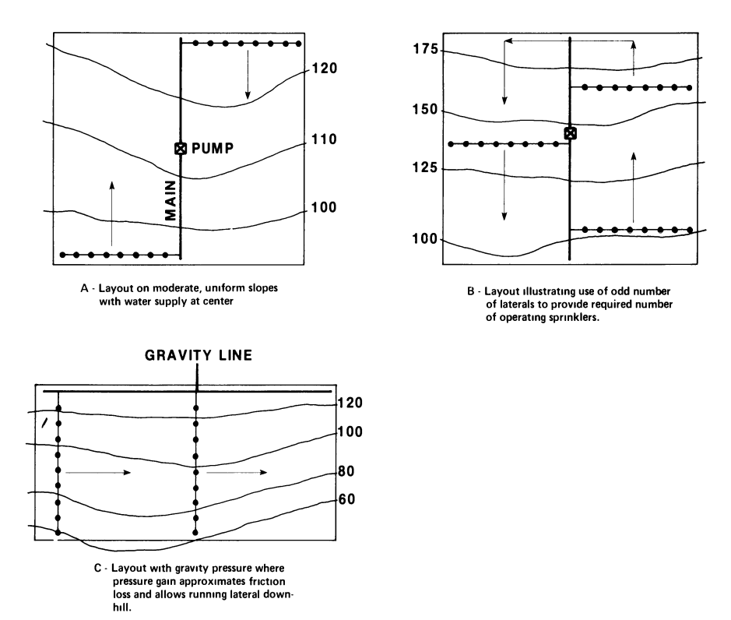
Topographic Effects (lateral layout)
Running laterals uphill should be avoided.
The lateral length in such case should be limited only to that length in which friction loss equals to 20% of P_{a} minus the pressure loss due to elevation difference.
The lateral length is limited to the length in which the friction loss equals 20% of average operating pressure.
Running laterals downhill is a distinct advantage , provided that the slope is fairly constant and not too steep.

Slide 12
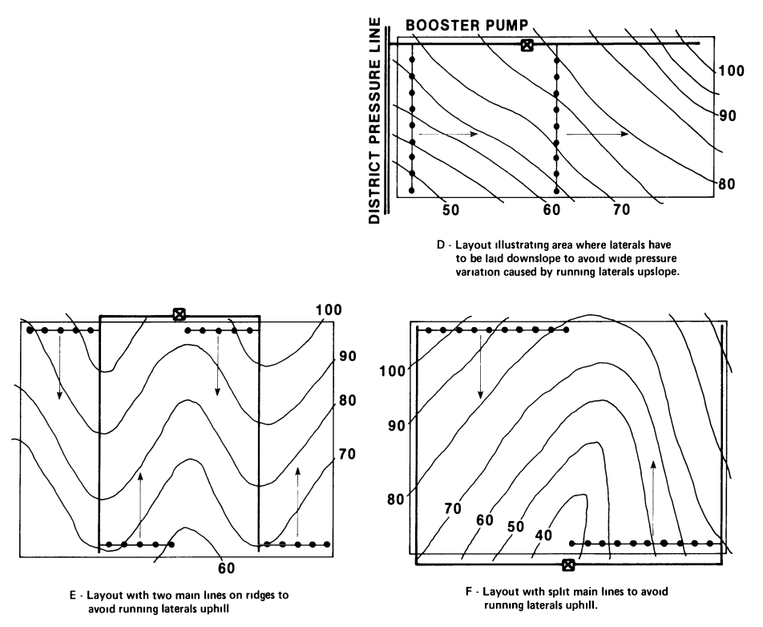
Topographic Effects (lateral layout)
In downslope condition difference in elevation between the two ends results in gain in pressure head.
Downslope laterals may be longer than similar laterals laid on level grounds.
Where ground slope along the lateral is about equal to the friction loss gradient, the pressure along the lateral would be nearly constant.

Slide 13
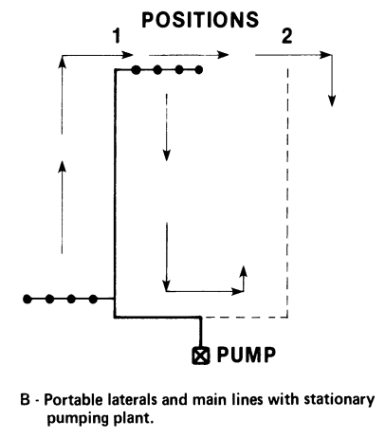
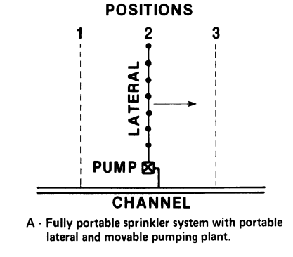
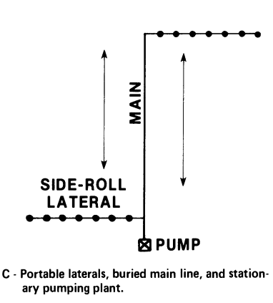
Topographic Effects (main line layout)
Main lines and sub-mains should usually run up and down slopes.
Where laterals are downslope, the main line will often be located along a ridge, with laterals sloping downward on each side or in split main line fashion (previous slide image E and F).

Slide 14
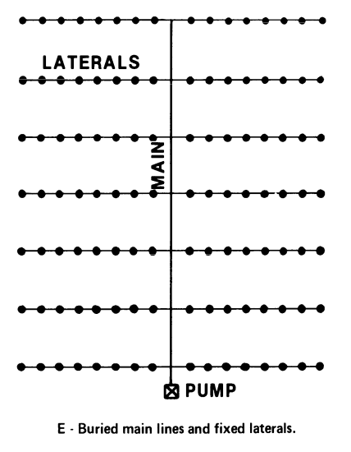
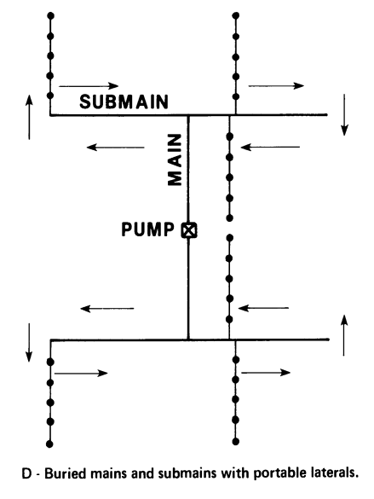
Topographic Effects (main line layout)

Slide 15
Water Source and Pumping Plant
Water supply should be located near the center of the design area.
On sloping fields the well should be located uphill from the center to better balance up- and downhill pressures and minimize the pipe sizes.
After completing the preliminary layout of laterals and main lines, it is often necessary to adjust one or more of the following variables:
Number of sprinklers operating, N_{n}
Water application rate, I
Gross depth of each irrigation, d
Average sprinkler discharge, q_{a}
Spacing of Sprinklers, S_{e} and/or S_{l}
Actual operating time per day, T

Slide 16
!!!-Thank You-!!!

