Slide 1

Sprinkler Irrigation – Pipeline Hydraulics
Sprinkler and Micro irrigation Systems
[BTAI 31]

Slide 2
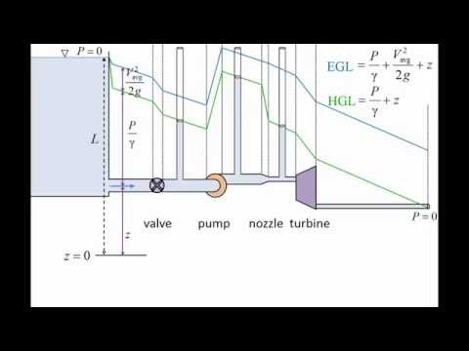
Pressure and Head Relationship
In an Irrigation system, the head consists of following components
Static head: simply the difference in elevation between the highest discharge point in the system and that point
Pressure head: pressure at that point divided by unit weight of water.
Velocity head: head required to accelerate the water from rest to the velocity at that point.
Friction head: energy required for water to flow between two points at same elevation.
Elevation above datum: distance of a given point in the system above some arbitrary datum.

Slide 3
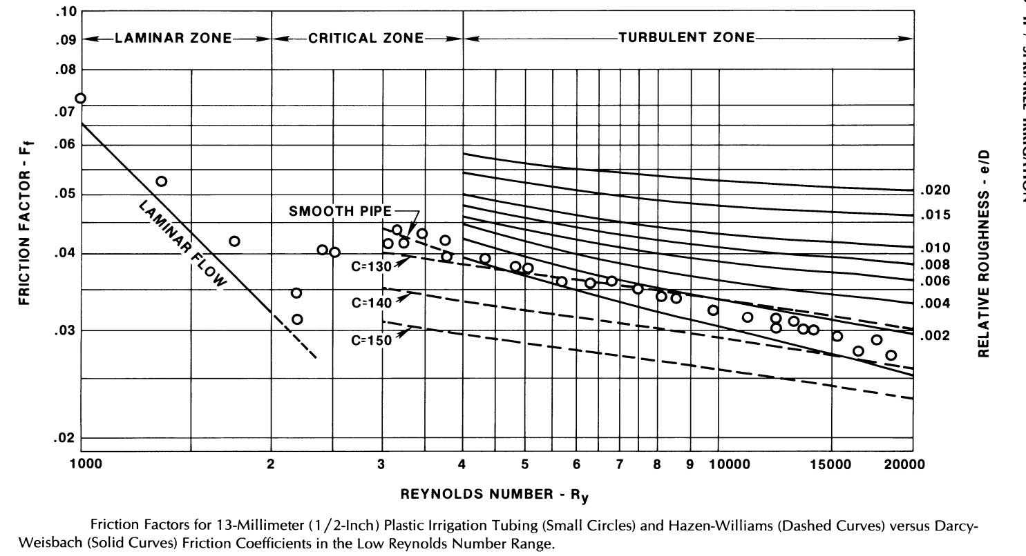

Calculation of Pipe Friction
Darcy-Weisbach equation
$h_{f}=F_{f}\frac{L}{D}\frac{V^{2}}{2g}$
h_{f} = head loss due to pipe friction (m)
F_{f} = Darcy-Weisbach pipe friction factor
V = velocity of flow in the pipe (m/s)
g = acceleration due to gravity (m/s²)
D = inside pipe diameter (m)
$F_{f}=\frac{64}{R_{y}} for R_{y}<2000$
$F_{f}=0.32{R_{y}}^{−0.25} for{ 2000 ≤R}_{y}≤10,000$
R_{y} = Reynold’s number

Slide 4
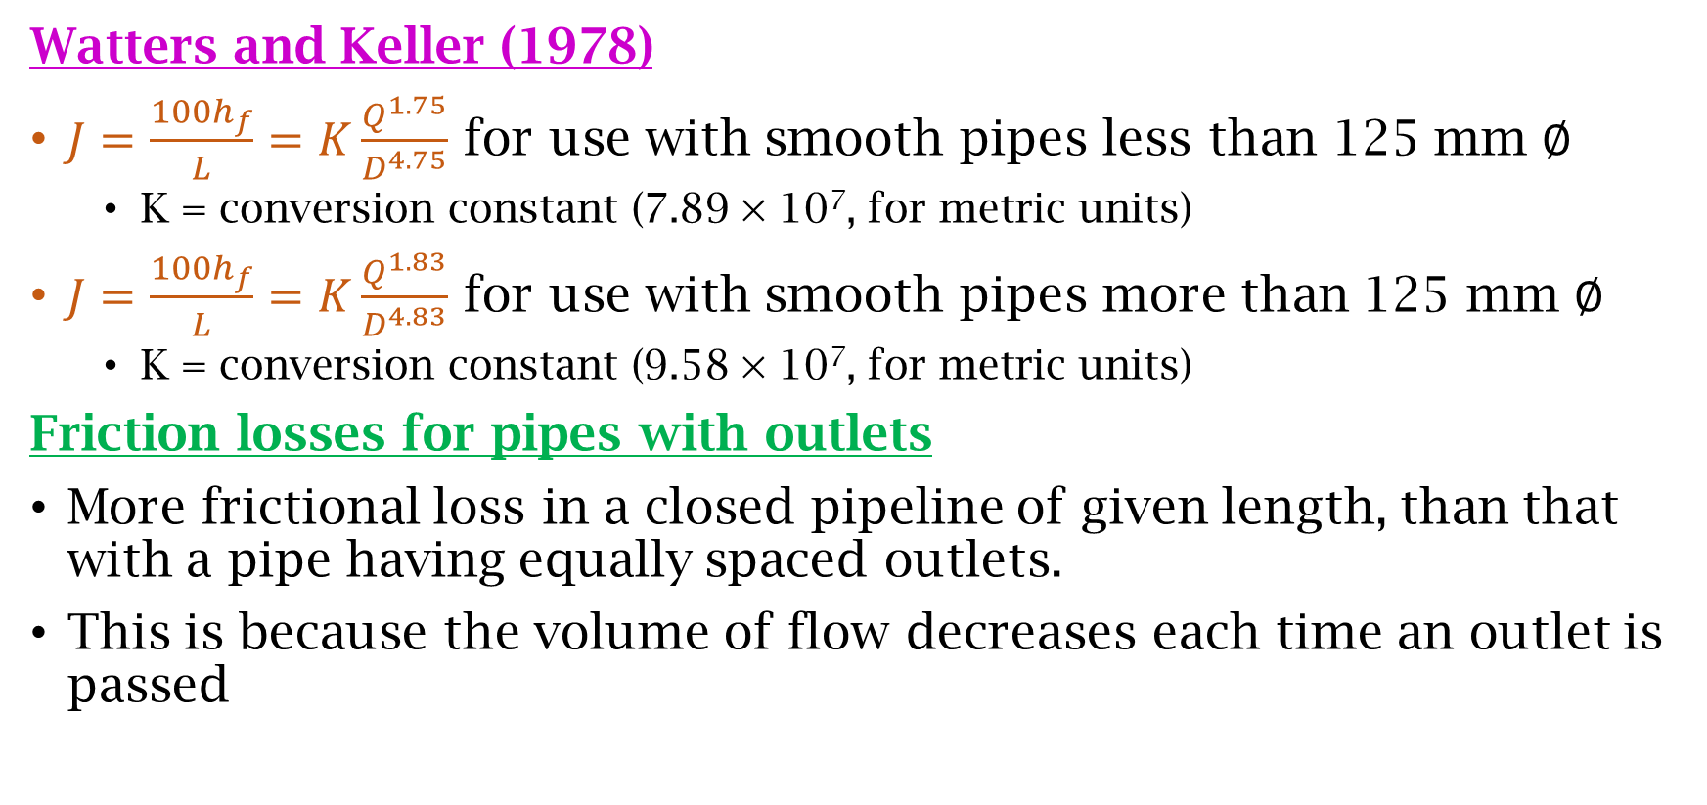
Calculation of Pipe Friction
Watters and Keller (1978)
$J=\frac{100h_{f}}{L}=K\frac{Q^{1.75}}{D^{4.75}}$ for use with smooth pipes less than 125 mm $∅$
K = conversion constant (7.89 × 10⁷, for metric units)
$J=\frac{100h_{f}}{L}=K\frac{Q^{1.83}}{D^{4.83}}$ for use with smooth pipes more than 125 mm $∅$
K = conversion constant (9.58 × 10⁷, for metric units)
Friction losses for pipes with outlets
More frictional loss in a closed pipeline of given length, than that with a pipe having equally spaced outlets.
This is because the volume of flow decreases each time an outlet is passed

Slide 5
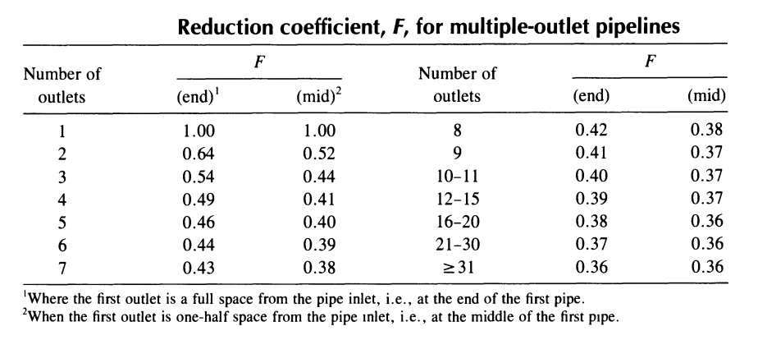
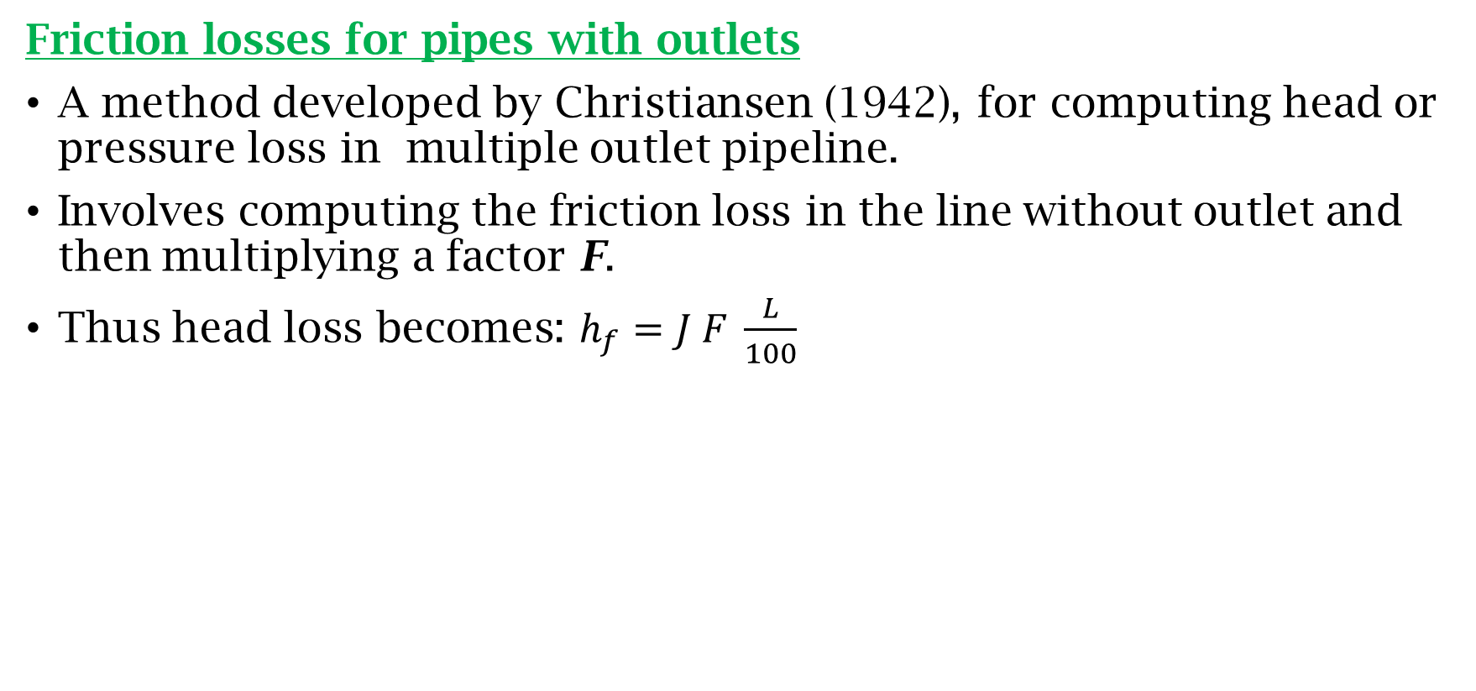
Calculation of Pipe Friction
Friction losses for pipes with outlets
A method developed by Christiansen (1942), for computing head or pressure loss in multiple outlet pipeline.
Involves computing the friction loss in the line without outlet and then multiplying a factor F.
Thus head loss becomes: $h_{f}=J F \frac{L}{100}$

Slide 6
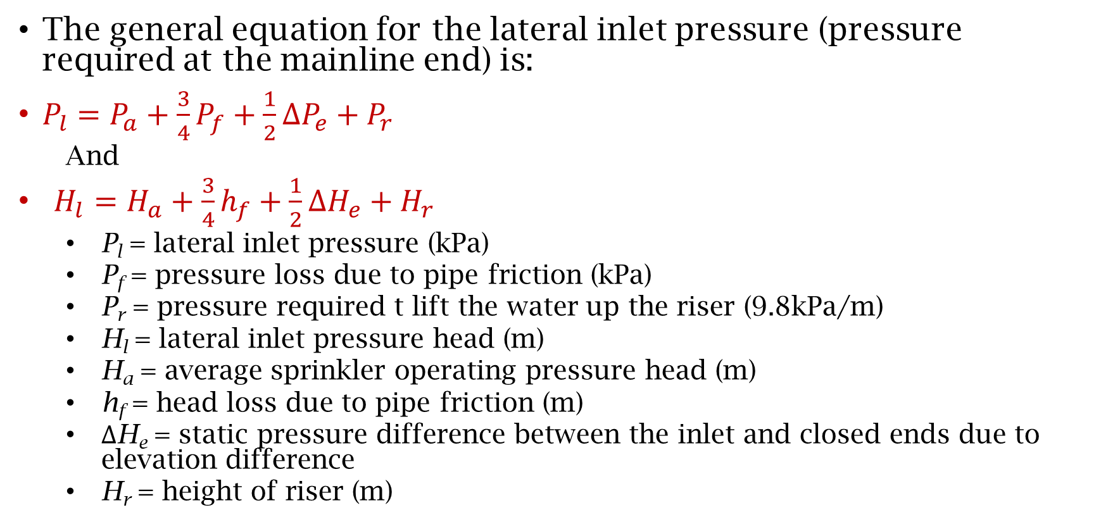
Lateral Inlet Pressure
The general equation for the lateral inlet pressure (pressure required at the mainline end) is:
$P_{l}=P_{a}+\frac{3}{4}P_{f}+\frac{1}{2}∆P_{e}+P_{r}$
And
$H_{l}=H_{a}+\frac{3}{4}h_{f}+\frac{1}{2}∆H_{e}+H_{r}$
P_{l} = lateral inlet pressure (kPa)
P_{f} = pressure loss due to pipe friction (kPa)
P_{r} = pressure required t lift the water up the riser (9.8kPa/m)
H_{l} = lateral inlet pressure head (m)
H_{a} = average sprinkler operating pressure head (m)
h_{f} = head loss due to pipe friction (m)
$∆$H_{e} = static pressure difference between the inlet and closed ends due to elevation difference
H_{r} = height of riser (m)

Slide 7
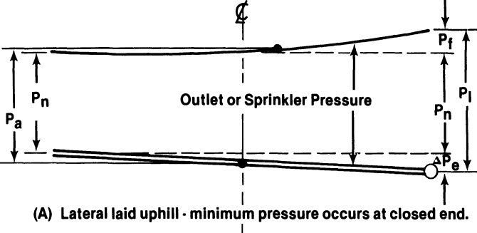
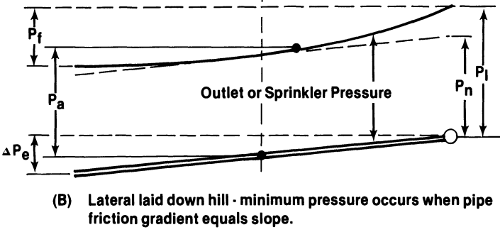
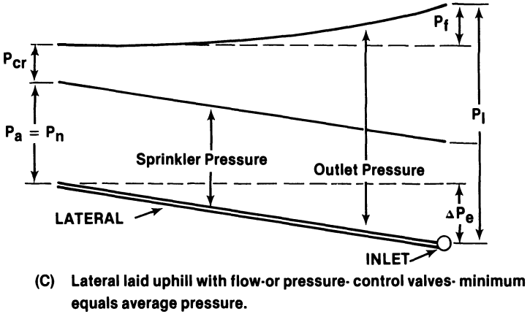
Lateral Inlet Pressure

Slide 8
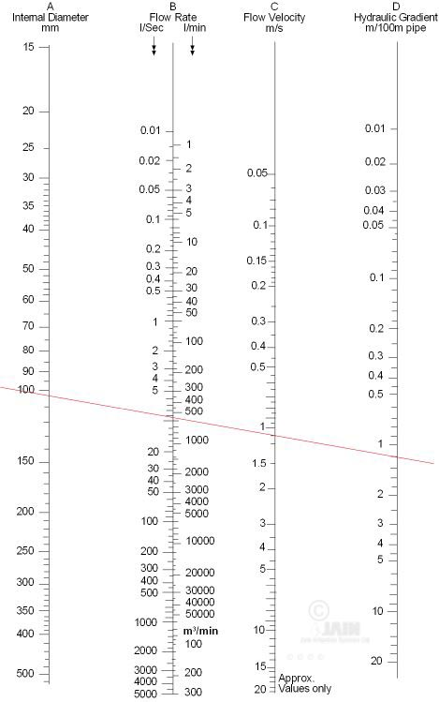
Main Line Pipe Size
The function of mainline and sub-mains is to convey the required quantity of water at desired pressure to all laterals under maximum pressure conditions.
Friction loss of 3m for small system and 12m for large system may be allowed.
A nomograph showing hydraulic gradient in m/100m length

Slide 9
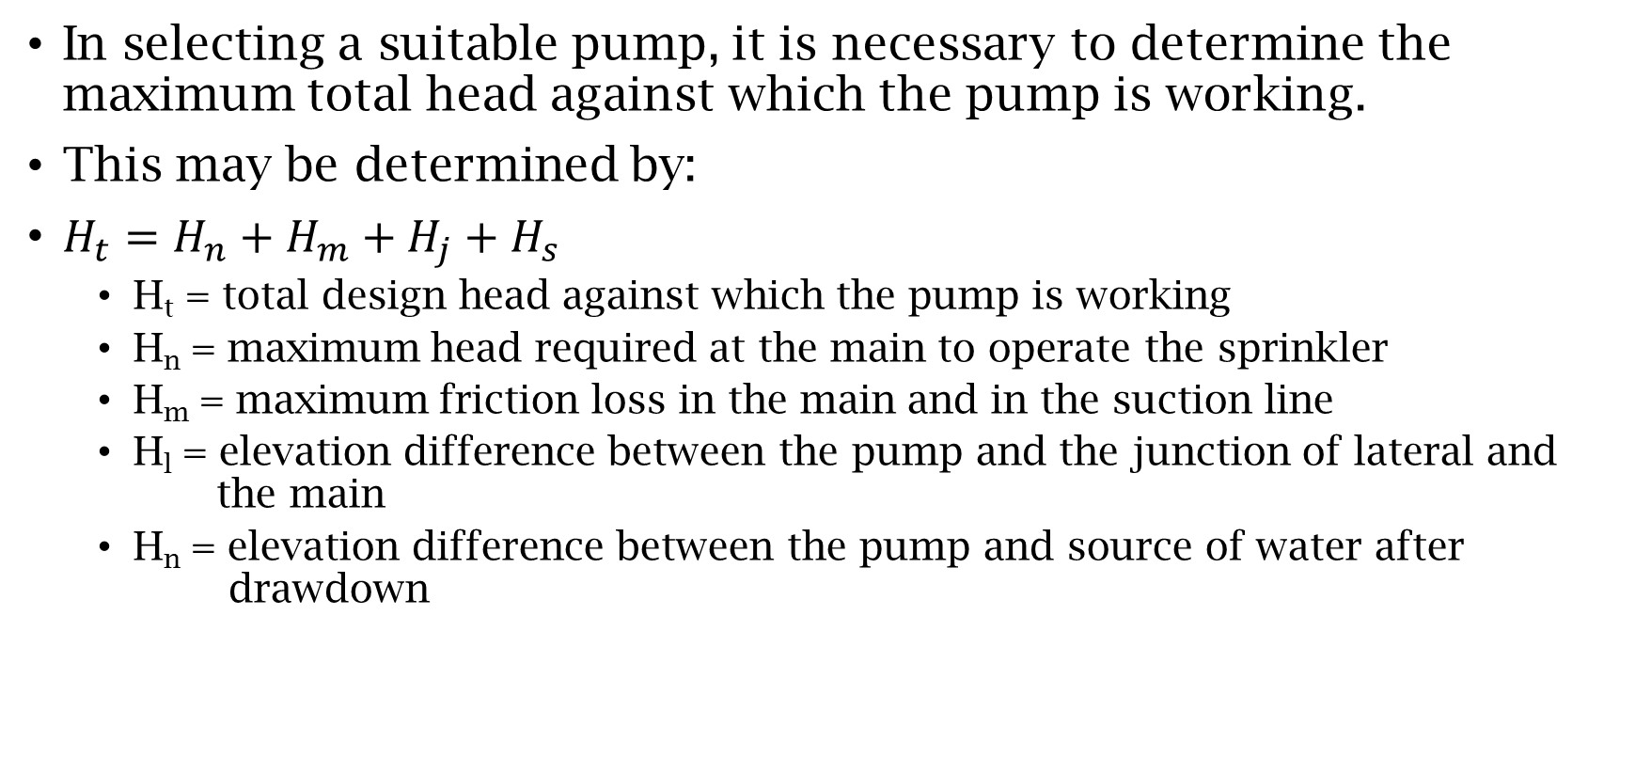
Pumps and Power Units
In selecting a suitable pump, it is necessary to determine the maximum total head against which the pump is working.
This may be determined by:
$H_{t}=H_{n}+H_{m}+H_{j}+H_{s}$
H_{t} = total design head against which the pump is working
H_{n} = maximum head required at the main to operate the sprinkler
H_{m} = maximum friction loss in the main and in the suction line
H_{l} = elevation difference between the pump and the junction of lateral and the main
H_{n} = elevation difference between the pump and source of water after drawdown

Slide 10
!!!-Thank You-!!!

