Slide 1

Micro Irrigation Systems - Introduction
Sprinkler and Micro irrigation Systems
[BTAI 31]

Slide 2
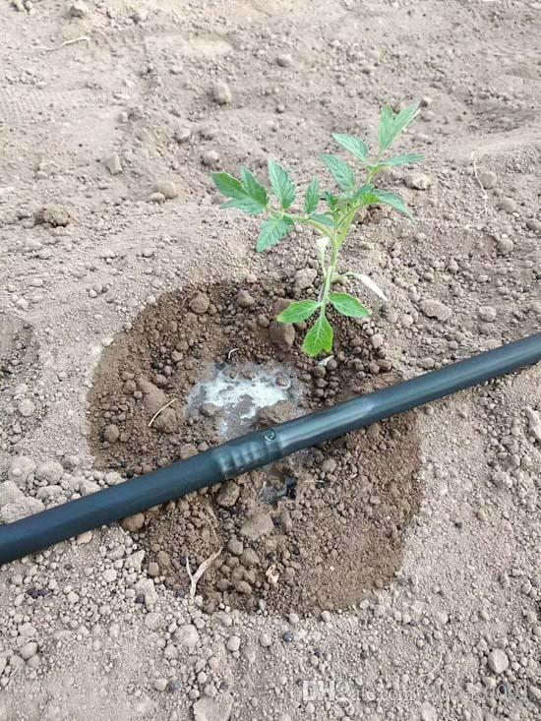
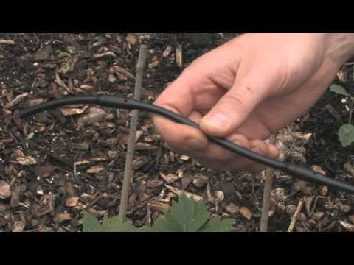
Drip Irrigation
One kind of micro irrigation system
The micro irrigation method is the low pressure irrigation system that sprays, sprinkles, mists, delivers or drips the water frequently at low discharges onto or into the soil near the plant roots and causing only partial wetting of the soil surface.
Drip irrigation also called as trickle irrigation: method of applying filtered water (and fertilizers soluble in water) at a low discharge through the emitters or drippers directly onto or in to the soil.

Slide 3
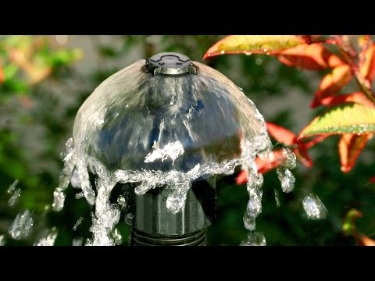
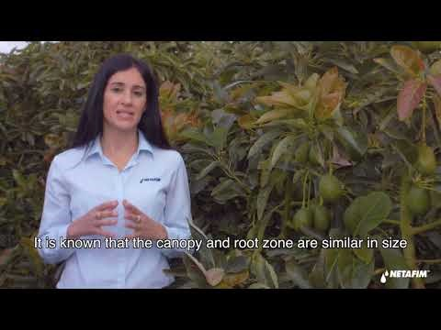
Drip Irrigation
Operating pressure, is usually small operating pressure (20 to 200 kPa or 1 to 2 kg/cm2) compared to the operating pressure required at the nozzle or sprinkler of the sprinkler irrigation system.
The discharge of the emitter varies from 0.5 to 12 lph depending on the soil type, discharge available at the source and the area to be irrigated.
The other types of the micro irrigation methods are micro-sprinkler, micro-jet, bubbler.

Slide 4
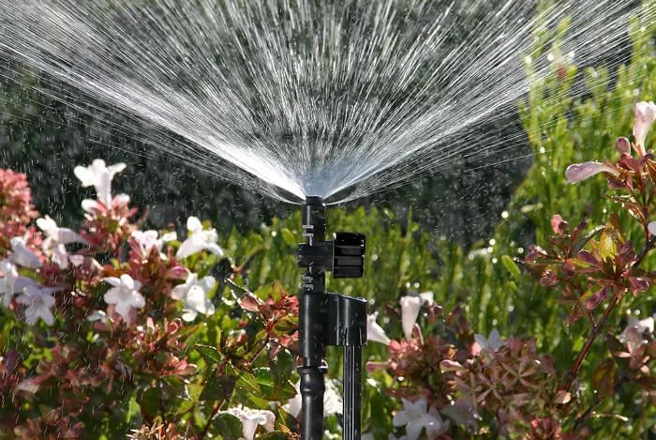
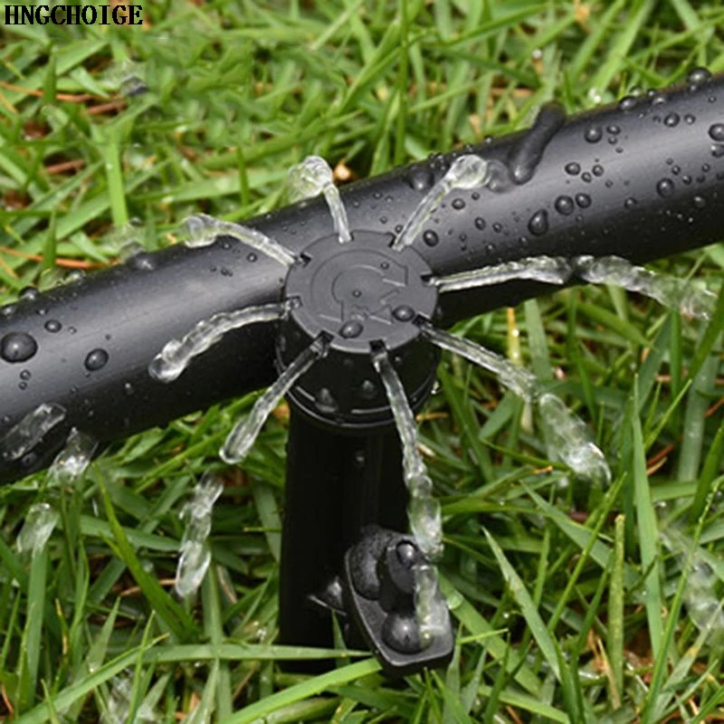
Drip Irrigation
Micro irrigation defers from sprinkler irrigation by the fact the only part of the soil surface is wetted in micro irrigation methods and these methods operate on low pressure and deliver low discharge

Slide 5
Advantages
Water Savings: In drip irrigation system, the water is not moved over the soil surface or through the air. Therefore the conveyance losses are totally eliminated. As water does not come in contact with the foliage, the interception losses are also eliminated.
Improved Plant Growth and Crop Yield: As this method allows the efficient application of water in low volumes frequently, it is possible to maintain the water content in the soil root zone near to the field capacity or within allowable depletion soil moisture.
Labor & Saving: There is considerable saving in labor, as the well-designed system needs labor only to start or stop the system. This method is also adaptable to automation of low to high level in water and fertilizer application.

Slide 6
Advantages
Energy Saving: Because of high irrigation efficiency, less amount of water is required to be applied and hence less time is required to supply the desired quantity of water and therefore this, method saves energy.
Suitability to Poor Soils: Very light soils are difficult to irrigate by conventional methods due to deep percolation of water. Like-wise, very heavy soils with low infiltration rates are difficult to irrigate even by sprinkler method.
Weed Control: In drip method, due to partial wetting of soil, weed infestation is very less in comparison to other methods of irrigation.
Economy in Cultural Practices & Operations: Besides achieving effective control of weeds, it also increases the efficiency of other operations like spraying, weeding, harvesting etc. due to the possibility of arranging the geometry of the plantation to suit to these operations.

Slide 7
Advantages
Use of Brackish/Saline Water: In this method the soil moisture can be maintained at low tension and therefore best suited to the application of brackish/saline water which is otherwise not possible in surface irrigation method due to moisture at high tension because of prolonged interval between two irrigations.
Enhanced Fertilizer Application Efficiency: In drip irrigation system, water soluble fertilizers can be applied. As water can be precisely applied in the root zone, fertilizer can also be applied in the root zone of the crop only.
No Soil Erosion: As water is not moved over the land surface, there is no soil erosion due to drip irrigation.
Minimum Diseases and Pest Problems: In drip system, because of less atmospheric humidity minimum diseases and pest problems are observed.

Slide 8
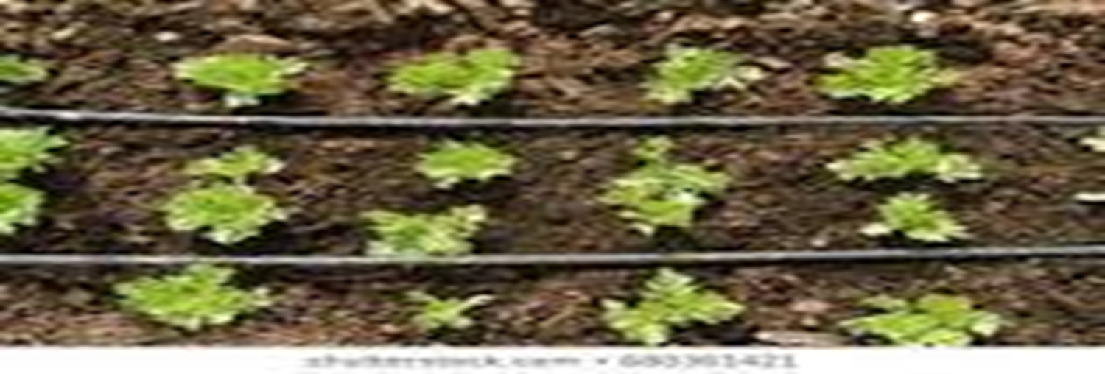
Limitations
Initial Heavy investment
Extensive Maintenance Requirement
Salinity Hazards
Economic and/or Technical Limitations
High Skill Requirements

Slide 9
!!!-Thank You-!!!

