Slide 1

Micro Irrigation Systems - Design
Sprinkler and Micro irrigation Systems
[BTAI 31]

Slide 2
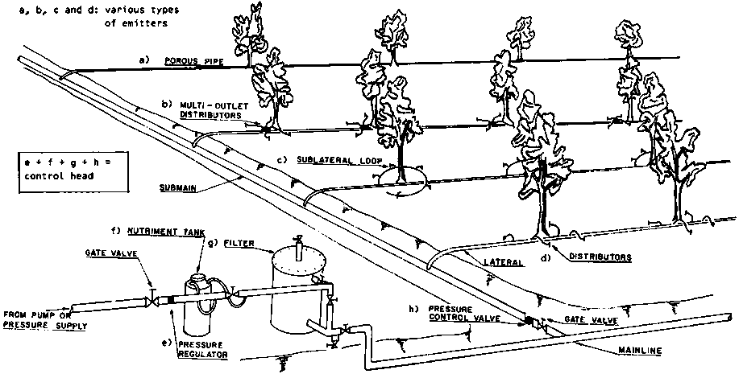
Components of Drip Irrigation System
Pumping set
Filters
Mainlines
Sub-main
Laterals
Drippers/emitters
https://slideplayer.com/slide/13173599/

Slide 3
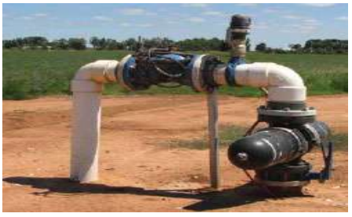
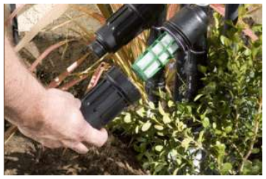
Components of Drip Irrigation System
Pumping Set
To create a pressure about 2.5kg/sq.cm to regulate the amount of water to be supplied
Filter Unit
To filter the water in order to remove the suspended impurities from the water.

Slide 4
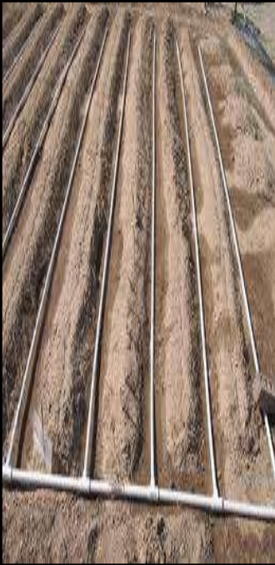
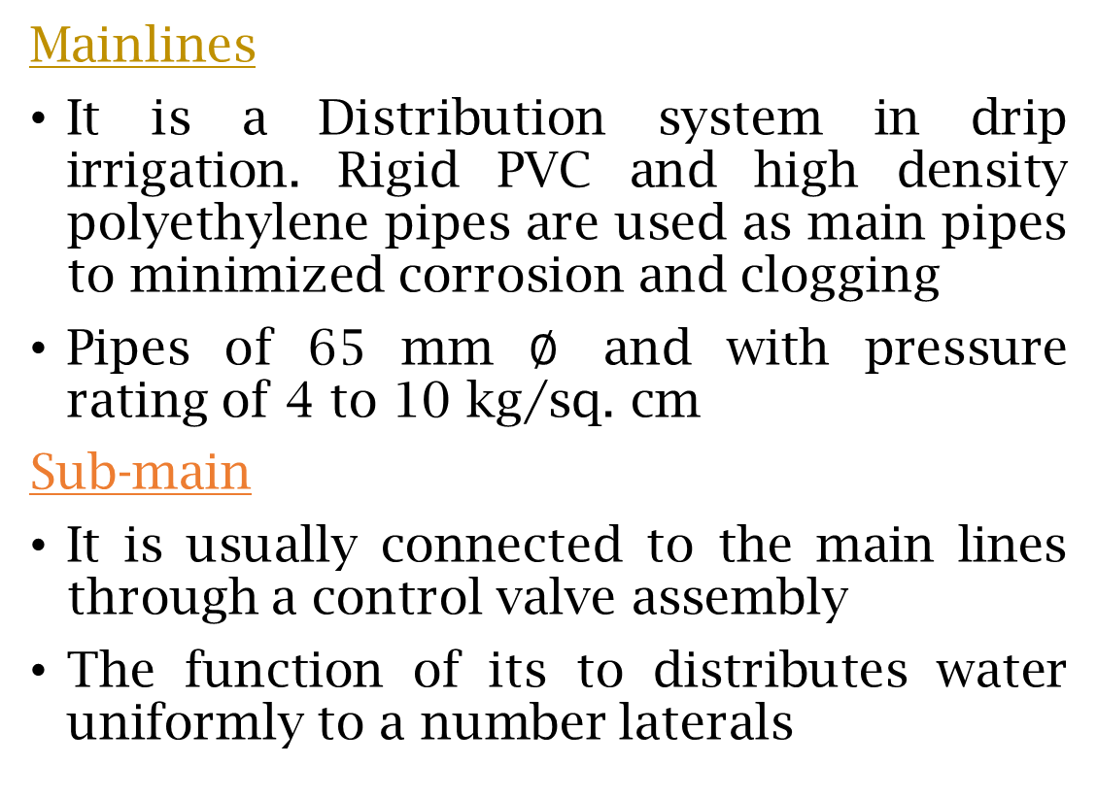
Components of Drip Irrigation System
Mainlines
It is a Distribution system in drip irrigation. Rigid PVC and high density polyethylene pipes are used as main pipes to minimized corrosion and clogging
Pipes of 65 mm $∅$ and with pressure rating of 4 to 10 kg/sq. cm
Sub-main
It is usually connected to the main lines through a control valve assembly
The function of its to distributes water uniformly to a number laterals

Slide 5
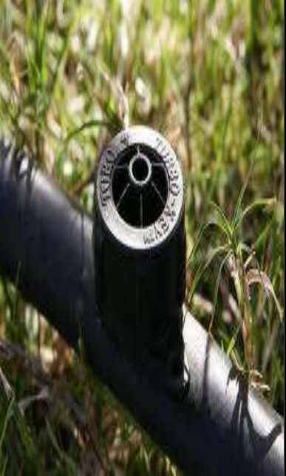
Components of Drip Irrigation System
Drippers and Emitters
It is fitted to a drip irrigation lateral and intended to emit water in the form of drops or continuous f low at emitter rates not exceeding 15 liters/hr
Drippers function as energy dissipated, reducing the inlet pressure head in the lateral, which generally range from 0.3 to 1.5 atmosphere

Slide 6
Design of Drip Irrigation System
Data Collection
Types of soil
Infiltration characteristics of soil
Types of crop
Consumptive use of water by crops
Water quality
Climate condition
Availability of funds
Contour map

Slide 7
Design Procedure
Prepare on inventory of available resources & operating conditions
Determine the water requirement to be met by the drip system
Determine the appropriate type of system
Determine the type and design of emitters
Determine the capacity of pumping system
Decide on the economic sizes of the pumping system
Determine the maximum and minimum operating pressure and the minimum efficiency required
Determine the appropriate filtering system
Determine the requirement of the fertilization system
Plan field evaluation
Prepare drawings, specification, cost ,schedules, installation, operations, maintenance.

Slide 8
Emitter Selection
The efficiency Of Drip irrigation system depends mainly on the selection of the type of emitter and its design.
Characteristic of emitter that influence the efficiency of irrigation system is Discharge rate
Critical items in emitter selection are the % area wetted(Pw) and the emitter reliability .
The density of emission points required to obtain Pw ≥ 33% .

Slide 9
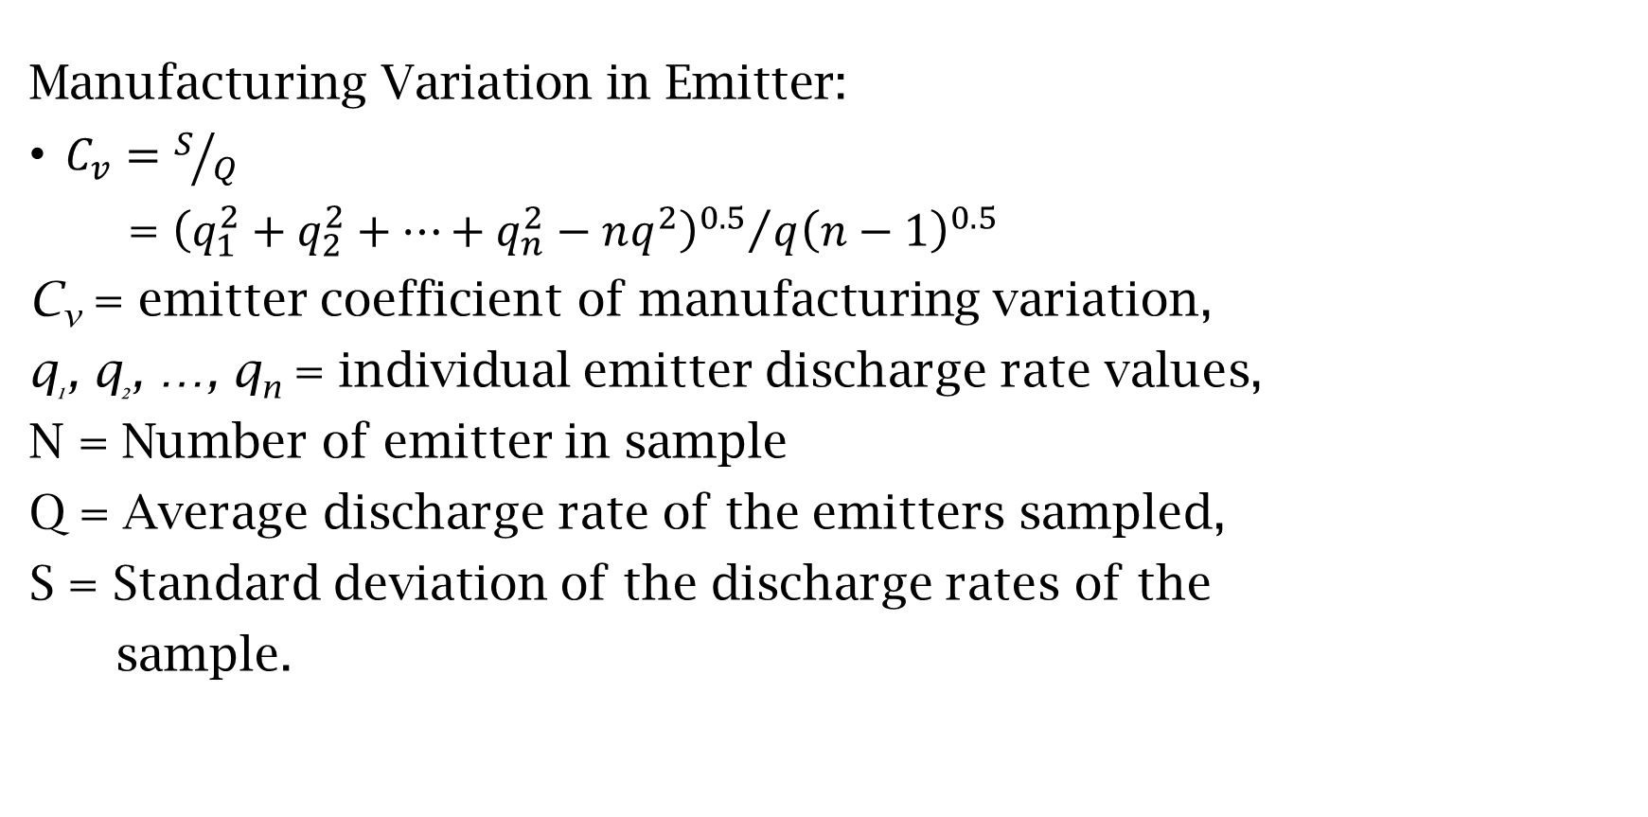
Emitter Selection
Manufacturing Variation in Emitter:
$C_{v}=S/Q$
= ${{\left(q_{1}^{2}+q_{2}^{2}+…+q_{n}^{2}−nq^{2}\right)}^{0.5}}/{{q\left(n−1\right)}^{0.5}}$
C_{v} = emitter coefficient of manufacturing variation,
q₁, q₂, …, q_{n} = individual emitter discharge rate values,
N = Number of emitter in sample
Q = Average discharge rate of the emitters sampled,
S = Standard deviation of the discharge rates of the
sample.

Slide 10
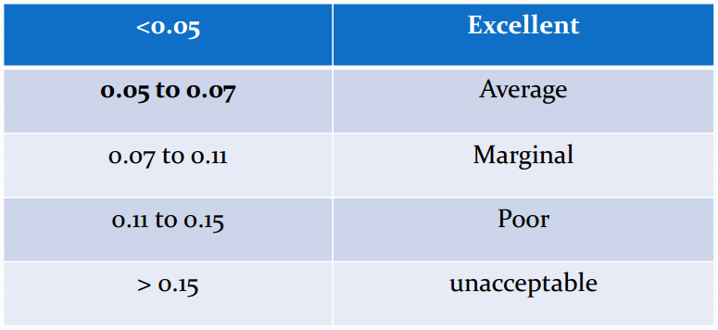
Emitter Selection
Recommended ranges of C_{v}
Emitter coefficient of manufacturing variation

Slide 11

Discharge of Drippers
$q=kh^{x}$
q = discharge of drippers (volume per time)
P = operating pressure (force/area)
X = constants for specified emitters

Slide 12
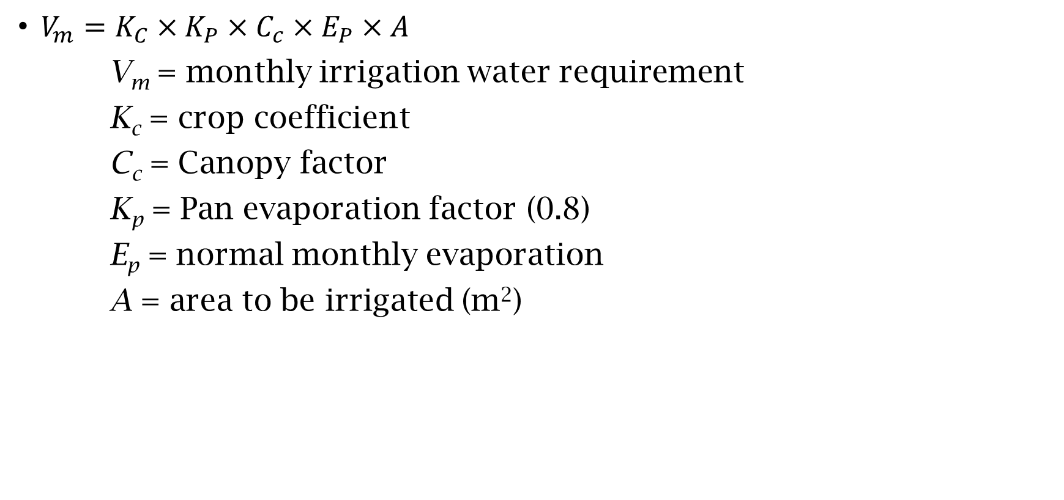
Irrigation Water Requirerments
$V_{m}=K_{C}×K_{P}×C_{c}×E_{P}×A$
V_{m} = monthly irrigation water requirement
K_{c} = crop coefficient
C_{c} = Canopy factor
K_{p} = Pan evaporation factor (0.8)
E_{p} = normal monthly evaporation
A = area to be irrigated (m²)

Slide 13
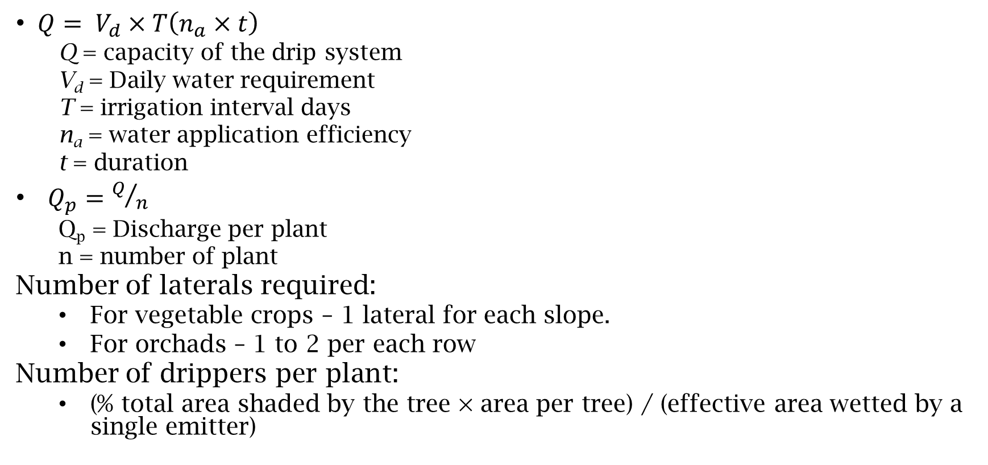
Capacity of the Drip Irrigation System
$Q= V_{d}×T\left(n_{a}×t\right)$
  Q = capacity of the drip system
  V_{d} = Daily water requirement
  T = irrigation interval days
  n_{a} = water application efficiency
  t = duration
  $Q_{p}=Q/n$
    Q_{p} = Discharge per plant
    n = number of plant
    Number of laterals required:
      For vegetable crops – 1 lateral for each slope.
      For orchads – 1 to 2 per each row
    Number of drippers per plant:
      (% total area shaded by the tree × area per tree) / (effective area wetted by a single emitter)

Slide 14
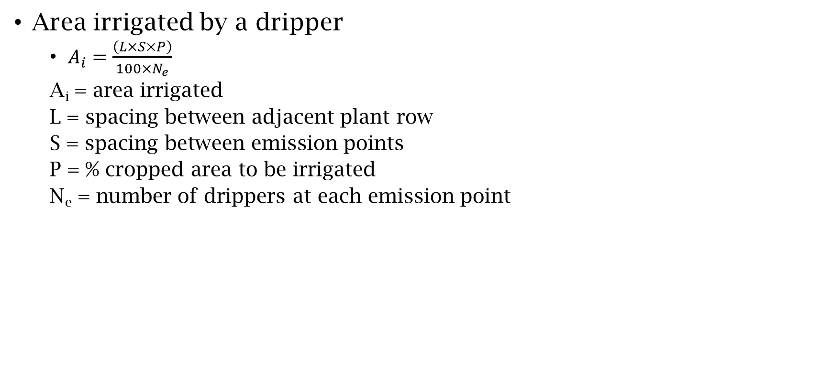
Area Irrigated by the Dripper
Area irrigated by a dripper
  $A_{i}=\frac{\left(L×S×P\right)}{100×N_{e}}$
  A_{i} = area irrigated
  L = spacing between adjacent plant row
  S = spacing between emission points
  P = % cropped area to be irrigated
  N_{e} = number of drippers at each emission point

Slide 15
!!!-Thank You-!!!

