Slide 1

Fertigation - Introduction
Sprinkler and Micro irrigation Systems
[BTAI 31]

Slide 2
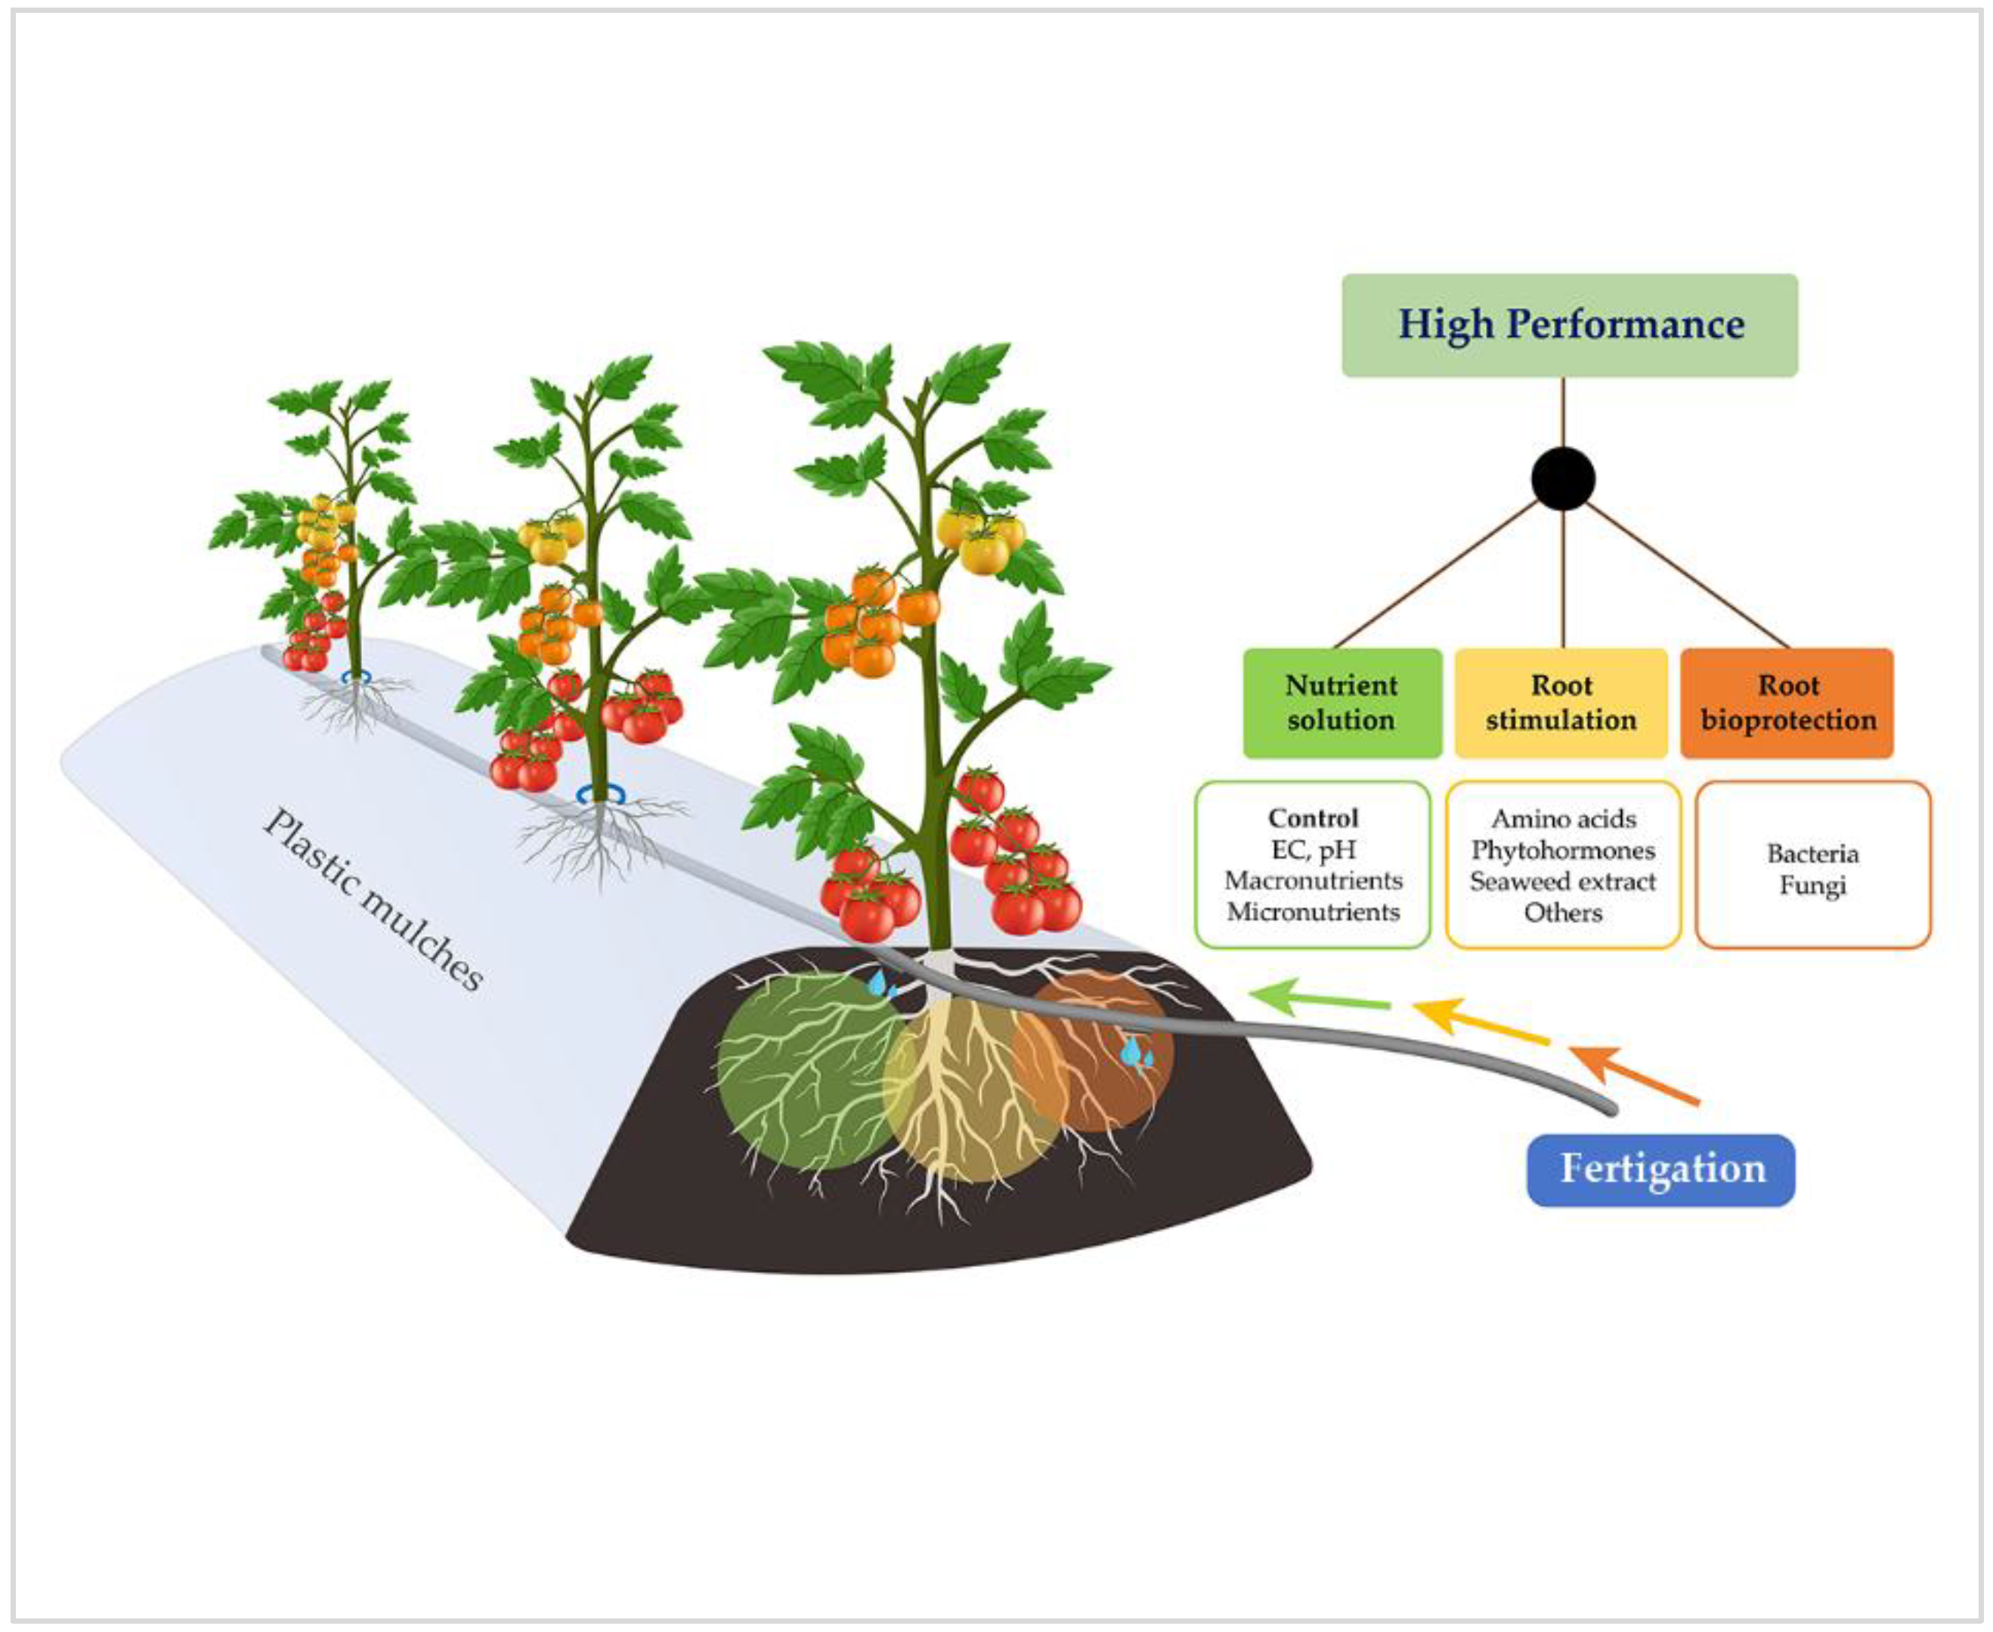
Introduction
Fertigation is a process in which fertilizer is dissolved and distributed along with water in your drip or spray irrigation system. There is abundant research available that supports the superiority of fustigations as compared to traditional fertilizing techniques.
Most fertigation systems for residential use require the use of liquid fertilizers since they are unable to solubilize (dissolve) higher concentration, water-soluble fertilizers.
Most companies that produce fertilizers for fertigation produce liquid fertilizers since that is the only option that their dispensing units can handle.

Slide 3
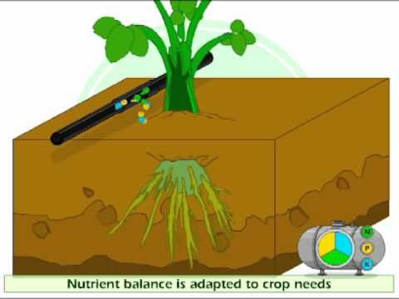
Introduction
The drawback of liquids is that when they are manufactured, they must be pre-diluted with water to make them weaker and less concentrated.
Producers do this because they must keep the fertilizers in suspension and can only do that when N-P-K are at low concentration levels. Therefore you rarely see a balanced fertilizer's rating (N-P-K) in a liquid form above 20%.
If you see any N-P-K concentration levels above 20%, it is most likely that this is primarily nitrogen in a urea-based form.

Slide 4
Meaning of fertigation
Fertigation is the application of soluble fertilizers (plant nutrients ) through an irrigation system.
Reduce fertilizer needed by 70-90% which virtually eliminates fertilizer runoff.
Save from 20-50% on your water usage
Improve the health and vitality of your landscape

Slide 5
Advantageous of fertigation:
Improves efficiency of fertilizer use
Increases nutrient availability
Saves 20-40% fertilizer without affecting growth and yield
Saves labour and energy in application of fertilizer
Reduce environmental contamination
Reduces leaching of nutrients
Limitations
Initial investment is high
Chemical reaction in drip system leading to corrosion and precipitation of fertilizer
Clogging of emitter

Slide 6
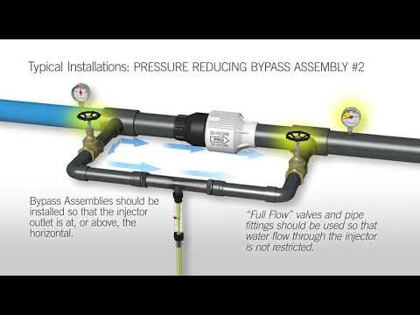
Fertigation Equipment
Venturi
Injector
Fertilizer tank
Fertilizer pump
Ventury Injector
This operates on venture principle, where a flow constriction with specific entrance and exit condition on the pipeline creates a vacuum because of the increased velocity of flow through construction.
The suction rate of Venture is 30-120lit/hours

Slide 7

Ventury Injector
Suction of the fertilizer solution is generated by water flow through a constricted passageway.
The high flow velocity of water in the constriction reduces water pressure below atmospheric pressure so that the fertilizer solution is sucked from an open tank in to the constriction through a small diameter tube.
The process of injection of fertilizer solution can be explained by Bernoulli’s principle, assuming inlet and outlet ports of venturi are at same elevation and total energy at a point is constant.
This can be given by energy equation ,
Where,
P = Pressure, V = Velocity, Z = Elevation, γ = unit weight of water,
g = acceleration due to gravity.

Slide 8
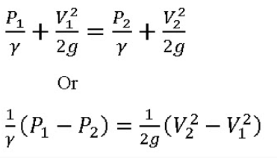
Ventury Injector
Considering inlet and outlet ends of a ventury injector are as points 1 and 2 respectively and they are located at same elevations, therefore Z1=Z2.
The above equation becomes
The change in velocity V2 from V1 due to constriction in venturi pipe diameter causes suction (change in pressure from P1 to P2) below atmospheric pressure, thereby suction of fertilizer solution. Figure 20.5 explains the principle of operation of a venturi injector.

Slide 9
Ventury Injector
Advantages
Very simple to operate, no moving parts.
Easy to install and to maintain.
Suitable for very low injection rates.
Injection can be controlled with a metering valve.
Suitable for both proportional & quantitative fertilization.
Disadvantages
Creates considerable pressure loss in irrigation pipe line and sometimes a booster pump is required.
Quantitative fertigation is difficult.
Automation is difficult

Slide 10
Fertilizer Injection Pump
In this method a pump is used to lift the fertilizer stock solution from the storage tank and inject it under pressure in a pipe carrying irrigation water.
The injection rate can be set to create a desirable mixing ratio.
The fertilizer solution is normally pumped from an unpressurised storage tank.
Fertilizer pumps are driven by electricity, internal combustion engines, tractor PTO or hydraulically by the inherent water pressure in the irrigation system.

Slide 11
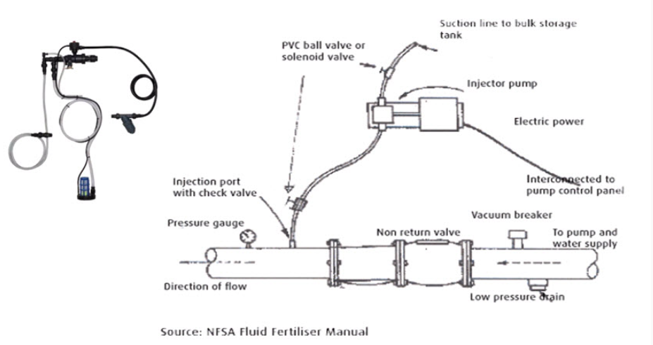
Fertilizer Injection Pump

Slide 12
Fertilizer Injection Pump
Advantages
Uniform nutrient concentration along the fertigation process
Easy control of amount and concentration of the nutrient solution
Convenient integration with automation
No pressure losses
Limitations
High initial cost
Complicated operation
Wear of moving components
Suitable only with fertilizer solutions
Some models need external power source
Some models emit surplus driving-water outside

Slide 13
!!!-Thank You-!!!

