Slide 1
Perovskites Photo-Voltaics
Lecture-17
Dr. Satyanarayan Dhal
Notes:
NOTE:
To change the image on this slide, select the picture and delete it. Then click the Pictures icon in the placeholder to insert your own image.

Slide 2
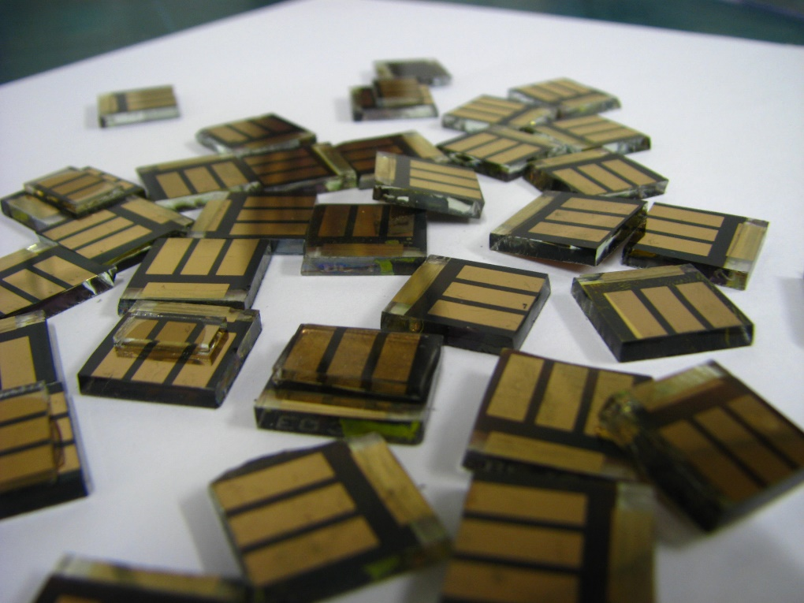
Why Perovskite solar cells ?
Thermoelectric
Piezoelectric,
Semi conductivity
Superconductivity
CH₃NH₃PbX₃(X = Cl, Br, I) : Out-standing perovskite materials, for PV applications.
Reason : (i) uplifted mobilities and diffusion lengths of electron and hole,
(ii) lower surface recombination rate and favorable grain boundary effects,
(iii) high optical absorptivity due to s-p antibonding coupling,
(iv) surpassing structural defect tolerance,
(v) electrically clear defect characteristics, comprising point defects and grain boundaries.
Pb-halide perovskite SCs have achieved efficiency approximating 20.1%.
This Photo by Unknown Author is licensed under CC BY-SA

Slide 3
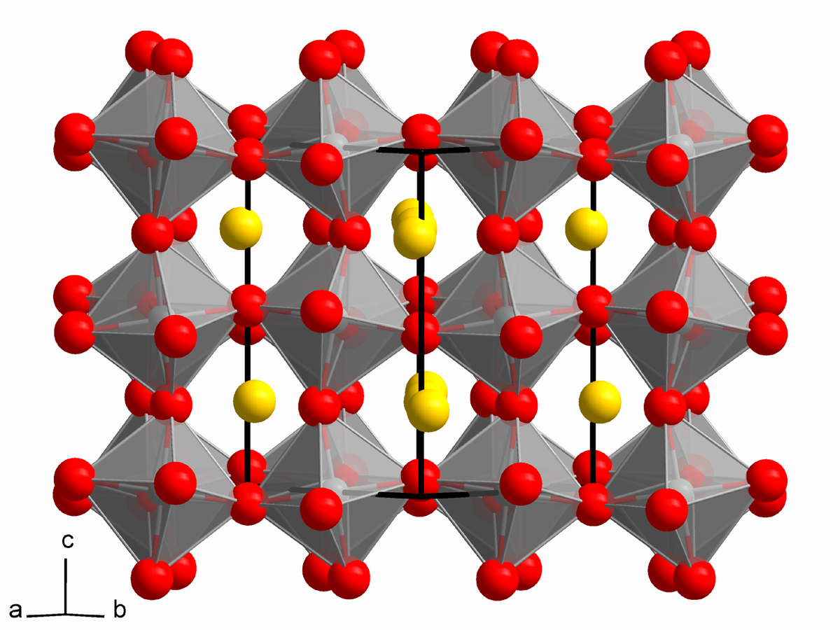
Structure of perovskite materials
AMX₃(X = oxygen, or halogen).
Cation A is occupied in a cubo-octahedral site.
Cation B is occupied in an octahedral site.
When X is O²⁻, A and B are generally divalent and tetravalent.
When X is a halogen anion then A and B sites are monovalent and divalent cations.
E.g. CH₃NH₃PbX₃ perovskite.
This Photo by Unknown Author is licensed under CC BY-SA

Slide 4
formability of perovskite materials
A dimensionless number called Goldschmidt tolerance factor(t)
Indicator of crystal stability and it’s structure deformity.
and is given by
r_{A} is the radius of the cation A,
r_{M} is the radius of the cation B.
r_{X} is the radius of X anion.
This Photo by Unknown Author is licensed under CC BY-SA

Slide 5
Crystal Structure of perovskite materials & Transformations
Cubic (At normal temperature)
Tetragonal
Orthorhombic
State transformations from cubic structure to tetragonal then to orthorhombic with decreasing temperatures.
More symmetric as one increases temperature.
This Photo by Unknown Author is licensed under CC BY-SA

Slide 6
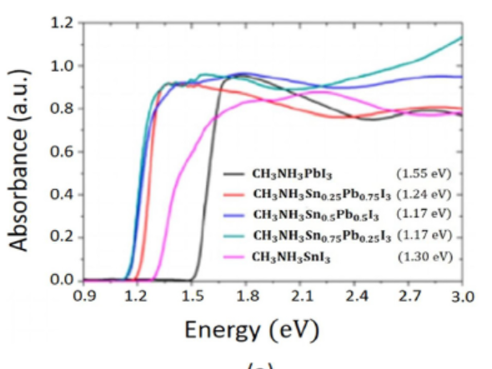
Bandgap tuning of perovskite materials
Hybrid perovskites show high optical absorptivity
Applicable for much thinner solar films for harvesting effectively solar radiation.
500 nm thicker film of perovskite material is sufficient for whole visible spectrum.
Perovskites MAPbI₃ and MASnI₃ exhibit sharp absorption peak signifying direct band gap, 1.50–1.55 eV.

Slide 7
Why Bandgap tuning of perovskite materials
To stretch the absorption spectrum towards Lower frequency region with no effect on absorption coeffi-cient.
How we can tune the bandgap??
(i) Replacing cation MA with other organic cations;
i.e. organic cations in A position of ABX₃ can modify the gap in band since they alter the M − X − M bond length and bond angle.
They do not modify valence band maximum.

Slide 8
Why Bandgap tuning of perovskite materials
If we substitute Sn into Lead in CH₃NH₃PbI_{3,} the gap in band reduces from 1.55eV to 1.17eV.
If we directly change the M − X bond, the valence band maxi-mum (VBM) and conduction band minimum (CBM), will change.
Similarly, we can change the halide of the M − X bond alters the bandgap.

Slide 9
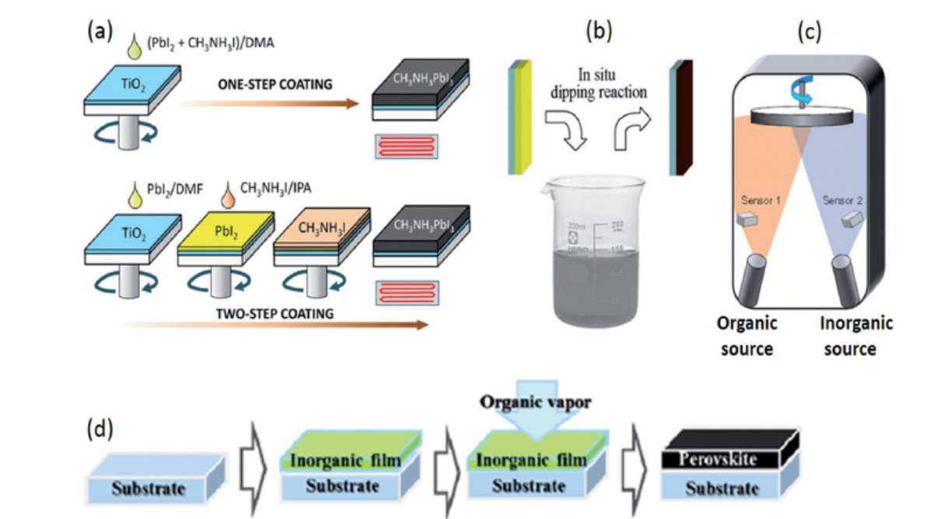
Preparation methods of perovskite films
one-step and two-step sequential deposition techniques
solution processing
vapour deposition
hybrid vapour-solution processing

