Slide 1
Quantum Dot Photo-Voltaics
Lecture-17
Dr. Satyanarayan Dhal
Notes:
NOTE:
To change the image on this slide, select the picture and delete it. Then click the Pictures icon in the placeholder to insert your own image.

Slide 2
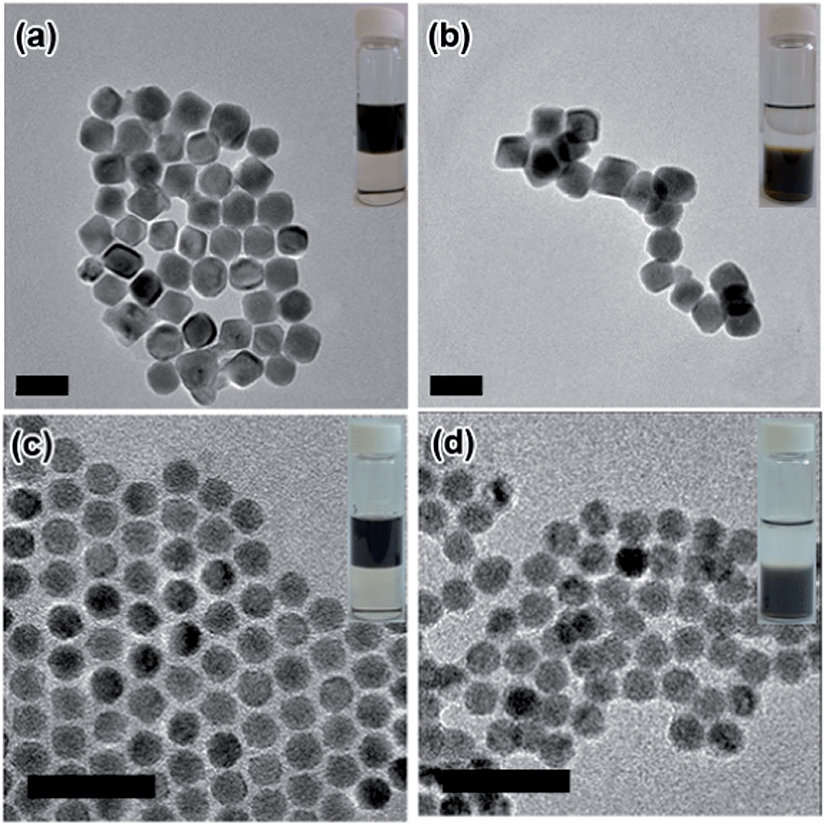
What is a Quantum Dot ?
Tiny semiconductor particles a few nanometres.
Electron in the quantum dot can be excited to a state of higher energy.
The excited electron can drop back into the valence band releasing its energy by the emission of light (photoluminescence).
The color of that light depends on the energy difference between the conductance band and the valence band.
Semiconductor materials tightly confine either electrons or electron holes.
Quantum dots (artificial atoms), having bound, discrete electronic states
Their optoelectronic properties change as a function of both size and shape.
This Photo by Unknown Author is licensed under CC BY

Slide 3
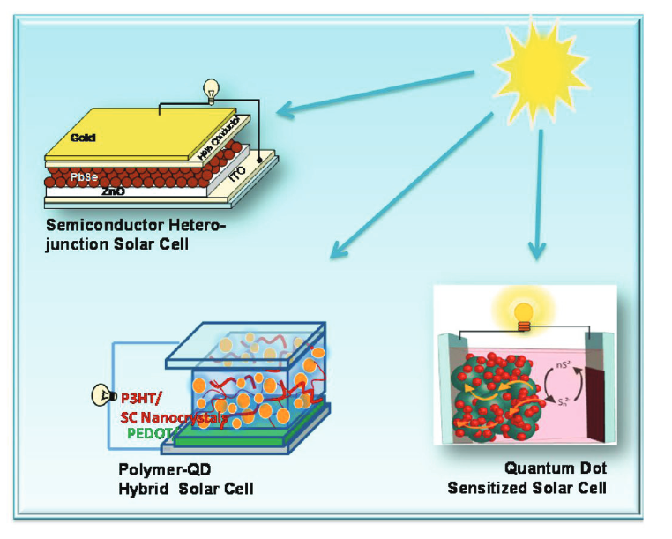
QDSC
Manipulation of photoinduced charge separation in semiconductor QDs.
Transport across the interface dictate the performance of QDSC.
Schematic illustration of a semiconductor-nanostructure-based next-generation solar cells

Slide 4
QDSC
The power conversion efficiency of liquid junction QDSC has increased from 1 to 5% during last couple of years.
Efficiencies in the range of 7% have also been reported for solid-state QDSC.
Will QDSC emerge as The Next Big Thing in Photovoltaics?
Schematic illustration of a semiconductor-nanostructure-based next-generation solar cells

Slide 5
Designing Photoactive Nanostructured Semiconductor Electrodes
The proper assembly and ordering of semiconductor QDs in a mesoscopic oxide film is an essential criterion for designing QDSC.
The mesoscopic TiO₂ and ZnO films (5−10μm thick) are cast on optically transparent electrodes (OTE).
These electrodes are modified with QDs so that they serves as light energy harvesters and convert incident photons to electricity.
Schematic illustration of a semiconductor-nanostructure-based next-generation solar cells

Slide 6
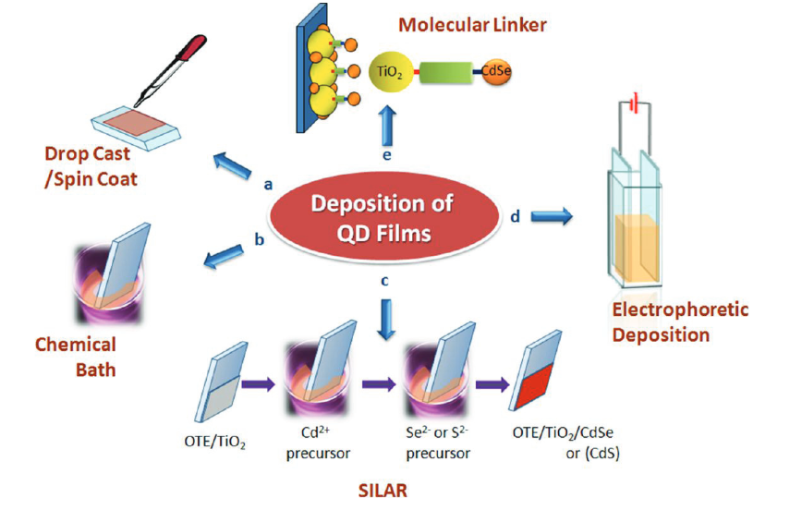
Designing Photoactive Nanostructured Semiconductor Electrodes
A majority of the solid-state QDSC employ photoanodes prepared by the drop casting or spin coating method.
Known amount of the colloidal QD suspension is added onto the electrode surface, and the film is dried in a controlled way.
The chemical bath deposition and surface ionic layer adsorption and reaction (SILAR) employ reactant precursors in solution that react on the electrode surface.
Schematic illustration of a semiconductor-nanostructure-based next-generation solar cells

Slide 7
Designing Photoactive Nanostructured Semiconductor Electrodes
The growth of crystallites is controlled by the time of reaction or number of cycles of the SILAR process.
Electrophoretic deposition = by applying a DC electric field between two electrodes immersed in a QD suspension.
linker-assisted attachment of QD particles to the oxide surface. This method allows selective attachment of pre synthesized metal chalcogenide QDs(e.g., CdS, CdSe) to an oxide surfaces (e.g., TiO2or ZnO) using a bifunctional linker molecule such as 3-mercaptopropionicacid.
Schematic illustration of a semiconductor-nanostructure-based next-generation solar cells

Slide 8
Solar Cell Assembly and Performance Evaluation.
QD photovoltaics
solid-state semiconductor heterojunction solar cells (SHJSC)
liquid junction solarcells or QD-sensitized solar cells (QDSC)
Both types of solar cells offer the convenience of benchtop fabrication with minimal necessity for a clean room or controlled atmosphere during solar cell assembly.

Slide 9
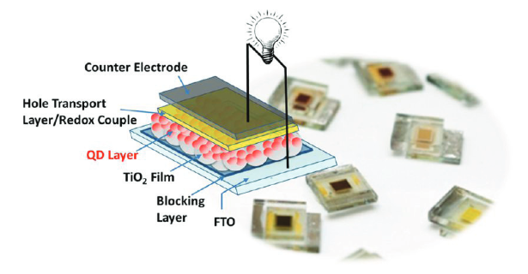
Solar Cell Assembly and Performance Evaluation.
The hole transport layer is a redox electrolyte in liquid junction solar cells and a solid-state hole-transporting layer in heterojunction solar cells.
The background image shows a few QDSC samples prepared with an active QD layer (∼0.25 cm2area) sandwiched between the two OTE and the redox electrolyte.

Slide 10
Solar Cell Assembly and Performance Evaluation.
The majority of the published work on SHJSC has centered on lead chalcogenides.
Both PbS and PbSe QDs deposited on mesoscopic TiO₂ or ZnO film serve as the photoanode.
CdSe, Sb₂S₃, CIGS, have also been employed as photon harvesters.
A thin layer of metal (e.g., Au or Ag) is deposited on top of the hole transport layer to make the electrical contact.
Upon photoexcitation of the semiconductor QDs, the electrons are driven toward the oxide layer, and the holes are driven toward the metal contact and thus generate photocurrent.

Slide 11
The principle of operation of QDSC
Most of the QDSC fabrication reported to date employs CdSe and CdS semiconductor QDs that are deposited on mesoscopic oxide films.
The sulfide/polysulfide electrolyte acts as a hole-transporter.
The casting of a blocking layer on the FTO surface(10−20 nm thick layer of close packed TiO2) before the deposition of mesoscopic TiO2films is important to achieve higher photovoltage.
Cu2S-based counter electrodes that exhibit redox activity toward the S2−/Sn2−couple deliver higher fill factors and steady photocurrent with good photostability.

Slide 12
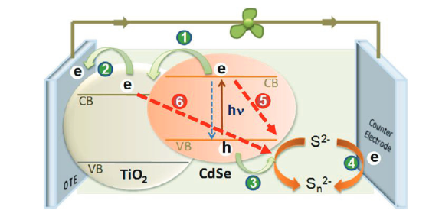
Interfacial Charge-Transfer Processes Dictating the QDSCPerformance.
photoinduced charge-transfer processes following a laser pulse excitation:
(1) Charge injection from excited CdSe into TiO2;
(2) transport of electrons to the collecting electrode surface;
(3) hole transfer to the redox couple;
(4)regeneration of the redox couple;
(5) recombination of electrons from CdSe and the oxidized form of the redox couple;
(6)interfacial recombination of electrons from TiO2and the oxidized form of the redox couple.

Slide 13
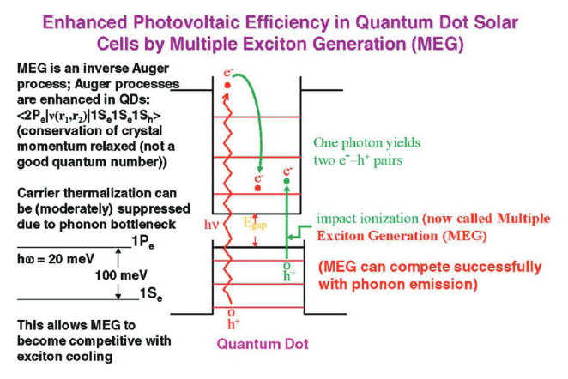
Emerging Strategies to Boost the Solar Cell Performance.
Multiple Exciton Generation (MEG) and Hot ElectronTransfer
Plasmonic Solar Cells
Supersensitization of QDs with Dye Molecules.
Tandem Layered QDSC.

Slide 14
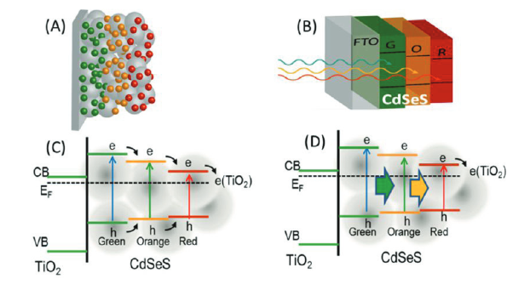
Emerging Strategies to Boost the Solar Cell Performance.
Multiple Exciton Generation (MEG) and Hot ElectronTransfer
Plasmonic Solar Cells
Supersensitization of QDs with Dye Molecules.
Tandem Layered QDSC.

Slide 15
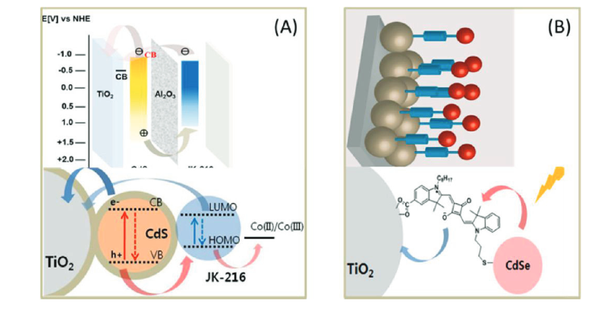
Emerging Strategies to Boost the Solar Cell Performance.
Multiple Exciton Generation (MEG) and Hot ElectronTransfer
Plasmonic Solar Cells
Supersensitization of QDs with Dye Molecules.
Tandem Layered QDSC.

Slide 16
Conclusion
QDSC development offer new opportunities.
Recent efforts to develop a solar paint with semiconductor nanocrystals highlights the concept of a viable transformative approach.
Solar ink printing and reel-to-reel flexible photovoltaics also offer similar opportunities.

Slide 17
References
Quantum Dot Solar Cells.The Next Big Thingin PhotovoltaicsPrashantV.Kamat* J.Phys.Chem.Lett.2013, 4, 908−918

