Slide 1
Nano-Catalysts for Hydrogen Production
Lecture-27
Dr. Satyanarayan Dhal
Notes:
NOTE:
To change the image on this slide, select the picture and delete it. Then click the Pictures icon in the placeholder to insert your own image.

Slide 2
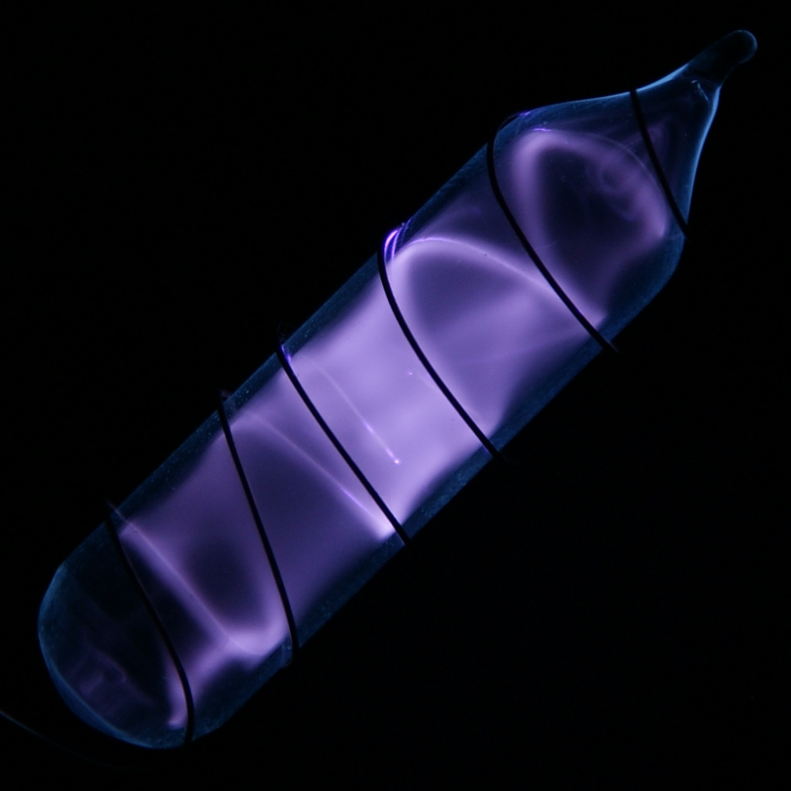
Why Hydrogen Gas ?
Green house gases such as CO2, CH4, nitrous oxide and CFCs are emitted into the atmosphere each day.
Adverse impacts on the atmosphere
H, great potential to become a widespread, clean and sustainable form of energy.
Potential of H: reproducibility, high energy density, renewable.
This Photo by Unknown Author is licensed under CC BY

Slide 3
Current Situation
Currently, more than 96% of the hydrogen is derived from fossil fuels.
Reason : lower cost of production.
But H should be produced from the renewable energy sources.
Large scale production technologies are required.
This Photo by Unknown Author is licensed under CC BY

Slide 4
Nanotechnology can help !!!
Significant part of the hydrogen economy.
Hydrogen production is a critical factor
Nanotechnology, is to face the challenges in existing production.
This Photo by Unknown Author is licensed under CC BY

Slide 5
How we can produce HYDROGEN ???
(i) hydrogen production by the direct reaction of chemical reagents including metals, acids and bases;
(ii) hydrogen production from hydrocarbons including fossil fuels and biomass;
(iii) hydrogen production by the direct splitting of water.
H Production
secondary energy sources
primary
energy sources
fossil fuels
Electricity
chemical energy
Solar energy
wind energy
biomass

Slide 6
Hydrogen Through Direct Reaction of Chemicals
Reactions can be roughly classified into three categories:
(1) Reactions involving acids,
(2) Reactions involving bases,
(3) Reactions between water and reactive metals.
This Photo by Unknown Author is licensed under CC BY

Slide 7
Hydrogen from Hydrocarbons
Hydrogen from Hydrocarbons
Hydrogen from Fossil Fuels
Nanotechnology and Hydrogen from Fossil Fuels
Hydrogen from Biomass
Nanotechnology and Hydrogen from Biomass

Slide 8
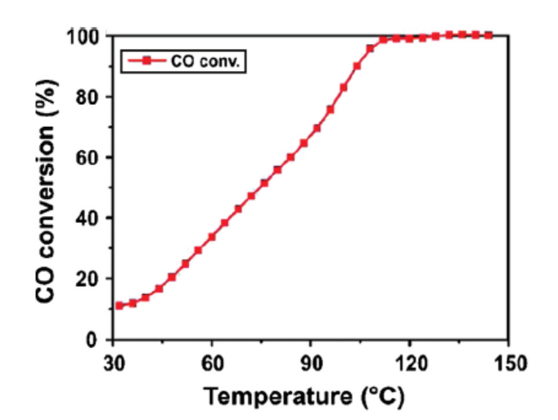
Nanotechnology and Hydrogen from Fossil Fuels
Researchers in the University of Pennsylvania synthesized :
Pd@CeO2 core-shell-nanostructured dispersible material
A catalyst precursor in the methanol steam reforming reactions.
The nanostructure is prepared by
a solution precipitation method
solution evaporation

Slide 9
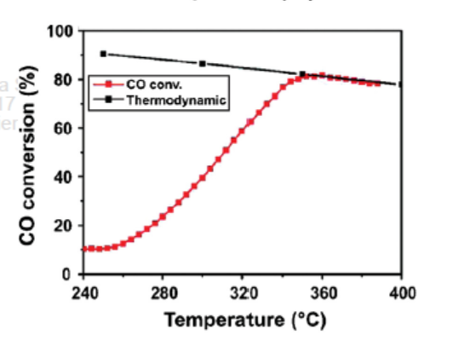
Nanotechnology and Hydrogen from Fossil Fuels
This synthesized Pd@CeO2 nanostructure could not be used as a steam reforming catalyst alone
Al2O3 substrate is necessary as a support for the catalytic function.
The Pd@CeO2/Al2O3 catalysts

Slide 10
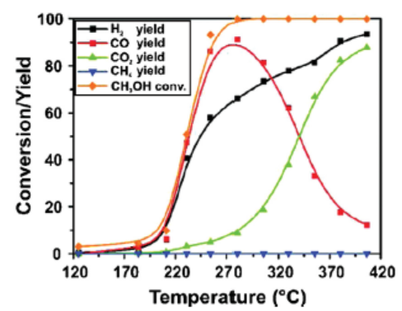
Nanotechnology and Hydrogen from Fossil Fuels
Researchers tested the above catalyst in methanol steam reforming reactions.
very promising activity on all yields including that of H2.

Slide 11
Some More nanostructured catalysts
Nanopowder of zirconia: For the steam reforming of bio-ethanol
Indium oxide

Slide 12
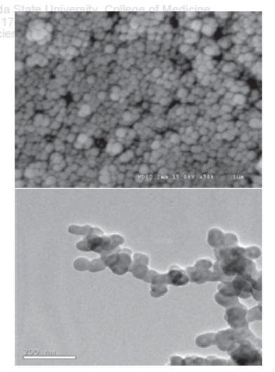
Nanotechnology and Hydrogen from Biomass
Nano- Ni-La-Fe/-Al2O3, a supported tri-metallic catalyst for tar removal in biomass steam gasification is developed to enhance the quality of the produced gas.
The activity and the performance of the nanostructured tri-metallic catalyst in the application of biomass gasification are evaluated by comparing the cases.
SEM image of the supported tri-metallic catalyst surface
and TEM micrograph of nano-particles on the tri-metallic catalyst surface (right).
Ref: J. Li, BioResources 4, 1520 (2009). © 2009, BioResources.

Slide 13
Nanotechnology and Hydrogen from Biomass
The tar yield after adding catalyst was reduced significantly, with the tar removal efficiency reaching 99% for catalytic gasification at 800 Deg, while the gas yield markedly increased with adding catalyst.
The percentages of C2 and CH4 in the product gas after catalysis were reduced, while that of the valuable H2 increased markedly to over 10 vol.% due to catalysis.
SEM image of the supported tri-metallic catalyst surface
and TEM micrograph of nano-particles on the tri-metallic catalyst surface (right).
Ref: J. Li, BioResources 4, 1520 (2009). © 2009, BioResources.

Slide 14
Hydrogen Production by Direct Splitting of Water
Electrolysis of water is an easy way to produce hydrogen.
The transformation of energy from electricity to hydrogen is not efficient, and electricity itself is not an ultimate energy source in nature.
Thermolysis of water is the thermal decomposition of water at very high temperature.
It uses heat as the energy source.
For water alone, the temperature required (2000 C∼3000 C) is too high for any practical use.

Slide 15
Hydrogen Production by Direct Splitting of Water
Catalysts can accelerate the dissociation of the water molecules at lower temperatures.
Photoelectrochemical water splitting revealed the possibility of generating hydrogen through solar energy.

Slide 16
Nanotechnology for the Decomposition of Water
In direct thermolysis and high temperature cycles, the separation of hydrogen and oxygen at that high temperature (T >2500 K) is the most severe problem.
If the separation is not done properly, the two gases may recombine into water again, or form a very explosive mixture when the temperature is relatively lowered.
To overcome this problem, porous ceramic membranes are developed.
E.g. Zirconia

Slide 17
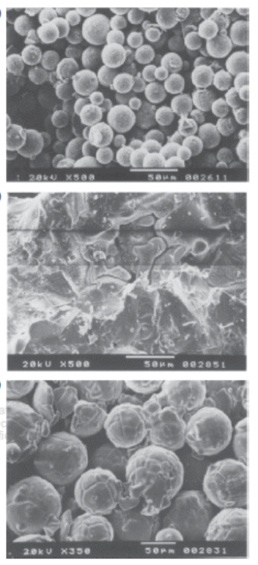
Nanotechnology for the Decomposition of Water
Zirconia is frequently used due to both its high melting temperature to withstand the harsh condition in the reactor and its excellent hydrogen permeability.
Researchers in Israel used sol–gel method for preparing homogeneous powders of relatively large spherical zirconia particles.
Their attempts are partially successful in bridging the gap between the normal sintering temperature of stabilized zirconia and the reactor operating temperature.
A. Kogan,
Int. J. Hydrogen Energ. 25, 1043 (2000). © 2000, Elsevier.

Slide 18
CONCLUSION
The methods of hydrogen production from fossil fuels, including the catalytic decomposition and steam reforming of natural gas, the partial oxidation of heavy oil and coal gasification, are very effective.
The gasification of biomass would become an increasingly more important way of hydrogen production
Nanotechnology is expected to play an important role in this process.
Direct water-splitting, especially with renewable energy, is supposed to be one of the most effective solutions to the problems of carbon emission and global warming.
Nanomaterials and nanotechnology have a great role to play not only in the application of the hydrogen production but also in the hydrogen energy storage.

Slide 19
References
1. J. Nanosci. Nanotechnol. 11, 3719–3739, 2011

