Slide 1
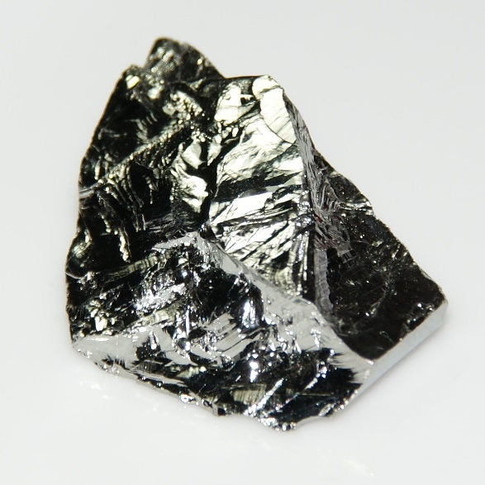
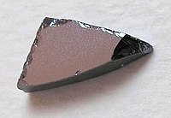
Direct Bandgap & Indirect Bandgap Semiconductor
Lecture-3
Ge
GaAs
This Photo by Unknown Author is licensed under CC BY-SA
This Photo by Unknown Author is licensed under CC BY-SA
Dr. Satyanarayan Dhal
Notes:
NOTE:
To change the image on this slide, select the picture and delete it. Then click the Pictures icon in the placeholder to insert your own image.

Slide 2
What and Why Semiconductors ?
Q: Semiconductors :
Resistivity at Room Temperature : 10⁻² to 10⁹ ohm-cm (depends on T)
Q: Insulators :
Resistivity at Room Temperature : 10¹⁴ ohm-cm
Q: Why do we read about semiconductors ?
A: Applications in photovoltaic cells, detectors, transistors, optoelectronic applications

Slide 3
Nomenclature
AB
III-V
II-VI
InSb, GaAs
ZnS, CdS

Slide 4
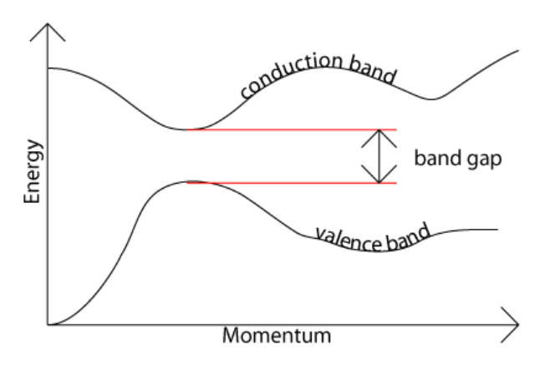
—
Direct Band-Gap Semiconductor
Generally, the top of the valence band and the bottom of the conduction band are not generally at the same value of the electron momentum.
Here, the valence band and the bottom of the conduction band occur at the same value of momentum.
A photon of energy Eg, can create an electron-hole pair in a direct band gap semiconductor .
Reason : Electron does not need to be given very much momentum.
Ref : https://www.doitpoms.ac.uk/tlplib/semiconductors/direct.php

Slide 5
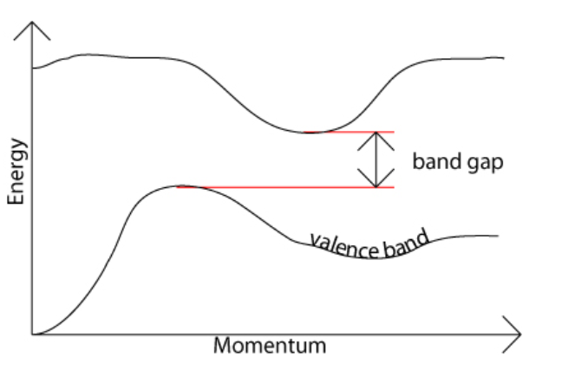
—
Indirect Band-Gap Semiconductor
In an indirect band gap semiconductor, the maximum energy of the valence band occurs at a different value of momentum to the minimum in the conduction band energy below.
The difference between the two is most important in optical devices. As has been mentioned in the section charge carriers in semiconductors, a photon can provide the energy to produce an electron-hole pair.
Each photon of energy E has momentum p = E /c, where c is the velocity of light. An optical photon has an energy of the order of 10^{–19} J, and, since c = 3 × 10⁸ ms^{–1}, a typical photon has a very small amount of momentum.
Ref : https://www.doitpoms.ac.uk/tlplib/semiconductors/direct.php

Slide 6
—
Indirect Band-Gap Semiconductor
In an indirect band gap semiconductor, an electron must also undergo a significant change in its momentum for a photon of energy Eg to produce an electron-hole pair.
It needs an electron to interact not only with the photon to gain energy, but also with a phonon in order to either gain or lose momentum.
Proceeds at a much slower rate, as it requires three entities to intersect in order to proceed: an electron, a photon and a phonon.
Ref : https://www.doitpoms.ac.uk/tlplib/semiconductors/direct.php

Slide 7
—
Why GaAs is used to make optical devices such as LEDs and semiconductor lasers, whereas Si is not ?
The same principle applies to recombination of electrons and holes to produce photons.
The recombination process is much more efficient for a direct band gap semiconductor than for an indirect band gap semiconductor, where the process must be mediated by a phonon.
Ref : https://www.doitpoms.ac.uk/tlplib/semiconductors/direct.php

Slide 8
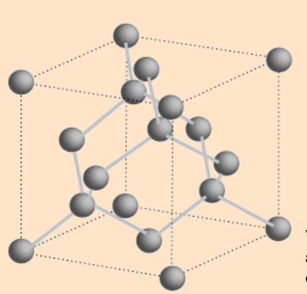
Silicon (Crystal structure of Diamond)
This Photo by Unknown Author is licensed under CC BY-SA

Slide 9
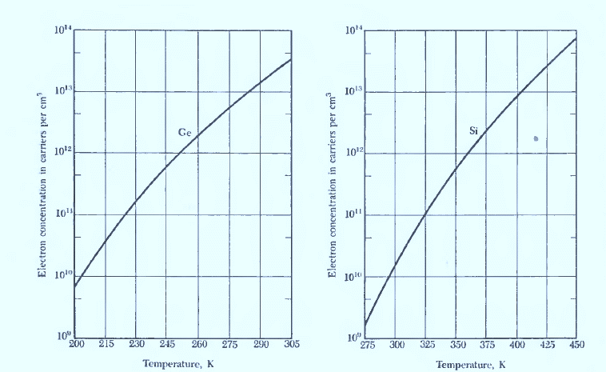
Intrinsic Electron Concentration as a function of T !
Under intrinsic conditions, the hole concentration is equal to the electron concentration.
The intrinsic concentration at a given temperature is higher than Ge than in Si because the energy gap is narrower in Ge than in Si.
Ge
Si
Ref. C. Kittel

Slide 10
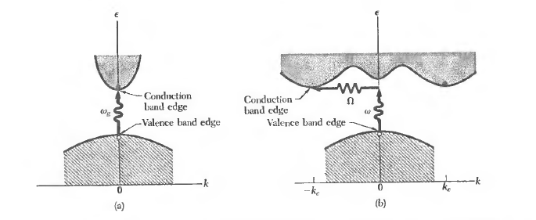
Contd.
The lowest point in the conduction band is called conduction band edge.
The highest point in the valence band
is called valence band edge.
(a) The lowest point of the conduction band occurs at the same k as the highest point of the valence band.
Ref. C. Kittel

Slide 11
Contd.
Eg/ kT : The ratio of band-gap to temperature
Intrinsic carriers concentration will be low, if Eg/ kT is large.
The threshold of continuous optical absorption at frequency $w$ determines the band gap.
What happens in a direct absorption process ?
Photon is absorbed by the crystal with an electron-hole pair.
What happens in a indirect absorption process ?
The min. energy gap of the band structure involves electrons and holes separated by k.

Slide 12
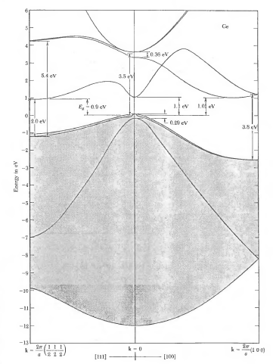
Band structure of Ge
The four valence bands are in gray.
The fine structure of the valence band edge is caused by spin-orbit splitting.
The energy gap is indirect
The band edge is at the point (2π/a)(1/2,1/2, 1/2).
The constant energy surfaces around this point are ellipsoidal.
Ref. C. Kittel

Slide 13
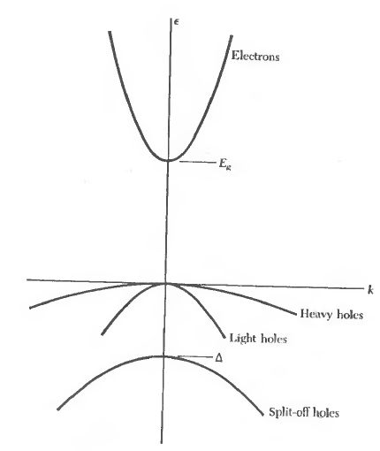
Band edge structure of a Direct Band Gap Sc
The conduction band edge is spherical with
the effective mass m_{e.}
The valence bands are characteristically 3 fold near the edge, with the heavy hole hh and light hole lh bands degenerate at the center
A band soh split off by spin-orbit splitting .
Ref. C. Kittel

Slide 14
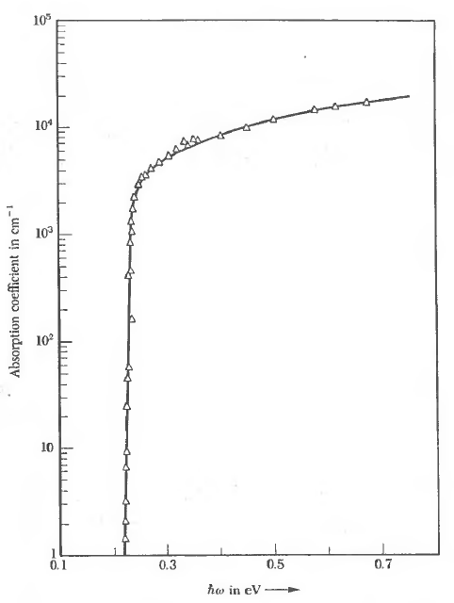
Optical Absorption
Optical absorption in pure indium antimonide, InSb.
The transition is direct because both conduction and valence band edges are at the center of the Brillouizin zone, k = 0.
Ref. C. Kittel

Slide 15
Interesting Feature
In some materials with an indirect gap, the value of the gap is negative.
The top of the valence band is higher than the bottom of the conduction band in energy.
Such materials are known as semimetals.
Need exploration more ???

Slide 16
Further Reading ….
Ashcroft, N. W. and Mermin, N. D., Solid State Physics, Saunders, 1976.
Kittel, Charles, Introduction to Solid State Physics, 7th Ed., Wiley, (1996).

