Slide 1
P-N JUNCTION
Lecture-5
Dr. Satyanarayan Dhal
Notes:
NOTE:
To change the image on this slide, select the picture and delete it. Then click the Pictures icon in the placeholder to insert your own image.

Slide 2
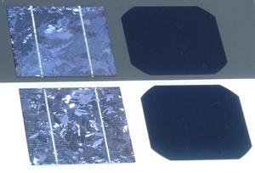
Types of Semiconductor junctions
ALL PV cells comprise of junctions between (different) materials of different doping.
p-n homojunction : fabricated in the same semiconductor material, such as c-Si.
p-n heterojunction : fabricated by two chemically different semiconductors.
p-i-n junction: Region of the internal electric field is enhanced by inserting an intrinsic, i, layer between the p-type and the n-type layers.
Metal-Semiconductor Junction : The Schottky barrier formed at the metal-semiconductor interface.
This Photo by Unknown Author is licensed under CC BY-SA
p-n homojunction

Slide 3
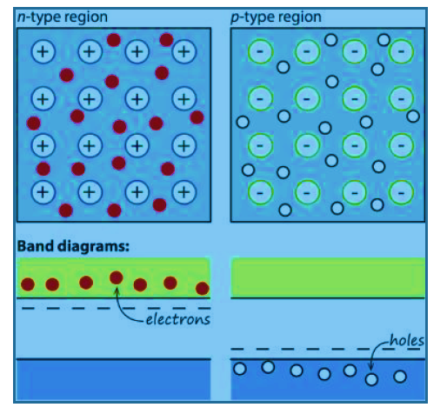
p-n homojunctions
How a space-charge region is formed in the p-n junction ?
In the n-type semiconductor, the majority free electrons is compensated by positively-charged ionized donor atoms.
In the p-type semiconductor, the majority holes is compensated by ionized acceptor atoms.
Isolated pieces of a p-type and an n-type semiconductor and their corresponding band diagrams.

Slide 4
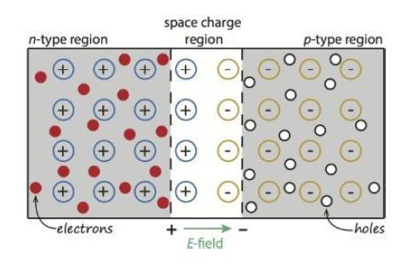
p-n homojunctions
When a p-type and an n-type semiconductor are brought together?
the space-charge region or depleted region
A diffusion current of electrons from the n-type material across the metallurgical junction into the p-type material.
Similarly, diffusion current of holes from the p- to the n-type material.
What happens because of this diffusion process ?
Ans:
Region close to the metallurgical junction becomes almost completely depleted of mobile charge carriers.
The gradual depletion of the charge carriers gives rise to a space charge created by the charge of the ionized donor and acceptor atoms that is not compensated by the mobile charges any more.
quasi-neutral regions : outside the depletion region, in which the charge neutrality is conserved.
metallurgical junction
= interface between the n- and p-type regions

Slide 5
p-n homojunctions
Results :
the space-charge region or depleted region
The space charge creates internal electric field which forces the charge carriers to move in the opposite direction than the concentration gradient.
The diffusion currents continue to flow until the forces acting on the charge carriers, namely the concentration gradient and the internal electrical field, compensate each other.
The driving force for the charge transport does not exist any more and no net current flows through the p-n junction.
metallurgical junction
= interface between the n- and p-type regions

Slide 6
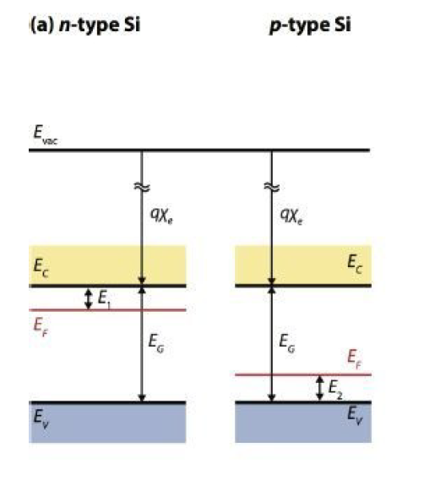
p-n homojunctions
Under the equilibrium Condition
Vacuum energy level Evac is aligned.
This energy level represents the energy just outside the atom, if an electron is elevated to Evac it leaves the sphere of influence of the atom.
Electron affinity χe is the potential that an electron present in the conduction band requires to be elevated to an energy level just outside the atom, i.e. Evac.
The energy band diagrams of an n- and a p-type material that are separated from each other.

Slide 7
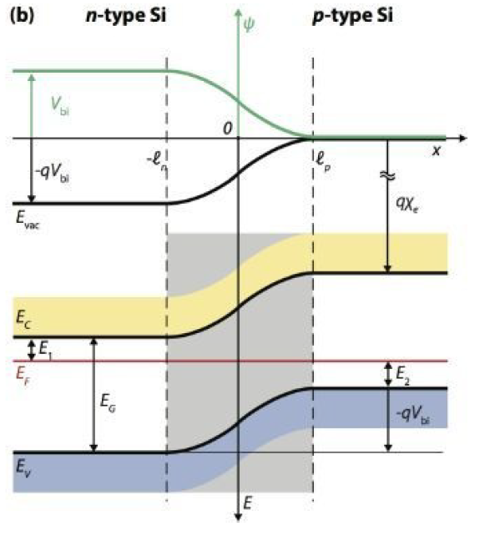
p-n homojunctions
Under the equilibrium Condition
Fermi energy is constant across the junction, not the vacuum energy.
Why ?? Fermi energy denotes the “filling level” of electrons, this is the level that is constant throughout the junction.
E_{C} and E_{V} and Evac must be continuous. Hence, the bands get bended, which indicates the presence of an electric field in this region.
The energy-band diagram of the p-n junction under equilibrium.

Slide 8
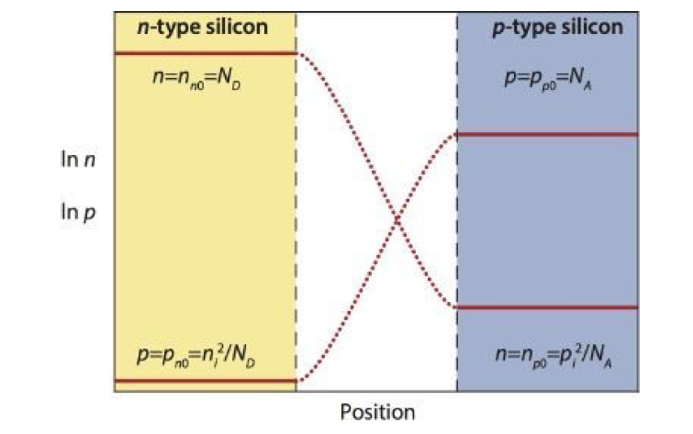
p-n homojunctions
Under the equilibrium Condition
In the quasi-neutral regions, the concentration of electrons and holes is the same as in the isolated doped semiconductors.
In the space-charge region the concentrations of majority charge carriers decrease very rapidly.
The space charge in this region is fully determined by the ionized dopant atoms fixed in the lattice.
Concentrations profile of mobile charge carriers in a p-n junction under equilibrium.

Slide 9
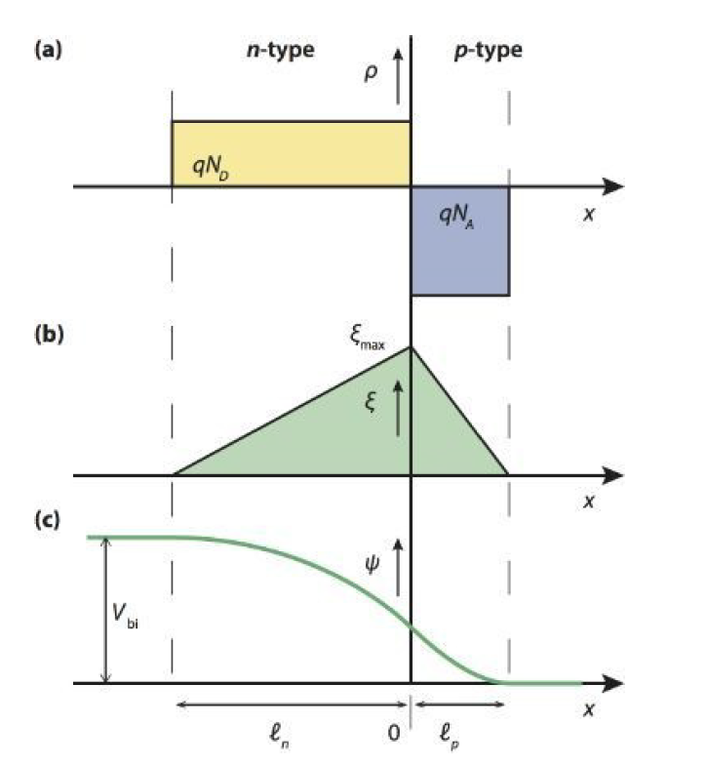
p-n homojunctions
Under the equilibrium Condition
Electrostatic potential difference, V_{bi}, across the space-charge region.
Depletion approximation : space-charge density, ρ, is zero in the quasi-neutral regions and it is fully determined by the concentration of ionized dopants in the depletion region.
N_{D} = In the depletion region of the n-type semiconductor it is the concentration of positively charged donor atoms, which determines the space charge in this region.
N_{A} = In the p-type semiconductor, the concentration of negatively charged acceptor atoms, determines the space charge in the depletion region.
Assume that : p-n junction is a step junction; it means that there is an abrupt change in doping at the metallurgical junction and the doping concentration is uniform both in the p-type and then-type semiconductors.
Concentrations profile of mobile charge carriers in a p-n junction under equilibrium.

Slide 10
A Numerical !!!!
A crystalline silicon wafer is doped with 10¹⁶ acceptor atoms per cubic centimetre. A 1 micrometer thick emitter layer is formed at the surface of the wafer with a uniform concentration of 10¹⁸ donors per cubic centimetre.
Assume a step p-n junction and that all doping atoms are ionized. The intrinsic carrier concentration in silicon at 300 K is 1.5 · 10¹⁰ cm⁻³.
calculate the electron and hole concentrations in the p- and n-type quasi-neutral regions at thermal
equilibrium.

Slide 11
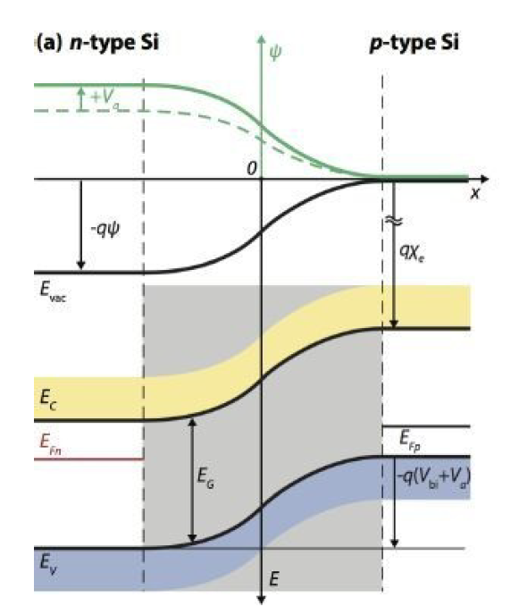
What happens to p-n junction under applied voltage ??
When an external voltage, V_{a}, is applied to a p-n junction
The potential difference between the n- and p-type regions will change and the electrostatic potential across the space charge region will become (V_{bi} − V_{a}).
Under equilibrium the built-in potential is negative in the p-type region with respect to the n-type region.
When the applied external voltage is negative with respect to the potential of the p-type region, the applied voltage will increase the potential difference across the p-n junction.
This situation is p-n junction under reverse-bias voltage.
The potential barrier across the junction is increased under reverse-bias voltage, which results in a wider space-charge region.
Energy band diagram and electrostatic-potential (in green) of a p-n junction under reverse bias

Slide 12
What happens to p-n junction under applied voltage ??
Under external voltage,
the p-n junction is no longer under equilibrium any more
the concentrations of electrons and holes are described by the quasi-Fermi energy for electrons, E_{Fn}, and the quasi-Fermi energy for holes, E_{Fp}, respectively.
Energy band diagram and electrostatic-potential (in green) of a p-n junction under reverse bias

Slide 13
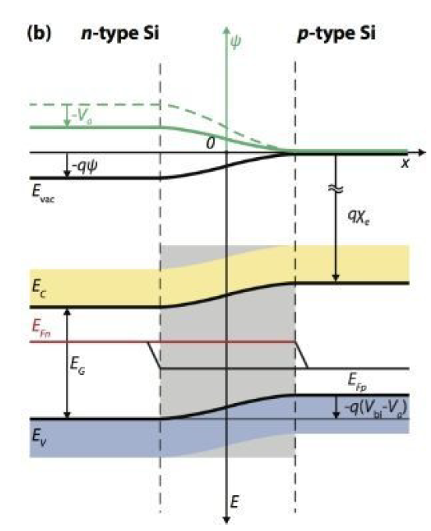
What happens to p-n junction under applied voltage ??
When the applied external voltage is positive with respect to the potential of the p-type region, the applied voltage will decrease the potential difference across the p-n junction.
This situation as p-n junction under forward-bias voltage.
The potential barrier across the junction is decreased under forward-bias voltage and the space–charge region becomes narrower.
The balance between the forces responsible for diffusion (concentration gradient) and drift (electric field) is disturbed.
Lowering the electrostatic–potential barrier leads to a higher concentration of minority carriers at the edges of the space-charge region compared to the situation in equilibrium.
This process is referred to as minority-carrier injection.
This gradient in concentration causes diffusion of the minority carriers from the edge into the bulk of the quasi-neutral region.
Energy band diagram and electrostatic-potential (in green) of a p-n junction under foraward bias

Slide 14
Boltzmann approximation
The diffusion of minority carriers into the quasi-neutral region causes a so-called recombination current density, J_{rec}, since the diffusing minority carriers recombine with the majority carriers in the bulk.
The recombination current is compensated by the socalled thermal generation current, J_{gen}, which is caused by the drift of minority carriers.
These are present in the corresponding doped regions (electrons in the p-type region and holes in the n-type region), across the junction.
Both the recombination and generation current densities have contributions from electrons and holes.
When no voltage is applied to the p-n junction, the situation inside the junction can be viewed as the balance between the recombination and generation current densities,
when a moderate forward-bias voltage is applied to the junction the recombination current density increases with the Boltzmann factor exp(eVa/kBT),
Energy band diagram and electrostatic-potential (in green) of a p-n junction under foraward bias

Slide 15
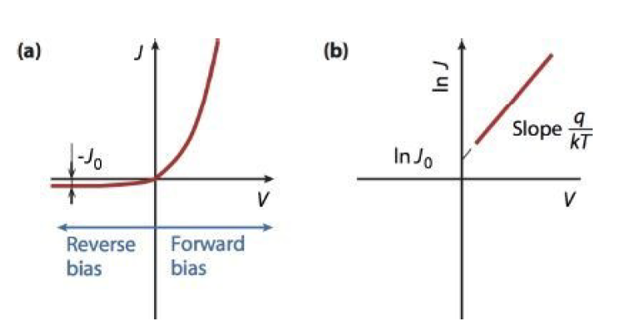
Shockley equation
The external net current density
where J0 is the saturation current density of the p-n junction
Shockley equation describes the current–voltage behaviour of an ideal p-n diode.
Fundamental equation for microelectronics device physics.
The saturation current density is also known as dark current density
The current density-voltage (J-V) characteristic of an ideal p-n junction

Slide 16
References:
Arno HM Smets, Klaus Jäger, Olindo Isabella, René ACMM van Swaaij, Miro Zeman; UT Camnridge

