Slide 1
Solar Cell Parameters
Lecture-7
Dr. Satyanarayan Dhal
Notes:
NOTE:
To change the image on this slide, select the picture and delete it. Then click the Pictures icon in the placeholder to insert your own image.

Slide 2
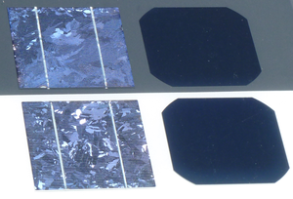
External solar cell parameters
Performance
peak power P_{max},
short circuit current density J_{sc}
open circuit voltage V_{oc}
fill factor Voltage FF,

Slide 3
Standard test conditions
Total irradiance on the solar cell that should be measured is equal to 1000 W/m².
Temperature of the solar cell should be kept constant at 25 °C.

Slide 4
Short circuit current density (I_{sc})
Defn : - The current that flows through the external circuit when the electrodes of the solar cell are short circuited.
The short circuit current of a solar cell depends on the photon flux incident on the solar cell.
I_{sc} depends on the area of the solar cell.
The maximum current that the solar cell can deliver strongly depends on the optical properties of the solar cell, such as absorption in the absorber layer and reflection.

Slide 5
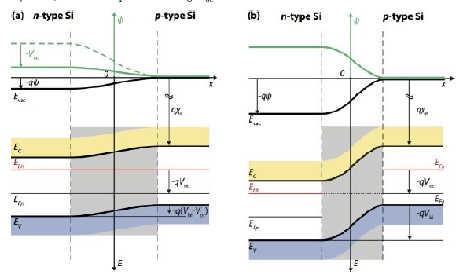
Short circuit current density (I_{sc})
Ideally, J_{sc} = J_{ph},
J_{ph} shows that in the case of an ideal diode (for example no surface recombination) and uniform generation, the critical material parameters that determine Jph are the diffusion lengths of minority carriers.
Crystalline silicon solar cells can deliver a maximum possible current density of 46 mA/cm².
In laboratory c-Si solar cells the measured J^{sc} is above 42 mA/cm², while commercial solar cells have a Jsc exceeding 35 mA/cm².
LN and LP are the minority-carriers diffusion length
for electrons and holes.
J_{ph} = photogenerated current density.
Under a uniform generation rate, G,

Slide 6
Open circuit voltage
The open-circuit voltage is the voltage at which no current flows through the external circuit.
It is the maximum voltage that a solar cell can deliver.
Voc corresponds to the forward bias voltage, at which the dark current density compensates the photocurrent density.
Voc depends on the photo generated current density can be calculated from the equation assuming that the net current is zero,
where the approximation is justified because of Jph ≫ J0
Voc depends on the saturation current density of the solar cell and the photo generated current.
Commercial solar cells typically have Voc exceeding 600 mV.

Slide 7
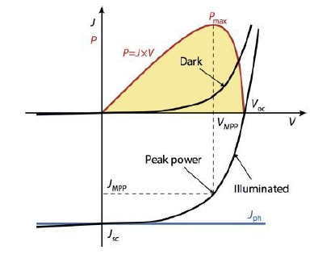
Fill factor
The fill factor is the ratio between the maximum power (P_{max} = J_{mpp}V_{mpp}) generated by a solar cell.
The subscript “mpp” denotes the maximum power point (MPP) of the solar cell, i.e. the point on the J-V characteristic of the solar cell, at which the solar cell has the maximal power output.
To optimize the operation of PV systems, it is very important, to operate the solar cells (or PV modules) at the MPP.
Only carriers generated in the depletion region and in the regions up to the minority-carrier diffusion length from the depletion region can contribute to the photogenerated current.
The thickness of the absorber should not be greater than the region from which the carriers contribute to the photogenerated current.
J-V characteristics of a p-n junction in the dark and under illumination.

Slide 8
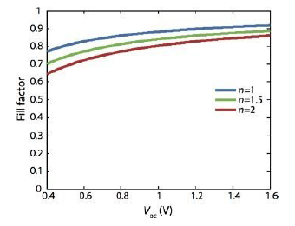
Fill factor and open circuit voltage V_{oc}
The graph shown below demonstrates the importance of the diode ideality factor when introduced into the normalized voltage.
The ideality factor is a measure of the junction quality and the type of recombination in a solar cell.
good approximation of the ideal value of FF for voc > 10.
Maximum achievable FF
FF does not change drastically with a change in Voc.
For a solar cell with a particular absorber, large variations in Voc are not common.
E.g. GaAs solar cell may have an FF approaching 0.89.
The FF as a function of Voc for a solar cell with ideal diode behaviour.

Slide 9
Conversion efficiency
The ratio between the maximal generated power and the incident power.
under the STC, where the incident light has an irradiance of I_{in} = 1000 W/m₂,
Typical external parameters of a crystalline silicon solar cell as shown are; Jsc ≈ 35 mA/cm2,
Voc up to 0.65 V
FF in the range 0.75 to 0.80.
The conversion efficiency lies in the range of 17 to 18%.

Slide 10
Numerical for Practice ???
A crystalline silicon solar cell generates a photo current density of Jph = 35 mA/cm2.
The wafer is doped with 10¹⁷ acceptor atoms per cubic centimetre and the emitter layer is formed with a uniform concentration of 10¹⁹ donors per cubic centimetre.
The minority-carrier diffusion length in the ptype region and n-type region is 500 × 10⁻⁶ m and 10 × 10⁻⁶ m, respectively.
Further, the intrinsic carrier concentration in silicon at 300 K is 1.5 × 10¹⁰ cm⁻³,
the mobility of electrons in the p-type region is μ^{n} = 1000 cm²V⁻¹s⁻¹ and holes in the n-type region is μ_{p} = 100 cm²V⁻¹s⁻¹.
Assume that the solar cell behaves as an ideal diode. Calculate the built-in voltage, the open circuit voltage and the conversion efficiency of the cell.
J_{ph} = 350 Am⁻².
N_{A} = 10¹⁷ cm⁻³ = 10²³ m⁻³.
N_{D} = 10¹⁹ cm⁻³ = 10²⁵ m⁻³.
LN = 500 × 10⁻⁶ m.
LP = 10 × 10⁻⁶ m.
DN = (kBT/q)μn = 0.0258V × 1000 × 10⁻⁴ cm²V⁻¹s⁻¹.
DP = (kBT/q)μp = 0.0258V × 100 × 10⁻⁴ cm²V⁻¹s⁻¹

Slide 11
The external quantum efficiency (λ)
It is the fraction of photons incident on the solar cell that create electron-hole pairs in the absorber which are successfully collected.
It is wavelength dependent
It is usually measured by illuminating the solar cell with monochromatic light of wavelength λ and measuring the photocurrent I_{ph} through the solar cell. The photon flow is usually determined by measuring the EQE of a
calibrated photo diode under the same light source.
q is the elementary charge
Ψph,λ is the spectral photon flow incident on the solar cell.
Since Iph is dependent on the bias voltage, the bias voltage must be fixed during measurement.
The photon flow is usually determined by measuring the EQE of a calibrated photo diode under the same light source.

Slide 12
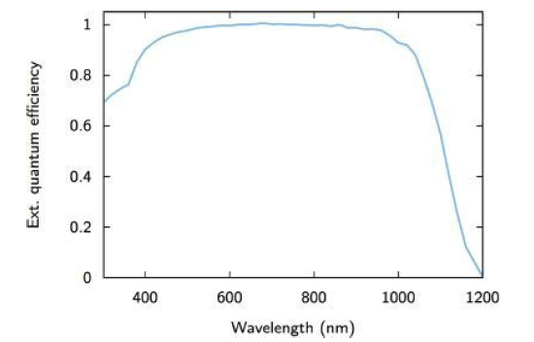
The external quantum efficiency (λ)
The shape of this EQE curve is determined by optical and electrical losses such as parasitic absorption and recombination losses, respectively, which can make the analysis complex.
The minority-carrier diffusion length in the crystalline silicon substrate is very long and surface recombination is virtually suppressed.
We can identify the major optical loss mechanisms in the EQE for such a solar cell:
For short wavelengths only a small fraction of the light is converted into electron-hole pairs. Most photons are already absorbed in the layers that the light traverses prior to the absorber layer; this is called parasitic absorption.
For long wavelengths, the penetration depth, exceeds the optical thickness of the absorber. Then the absorber itself becomes transparent so that most of the light leaves the solar cell before it can be absorbed.
A typical EQE for a high quality crystalline silicon-based
solar cell.

