Slide 1
Lecture-1
By N.Jeevaratnam

Slide 2
Microprocessor is a simple central processing unit (CPU) on a single chip (remember the word 'Single Chip'). It includes Arithmetic logic unit (ALU), control unit (CU), registers, instruction decoders, bus control circuit etc. but everything should be on a single chip.

Slide 3
A microcontroller (or MCU for microcontroller unit) is a small computer on a single integrated circuit. In modern terminology, it is a system on a chip or SoC. A microcontroller coains one or mornte CPUs (processor cores) along with memory and programmable input/output peripherals.A microcontroller is a computer present in a single integrated circuit which is dedicated to perform one task and execute one specific application. It contains memory, programmable input/output peripherals as well a processor.

Slide 4
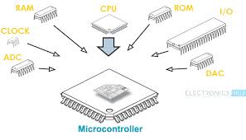

Slide 5
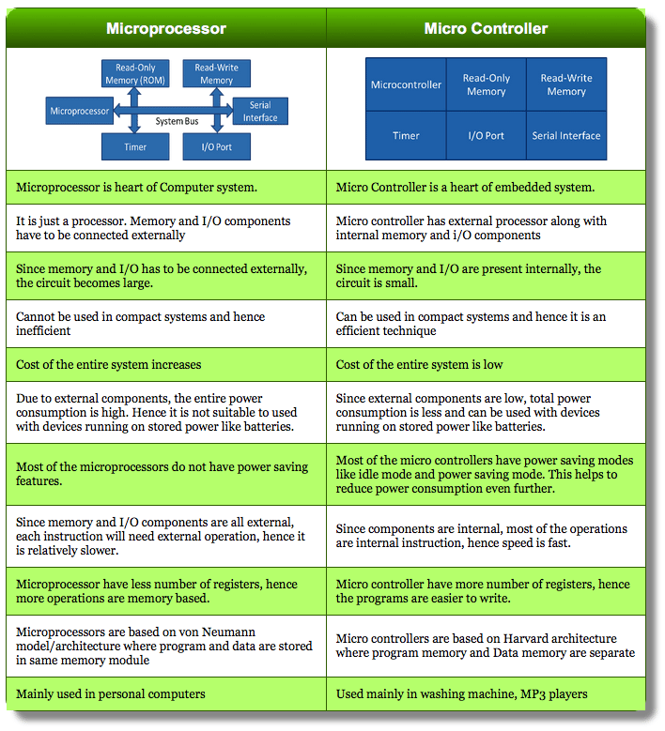

Slide 6
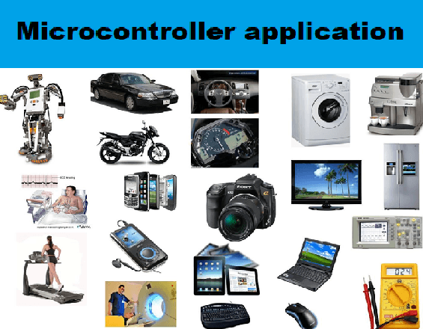

Slide 7
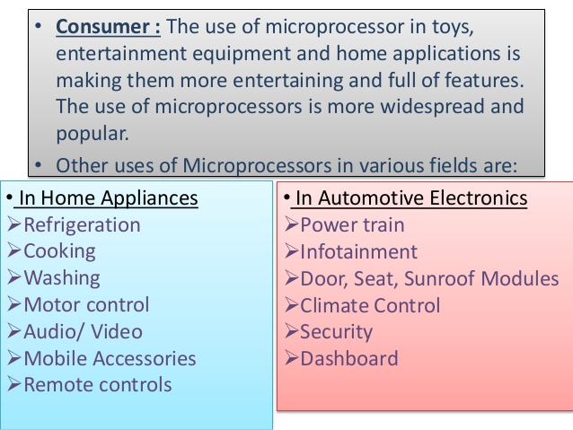

Slide 8
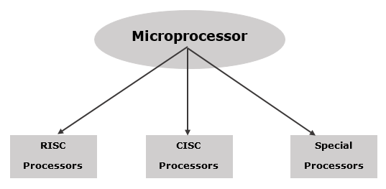

Slide 9
Applications of RISC and CISC
RISC is used in high-end applications like video processing, telecommunications and image processing. (Reduced Instruction Set Computer)
CISC is used in low-end applications such as security systems, home automation, etc. (Complex Instruction Set Computer)

Slide 10
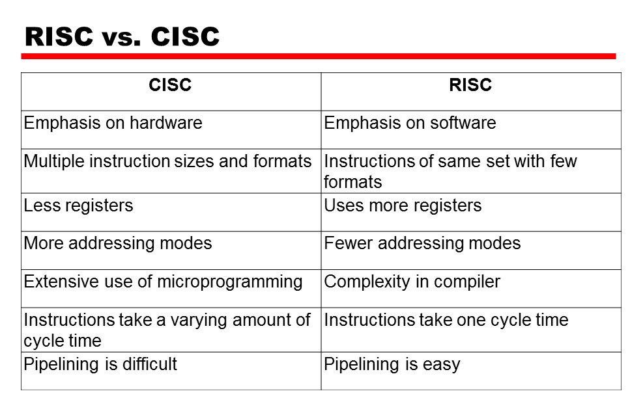

Slide 11


Slide 12
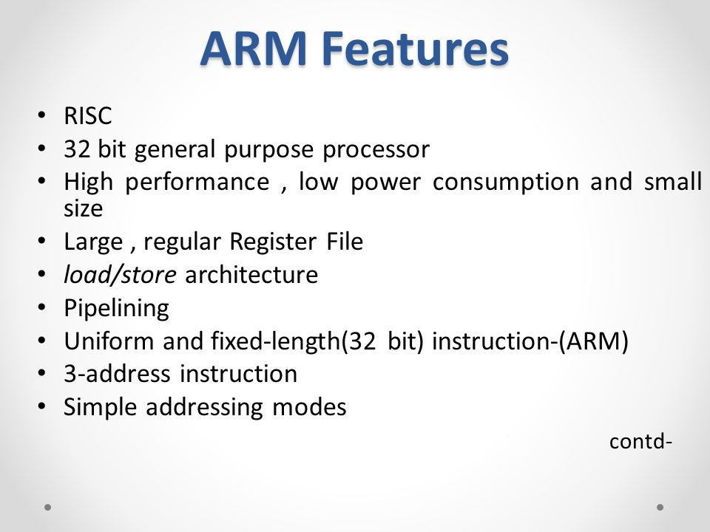

Slide 13
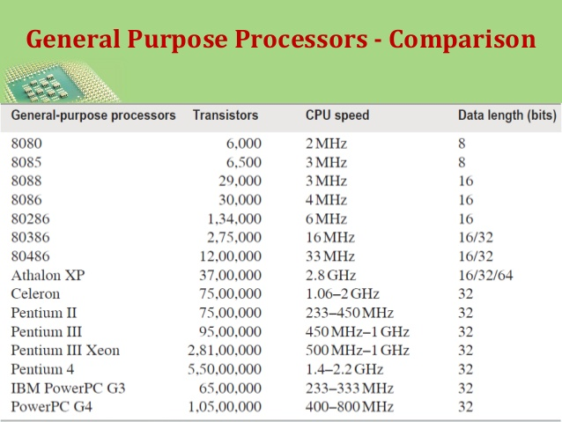

Slide 14
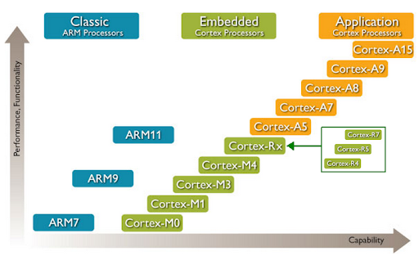

Slide 15
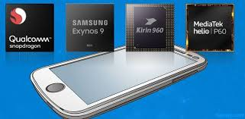
Smart phone processor maker

Slide 16
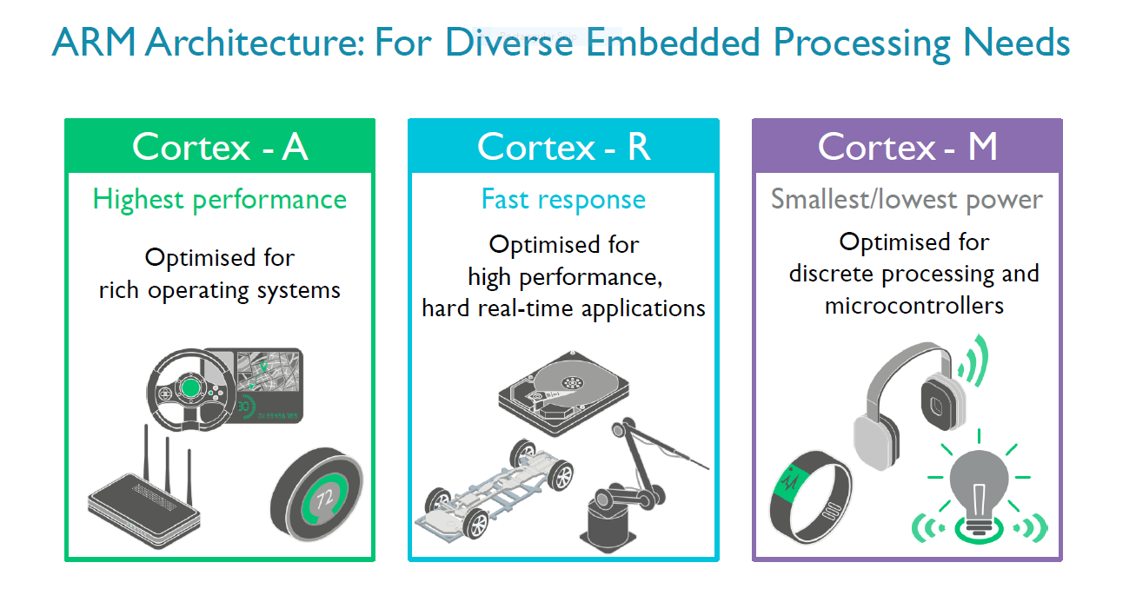

Slide 17
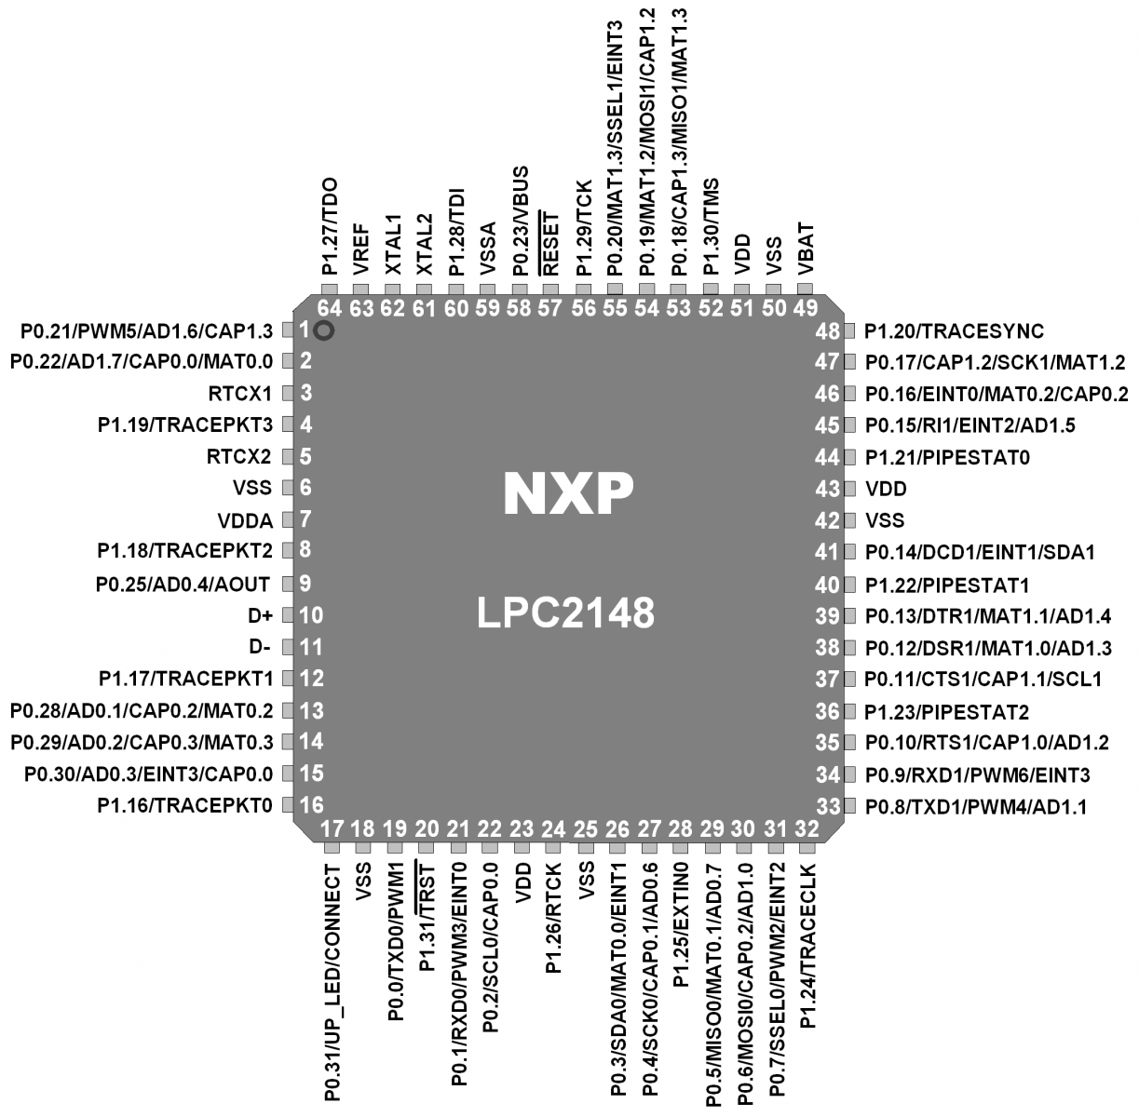

Slide 18
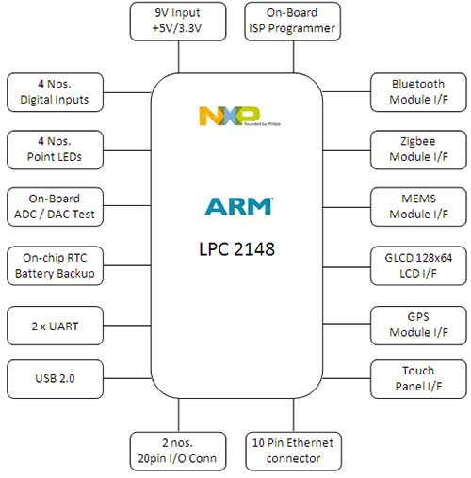

Slide 19
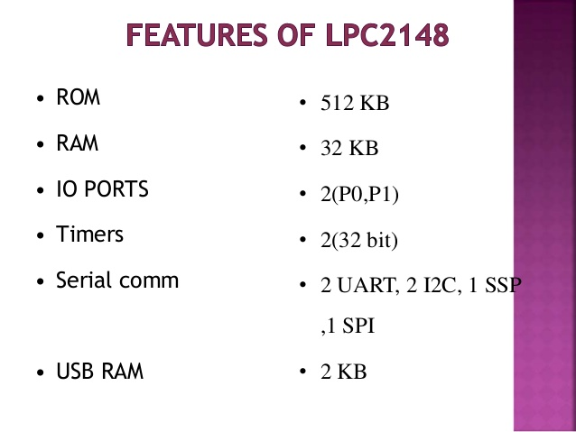

Slide 20


