Slide 1
Lecture -15 & 16
Resource use efficiency and optimization techniques, Resource cycling and Flow of energy in different farming system farming system and environment

Slide 2
Efficiency
Efficiency in any system is an expression of obtainable output with the addition of unit amount of input.
The ratio of energy intake and energy of the produced biomass i.e. of input and output is called ecological efficiency. This can be studied at any trophic level.
Resource use efficiency (fertilizer, water etc) is the output of any crop or any thing else per unit of the resource applied under a specified set of soil and climatic conditions.

Slide 3
Cultivated Land Utilization Index ( CLUI):
Cultivated land utilization Index (Chuang, 1973) is calculated by summing the products of land area to each crop, multiplied by the actual duration of that crop divided by the total cultivated land times 365 days.
Where, n total number of crops; a_{i} area occupied by the ith crop, d_{i}, days that the ith crop occupied and A = total cultivated land area available for 365 days.
=
365

Slide 4
LUI can be expressed as a fraction or percentage. This gives an idea about how the land area has been put into use. If the index is 1 (100%), it shows that the land has been left fallow and more than 1, tells the specification of intercropping and relay cropping. limitation of CLUI is its inability to consider the land temporarily available to the farmer for cultivation.

Slide 5
FUE is the output of any crop per unit of the nutrient applied under a specified set of soil and climatic conditions.
The NUE/FUE can be expressed in several ways.
Mosier et al. (2004) described 4 agronomic indices to describe NUE: partial factor productivity (PFP, kg crop yield per kg input applied);
agronomic efficiency (AE, kg crop yield increase per kg nutrient applied);

Slide 6
apparent recovery efficiency (RE, kg nutrient taken up per kg nutrient applied); and
physiological efficiency (PE, kg yield increase per kg nutrient taken up).
Crop removal efficiency (removal of nutrient in harvested crop as % of nutrient applied) is also commonly used to explain nutrient efficiency.

Slide 7
Energy efficiencies
Energy efficiency = Energy output (MJ/ ha) / energy input (MJ/ ha)
Net energy (MJ/ ha) = Energy output (MJ/ ha) - energy input (MJ/ ha)
Energy productivity (kg/MJ)= output (grain + byproduct (kg/ha) / energy input (MJ/ ha)
Energy intensity = energy (MJ/ ha) / output (grain + byproduct (kg/ha).

Slide 8
Crop water use efficiency
Crop water use efficiency is a ratio between marketable crop yield and water used by the crop in evapotranspiration.
Field water use efficiency
Field water use efficiency is a ratio between marketable crop yield and field water supply which includes water used by the plant in metabolic activities, ET and deep percolation losses.

Slide 9
Weed control efficiency
[Weed count or dry weight in weedy - weed count or dry weight in a treatment]/weed count or dry weight in weedy
Resource use efficiency:
Resource use efficiency in agriculture is defined to include the concepts of technical efficiency, allocative efficiency and environmental efficiency (Haque 2006).

Slide 10
Technical efficiency is the ability of a firm to produce a given level of output with minimum quantity of inputs under a given technology.
Allocative efficiency is a measure of the degree of success in achieving the best combination of different inputs in producing a specific level of output considering the relative prices of these inputs.

Slide 11
Economic efficiency is a product of technical and allocative efficiency.
In one sense, the efficiency of a firm is its success in producing as large an amount of output as possible from given sets of inputs.
Maximum efficiency of a firm is attained when it becomes impossible to reshuffle a given resource combination without decreasing the total output.

Slide 12
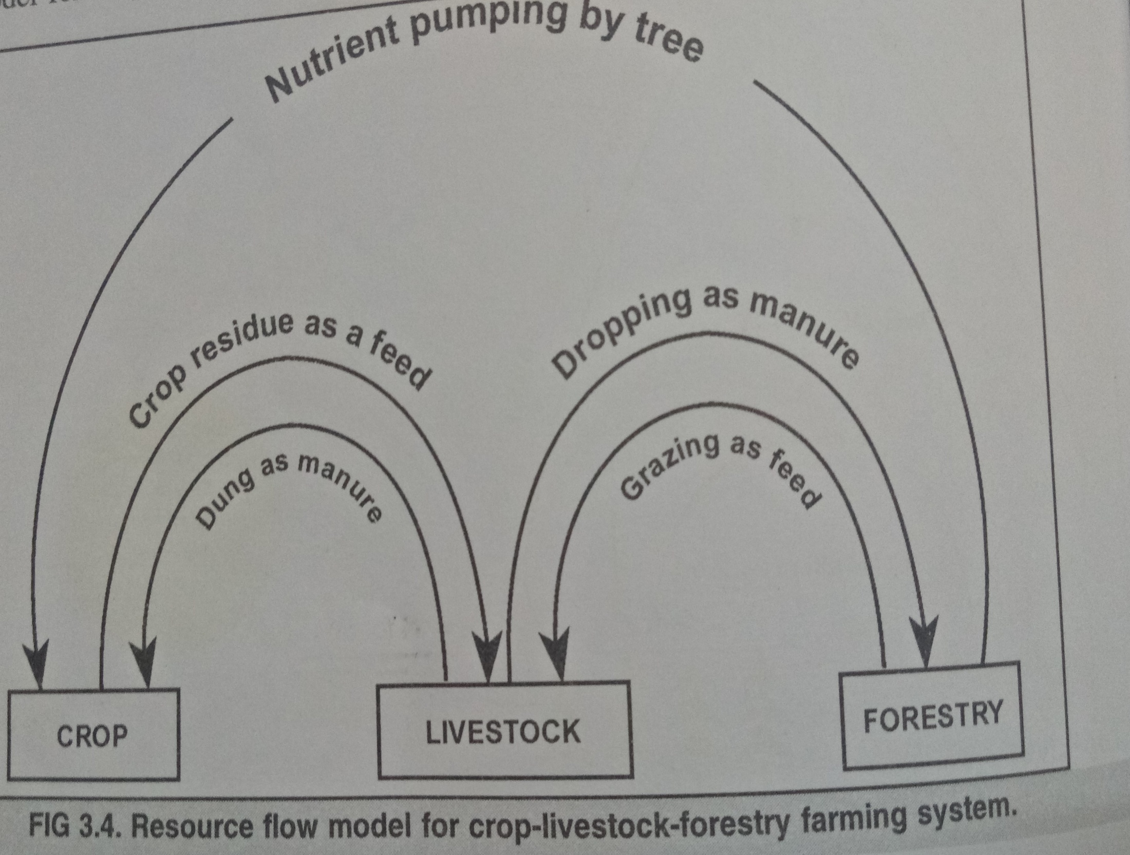

Slide 13
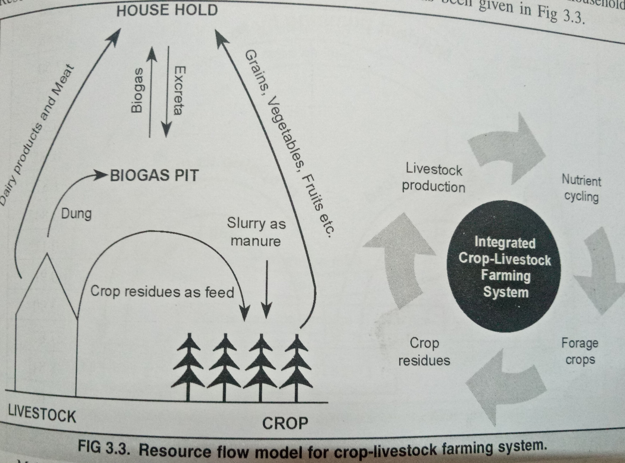

Slide 14
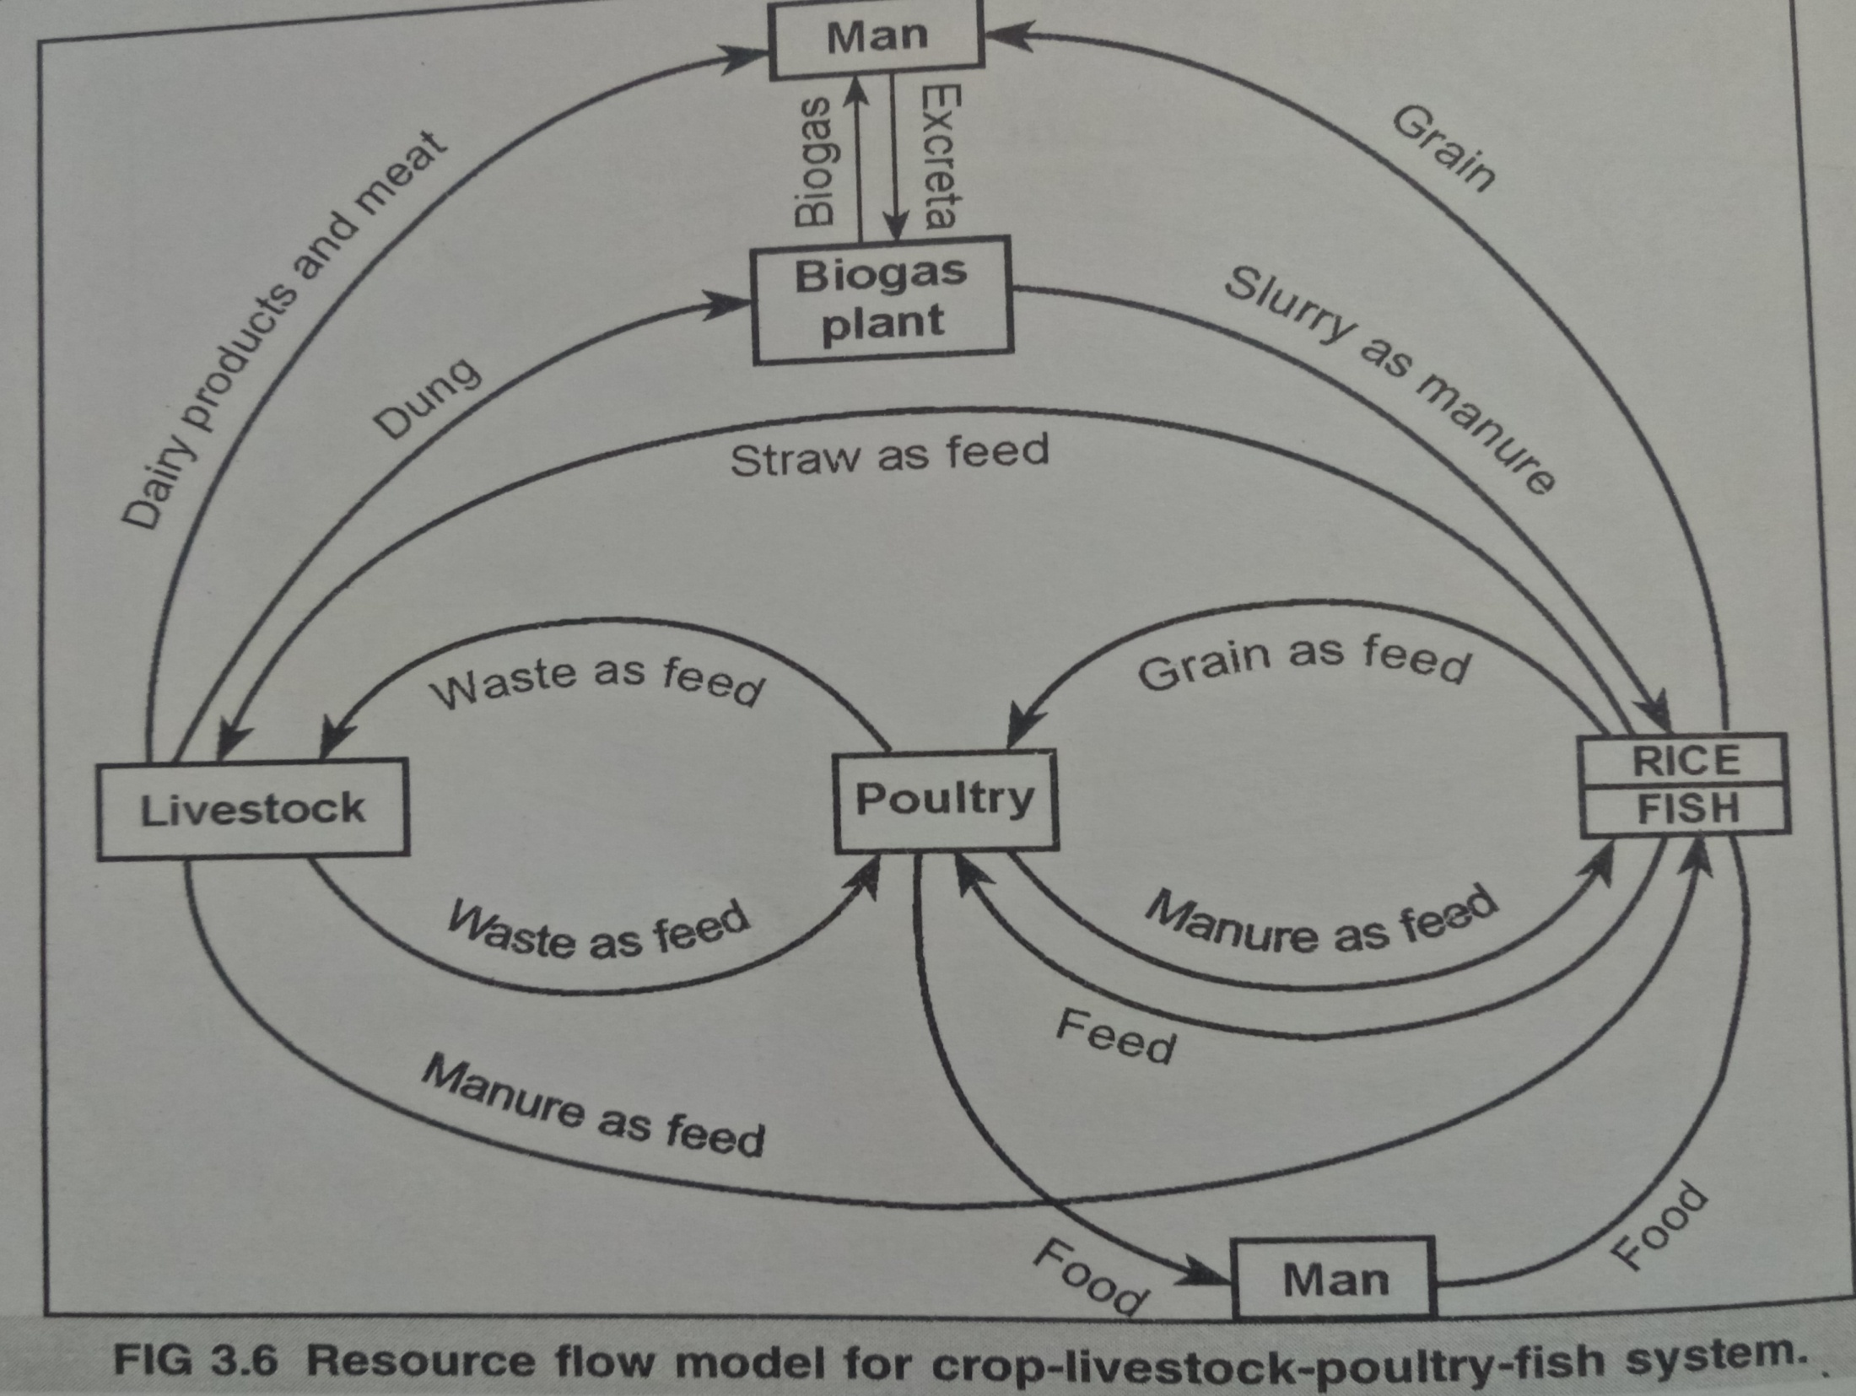

Slide 15
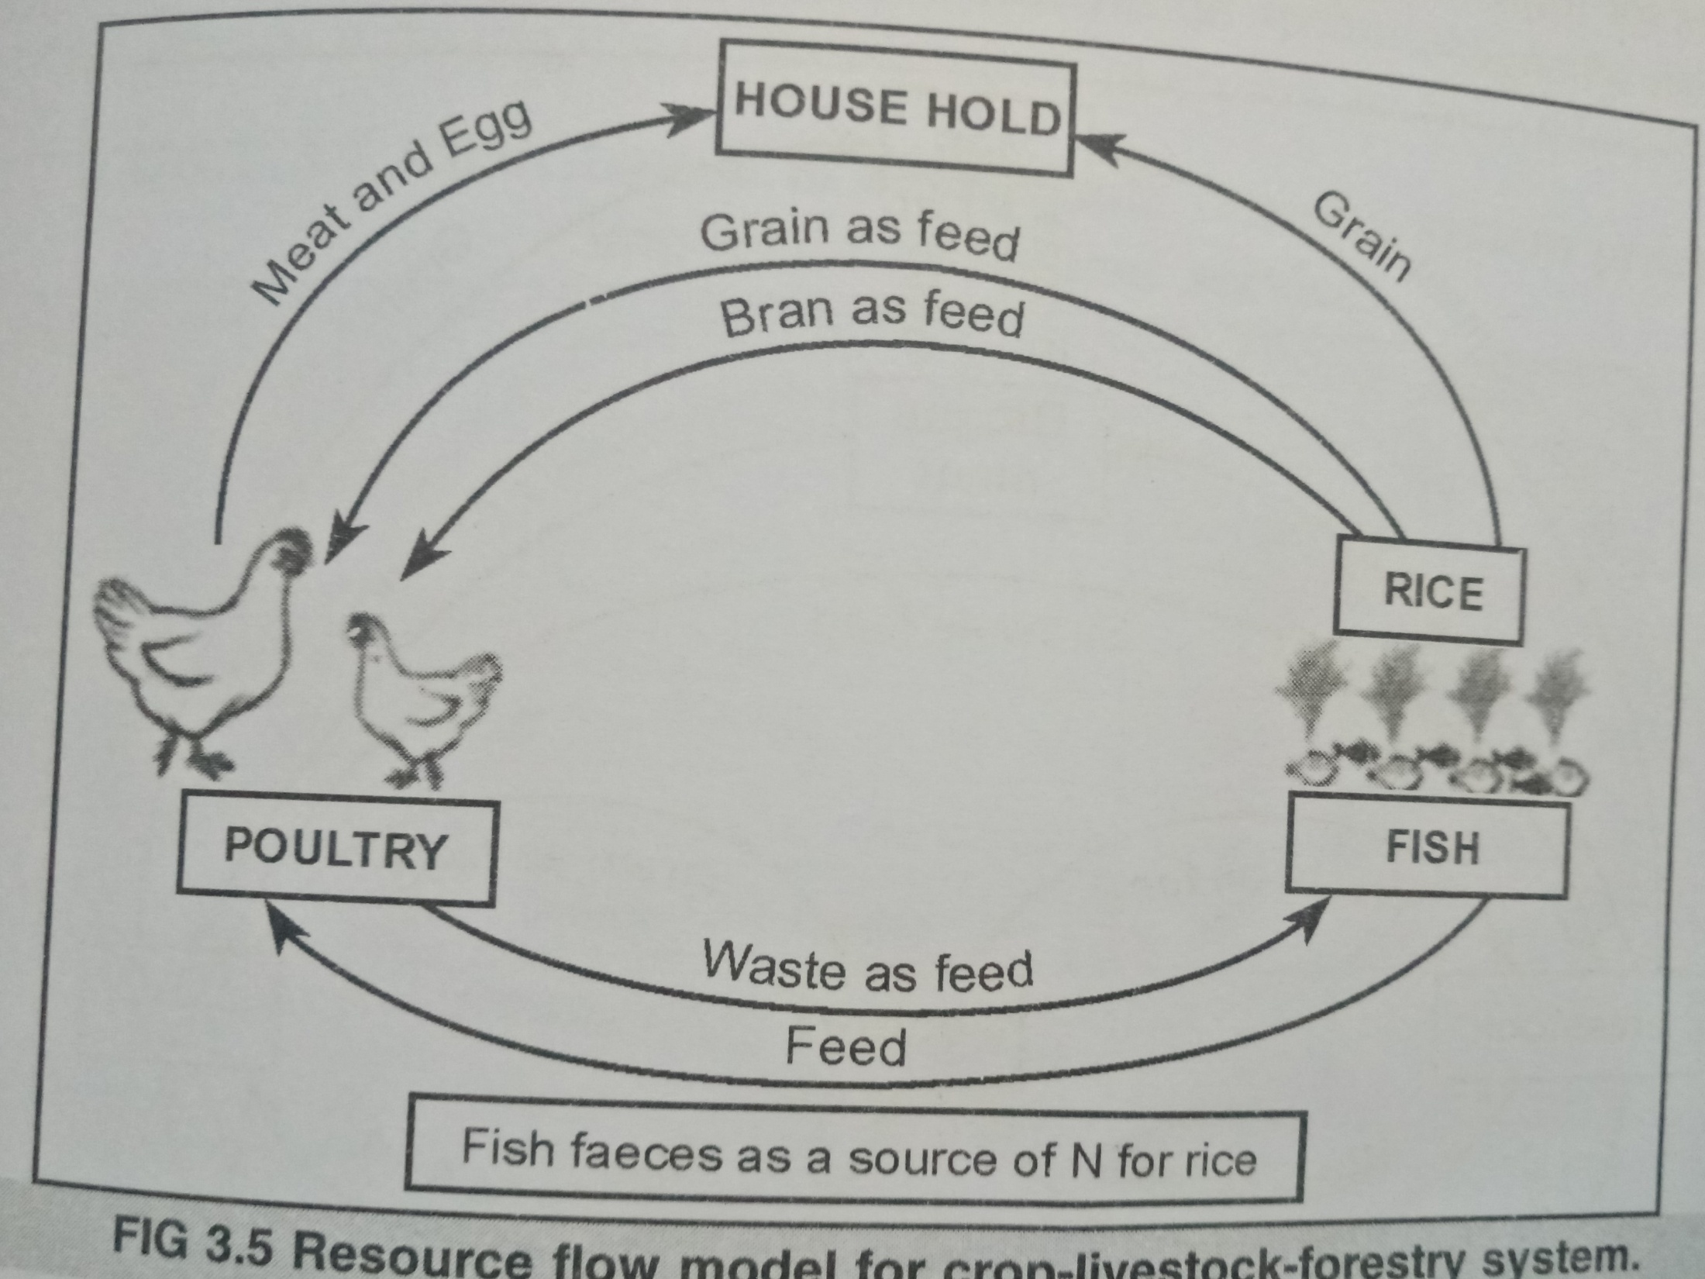

Slide 16
Thank You

