Slide 1
BREEDING OF GUAVA
Lecture #7

Slide 2
GUAVA
B.N.: Psidium guajava L.
Family: Myrtaceae Chromosome number 2n-2x-2 Origin: Tropical America

Slide 3
Important guava growing states in the country are Uttar Pradesh, Bihar, Madhya Pradesh and Maharashtra.
Allahabad district of Uttar Pradesh has the reputation of growing the best quality of guava fruits in the world.
The importance of guava is due to the fact that it is the hardy fruit which can be grown in alkaline and poorly drained soil.

Slide 4
Germplasm resources:
Guava is mainly a self pollinated crop but occurrence of cross pollination results in great variation in the seedling population.
About 103 genotypes are available in the Indian collections
Yadav (1990) has listed 153 genotypes including Psidium species, cultivars and hybrids mainly at CISH, Lucknow, IIHR, Bangalore, NDUAT, Faizabad, and HAU, Hisar.

Slide 5
Breeding objectives
1. Development of seedless variety
2. Less pectin content for edible purpose
3. More pectin content for processing
4. Uniform ripening
5. High keeping quality
6. Resistance to tea mosquito bug and wilt.

Slide 6
Botany
Most of the Cultivars of Indian guava belongs to the genus Psidium and species gujava.
Based on the shape of common guava fruits, they are classified into two groups i.e. Psidium pyriferum, Psidium pomiferum.

Slide 7
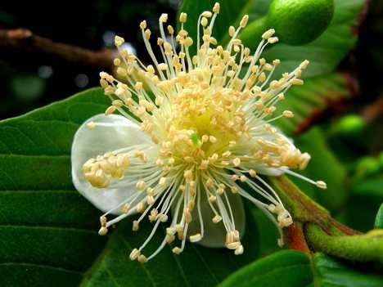
FLORAL BIOLOGY
Guava bears flower solitary or in cyme of two to three flowers, on the current season growth in the axil of the leaves.
About one month is required from flower bud differentiation to complete development upto calyx cracking stage.

Slide 8
Peak time of Anthesis is between 5.00-6.30 AM in most of the varieties of guava. The dehiscence of anthers starts 15- 30 minutes after Anthesis and continues for two hours.
The pollen fertility is high in almost all the cultivars. The pollen fertility is 78% and 91% in Allahabad Round and Lucknow Safed, respectively.

Slide 9
Inheritance pattern
Bold seed is found to be dominant over soft seed and governed monogenically.
Red flesh color is dominant to white pulp color and also governed monogenically.
Red fleshed cultivars are supposed to be heterozygous.
There is linkage between red flesh color and bold seed size.
Triploidy and some other genetic factors are responsible for female sterility.

Slide 10
Breeding methods and achievements
Clonal Selection
Hybridization
Polyploidy Breeding

Slide 11
CLONAL SELCTION
Improvement work in guava was started for the first time in the country in 1907 at Ganesh khand fruit Research Station, Pune primarily with the collection of seeds of varieties, grown in different places to isolate superior strains.
At Horticultural Research Station, Saharanpur, evaluation of seedling types resulted in a superior selection, S-1, having good fruit shape, few seeds, sweet taste and high yield.
At IIHR, Bangalore, from 200 open pollinated seedlings of variety Allahabad Safeda collected from Uttar Pradesh, one seedling selection, selection-8, was found to be promising.

Slide 12
S.N o | Varieties | Important characters
1 | L.49 | Developed at GFES, Pune, Seedling selection of Allahabad Safeda, Semi dwarf tree, high yielding
2 | Banarsi Surkha | It is a selection from local red fleshed type, heavy bearer, large fruits, flesh soft and pink.
3 | CISHG-1 | Developed at CISH, Lucknow. Fruit skin color is deep red, TSS 15° Brix, soft seeds.
4 | Bangalore Local | It is a local selection, with white flesh and soft seeds, fruit is large.
5 | Arka Mridula (Sel -8) | Developed at CISH, Lucknow, it is a selection from apple color seedling, skin and flesh color is pink with good acid sugar blend.
6 | Plant prabhat | Seedling selection from GBPUAT, Pantnagar, Prolific bearer, soft seed with good quality

Slide 13
Hybridization
At IIHR, Bangalore, as a result of hybridization among Allahabad Safeda, Red Flesh Chittidar, Apple color, Lucknow-49 and Bananas, 600 F1 hybrids were raised.
One hybrid Arka Amulya has been released recently.
It is a progeny from the cross Allahabad Safeda x Triploid.
Hybrid 16-1 (Apple color x Allahabad safeda) has been developed.

Slide 14
At Fruit Research Station, Sangareddy (Telangana), inter-varietal hybridization resulted in the isolation of two superior hybrids.
Safed Jam: This is a hybrid between Allahabad Safeda and Kohir (a local collection from Hyderabad
– Karnataka region). It is similar to Allahabad Safeda in growth habit and fruit quality. The fruits are bigger in size with good quality and few soft seeds.
Kohir Safeda: It is a hybrid between Kohir x Allahabad Safeda, Tree is vigorous, fruits are larger with few soft seeds and white flesh.
CISH, Lucknow isolated two hybrids H-136 for red pulp and Soft seeler with high TSS.

Slide 15
Haryana Agricultural University, Hisar has released two hybrid varieties.
Hisar Safeda: It is a cross between “Allahabad
Safeda” x ‘Seedless’, which has upright growth with a compact crown. Its fruits are round, weighing about 92g each, pulp is creamy – white with less seeds, which are soft, TSS is 13.4% and ascorbic acid 185 mg/100g.
Hisar Surkha: It is a cross between ‘Apple Color’ x ‘Banarasi Surkha’. Tree is medium in height with broad to compact crown, fruit is round weighing 86g each. Pulp is pink having 13.6% TSS.0.48% acidity and 169 mg/100g ascorbic acid. Yield is 94 kg/tree/year

Slide 16
Breeding for wilt resistance
Work at CISH, Lucknow has shown that Chittidar, Portugal, Seedless and Spear Acid are tolerant to wilt.

Slide 17
Polyploidy Breeding
Producing triploids will be futile since the fruit shape in triploid is highly irregular and misshapen because of differential seed size.
However, in order to evolve varieties with less seeds and increased productivity, crosses were made at IARI, New Delhi, between seedless triploid and seeded diploid variety Allahabad Safeda.
Of the 73 F1 hybrids raised 26 were diploids, 9 trisomics 5 double trisomics and 13 tetrasomics. Distinct variation in tree growth habit and leaf and fruit characters was observed.

Slide 18
Three trisomic plants had dwarf growth habit and normal shape and size of fruits with few seeds. The imbalance in chromosome numbers in aneuploids imparted sterility resulting in seed reduction in fruits.

Slide 19
BREEDING IN BANANA
Lecture #4

Slide 20

Botanical name: Musa sp.
Family : Musaceae
Chromosome number: n=11 2n = 22, 33 or 44.
Origin: South East Asia

Slide 21
History of banana breeding:
Banana breeding was started in Trinidad, West Indies in 1922 and in Jamaica in 1924.
The driving force for this breeding programme was to develop improved Fusarium wilt (Fusarium oxsyorum F.sp. Cubense) resistant banana for export trade.
In 1960, both the programmes were combined under the Jamaica Banana Board.
United Fruit Company also started a small breeding programme in Panama in 1920s.
In India hybridization work was started at Central Banana Research Station, Adhuthurai, Tamil Nadu in 1949.
Important banana growing states are Maharashtra, Karnataka, Kerala, Tamil Nadu, Andhra Pradesh, Orissa,Bihar, West Bengal and Assam .

Slide 22
In South India, other than its edible use, banana is extensively used in all auspicious occasions such as wedding, festivals and worshipping God.
Banana is a good table fruit, besides, the cultivar Nendran is used for cooking.
Centre of diversity:
Edible banana is native to old world especially South East Asia (Simmonds, 1962).
Malayan area seems to be the primary center of origin of cultivated banana
(M.acuminata). M.acuminata, was probably introduced into India and Burma where M.balbisiana is a native species.
Natural hybridization between these two species might have resulted in many hybrid progenies (AAB, ABB etc
.).

Slide 23
Genetic resources
Musa has about 50 species and this genus is divided into five sections:
a) Eumusa: Includes about 13-15 species of edible and wild banana. The chromosome number is 2n=22 in wild species and most of the cultivated varieties are having 2n=33 (2n=44 rarely) e.g. M.acuminata, M.balbisiana, M.basjoo etc.
b) Rhodochlamys: Mostly diploid, spread from India to Indonesia. Five to seven species are kept in this group. Parthenocarpy is absent in this group e.g. M.ornata, M.velutina.
c) Callimusa: This is of ornamental value and x=10 and 2n =20. It is found in Indo-China, Malaya and Borneo. Parthenocarpy is absent in this type. It includes about 5-6 species e.g. M.coccinea.

Slide 24
d) Australimusa: Like Callimusa it has x = 10 and 2n=20 chromosome. Species of this group is common in Queensland and Philippines. Important species of this group are M. textilis or manilahemp, M.maclavi etc.
e) Incertae sedis: It includes M.ingens (x=7, 2n=14) of New Guinea which grows to a height of over 10
m. This is the largest known herb. Another species in this group is M.beccarii (x=9, 2n=18) from North Borneo.

Slide 25
The most important Musa cultivars are almost sterile triploids (2n=3x=33) and also tetraploid and diploid banana cultivars have also local importance in Asia.
All banana and plantain land races are farmers selection from intra and inter specific hybridization of two different species.
M.acuminata Colta, donor of the A genome and
M.balbisiana Colta, donor of the B genome.
Simmonds and Shepherd (1955) reported scoring technique to indicate the relative contribution of the two wild species for the constitution of a given cultivar.
Fifteen distinguishing characters between Musa acuminata and Musa balbisiana were identified them.
by

Slide 26
At the botanical garden, Howrah, seeds of few banana species were collected from Chittagong and Madras.
More number of genotypes of banana was also maintained at Central Banana Research Station, Aduthurai.
After that it was shifted to Horticulture college and research Institute, Tamil Nadu Agricultural University, Coimbatore.
After the formation of National Research Centre on Banana (NRCB) in 1995, a wide germplasm collection including wild types are being maintained at this center and intensive research programmes are being taken up on various problems related with banana.
Presently, TNAU also maintaining 186 collections of germplasm.

Slide 27
Taxonomic classification of edible banana (Simmonds and Shepherd, 1955)
Genome | Ploidy level | Nomenclature
AA | 2x | Matti, Anai komban
AAA | 3x | Cavendish, Robusta, Grand Nine
AAAA | 4x | Bodles Altafort (Synthetic hybrid of West Indies)
AB | 2x | Ney Poovan, Kunnan
AAB | 3x | Poovan, Hill banana, Champa, Rsathali
ABB | 3x | Monthan, Kanchkela,
ABBB | 4x | Klue Teparod

Slide 28
Objectives of breeding
To develop dwarf statured banana suitable for high density planting and to prevent damage from high wind velocity.
Production of good quality fruits.
Resistant to biotic and biotic stresses i.e. nematodes, panama wilt, bunchy top, sigatoka leaf spot, moko disease and pseudo stem weevil etc.
To develop varieties with wider agro-ecological adaptability.
Development of male fertile parthenocarpic diploids with resistance to major diseases and pests.
Developing longer finger size.
Suitability for export.
Good keeping quality.

Slide 29
Breeding methods and achievements:
  Introduction.
  Hybridization
  Mutation breeding
  Breeding works of different areas

Slide 30
Introduction
Introduction of some cultivators of banana was made with resistance to biotic stresses e.g. Lady Finger (EC 160160) resistant to bunchy top virus introduced from Australia and is being evaluated at IIHR, Bangalore and TNAU, Coimbatore.
Further, cultivars Naine MS (EC 27237) from France and Valery from West Indies were introduced for utilization in improvement programme

Slide 31
Hybridization
In India, breeding work was started at Central Banana Research Station, Aduthurai (Tamil Nadu) in 1949.
Technique of hybridization in banana is different from other crops.
Pollination is best carried out in the morning. The bunches of female parent are bagged at shooting and each successive hand is pollinated as it is exposed. At maturity and ripening the bunch is cut and seeds are extracted. Seeds are sown at once in the green house.

Slide 32
Evaluation of hybrid progenies from seedlings to harvest may not be the correct phase instead, evaluation of the same under next vegetative phase i.e., sucker to harvest stage will be ideal as full expression of yield potential could be observed only in the second crop of the F1 progeny.
The first crop (seedling to harvest) takes more than 15-19 months, where most of the energy of the plants is needed for corm formation.

Slide 33
HYBRIDIZATION:
Kallar Laden(AAB)
x M balbisiana cv. Sawai (AB)
AB X Kadali (AA)
CO-1 (AAB)

Slide 34
At Kerala Agricultural University, two hybrids viz.,
BRS-1 (Agniswar x Pisang lilin) and
BRS -2 (Vannan x Pisang lillin) have been developed.
BRS -1 (AAB) is 100 days earlier than Rasthali with significant differences in bunch weight. It has been released for homestead cultivation in Kerala, as it is resistant to sigatoka leaf spot.
BRS-2 (AAB) is a medium statured hybrid, tolerant to leaf spot and panama disease, rhizome, weevil and nematodes. The average bunch weight is 14 kg with 8 hands and 118 fruits crop duration of 314 days.

Slide 35
Breeding work in other Countries:
PITA-9: A Black Sigatoka Resistant (BSR) hybrid from the “False Horn” plantain, a tetraploid hybrid having black Sigatoka resistance has been developed at International Institute of Tropical Agriculture (IITA), Nigeria.
‘BITA-3’ is a tetraploid starchy banana hybrid with low partial resistance to black Sigatoka disease developed at IITA High Rainfall Station in Onne (Southeastern Nigeria), where both (Banana streak virus) and cucumber mosaic virus (CMV) have been observed.
‘BITA-3’ is a hybrid from the interspecific cross ‘Laknau’ x ‘Taju Lagada’, ‘Laknau’ is a female –fertile AAB starchy banana that closely resembles plantains.

Slide 36
Mutation breeding:
Bud mutation in Indian banana is very common perhaps due to spontaneous rearrangement of chromosomes in somatic meristem and structural re-assortment.
High gate (AAA) is a semi-dwarf mutant of Gros Michel (AAA),
Motta Poovan (AAB) is a sport of Poovan (AAB),
Ayiranka Rasthali a sport of Rasthali (or Silk),
Barhari Malbhog is a sport of Malbhog,
Krishna Vazhai is a natural mutant of Virupakshi (or Pome),
Sambrani Monthan (ABB), a mutant of Monthan (ABB).

Slide 37
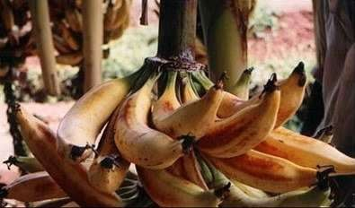


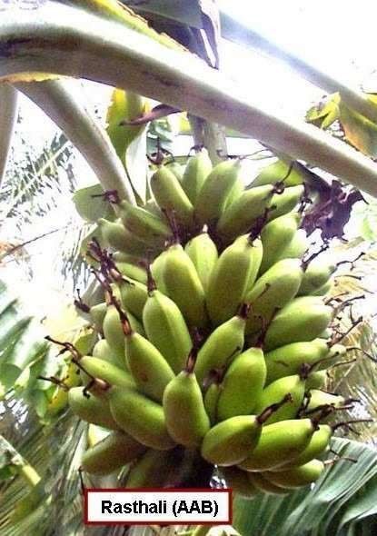

Slide 38
Name of the clone/cultivars
Name of the biotic and abiotic stress
Musa balbisiana
Drought
Calcutta-4
Black sigatoka
Pisang Lilin
Panama wilt (Race1)
SH3142 (Diploid hybrid)
Race 1 of Fusarium
Musa acuminata sp malaccensis
Race 1 and Race 2 of Fusarium
Musa acuminata sp burmannica
Bacterial wilt race 2, Moko
Disease
Burrowing nematode
Pisang Jari Buaya (PJB)
Tongat and Anaikomban
Nematodes

