Slide 1
Introduction to Ideotype breeding
In broad sense an Ideotype is a “biological model which is expected to perform or behave in a predictable manner within a defined environment.”
More specifically, crop Ideotype is a plant model which is expected to yield greater quantity of grains, fiber, oil or other useful product when developed as a cultivar.
The term Ideotype was first proposed by Donald in 1968 working on wheat.

Slide 2
MAIN POINT OF IDEOTYPE :
Crop Ideotype refers to model plants for specific environment.
Ideot ype differs from Idiotype.
It include morphological as well as physiological and biochemical traits.
Ideot ype is a moving goal.
It is difficult and slow method of cultivar development.

Slide 3
STEPS IN IDEOTYPE BREEDING
Development of conceptual theoretical model.
Selection of base material.
Incorporation of desirable characters into single genotype.
Selection of ideal or model plant type.

Slide 4
DEVELOPMENT OF CONCEPTUAL THEORETICAL MODEL
Ideotype consists of various morphological and physiological traits. The values of various morphological and physiological traits are specified to develop a conceptual theoretical model.
For example,
Plant height is important in fodder crops.
Maturity duration is important in rainfed.
Similarly leaf number, leaf angle, leaf size, photosynthetic rate,etc are
specified for each crops and situation.

Slide 5
SELECTION OF BASE MATERIAL
Selection of base material is an important step after development of conceptual model of Ideotype.
Genotype to be used in devising a model plant type should have broad genetic base and wider adaptability so that the new plant type can be successfully grown over a wide range of environmental condition with stable yield.
Genotypes for plant stature, maturity duration, leaf size, and angles are selected from the global gene pool of the concerned crop species.
Genotypes resistant or tolerant to drought, soil salinity, alkalinity, disease and insects are selected from the gene pool with the cooperation of physiologist, soil scientist, pathologist and entomologist.

Slide 6
INCORPORATION OF DESIRABLE TRAITS
The next important step is combining of various morphological and physiological traits from different selected genotypes into single genotype.
Knowledge of the association between various characters is essential before starting hybridization programme, because it help in combining of various characters.
Linkage between procedures, viz single cross, three way cross, multiple cross, backcross, composite crossing. E.g. Mutation breeding, heterosis breeding, etc. are used for the development of ideal plant types in majority of field crops. Backcross technique is commonly used for transfer of oligogenic traits from selected germplasm lines into the background of an adapted genotype.

Slide 7
SELECTION OF IDEAL PLANT TYPE
Plant combining desirable morphological and physiological traits are selected in segregating population and intermated to achieve the desired plant type.
Morphological physiological instruments.
features are judged through visual observation and parameters are
recorded with the help of sophisticated
Screening for resistance to drought, soil salinity, alkalinity, disease and insects is done under controlled conditions. This task is completed with the help of scientist from the disciplines of physiology, soil science, pathology and entomology.
Finally, genotypes combining traits specified in the conceptual model are selected, multiplied, tested over several locations, and released for commercial cultivation.

Slide 8
FEATURES OF CROP IDEOTYPE
The crop Ideotype consists of several morphological and physiological traits which contribute for enhanced yield or higher yield than currently prevalent crop cultivars.
The morphological and physiological features of crop Ideotype is required for irrigated cultivation or rainfed cultivation.
Ideal plant whether the Ideotype is required for irrigated cultivation or rainfed
cultivation.
Ideal plant types or model plants have been discussed in several crops like wheat,
maize, cotton, and pulses.
The important features of Ideotype for some crops are briefly described below:

Slide 9
WHEAT
A short strong stem. It imparts lodging resistance and reduces the losses due to lodging.
Erect leaves. Such leaves provide better arrangement for proper light
distribution resulting in high photosynthesis or CO2 fixation.
Few small leaves. Leaves are the important sites of photosynthesis, respiration,
and transpiration. Few and small reduce water loss due to transpiration.
Larger ear. It will produce more grains per ear.
A presence of owns. Awns contribute towards photosynthesis
single culm.

Slide 10
MAIZE
In 1975, Mock and Pearce proposed ideal plant type of maize.
In Maize , higher yields were obtained from the plants consisting of
Low tillers,
Large cobs, and
Angled leaves for good light interception. Planting of such type at closer
spacing resulted in higher yields.

Slide 11
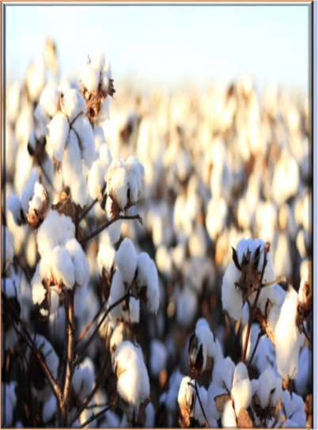
COTTON
Short stature (90-120 cm) ,
Compact and sympodial plant habit making
pyramidal shape,
Determinate the fruiting habit with unimodal
distribution of bolling,
Short duration (150-165 days),
Responsive to high fertilizer dose,
High degree of inter plant competitive ability,
High degree of resistance to insect pests and
diseases, and
High physiological efficiency

Slide 12
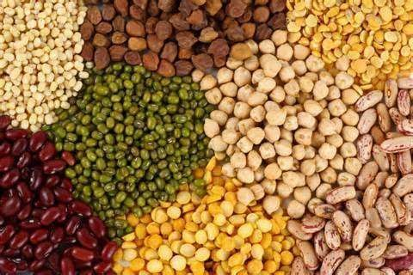
GENERAL PLANT IDEOTYPE CONCEPT IN PULSES
Determinate plant type
Erect and upright plant
Average plant height
Early vigour, early flowering and synchronous maturity
Pod bearing from well above the soil surface
More pods/plant and more number of seeds /pod
High harvest index
Yield stability

Slide 13
Rainfed condition
Early vigour
Irrigated condition
High input responsiveness
Tall (75-90 cm) and erect habit with broom
shaped branching behaviour
Synchronous flowering, delayed senescence and determinancy
Long fruiting branches and short inter nodes
Lodging resistance
Pod bearing from 20 cm above the ground
50-60 cm plant height with 9-10
secondary branches
Tall, erect or semi-erect plant
More number of pods per plant
Podding from 10th node

Slide 14
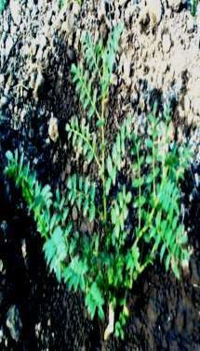
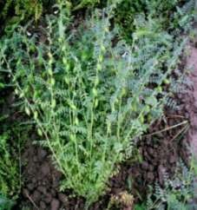
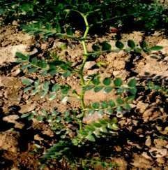
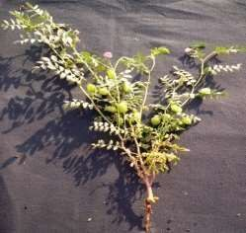
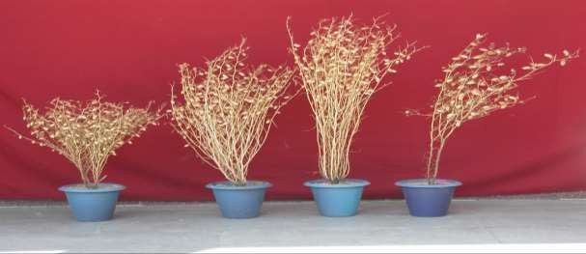
Chickpea plant type
North India: High biomass, more primary branches, Long duration
South India: low biomass, less primary
branches, short duration

Slide 15
Long and medium duration
Semi-dwarf plant type (1.5 – 1.8 m) for mechanized plant protection
Open canopy with determinancy
Non-cluster pod bearing
Long fruiting branches for high yield
Middle and top bearing
Spreading type for intercropping in south and central India
Compact plant type for intercropping in northern India

Slide 16
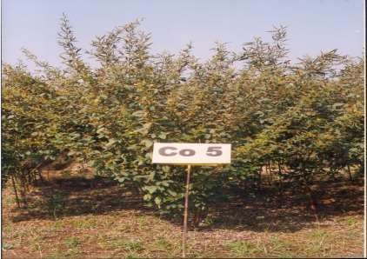
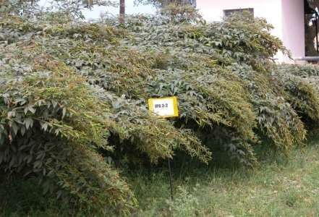
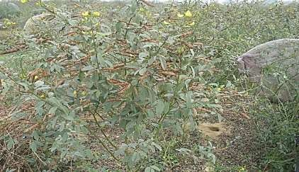
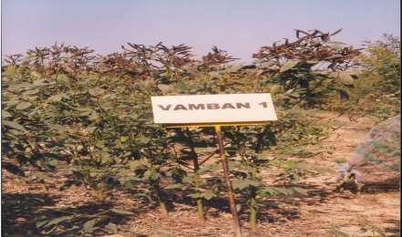
Long fruiting branches
Top pod bearing
Non cluster pod bearing
Determinate plant type

Slide 17
Spring/Summer season
Shorter duration (50-60 days)
Medium plant height (60-80 cm)
Determinate growth habit and
synchronous maturity
High initial growth vigor
More number of pods at top of plant
and non-shattering habit
Longer pods with >10seeds/pod
Tolerance to terminal heat stress
Kharif season
Optimum duration (65-75 days)
Balanced vegetative growth
Clear distinction between vegetative and
reproductive phase
Tall plants (80-100 cm) with more branches
Synchronous maturity
More no. of clusters/plant and pods/cluster
More number of seeds/pod
Shattering and pre-harvest sprouting tolerance

Slide 18
MERITS OF IDEOTYPE BREEDING
1.
Ideotype breeding is an effective method of enhancing yield through manipulation of various morphological and physiological crop characters. Thus, it exploits both morphological and physiological variation.
In this method of various morphological and physiological traits are specified and each character or trait contributes towards enhanced yield.
Ideotype breeding involves experts from the discipline of plant breeding, physiology, biochemistry, entomology and plant pathology. Each specialist contributes in the development of model plants for traits related to his field.
2.
3.

Slide 19
MERITS OF IDEOTYPE BREEDING
Ideotype breeding is an effective method of breaking yield barriers through the use of genetically controlled physiological variation for various characters contributing towards higher yield.
Ideotype breeding provides solution to several problems at a time like disease, insect and lodging resistance, maturity duration, yield and quality by combining desirable genes for these traits from different sources into a single genotype.
It is efficient method of developing cultivars for specific or environment.

Slide 20
DEMERITS OF IDEOTYPE BREEDING
Incorporation of several desirable morphological and physiological and disease resistance traits from different sources into a single genotype is a difficult task. Sometimes, combining of some characters is not possible due to tight linkage between desirable and undesirable characters. Presence of such linkage hinders the progress of Ideotype breeding.
Ideotype breeding is a slow method of cultivar development, because combining together of various morphological and physiological features from different sources takes more time than traditional breeding where improvement is made in yield and one or two other characters.

Slide 21
DEMERITS OF IDEOTYPE BREEDING
Ideotype breeding is not a substitute for traditional or conventional breeding. It is a supplement to the former.
Ideotype is a moving object which changes with change in knowledge, new requirements, national policy, etc. Thus new Ideotype have to evolved to meet the changing and increasing demands of economic products.

