Slide 1
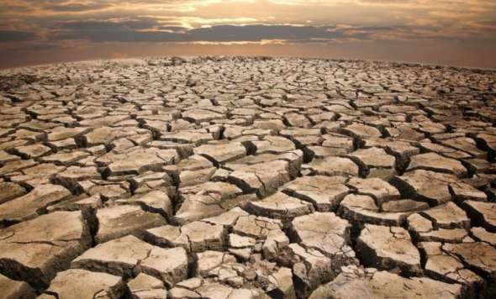
Drought Resistance

Slide 2
Drought: Scarcity of moisture (soil moisture) which restricts the expression of full genetic yield potential of a plant.
Drought resistance: The ability of crop plants to grow, develop and reproduce normally under moisture stress.
Mechanisms of drought resistance
There are 4 mechanisms of drought resistance.
1. Drought Escapes : It is due to ability of a genotype to mature early, before occurrence of drought. Drought escape is most common is plants grown is desert region.
Eg. Early maturing varieties of sorghum, maize, bajra, wheat, rice etc; give more yield than late maturing under drought.

Slide 3
2. Drought Avoidance (Dehydration avoidance) : It is due to the ability of plants to maintain favorable water balance even under stress. The plants which avoid drought retain high moisture content in their tissues and lose less water.
Drought Avoidance
This is possible either because of :
i) Increased water uptake (due to increase in root development) plants are called water spenders.(or) ii) Reduced water loss (due to reduction in growth of aerial parts are called water savers (i.e. to avoid transpiration)
Dehydration avoidance is interpreted as the ability of genotypes to maintain high leaf water potential when grown under soil moisture stress:

Slide 4
Several traits contribute to dehydration avoidance Such as : Leaf rolling, folding and reflectance narrow leaves, increased pubescence on aerial organs , presence of awns, osmatic adjustment of stomata, cuticular wax, increased water uptake
; Reduced Transpiration, Increase in concentration of
Abscisic Acid (ABA), closure of stomata, ABA plays role in reduction of leaf expansion, Promotion of root growth etc.
3. Drought Tolerance (Dehydration tolerance) : Ability of plants to produce higher yield even under ‘low water potential’. In cereals drought tolerance generally occur
during reproductive phase. Tolerant cultivars exhibit better germination, seedling growth and photosynthesis. Drought
tolerance may be due to
high proline accumulation
maintenance of membrane integrity

Slide 5
Drought Resistance : It is the sum total of avoidance and Tolerance. It refers to the genetic ability of plants to give good yield under moisture stress conditions.
Various morphological, physiological and biochemical features / parameters associated with drought resistance
a. Morphological
Earliness 2. Reduced tillering
3. Leaf characters : Leaf rolling , Leaf folding, Leaf shedding, Leaf reflectance 4. Reduced leaf area : Narrow leaf, Change in leaf angle 5. Hairiness (presence of hairs on leaf and other parts, lowers leaf temperature and reduce transpiration) 6. Colour of leaves 7. Wax content 8. Awns (eg. wheat and barley) 9. Root system (rooting depth and intensity)

Slide 6
b. Physiological
Photosynthesis (efficient system like C4) under stress, photosynthetic efficiency is reduced due to chloroplast damage.
Reduced Transpiration and reduced respiration losses
Stomatal behavior (closure of stomata, also change in size and number of stomata)
Osmotic adjustment
Leaf enlargement (increase in thickness)
Leaf cuticle wax (increases)

Slide 7
C. Biochemical
Accumulation of proline and betaine
Increase in Abscisic acid (barley) and Ethylene (maize & wheat)
Protein synthesis (increases under stress)
Nitrate – reductase activity
Sources of drought resistance
Cultivated varieties
Land (old or desi primitive varieties)
Wild relatives (reported in several crops)

Slide 8
For example :
In Wheat Aegilops Variabilis, Aegilops speltoides, Aegilops umbellulata, Aegilops squarrosa are drought resistant
In Sugarcane Sacharum spontaneam is resistant to Drought & salinity
4. Transgenes :
Eg. ‘Rab’ (Responsive to abscisic acid) in rice
Screening / Evaluation
Field Env. Highly desirable
Green house Env. More precisely controlled than field

Slide 9
Breeding Methods and Approaches
It is important that drought resistance can be incorporated in material with high genetic potential for yield.
Yield and yield components are best evaluated under non stress / optimal environments, while
Drought resistance must be evaluated under water stress.
Breeding methods :
Methods are same as for yield and other economic characters. Breeding for drought resistance refers to breeding for yield under moisture stress, i.e. developing varieties which can give high yields under stress. The common methods are

Slide 10
1. Introduction 2. Selection 3. Hybridization 4. Mutation
5. Biotechnology
Limitations :
Generally resistant varieties have low yield
Do not have much wider adaptability (as abiotic resistant is location specific)
Drought resistant genes may have linkage with undesirable genes.
Transfer of resistant genes from wild types may post problem.
Drought resistance is a consequence of a combination of characters and single character can be used for selection.

Slide 11
Measurement of many drought resistant traits is difficult and problematic, since virtually all the useful drought resistant traits are under polygenic control. (So pedigree method most common). But if resistant genes is from agronomically inferior race then 1-2 backcrossing with cultivated type in made. If resistance gene is from wild species-go for backcrossing breeding. Generally selection is performed on individual plant progenies instead of individual plants (i.e. similar to line breeding)
Creation of controlled moisture stress Environments
Selection require considerable resources

Slide 12
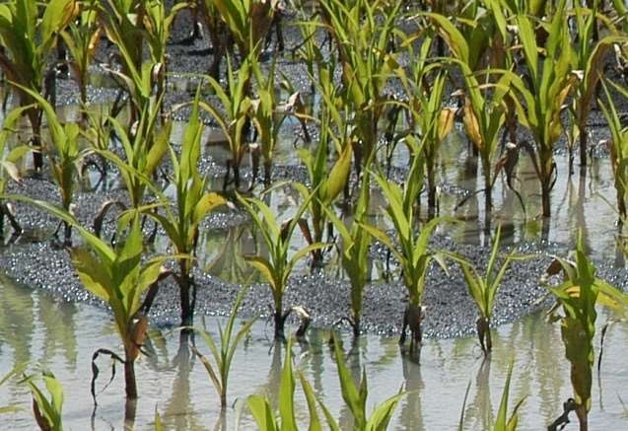
WATER LOGGING

Slide 13
As per Levitt (1980 b) flooding (i.e. water logging) is the presence of water in soil excess of field capacity.
It leads to deficiency of O2 and build up of Co2, Ethylene and other toxic gases and this leads to reduction in aerobic respiration.
Effects of water logging:
Once soil becomes water logged, air space in soil is displaced with water, the O2 in the soil in dissolved in water. i.e. O2 decreases; Co2 ethylene and other toxic gases increases.
O2 replacement in the soil is very inefficient. Diffusion of atmospheric O2 into the water logged soils is very inefficient (because of the slow diffusion of atmospheric O2 to water logged soil).

Slide 14
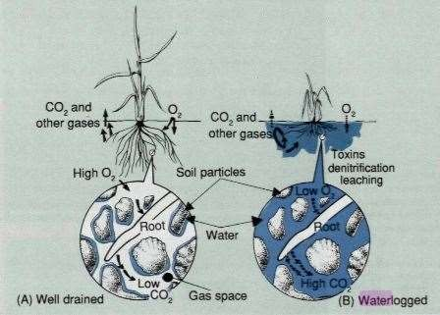
3. Root systems are suddenly plunged into an anaerobic condition. This switching from aerobic to anaerobic respiration disrupts root metabolism.
Carbohydrates level get depleted it is due to
Dissipation of metabolism
High water temperatur
Low light
e
If air space in soil is displaced with water, the O2 in the soil in dissolved in water. i.e. O2 decreases

Slide 15
Characteristics of plants in response to water logging stress :
Reduced growth / elongation.
Chlorosis, senescence and abscission of lower leaves
Wilting & leaf curling
Hypertrophy (increase in size of organ due to increase in cell size)
Epinasty (downward growth of petioles)

Slide 16
Mechanisms of tolerance:
Adventitious root formation on lower part of stem (close to surface so that O2 tension is quickly restored after transient water logging) eg. Tomato
Lenticel (i.e. raised pores in the stem of plants) formation
Aerenchyma formation (soft plant tissue continues air spaces found in acquatic plants) in the cortex that provide canal paralled to the axis of the root through which gases can diffuse longitudinally (eg. rice)

Slide 17
4. Elongation capacity (In rice – best elongation response give 100% recovery from submergence and poorest elongation gives upto 49% recovery) Scoring for elongation can be done between booting and flowering stage after flooding the crop to varying depths.
In sugarcane, S. spontaneum has more tolerance to flooding.
Some canes gave upto 70% of their production potential when in continuous flood for 5 months (in an east at canal point Florida, USA)

Slide 18
Ideotype for flooded areas : The postulated ideotype for flooded areas should have the following characterstics.
Capacity to carry out functional activity at low O2 concentration (i.e. High cytochrome activity)
Ability for photosynthesis under low light intensity
Capacity to synthesis food rapidly
Regeneration capacity of shoots when damaged by flood
Ability to withstand drought at later growth stage
Deep root system
Narrow, medium long and dark green leaves with high sugar and protein content.

Slide 20
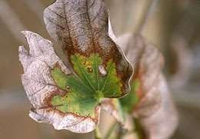
BREEDING FOR SALT TOLERANCE

Slide 21
Salt Tolerance: refers to the ability of plants to prevent, reduce or overcome injurious effects of soluble salts present in their root zone.
It is a global problem as saline and alkali soils are fond in almost all the countries of the world, more in Semi Arid Tropic (SAT) of world.
Problem of salinity can be overcome by two ways:
Soil reclaimation : costly, time consuming and short lived
Resistant varieties : less costly, more effective, long lasting require longer period to develop.

Slide 22
Behavior / characteristics of plants to salt :
Land races more tolerant than High yielding varieties. Tolerant plants varieties are found is salt affected areas
Salt tolerance capacity differs from species to species. Also genetic differences exist among cultivars for their salt tolerance capacity.
Different crop plants show differential response to salinity
Higher ploidy level crops are more tolerant than lower ploidy level crops.
Eg. Hexaploid wheat more tolerant than tetraploid Tetraploid Brassica more tolerant than diploid Brassica
In rice tall, coarse grained, late maturing varieties- more tolerant

Slide 23
In sugarcane different strains have differential tolerance; Barley is more tolerant than wheat.
Highly tolerant crops: Sugabeet, sunflower, barley (grain), cotton, datepalm, asparagus
Moderately Tolerant crops: Barley (Forage), rye, sorghum, wheat, safflower, soybean
Moderately sensitive: Rice, corn, foxtail millet, cow pea, peanut, sugarcane, tomato, potato, sweet potato, radish, alfalfa, cabbage
Extremely sensitive: Citrus, straw berry, melon, peas, other legumes, apple, rajmabean, carrot, okra, onion (orange)

Slide 24
Symptoms of plants to salt stress :
Retardation / cessation of growth
Necrosis
Leaf abscession
Loss of turgor
Ultimate death of plant
Mechanisms of salt tolerance :
2 types of mechanisms
1. Salt Tolerance : Plants respond to salinity stress by accumulating salt, generally in their cells or glands and roots etc.

Slide 25
2. Salt avoidance : plants avoid salt stress by maintaining their cell salt concentration unchanged either by water absorption eg. Rice, chenopodiaceae family or by salt exclusion eg. Tomato, soybean, citrus, wheat grass
Glycophytes (Non-halophytes) plants owe their resistance primarily to avoidance. Eg. Barley
Hallophytes (plants that grew in salty or alkaline soils) show tolerance by ion accumulation mechanism

Slide 26
Breeding methods
Breeding methods are same but breeding strategies are
Breeding for yield potential should have greater emphasis than breeding for salt resistance per se (As screening is done on the basis of yield reduction in stress environment as compared to non-stress Environment.).
Selection should be done is stresses target environments (As abiotic stress resistance is an important part of Environ. Fitness & is bound to be location specific i.e. it is related to narrow adaptation.

Slide 27
Screening Techniques
Common methods are
Sand culture by using nutrient solution in sand & irrigation with saline water
Solution culture by using solution culture tanks (Hydroponic culture)
Microplot techniques by using small microplots
Microplot Techniques: By using small microplots of size 6 x 3 x 1 m (CSSRI, Karnal, Haryana) at central soil salinity Research Institute.
Then Multilocation Trial (MLT) conducted over seasons to get more reliable results.Genotypes which survive better under salinity are considered tolerant & tested further.

Slide 28
Selection criteria
Germination (%) is saline medium
Dry matter accumulation (seeding / plant dry wt.) / Early vigour
Leaf senescence or death – Estimated by total dead leaf area or No. of dead leaves
Leaf necrosis
Leaf ion content
Osmoregulation (Determined as maintenance of turgor under stress) Measured as proline or CHO accumulation or accumulation of glycine, betaine etc.
Yield – Economic yield

Slide 29
Problems
Creation of reliable controlled salinity Env.
Scoring for salinity resistance
Genetic control – it is complex & polygenic
Mechanisms of resistance poorly understood. Salinity may have interaction with other stresses.

Slide 30
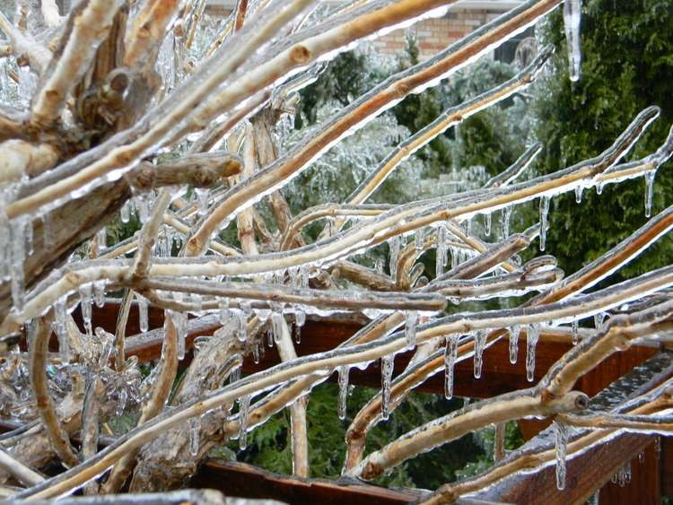
COLD TOLERANCE

Slide 31
When temperatures remain above-freezing i.e. >0C to <10- 15C it is called chilling
When temperature. remain below freezing i.e.<0C it is called Freezing.
A. Chilling Resistance:
Chilling sensitive plants are typically tropical plants.
Temperate plants are generally tolerant to chilling injury.

Slide 32
Effects of chilling stress on plants :
Reduced germination
Poor seedling establishment
Stunted growth
Wilting
Chlorosis
Necrosis
Pollen sterility
Poor fruit set / seed formation
Reduced root growth
Locked open stomato
ABA accumulation

Slide 33
At subcellular level
Reduces membrane stability
Poor chlorophyll synthesis (affected)
Reduced photosynthesis & respiration
Toxicity due to H2O2 formation
Chilling Tolerance
Ability of some genotypes to survive / perform better under chilling stress than other genotypes is called chilling tolerance. It is because of chilling hardening, i.e. an earlier exposure to a near chilling temperature for a specified period as a result of which chilling tolerance of the concerned plants increases.

Slide 34
Mechanisms of chilling tolerance:
Membrane lipid un-saturation
Reduced sensitivity of photosynthesis
Increased chlorophyll accumulation
Improved germination
Improved fruit / seed set
Pollen fertility
Sources of chilling Tolerance :
Late adopted breeding populations eg. maize
Germplasm (eg. That collected from high altitude , low temperature geographic regions)

Slide 35
Induced mutants for cold tolerance
Cold tolerant somaclonal variants
Related wild species eg. Tomato
Selection criteria: Based on -
Germination test
Growth under stress (measured as plant dry matter accumulation)
Chlorophyll Loss under chilling stress eg. rice, cucumber, tomato (measured as seedling colour)
Membrane stability : (Assayed in terms of solute leakage from tissues)
Photosynthesis : Chilling injury to photosynthesis is assayed as variable chlorophyll fluorescence at 685 nm

Slide 36
Seedling mortality
Seed / Fruit set
Pollen fertility (apply during injury at PMC)
B. Freezing Resistance
Freezing injury / Frost injury / cryo injury
Freezing Stress : Dormant state is conducive to freezing resistance, while resistance in actively growing tissue is rare : Thus Freezing resistance largely involves surviving freezing stress in such a manner as to enable subsequent regrowth when the temperature rises.
As water in plants cools below 0C, it may either
1. Freeze i.e. form ice or 2. Super cool without forming ice.

Slide 37
Effects of freezing stress
1. Ice formation : Two types
A. Intercellular ice formation,B. Intracellular ice formation Intercellular Ice formation: Initiation of ice formation on plant
surface is sufficient to induce freezing of the internal (intercellular & xylem vessels etc.) water in most plant
species. Intracellular ice formation: It is more lethal may be due to physical disruption of subcellular structure by ice
crystal. Intracellular ice formation is the major and terminal freezing stress.
Extracellular ice formation in a cases the concentrations of extracellular solutes, there by water is withdrawn from the cells during extracellular ice formation. This creates water stress in the frozen tissue / plant.

Slide 38
Membrane disruptions :
Freezing causes disruptions or alter the semipermeable properties of plasma membrane. Loss of solutes from the cells occur, Cells remain plasmolyzed even after thawing which is often called as frost plasmolysis. Cells may become highly effected due to uptake of excess water.
Supercooling :
Cooling of water below 0C without ice crystal formation is called supercooling . In plants water may cooldown to -1 to- 15C is herbaceous sps and to -4 to -45C in hardy trees. This becomes possible apparently because internal ice nucleators are absence in such cases.This is regarded as an important.
Mechanism of freezing avoidance

Slide 39
4. Stress due to external factors : Consequent to freezing
Ice sheet formation below and above the ground causes reserve depletion anoxia etc. in plants.
Tissues killed during freeze-thaw are highly prone to pathogen attacks
Auto toxicity may occur

Slide 40
Mechanism of Freezing resistance.
1. Freezing avoidance : The ability of plant tissues / or genes (but the whole plants) to avoid ice formation at sub zero temperature is called freezing avoidance. Supercooling is a mechanism of freezing avoidance.
It is controlled by
Lack of ice-nucleators
Small cell size
Little or no intercellular space
Low moisture content
Barriers against external nucleators
Presence of antinucleators

Slide 41
2. Freezing Tolerance : Ability of plants to survive the stresses generated by extra cellular ice formation and to recover and regrow after thawing is known as freezing tolerance.
The various components of freezing tolerance are as follows:
Osmotic adjustment
Amount of bound water
Plasma membrane stability
Cell wall components properties
Cold-responsive proteins Eg. ABA

Slide 42
Sources of freezing tolerance
Cultivated varieties
Germplasm lines
Induced Mutations
Related wild species Eg. Wheat Agropyron sps; rye, Barley –
H. jubatum, H.brachyantherum x H.bogdanii, H.jubatum x H.compressum, Oats – Avena sterilis
5. Transgenes : Eg. chemical Synthesized antifreeze protein gene, ala 3, in tobacco

Slide 43
Selection criteria:
Based on
Field survival
Freezing test in laboratory
Cryo freezing
Osmoregulation

Slide 44
Problems in breeding for freezing tolerance
Freezing Tolerance is a complex trait & involves several components. So, it is not ready measurable under field conditions
Breeding work under field conditions is highly influenced by other environmental factors and biotic stresses
Due to large G X E for the trait field survival shows poor heritability
Freezing tolerance also shows a large GXE interaction which limits progress under selection
Laboratory tests are yet to be developed to screen large breeding population

