Slide 1
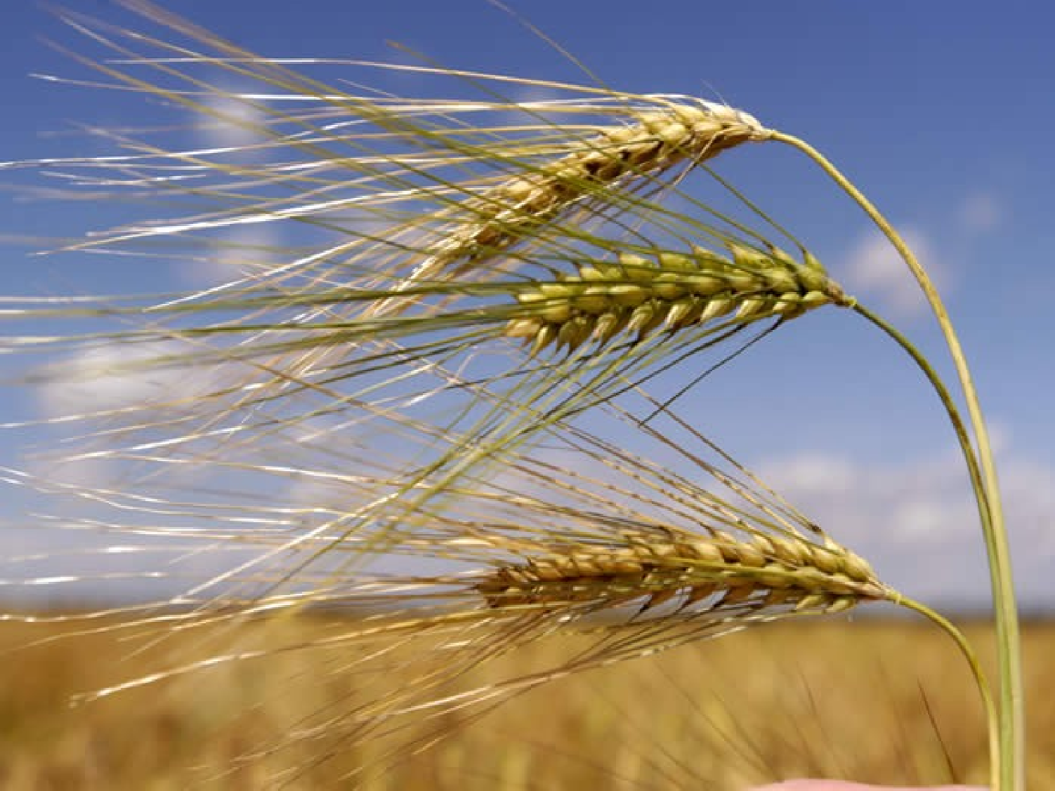


Slide 2
BARLE Y
Hordeum vulgare L.
FAMILY:
POACEAE
URDU:
JOW

Slide 3
BARLEY
♣
ANNUAL
♣
MONOCOT
♣
RABI CROP
♣
DETERMINATE
♣
95% MORE ENERGY AS COMPARED TO
MAIZE FODDER

Slide 4
IMPORTANCE
♣
LESS IMPORTANT THAN WHEAT
♣
FOOD , SATU , ALCOHOL , BREAD
♣
RICH IN ENZYMEZ
♣
BALLANCED IN FAT & ENERGY
♣
HIGH IN FIBER & PROTIEN
♣
LOW ACID CONTENT

Slide 5
ORIGIN
♣
DEFINITE ORIGIN NOT KNOWN
♣
WESTERN PART OF IRAN (ZAGROS MOUNTAINS)
♣
WESTERN PARTS OF PAKISTAN

Slide 6
ADAPTATION
♣
WIDE RANGE OF ADAPTABILITY
♣
DROUGHT RESISTANT
♣
DISEASE RESISTANT
♣
RAINFED AREAS
♣
SUSCPTEIBLE TO WATER LOGGING

Slide 7
PRODUCTION
PAKISTAN 2015
Area | 84,100 ha
Production | 71,400 tones
yield | 0.85 t ha⁻¹
Pakistan not in top 20 barley producers

Slide 8
MORPHOLOGY
♣
HYPOGEAL MODE OF GERMINATION
♣
ADVENTITIOUS ROOT SYSTEM
♣
100 CM NORMAL (UP TO 400 CM) ROOT
DEPTH

Slide 9
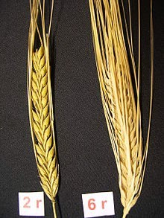
INFLORESCENCE
♣
SPIKE
♣
AWNED
♣
SPIKELETS ALWAYS ARRANGED
♣
TWO PARTS (LEMMA & PALEA)
♣
LEMMA (Hull) :outer covering containing awn
♣
PALEA (Husk) :beneath lemma and covers grain

Slide 10
SOIL
♣
ALMOST ALL SOIL TYPES
♣
HEAVY TO LOAM TO SANDY
♣
CAN NOT BE GROWN IN WATERLOGGED
SOILS
♣
SALT TOLERANT

Slide 11
SOWING TIME
RAINFED
♣EARLY SOWING 15 OCT. 31 OCT.
♣MID SOWING NOV. – DEC.
♣LATE SOWING TILL 15 JAN. IRRIGATED
♣NOVEMBER (OPTIMUM)
♣DECEMBER

Slide 12
BREEDING METHODS
Bulk Method
Pedigree method
Mass Selection
Pure line selection
Back cross method
Single seed descent method

Slide 13
SEED RATE
♣
70-80 Kg Ha⁻¹
♣
METHOD
♣
PURITY
♣
GERMINATION PERCENTAGE
♣
VAREITY

Slide 14
VARIETIE S
♣
RATNA (rainfed)
♣
Azad (K.125) (yellow rust)
♣
Karan-201, 231 and 264 (Huskless)
♣
C- l64 (long awns)

Slide 15
SELFFING
®
Because it is highly self pollinated crop.
®
Only 03% chances of crossing.
®
For selffing Simply cover the spike of desired plant with Butter paper bag.

Slide 16

EMESCULATION:
Plant selection
Spike selection (stage) Cut spike 1/3rd from top Cut 1/3rd of floret Remove anthers Cover the spike
Tagging for female plant
®
®
®
®
®
®
®

Slide 17
POLLINATION
®
Selection of Male plant
®
Cut 1/3rd of each floret
®
Place spike in sunlight for almost 5min
®
Shred pollens on emasculated spike
®
Tagging

