Slide 1
INTRODUCTION
Scientific name : Nicotiana tobaccum
Family: solanaceae
Chromosome number :2n=4x=48
Origin :America
2

Slide 2
IMPORTANCE
Nicotiana is one of five large genera of solanaceae and it is represented by about 60 species
INDIA is the 4th largest producer of tobacco after USA,Brazil,Canada.
India is the 8th largest exporter of tobacco
3

Slide 3
ORIGIN AND EVOLUTION
Nicotiana sylvetries X Nicotiana tomentosa
2n=24 2n=24
F1(sterile)
Natural doubling of Chromosome
Nicotiana tobaccum
2n=2x=48

Slide 4
continued
Nicotiana paniculata X Nicotiana undulata
2n=24
•
Natural doubling of
2n=24
F1(sterile)
chromosome
•
•
Nicotiana rustica
2n=4x=48

Slide 5
FLORAL BIOLOGY
The inflorescence of tobacco is a terminal raceme
The flowers are pedicellate and hermophrodite
Calyx contain five sepals
Corolla contain five petal

Slide 6
continued
The stamens are five in number
It has superior ovary
It is self pollinated crop but;4-10; of cross pollination occurs due to insects. therefore it is
Grouped into often cross pollinated crop

Slide 7
Cont…..
Pollens are viable for 24hrs
Stigma is receptive one day before and after flower opening

Slide 8
Selfing technique
Covering entire inflorescence with paper bag will ensures the selfing technique

Slide 9
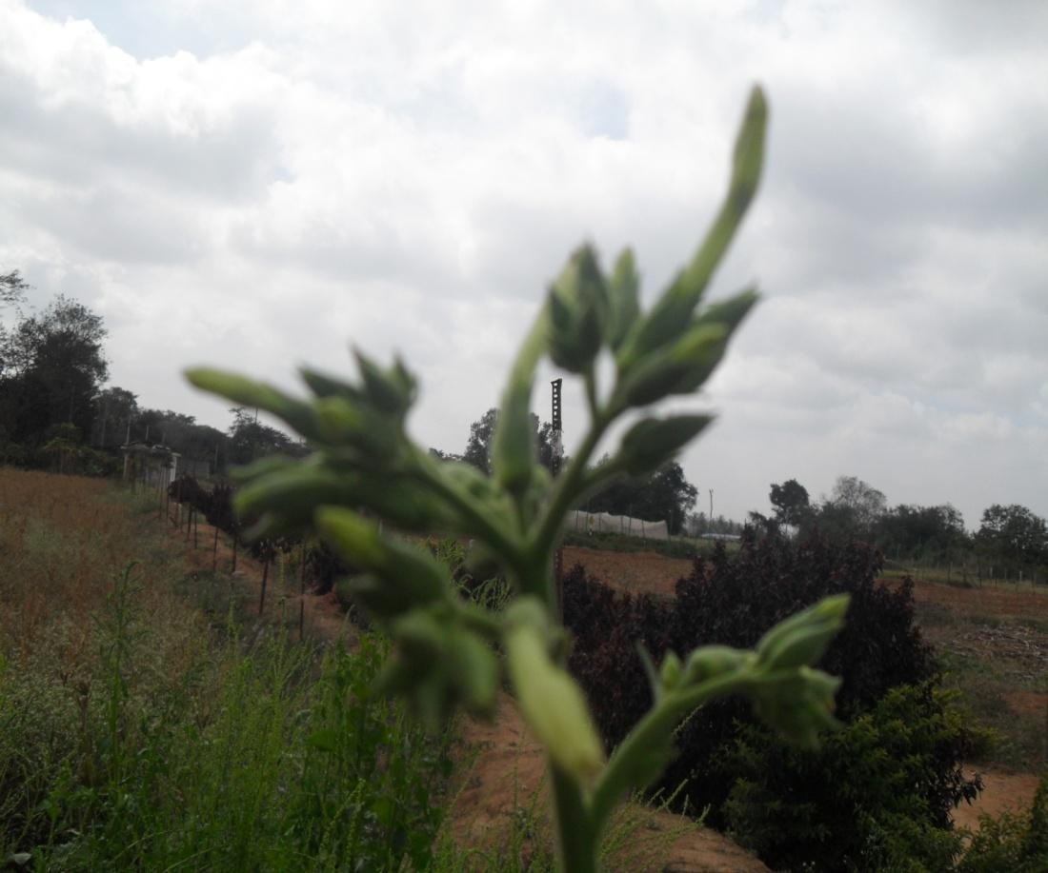
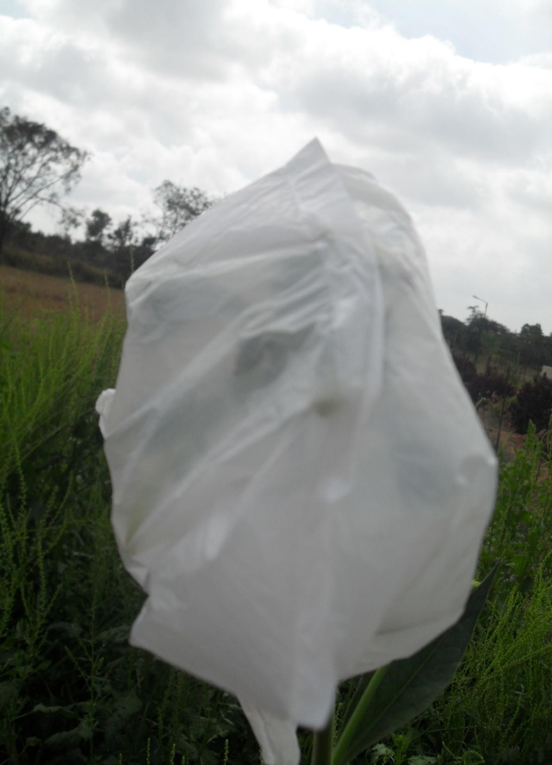

Slide 10
Crossing technique
It involves emasculation followed by pollination
For emasculation select the unopened flowers with pink colour tip and anthers are removed with five pointed forceps after tearing petals
Collect the pollen grain from matured flowers and dust it on the emasculated flower
Bag the pollinated flower and then tag it

Slide 11
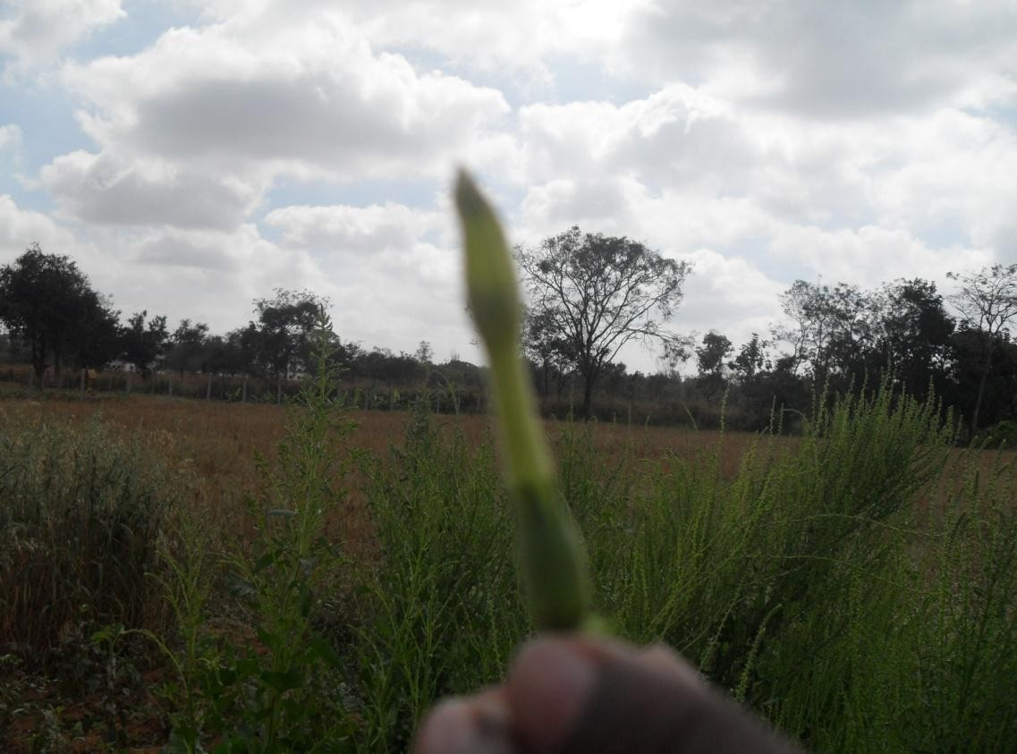
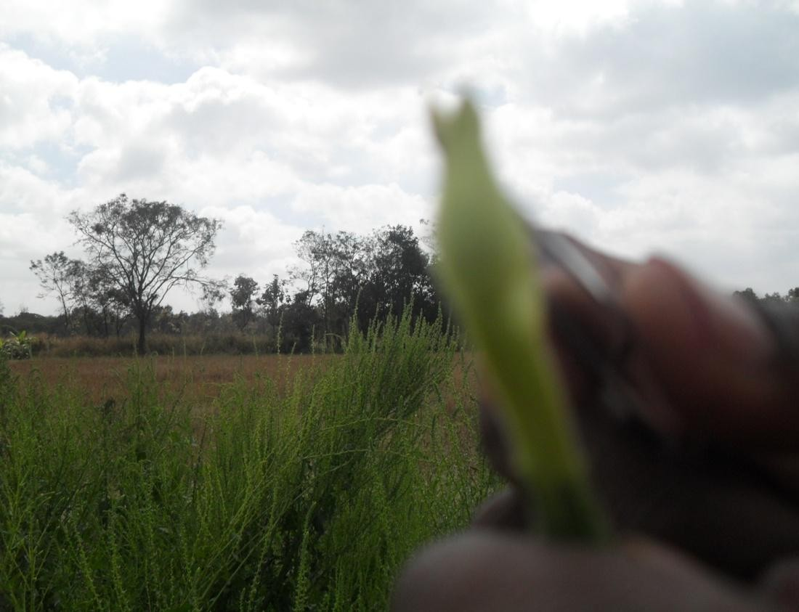
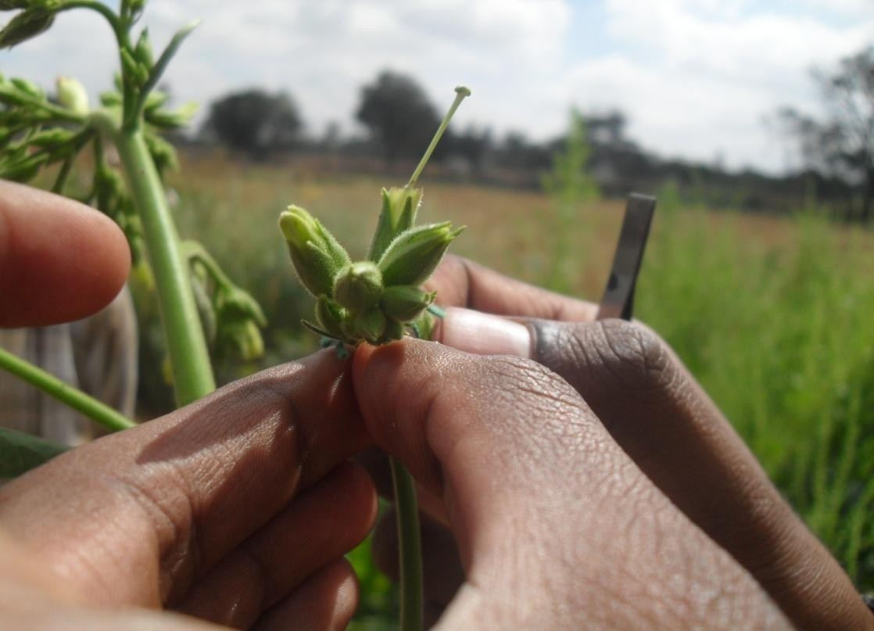
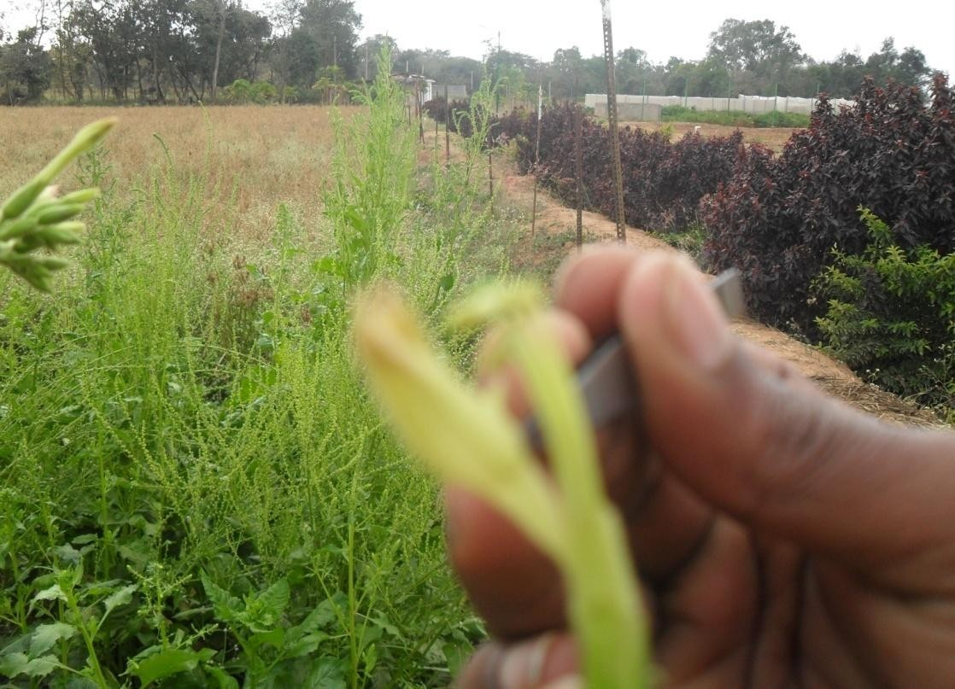

Slide 12
IMPORTANT VARITIES
Godavari,swarna,krishna,thangam
Sona,maragandam

