Slide 1
BREEDING
FOR DEVELOPMENT OF IMPROVED OKRA
1

Slide 2
INTRODUCTION
Perennial plant but mostly cultivated as annual.
Popular summer vegetables in Bangladesh.
Green seed pods are eaten as vegetable.
Young aged okra can be used as salad.
Allopolyploid.
2

Slide 3
BENEFITS OF OKRA
Significant amounts of vital nutrients- Protein, Fiber, Calcium, Iron and Zinc.
Prevents Liver Disease.
Boosts Immunity.
Improves Eyesight.
Help to Loss Weight.
Okra Seeds can delay Fatiguing.

Slide 4
TAXONOMY
Kingdom: Plantae Division: Magnoliophyta
Class: Magnoliopsida Order: Malvales
Family: Malvaceae
Genus: Abelmoschus
Species: Abelmoschus esculentus

Slide 5
Major Okra Growing Countries
Tropical, Subtropical and Warm Temperate Regions around the World.
India
Sudan
Pakistan
Ghana
Nigeria
Iraq
Cameroon
Egypt

Slide 6
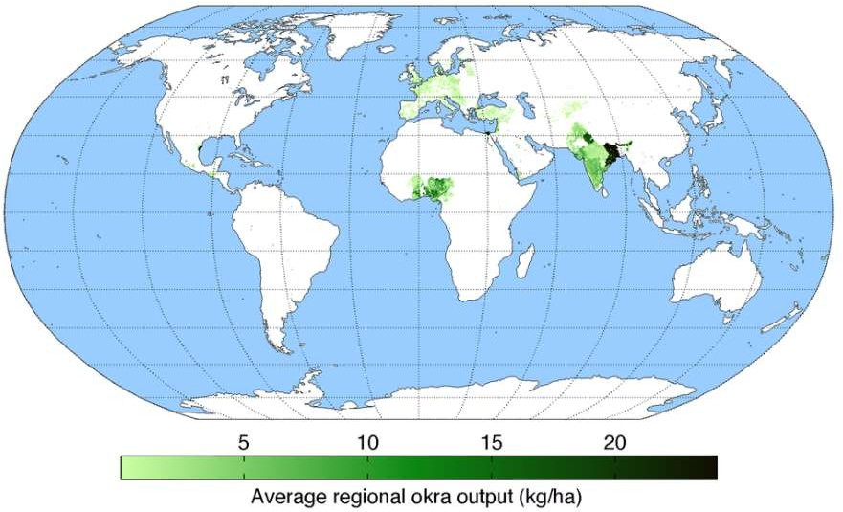
Map Showing Worldwide Okra Production

Slide 7
Origin Of Okra
Tropical Asia and Africa
Two wild species are originated from Asia
Crinitus
A. angulosus
Primary Center of Origin
Central Asia, Near East
Secondary Center of Origin
Africa

Slide 8
BOTANICAL DESCRIPTIONS
Okra is an herbaceous annual plant.
Stem: Small and Erect.
Leaves: Heart shaped, Alternate,10–20 cm long.
Hight: 1.2–1.8 m tall.
Propagation: Typically propagated from seed.
Chromosome Number: 2n = 130 and 2n = 72

Slide 9
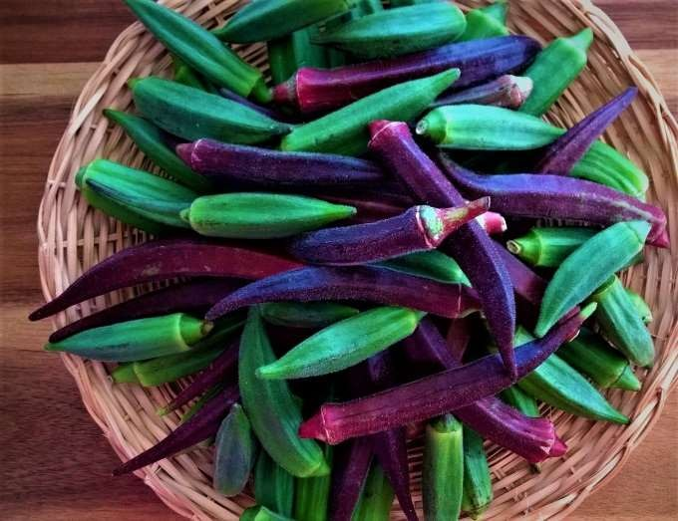
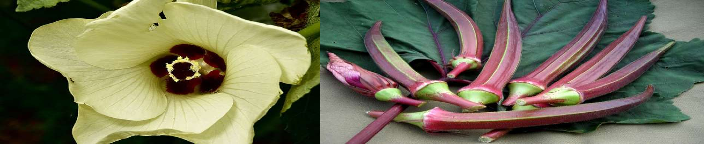

Slide 10
FLORAL BIOLOGY
FLOWER: Solitary, long pedancle
EPICALYX: Long , narrow hairy
CALYX: Splits longitudinally as the flower open
PETALS: 5, yellow in color
STAMENS: Staminal column is united to base of Petal with many stamens
OVERY : Superior
FRUITS: Capsule
POLLEN VIABILITY: 55 days
PROTOGYNY: Allogamy, but out cross by insect 19%

Slide 11
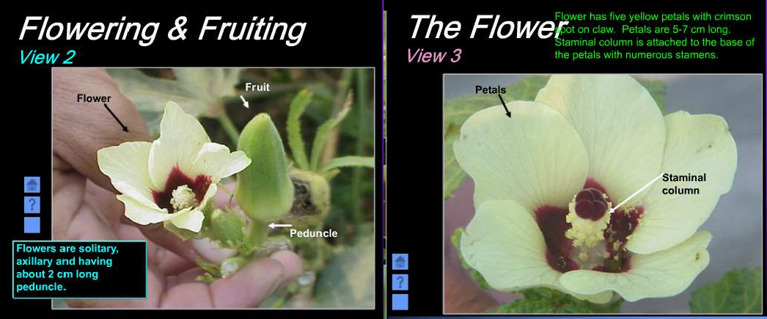
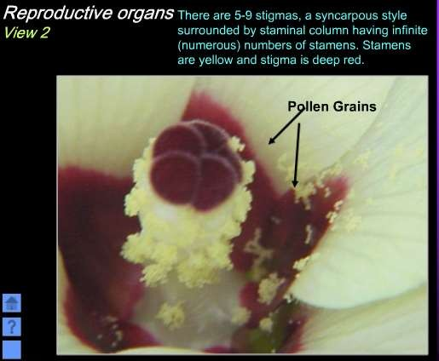
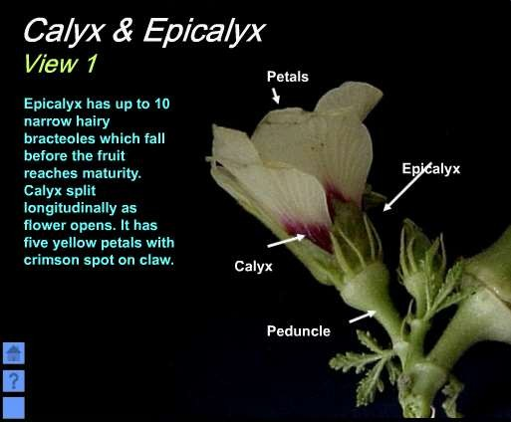

Slide 12
Types Of Okra
Spineless Okra
Dwarf Okra
Giant Okra
Round-Pod Okra
Star-Pod Okra

Slide 13
Variety and cultivar
Clemson Spineless
Chinese Okra
Purple Okra
Punjab-8
BARI Dherosh-1
BARI Dherosh-2

Slide 14
BREEDING OBJECTIVES
To study the every part of the okra cultivation and management practices.
To evaluate the yield of the crop.
To analyze the cost benefit.
To identify the problems during the crop management.
To propose the suggestions for the problems.

Slide 15
Breeding Methods
Pure-line Selection
Pedigree Method
Mutation Breeding
Heterosis Breeding

Slide 16
PURE-LINE SELECTION
Large numbers of plants are selected from a self- pollinated crop and is harvested individually. Then the individual plant progenies from them are evaluated separately and the best one is released as pure line variety.
The pure line becomes genetically variable with time, due to mechanical mixture, mutation, etc.
Superior line is used as variety.

Slide 17
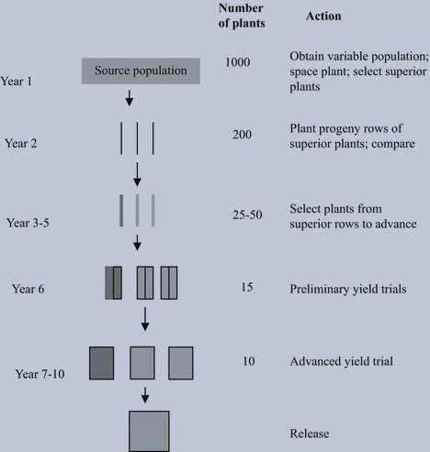

Slide 18
Advantages
Maximum possible improvement
Extremely uniform
Easy Method
Required Less Skill
Used to Develop Inbreed and Pure lines

Slide 19
PEDIGREE METHOD
This method is applicable to the segregating generations after hybridization between desirable promising donors.
The individual plant selection starts in the F2 generation and continues till F5 or F6.

Slide 20
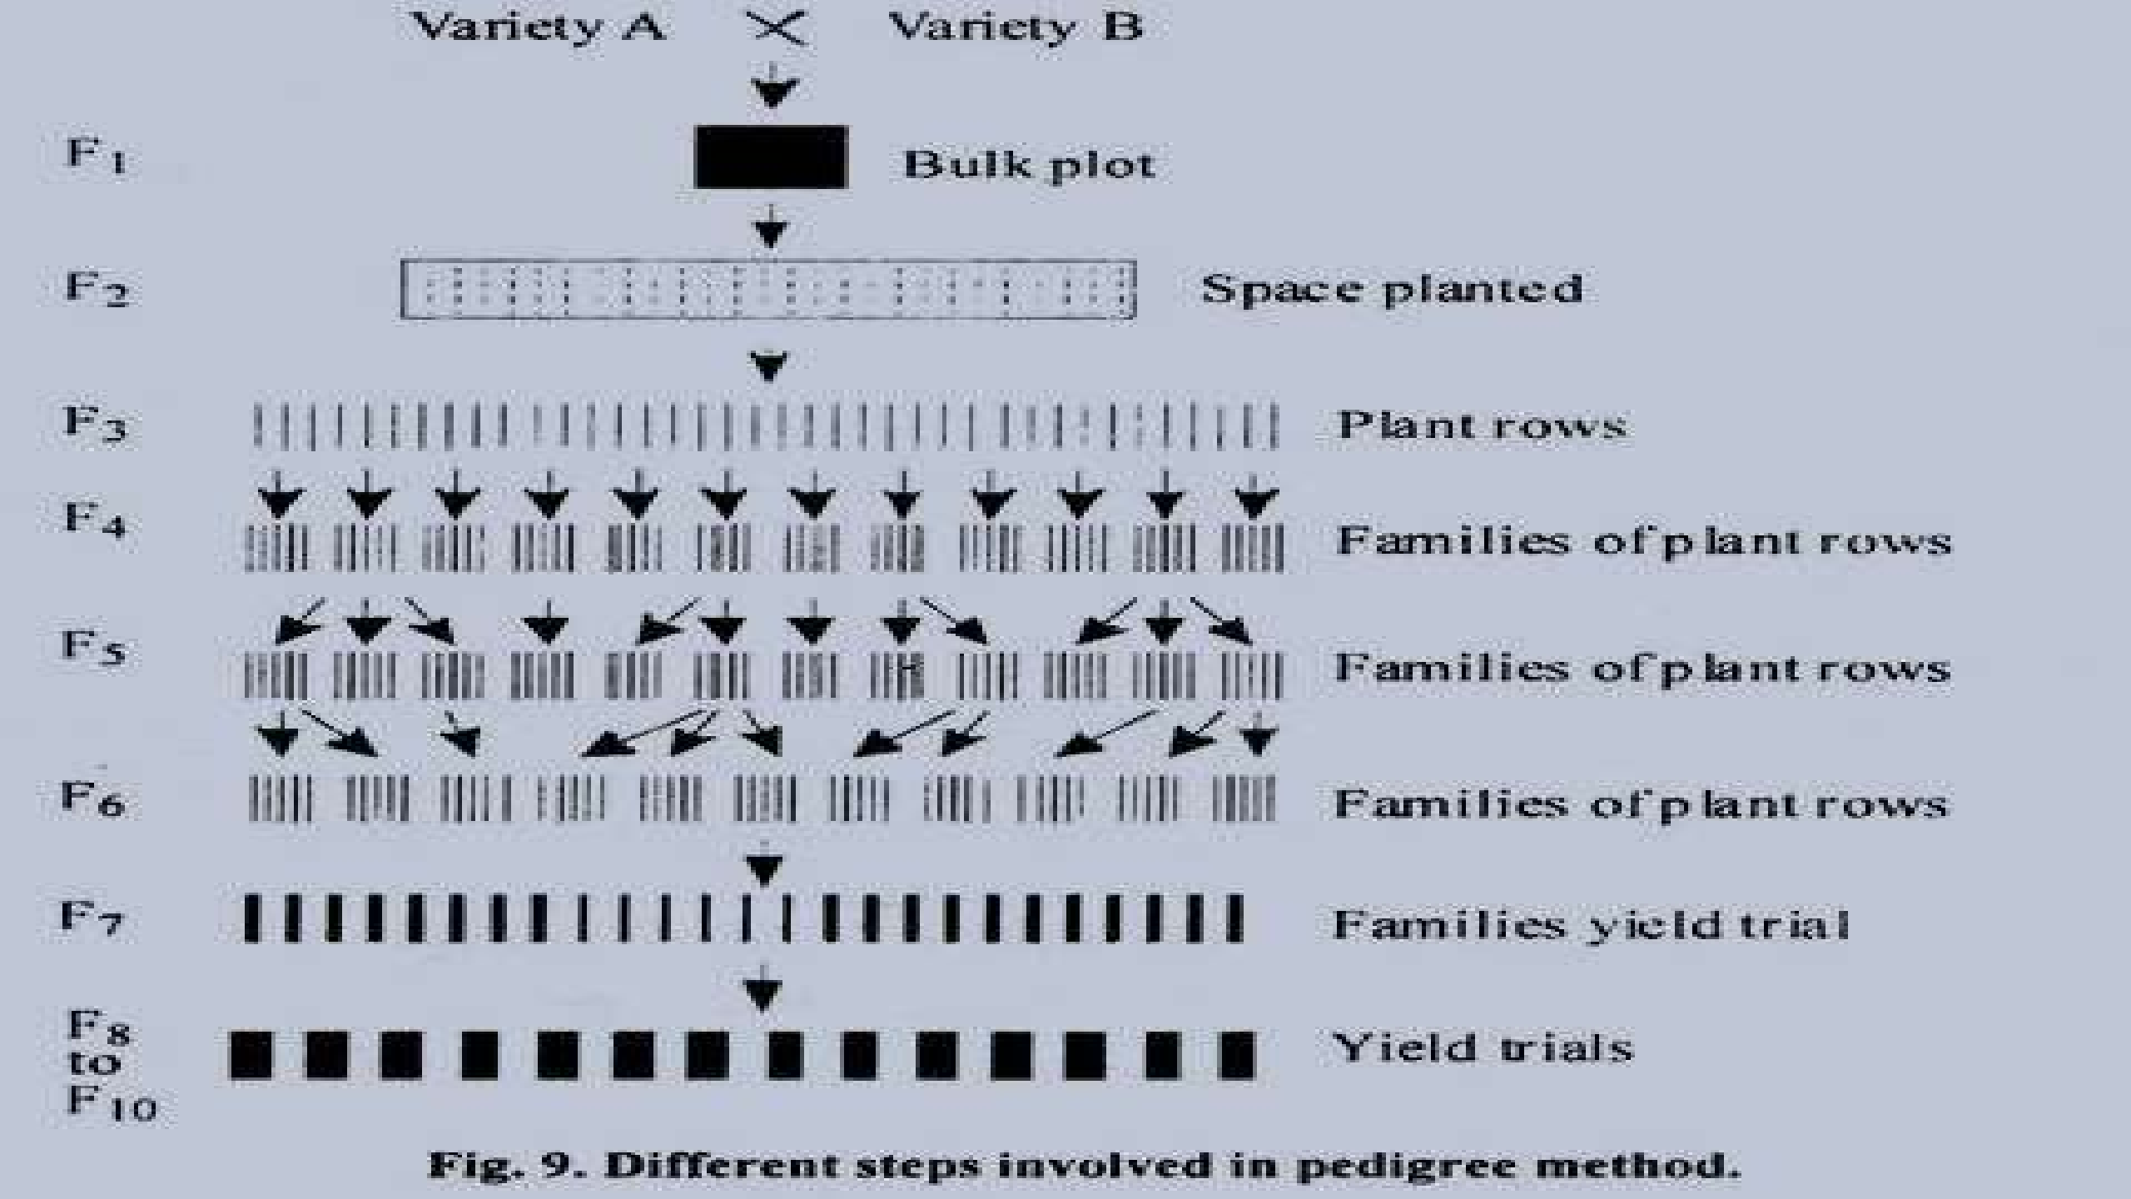

Slide 21
MUTATION BREEDING
Mutation breeding is the process of exposing seeds to chemicals or radiation in order to generate mutants with desirable traits to be breed with other cultivars.
There are different kinds of mutagenic breeding such as using chemical mutagens like ethyl methane sulfonate and dimethyl sulfate, radiation and transposons are used to generate mutants.

Slide 22
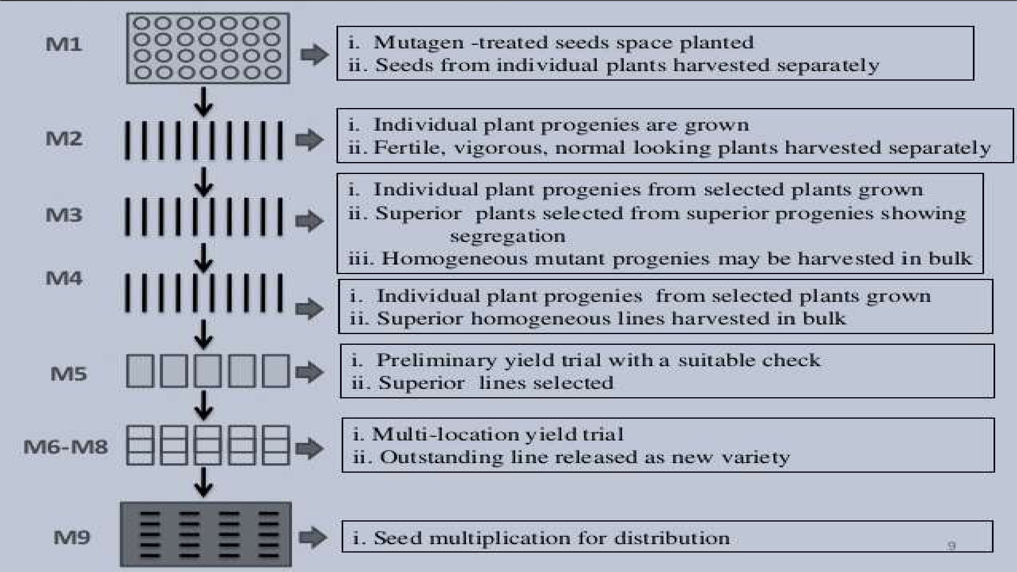

Slide 23
Advantages
Improves Morphological And Physiological Characters Of Plant.
Improves Disease Resistant Plant Crops
To Create High Yielding Variety
To Disseminate Undesirable Characters From Plant
Quantitative Characteristics Of Plant Including Yield Can Be Improved.

Slide 24
HETEROSIS BREEDING
Improved Quality of progeny over its parents is called heterosis.
Heterosis in okra has been reported for various economic traits, viz. early and late flowering, plant height, number, weight and size of pods, number of ridges, marketable and total yield.
Using hand emasculation and pollination, commercial hybrids are developed.

Slide 25

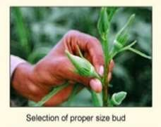
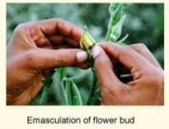
HYBRID SEED PRODUCTION
Hand emasculation is the removal of stamens from Bi-sexual flowers.

Slide 26
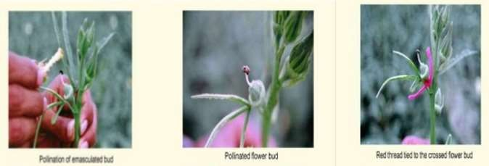
POLLINATION
Pollen from freshly open bud which are previously bagged from the male parent line is collected in the morning.
Pollen is dusted directly on stigma of the emasculated flower of the female parents with the help of camel hair brush.
For selfing, cover the individual flower with the butter paper bag.

Slide 27
CONSTRAINTS OF OKRA PRODUCTION
Seeds do not germinate; Plants do not emerge. Soil temperature must be at least 70°F for okra to germinate. Seeds are needed to be pre-soaked in water for 24 hours before sowing.
Flowers and buds drop before pods set. Temperatures greater than 95°F also Temperatures too cool can cause flower and bud drop.
Heat and cold can interfere with pollinations. Pollination will be poor if temperatures rise above 90°F or drop below 55°F. Too little light, water stress, and excess nitrogen also inhibit pod formation.

Slide 28
Deformed pods. Bug sucks sap from leaves and pods causing them to become twisted and deformed. Spraying with insecticidal soap and Dusting with sabadilla can be useful.
Pods are woody and tough. Okra should be picked just a few days after flowering.

Slide 29
Others:
Lack of breeding knowledge
Lack of field
Abiotic stress
Lack of proper management practices
Standing of water

Slide 30
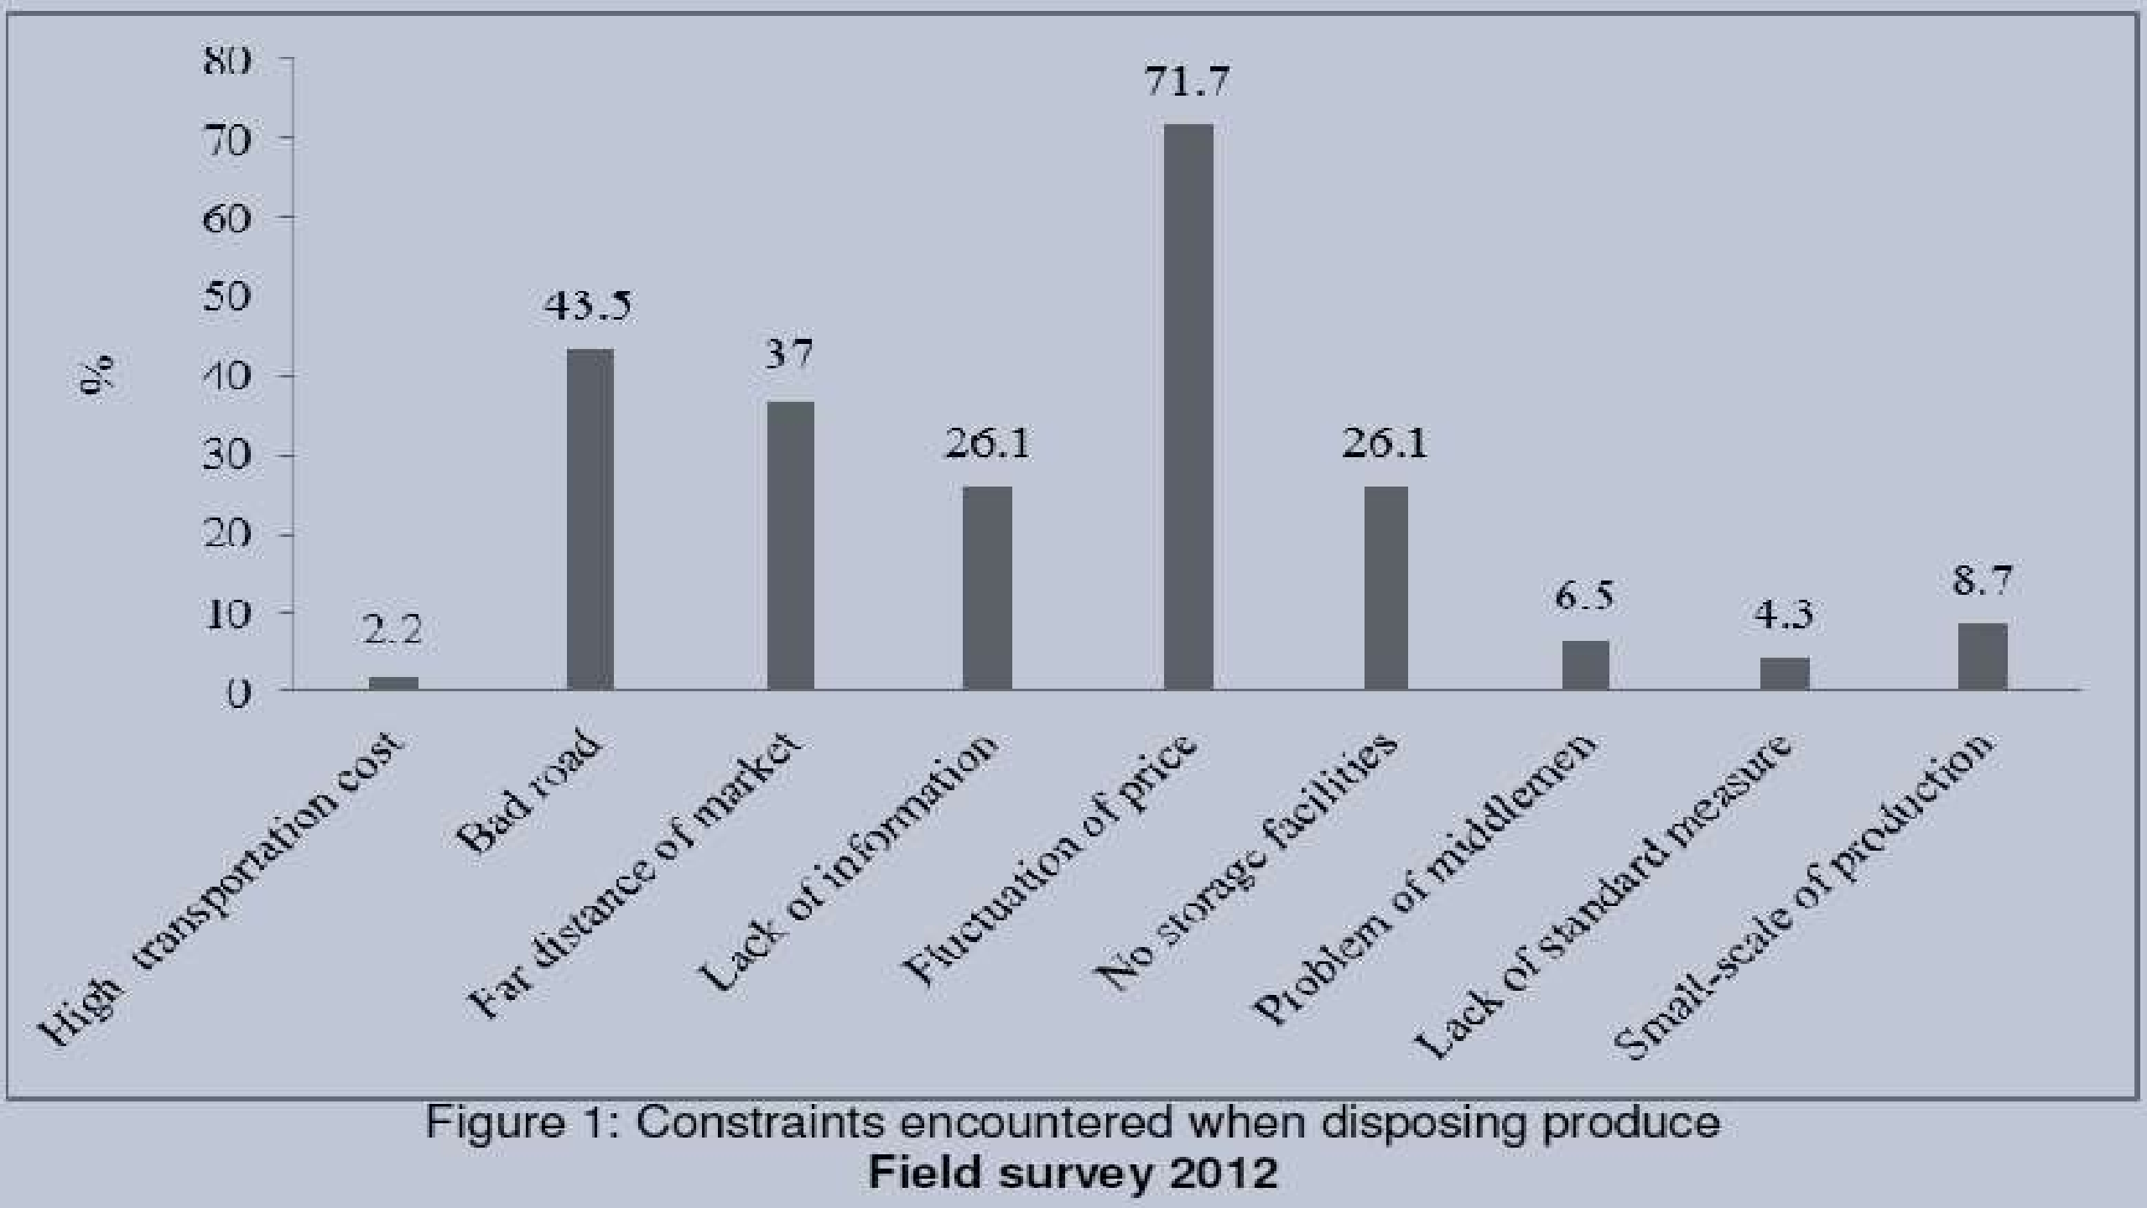

Slide 31
CONCLUSION
In Bangladesh vegetable production is not uniform round the year. Vegetables are plenty in winter, but are lower in summer. Though it is popular in the country, its production is mainly concentrated during summer. So, as vegetable okra can get an importance in summer.
Okra is one vegetable crop where heterosis has been exploited successfully.
32

Slide 32
Yield plateau seems to have been reached in heterotic hybrids. In order to break this barrier there is a need to
develop truly combination can
potential inbred lines which in produce really novel hybrids with
desirable maximum heterosis.
Among the various approaches for developing inbred lines, selection in potential segregating populations is an important one. But then, the key to success lies in developing the really promising potential segregating populations.

Slide 33


