Slide 1
MODIFICATION OF MYCELIUM/ SPECIALISED SOMATIC STRUCTURES
Purpose:
1. to obtain nourishment i. e., for nutrition .
2. to resist or tolerate unfavourable conditions for their survival .
3. for reproduction.
1.Rhizomorphs: ( rhiza=root, morph=shape) Thick strands of somatic hyphae, which is resistant to adverse conditions . The structure of growing tip of rhizomorphs res emble that of a root tip, hence the name rhizomorph. Eg. Armillariella mellea.
2. Sclerotium: (skleron=hard) pl.sclerotia: It is a hard, round,dark coloured resting body formed due to aggregation of mycelium, resistant to unfavourable conditions .
Eg. Sclerotium, Rhizoctonia .
3. Stroma: (stroma=mattress) pl.stromata. It is a compact somatic structure looks like a mattress or a cushion on which or in which fructifications ( spores or fruiting bodies ) are usually formed.
Eg.Claviceps, Xylaria.
4. Haustorium: ( hauster=drinker) pl.haustoria.It is a outgrowth of somatic hyphae regarded as special absorbing organ produced on certain hyphae by parasitic fungi for obtaining nourishment by piercing into living cells of host. They may be knob like
( Albugo), elongated ( Erysiphe, Uncinula), finger like ( Peronospora ).

Slide 2
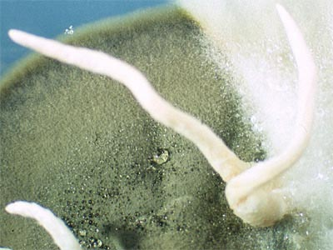
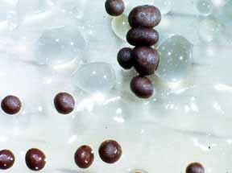
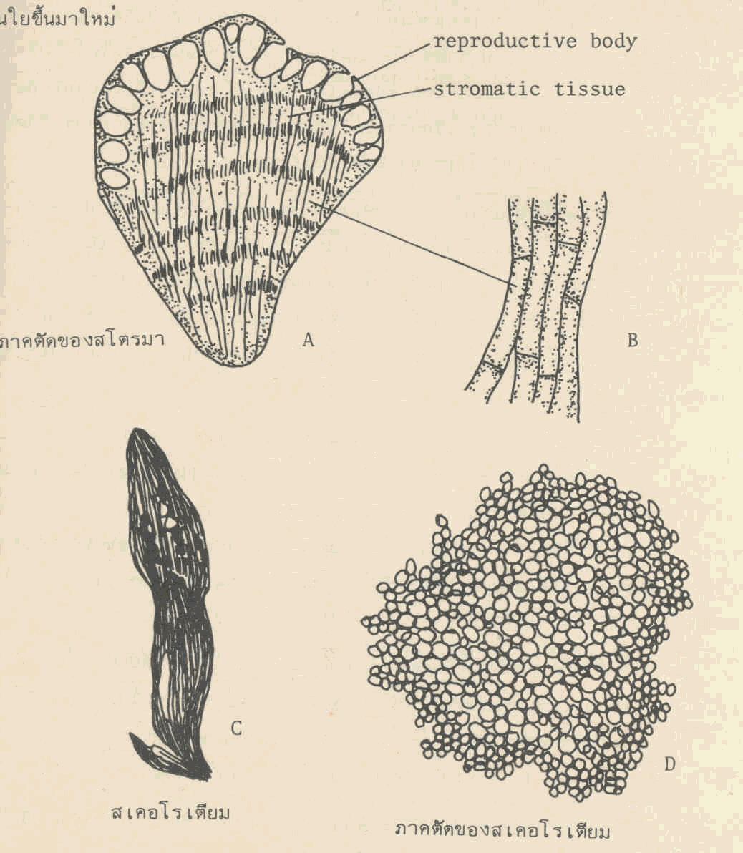
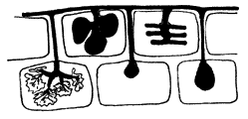
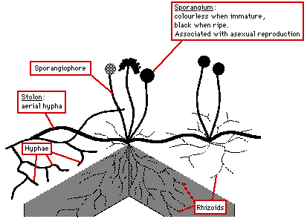
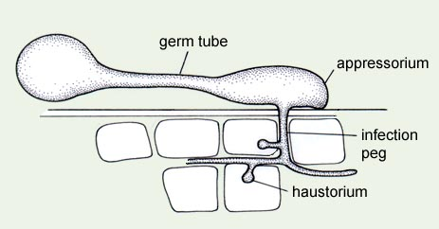
5.Rhizoids: (rhiza=root, oeides=like) These are slender root like branched structures found in the substratum produced by some fungi which are useful for anchoring the thallus to substratum and for obtaining nourishment from the substrate.Eg. Rhizopus stolonifer.
6. Appresorium: (apprimere=to press against) pl.appressoria A flattened tip of hyphae or germ tube acting as pressing organ by attaching to the host surface and gives rise to a minute infection peg which usually grows and penetrates the epidermal cells of the host. Eg. Puccinia, Colletotrichum, Erysiphe.
1 Rhizomorph
2 Sclerotia
3 Stroma
4 Haustorium
5 Rhizoids
6 Appressorium

