Slide 1
Module2.1 Epidemiology of low vision

Slide 2
Content
Definition of Epidemiology
Global epidemiology
Global distribution of blindness
Epidemiological methodologies
Age blindness burden
Regional burden of blindness

Slide 3
Epidemiology
Epidemiology has been deﬁned as the study of the distribution, determinants and control of diseases in human populations.

Slide 4
Global epidemiology
Although analysis of registration data from developed countries with adequate social care facilities provides a basis for comparison, an entirely different approach has to be taken when looking at the incidence and prevalence of visual impairment in the developing world.
In these cases prevalence has to be established from representative community-based studies, the results of which need to be extrapolated to the population as a whole.

Slide 5
continue
world data into eight economic regions and examined the prevalence accordingly.
In established market economies, including
western Europe:- the USA, Australia, New Zealand and Japan, the prevalence of blindness is estimated as 0.3%.
In Latin America:- China and the Middle East it rises to 0.5–0.7%, whereas in Asia and India the proportion rises to almost 1.0%.

Slide 6
Continue ..
Most strikingly the prevalence in sub-Saharan Africa is approximately 1.4%.
The overall global estimate of blindness is 45 million, with a further 135 million individuals classiﬁed as having low vision .

Slide 7
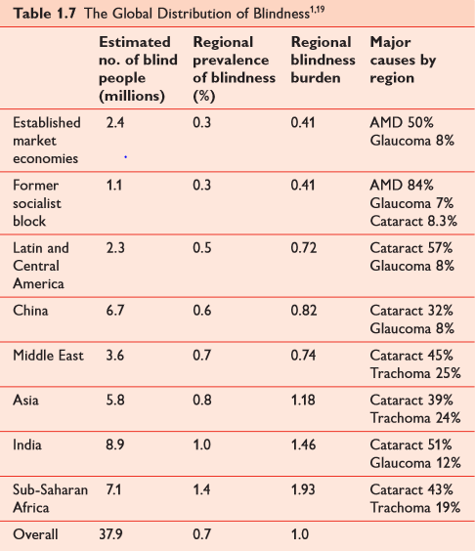
Global distribution of blindness

Slide 8
Continue..
Another striking factor is the relative distribution of blindness according to age across the world.
Foster & Gilbert20 estimated that, of the 1.5 million blind children worldwide, 1.3 million reside in Asia and Africa, and that 75% of this blindness could have been prevented or is curable.
The prevalence rate for childhood blindness in Europe and North America (0.03%) contrasts markedly with that in Africa (0.11%).

Slide 9
Continue…..
Distressingly, between 60% and 80% of children who become blind die within 2 years of having become blind.

Slide 10
Reference
Low vision manual by A. Jonathan Jackson james. S wolffson Page no 10 to 16.

Slide 11
Thank you

