Slide 1
Module 2.3.3 Evaluation of low vision patient

Slide 2
Near Vision Testing
1. In low vision near vision is recorded as the size of print that can be read fluently and easily.
2. Allow the patient to read at his/her preferred distance
3. Secondly measure functional reading ability for each eye at 40 cms .
4. For both near testing situation use reading cards specifically designed for low vision.

Slide 3
D. REFRACTION
Importance of a good refraction in a low vision examination cannot be over-state.
Many times, people with low vision will have improvement with just careful refraction.
Refraction of low vision persons are not too different from the normal refraction procedure.

Slide 4
Tests conducted
Visual Field Testing and Amsler Grid Testing.
Contrast Sensitivity Function (CSF).
Colour Vision Testing.
Glare Testing.
Binocular Testing.

Slide 5
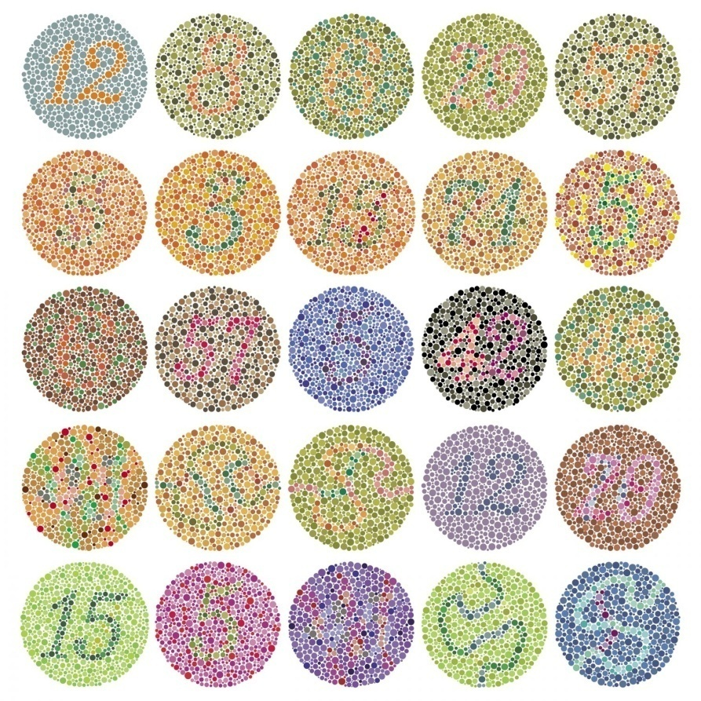
Continue…
Fig no : 5 , color vision chart

Slide 6
E. ASSESSMENT OF VISUAL FIELDS
Helps to evaluate central scotoma’s ,Mid, long and peripheral constrictions
Importance for orientation mobility and help in searching.

Slide 7
Continue…
Fig no 6 : Confrontation test

Slide 8
F. AMSLER GRID TESTING
Helps to know, extent of central retina available for magnification.
Visual Fields of 5 Degrees or less may limit the amount of magnification.
Visual fields are reduced below 40 Degrees.
It is a parameter of “LEGAL BLINDNESS”

Slide 9
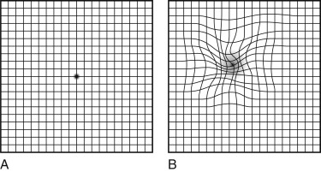
Continue…
Fig no 6 : Amsler grid

Slide 10
G. CONTRAST SENSITIVITY ASSESSMENT
Need for Magnification.
Ability to use Optical Devices.
Lighting (Functional Adaptive Device).
Overall Function-contrast enhancing techniques.

Slide 11
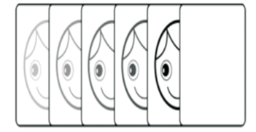
Continue…
Fig no 8 :Contrast sensitivity testing

Slide 12
H. COLOUR VISION TESTING
Significantly affect educational, vocational, daily living, and mobility needs.
Diagnostic of specific diseases.
Some colour vision tests e.g., Holmgren wool, D15 panel test, Ishihara's test.

Slide 13
Continue…
Fig no 9 : Colour vision testing beads

Slide 14
I. GLARE SENSITIVITY
Glare is the reduction of visual function caused by the scattering of incoming light.
Clear ocular media is required for clear image on the retina
Glare may be caused by the opacification of the ocular media.

Slide 15
Importance of Glare Testing
To choose proper levels of illumination.
Preferred non optical devices like tinted lenses/polaroid's or peaked caps.
Tinted Lenses/ polaroid's.
Peaked Cap.

Slide 16
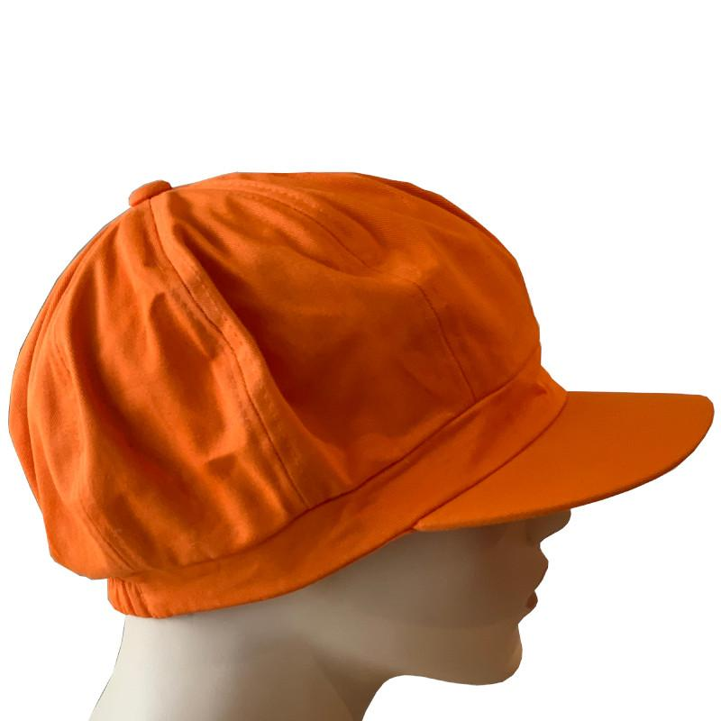

Continue…
Fig no 10 Cap
Fig no: 11 Tinted glasses

Slide 17
J. BINOCULAR TESTING
Gross assessment of ocular alignment.
Sensorimotor testing (e.g., Worth four dot, stereo fly, red lens test).
Amsler grid testing.
Contrast sensitivity.

Slide 18
REFERENCE
Guidelines for comprehensive management of low vision in India , 2013 ,chapter no:7 , pg. no 17 to 29 .

