Slide 1
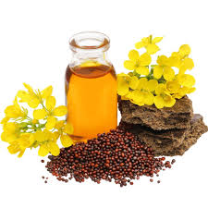
Name- Gungun Singh Regd. No – 210704170006 Branch – B.Sc. Zoology Subject- Economic botany
Topic to be presented –
MUSTARD

Slide 2
CONTENT
Introduction
Scientific classification
Origin
Climate and temperature
Soil
Morphology
Types of Mustard
Forms of mustard and Use

Slide 3
INTRODUCTION
It is originated native to temperate regions of Europe.
One of the first domesticated crops.
Major cultivating countries are Nepal, Canada, Myanmar, China and United States.

Slide 4
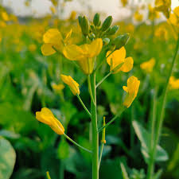
SCIENTIFIC CLASSIFICATION
Scientific name – Brassica indica
Kingdom- plantae
Order- brassicales
Family – Brassicaceae
Genus – Brassica
Vernacular name – Sarso, Rai

Slide 5
ORIGIN
It originated In Europe.
India occupies the first position for the production of mustard.
It includes over 150 species which are mostly native to the north temperate parts of the world.
These are centre of genetic diversity.
Europe
Central and southern Asia
China
Some different species have spread to the tropic and sub-tropics as cold season crops.

Slide 6
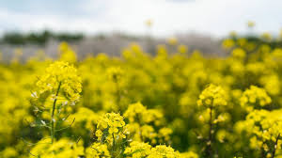

Slide 7
CLIMATE AND TEMPERATURE
Mustard is a cool season crop that can be grown in a short growing season.
Seedlings are usually somewhat tolerant to mild frosts after emergence, but severe frosts can destroy the crop.
Moisture stress caused by hot , dry condition during the flowering period frequently causes lower yields.

Slide 8
SOIL
Mustard can be raised on variable soil types with;
Fertile
Well drained
Loamy soil

Slide 9
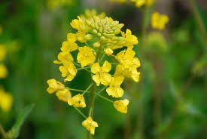
MORPHOLOGY
Flower – Actinomorphic flowers are present.
These flowers contain four sepals , four petals
6 stamen
superior ovary
two carpels
one pistil is present

Slide 10
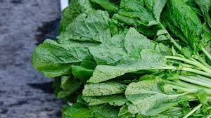
LEAVES
Leaves are opposite.
No stipules are present.
Net venation is seen .

Slide 11
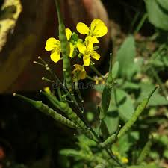
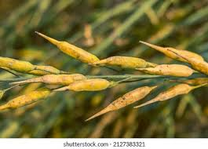
Fruits – The fruit is siliqua or silicula.
It contains short and compressed pod .
Many are slender and long.
Seeds- Seeds are small , spherical, yellow brown to black in colour.
Usually about 1 to 2mm in diameter.
Seeds of brassica posses a glytocyte sinigrin and potassium myronate.

Slide 12
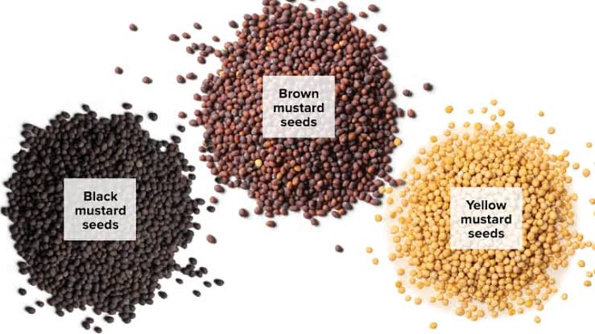
TYPES OF MUSTARD
There are 3 types of mustard
1) Black mustard
2) Brown Indian/ oriental mustard
3) White/Yellow mustard

Slide 13
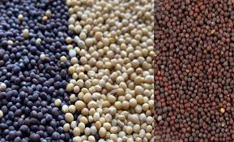
Brown mustard – It is known as oil seed crop in Indian sub-continent, Canada , Great prritain , Denmark, China, US , South ukarine.
Yellow/ White Mustard- It comprises about 90% of countries like Europe, England and Netherland.
Black mustard- It grown in Argentina, US, and some European countries.
Mustard seeds are the production between 450000-700000 tones annually in the world.

Slide 14
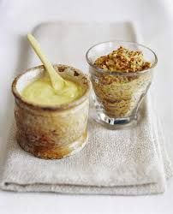
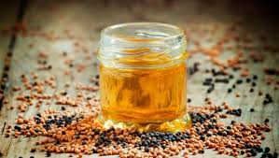
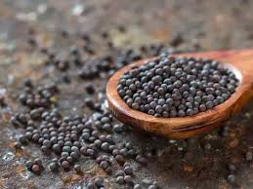
Forms of mustard and Use
1) Mustard Oil
2) Mustard Powder
3) Mustard Cream
4) Mustard Seeds

Slide 15
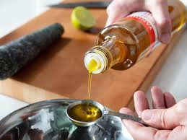
Medicinal Use
Mustard is used as a food flavoring and as a forage crop. It has traditionally been used as an emetic and diuretic, as well as a topical treatment for inflammatory conditions such as arthritis and rheumatism.
Relief from tried feet.
Back ache treating bath .
Sore throat relief.
Medicinally, the essential oil of mustard is an extremely powerful irritant, causing severe blister of the skin.
Cosmetic production
Agrochemical production

