Slide 1
III. Eradication:
Cultural methods B) Physical methods C) Biological methods D) Chemical methods
A) Cultural methods
Rouging: Ex: whip smut of sugarcane
b) Eradication of alternate and collateral hosts: Ex: Barbery eradication programme in France and USA reduced the severity of black stem rust of wheat
c) Crop rotation:
Ex: club root of cabbage (6-10 yrs).
d) Crop sanitation:
e) Manures and fertilizers: Ex: Ganoderma root rot of citrus
f) Mixed cropping: Ex: Root rot of cotton (Phymatotrichum omnivorum) is reduced when cotton is grown along with sorghum.
g) Hot weather ploughing:
h) Soil amendments: Ex: Application of lime (2500 Kg/ha) reduces the club root of cabbage by increasing soil pH to 8.5
i) Changing time of sowing: Ex: Rice blast can be managed by changing planting season from June to September/October.
j) Seed rate and plant density:

Slide 2
k) Irrigation and drainage: Ex: Pythium
B) Physical methods:
Soil solarization: or slow soil pasteurization
First time developed in Israel- Egley and Katan
Hydrothermal process
5-6 weeks during summer
ii. Soil sterilization: 62⁰C
50⁰C- Nematodes, Some oomycetes and other water molds
60 and 72⁰C- Most of the pathogenic fungi and bacteria
82⁰C- Most weeds, plant pathogenic bacteria and insects
95-100⁰C-TMV
iii. Hot water or Hot air treatment:
HWT carried out to Seeds, bulbs and
Ex: Red rot of sugarcane (52⁰C for 30 min)
Loose smut of wheat (52⁰C for 11 min).
iv. Solar seed treatment- Loose smut of wheat

Slide 3
C) Biological methods:
Mechanisms of biological control
Competition: Ex: Siderophores produced by Pseudomonas fluorescens (known as pseudobactins or pyoveridins) helps in the control of soft rot bacterium, Erwinia caratovora.
2. Antibiosis:
a. Antibiotics: Ex: Ex: Gliocladium virens produces gliotoxin that was responsible for the death of Rhizoctonia solani on potato tubers.
b. Bacteriocins: Ex: The control of crown gall (caused by Agrobacterium tumefaciens) by the related Agrobacterium radiobacter strain K 84 is by the production of bacteriocin, Agrocin K84.
c. Volatile compounds:
NH₃, HCN-
Ex: Pythium ultimum, Rhizoctonia solani and Verticillium dahliae- Enterobacter cloacae
3. Hyperparasitism:
Rhizoctonia and Sclerotium- Trichderma harzianum

Slide 4
4. Cross protection: McKinney (1929)
It is defined as inhibition of disease symptoms resulting from the prior of simultaneous inoculation of the host with a closely related species of the pathogen
Ex: Mild strain of Citrus tristeza virus prevent the host damage caused by severe strain of the same virus
5. Induced resistance
Plants respond to a variety of chemical stimuli produce by soil and plant associated microbes
Such stimuli can induce plant host defences through biochemical changes that enhance resistance against subsequent infection by a variety of pathogens
Ex: Trichoderma harzianum- Grey mold of cotton
Pseudomonas fluorescens- Cucumber mosaic virus in tomato

Slide 5
6. Growth promotion
Biocontrol agents enhance the plant growth promotion through induced production of IAA in plants following treatment of seed, root cutting and soil with bacterial and fungal biocontrol agent
Ex: Aspergillus niger AN-27 : Promotes seedling growth and yield in Cauliflower
Trichoderma harzianum: Enhances seed germination in Beans

Slide 6
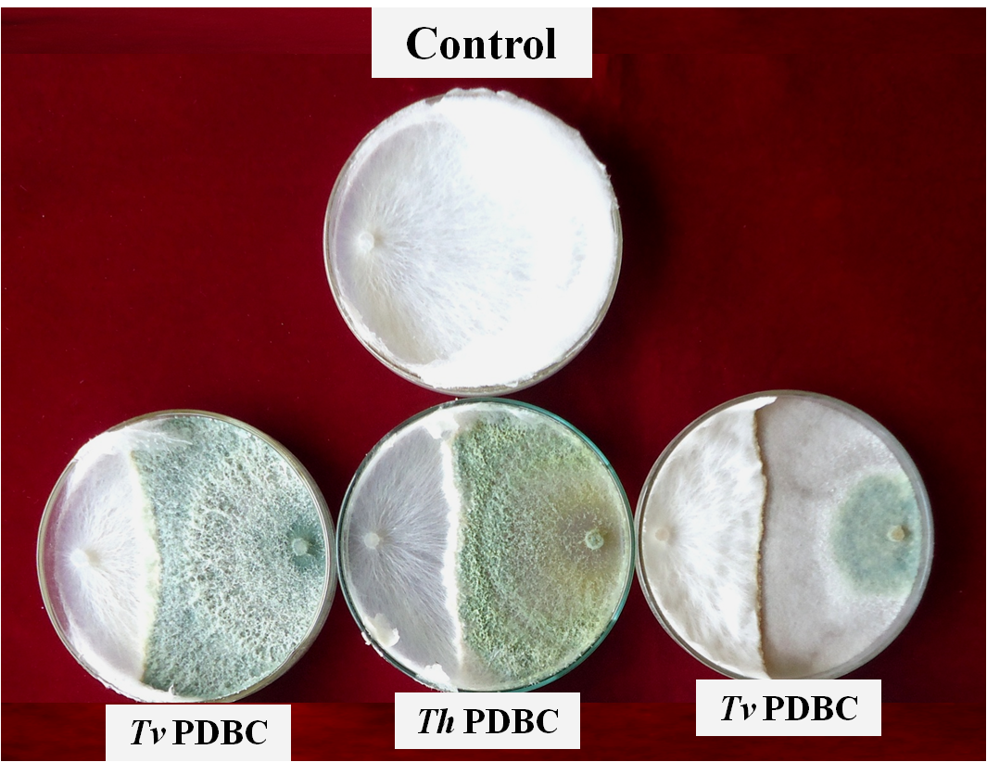
Efficacy of Trichoderma spp. on radial growth of Sclerotium rolfsii

Slide 7
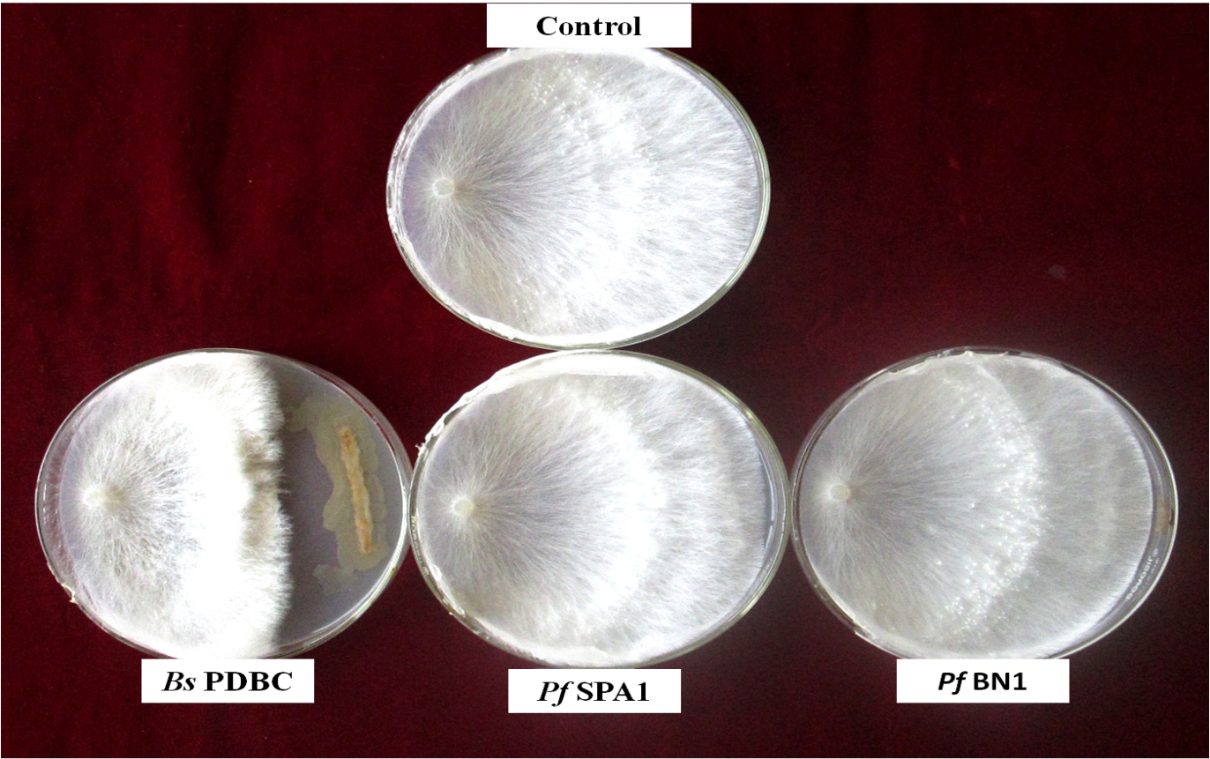
Effect of bacterial antagonists on radial growth of Sclerotium rolfsii

Slide 8
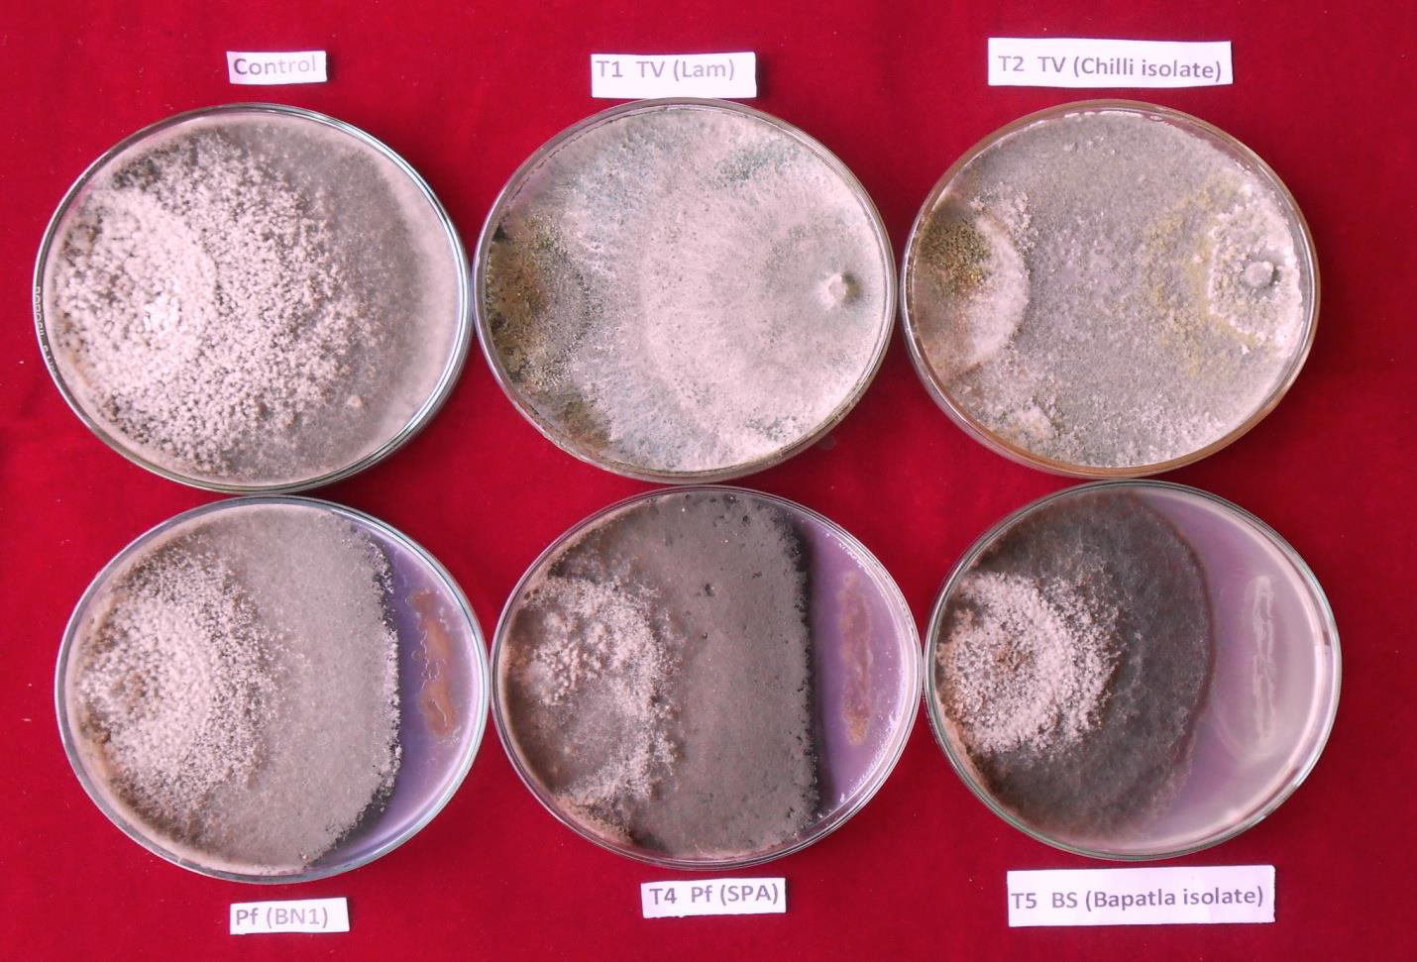

Slide 9
Efficacy of botanicals on Sclerotium rolfsii

Slide 10
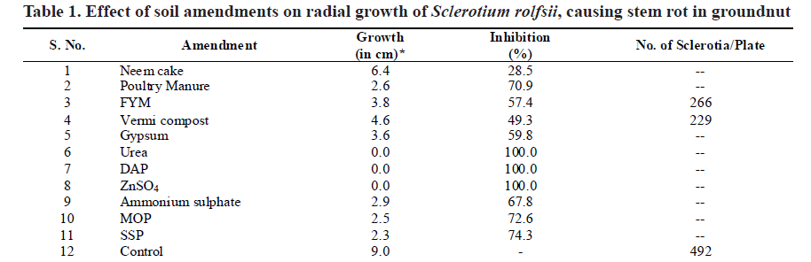

Slide 11
