Slide 1
Lecture 1
Introduction: Importance, scope and objectives of Plant Pathology
INTRODUCTION
Plant Pathology/ Phytopathology
(Phyton=plant, Pathos=suffering, ailment, Logos=study) ie., the study of nature, development and management of plant diseases.
Definition: A branch of Agricultural science which deals with cause,etiology,resulting losses and management of plant diseases.
Pathogen: A micro organism that can incite disease in susceptible plants.
Plant Disease: (dis-un, ease-comfort):It is the malfunctioning of host cells and tissue that results from continuous irritation by a pathogenic agent and leads to development of symptoms.

Slide 2
Symptoms: External or internal reactions or alterations of a plant as a result of disease
Important Phytopathogenic organisms :
1.Fungi 2.Bacteria 3.Fastidious vascular bacteria (RLO’s) 4.phytoplasma 5.viruses 6.viroids 7.Algae 8.Flagellated protozoans .
Plant Pathology relation with other sciences
Virology
Soil Science
Physiology
Mycology
Biochemistry
Plant Pathology
Bacteriology
Genetics
Biotechnology

Slide 3
Importance of Plant Pathology
Plant diseases are of paramount importance to humans because they damage plants and plant products
2. Millions of people all over the world still depend on their own plant produce for their
survival
3. Plant diseases reduce the quality and quantity of plant produce
4. Severe pathological effects on humans and animals that eat plant products
5. Destroy beauty of environment by damaging plants around home, park and forests
6. The pesticides used to control disease, pollute the water and environment

Slide 4
7. Cause financial loss ie., the money spent for plant protection chemicals
8. Changes agricultural pattern
9. Influences the industries ie., lack of raw material
10. Some plant diseases even change food and drinking habits of people
Few examples of serious plant diseases
1. Lateblight of potato- Phytophthora infestans- Irish famine (1845)
2. Brown spot of rice- Bipolaris oryzae- Bengal famine (1942-43)
3. Coffee rust- Hemileia vastatrix (1868), SriLanka
4. Wheat rust- Puccinia graminis f.sp.tritici (1940), USA
5. Southern corn leaf blight- Bipolaris maydis (1970), USA

Slide 5
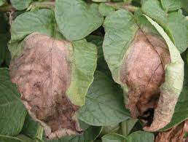
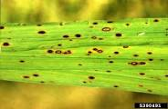
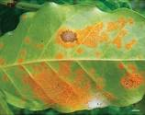
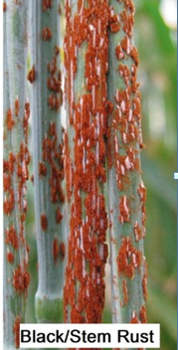
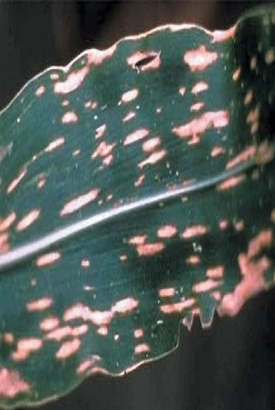
1. Lateblight of potato
2. Brown spot of rice
3. Coffee rust
4. Wheat rust
5. Southern corn leaf blight

Slide 6
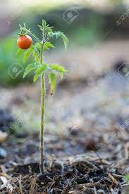
Objectives of Plant Pathology
1. To study the living, non-living and environmental causes of plant diseases
2. To study the mechanisms of disease development by pathogens
3. To study the interactions between the plants and the pathogen
4. To develop the Control method thereby reducing the losses caused by them.

