Slide 1
DISEASES OF RICE

Slide 2
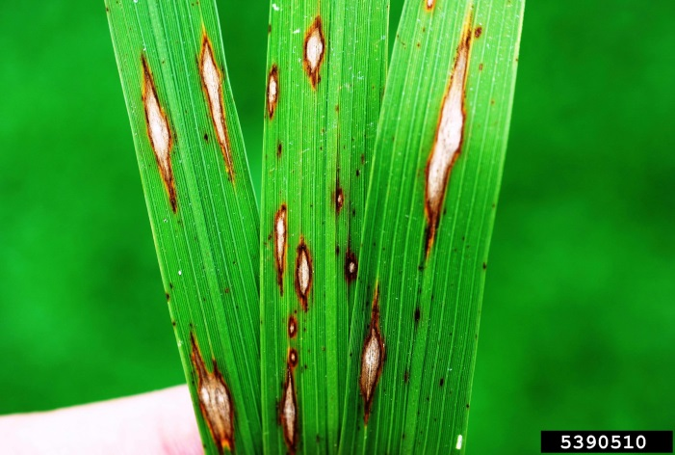
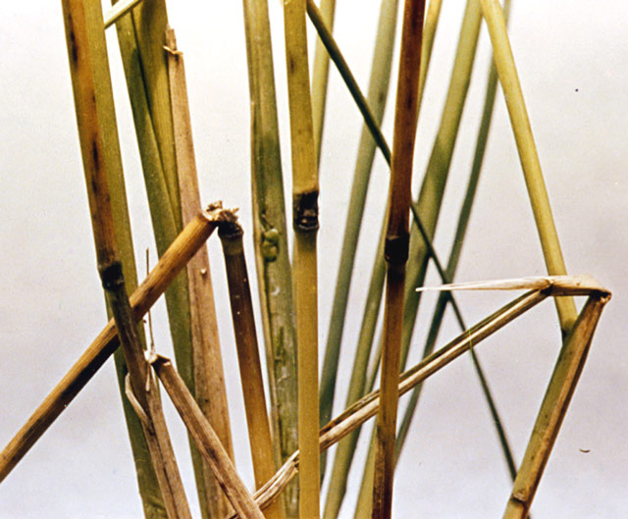
1. BLAST DISEASE
Symptoms
The fungus attacks the crop at all stages from seedlings in nursery to heading in main field. The typical symptoms appear on leaves, leaf sheath, rachis, nodes and even the glumes.
Leaf blast: On the leaves, the lesions start as small specks, soon enlarge and form characteristic spindle shaped spots with grey centre and dark brown margin. The spots join together as the disease progresses and large areas of the leaves dry up and wither.
Node blast: In infected nodes, irregular black areas that encircle the nodes can be noticed. The affected nodes may break up and all the plant parts above the infected nodes may die

Slide 3
Neck blast: When ear emerges the neck of the panicle is infected and it becomes black and shrivelled. This stage of infection is commonly referred to as rotten neck/neck rot/neck blast/panicle blast. In early neck infection, grain filling does not occur and the panicle remains erect like a dead heart caused by a stem borer. In the late infection, partial grain filling occurs.
Causal organism/ Etiology
Pyricularia oryzae (Sub-division: Deuteromycotina)
Perfect stage – Magnaporthe grisea
Conidiophores are simple, 2-4 septate and olivaceous in color
At the tip of conidiophore 3 celled, pyriform- obclavate hyaline to pale olive conidia are formed
The pathogen produces toxins namely piricularin, pyriculol, α-picolinic acid

Slide 4
Disease Cycle
Primary Infection – Mycelium & Conidia in the infected straw & seeds
Secondary Infection – Conidia spread by wind and rain splashes
Epidemiology/ favourable coditions
The fungus causes infection rapidly at a temperature of around 24-28°C
A high relative humidity(92%), cloudy weather, dew deposition favours disease development

Slide 5
Disease Management
Planting disease free seeds
Judicious application of nitrogenous fertilizers
Spraying fungicides e.g. Kitazin, carbendazim, bavistin
Application of antibiotics e.g. Blasticidin, Kasugamycin @ 20 ppm
Cultivation of blast resistant varieties like IR-8, IR-36, Jaya, Swarnadhan.

Slide 6
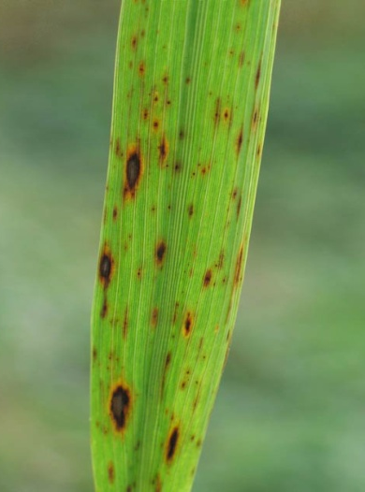
2. Brown spot of rice
This disease is also referred to as fungal blight
This disease is the principal cause of the famous Bengal Famine in 1942-43
Symptoms
Brown colour, round to oval spots appear on the leaf and leaf sheath
In severe case the spots coalesce to form large patches of withered tissues
The grains also become infected and black colour spots appear on glumes

Slide 7
Causal Organism:
Helminthosporium oryzae (Deuteromycotina)
(Sexual stage: Cochliobolus miyabeanus)
Sporophores arise as lateral branches from the hyphae and bears conidia. Typical conidia are slightly curved, widest at the middle and tapering toward the apex. Mature conidia are brownish with a moderately thin peripheral wall. The pathogen produces toxin namely cochliobolin/ ophiobolin.
Disease Cycle
Primary infection – Fungal mycelium surviving in infected plant parts and seeds (seed borne) and on collateral hosts (Leersia hexandra, Echinocloa colona, Pennisetum typhoides)
Secondary infection – Conidia spread through wind and water.

Slide 8
Epidemiology
The fungus requires 25-30°C temperature and 90% or more RH for infection.
Excessive nitrogenous fertilizer application and cloudy weather aggravates the disease.
Disease Management
Seeds should be treated with Thiram, organomercurial before sowing
Cultivation of resistant varieties e.g. Padma, IR-24, Co-20, CH. 13, CH. 45
Seedlings should be sprayed with Dithane-Z-78
Spray the crop in the main field twice with Carbendazim + Mancozeb @0.2%, first after flowering and second spray at milky stage.

Slide 9
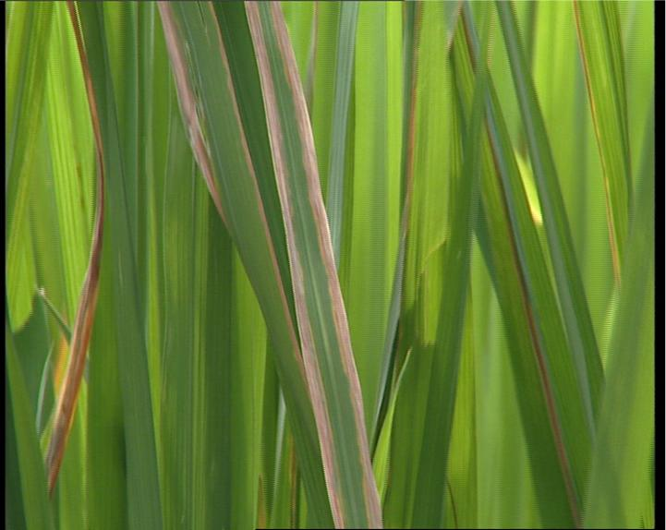
3. Bacterial blight
Symptoms
The bacterium induces either wilting or leaf blight or sometimes yellowing of leaves
Wilting known as Kresek occurs within 3-4 months after transplanting. It results in wilting of few leaves or death of plant
In leaf blight phase dull greenish water soaked or yellow spots appear on tips and margins of leaves
The lesions extends along margins to the leaf sheaths, coalesce to form straw color or blighted lesions
The inner margin of lesions become wavy

Slide 10
Sometimes droplets of bacterial ooze pale amber colour found on affected portions
In severe infections all leaves are attacked and premature drying results
Causal organism:
Xanthomonas oryzae pv. oryzae
Bacterium is rod shaped, gram negative, aerobic with polar flagellum

Slide 11
Disease Cycle
Primary infection - Bacterium overwintering in seed, soil or in plant stubbles
Secondary infection – Bacterial ooze
Epidemiology
Heavy rain with severe wind, heavy dew, deep irrigation water, and temperature of 22-26⁰C favours disease development. Application of excessive nitrogen and plants in shade are more prone to disease

Slide 12
Management
Grow resistant cultivars like Swarna, Ajaya, IR 20, IR 42, IR 50, IR 5.
Affected stubbles are to be destroyed by burning or through ploughing
Judicious use of nitrogenous fertilizers
Seed treatment with Agrimycin @0.025% and wettable Ceresan @0.05% followed by hot water treatment at 52-54°C for 10 mins eradicates bacteria
Seed treatment with Streptocycline @ 0.01 %.
Spray Streptocycline @ 0.01 % and Copper oxychloride @ 0.3%.

