Slide 1
SEXUAL REPRODUCTION
1) Sexual reproduction involves union of two compatible nuclei or sex cells or sex organs or somatic cells or somatic hyphae for the formation of new individuls.
2)Sexual stage is perfect stage and technically called as teleomorphic stage. Sexual spores or sexual structures which contain sexual spores are thick walled, resistant to unfavourable conditions .
Phases in Sexual reproduction:.There are 3 phases in sexual reproduction.
1. Plasmogamy: union of two protoplasts takes place.As a result of it the two nuclei come together within the same cell.
2. Karyogamy: union of 2 sexually compatible nuclei brought together by plasmogamy to form a diploid nucleus (2n) i.e., zygote.
3. Meiosis: This is reduction division . The number of chromosomes is reduced to haploid ( n ) i.e., diploid nucleus results into haploid nucleus.
Dikaryon : A pair of genetically different nuclei, lying side by side without fusion for a considerable period of time is called dikaryon.A cell containing dikaryon is called dikaryotic cell. And the process is known as dikaryogamy.
Methods of sexual reproduction : 5 methods.
1. Planogametic copulation. 2. Gametangial contact 3. Gametangial copulation
4. Spermatisation 5. Somatogamy .

Slide 2
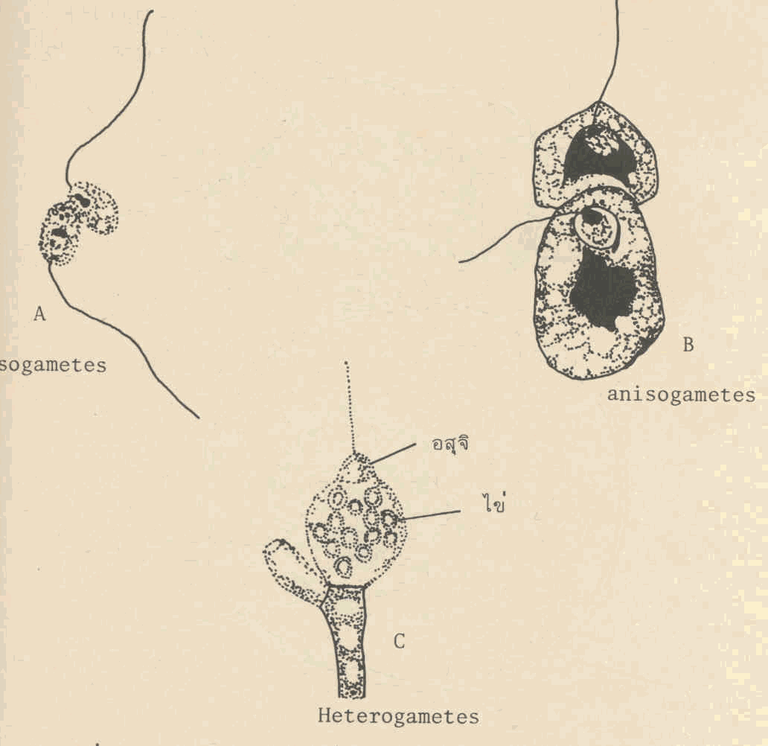
1.Planogametic copulation ( gametogamy ): This involves the union of two naked gametes one or both of which are motile.
a.Isogamy (Isogamous planogametic copulation) : If both gametes are motile and similar.Eg. Plasmodiophora brassicae.
b.Anisogamy (Anisogamous planogametic copulation) : If both gametes are motile but dissimilar.E g. Allomyces macrogynus
c.Heterogamy: If gametes are dissimilar, one motile, another is non motile. Eg. Monoblepharis polymorpha.

Slide 3
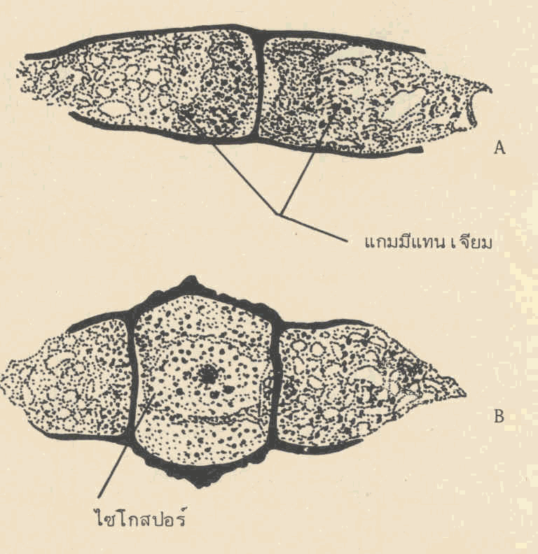
2.Gametangial contact ( gametangy / oogamy ): The conte nts of male gametangium migrate into female gametangium through a pore or fertilization tube.
Eg. Pythium aphanidermatum.
3.Gametangial copulation: The isogametangia come in contact, their intervening wall dissolves leading to fusion of entire contents of two contacting gametangia to form a single unit.
Eg. Rhizopus stolonifer.

Slide 4
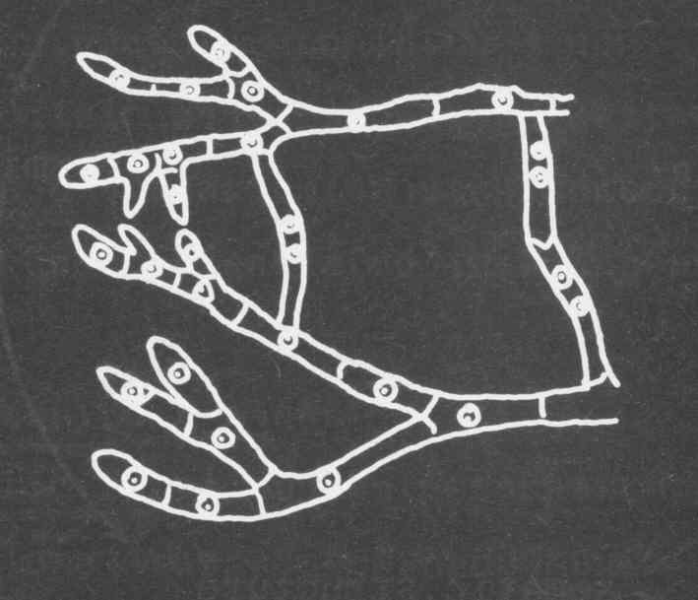
4 Spermatization:Spermatia and receptive hyphae come in contact and contents of male spermatium migrate into female receptive hypha, thus making the cell binucleate.
Eg. Puccinia graminis tritici.
5.Somatogamy: Many higher fungi do not produce sex organs.In such cases somatogamy takes place.It is the union of 2 somatic hyphae or somatic cells representing opposite sexes to form sexual spores
.Eg. Agaricus campestris

