Slide 1
IDENTIFICATION OF GARDEN TOOLS AND IMPLEMENTS

Slide 2
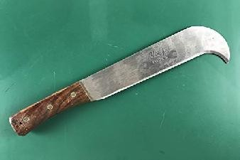
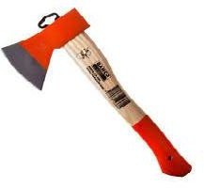
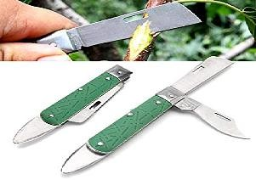
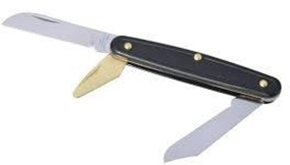
AXE BUDDING KNIFE BILL HOOK
BUDDING CUM GRAFTING KNIFE PICK AXE CARPENTER’S SAW

Slide 3
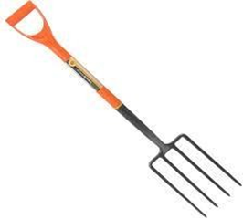
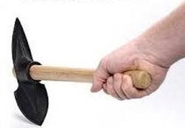
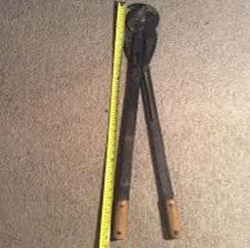
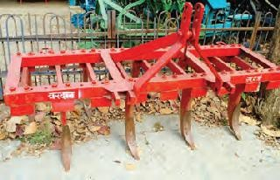
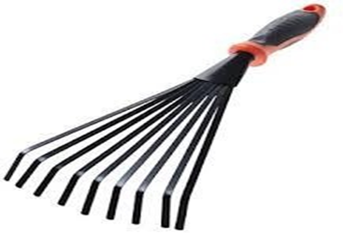
DIGGING FORK HAND HOES DRAINAGE HOE
FORESTERS’ SHEAR CULTIVATOR GARDEN HAND RAKE

Slide 4
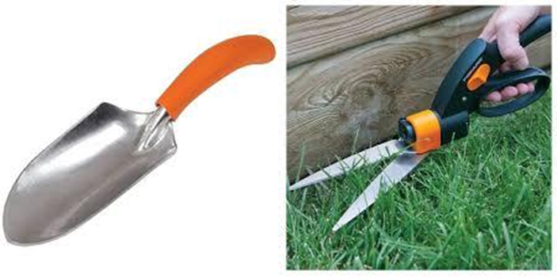
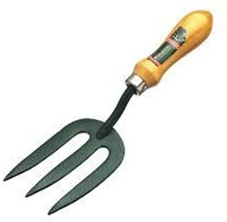
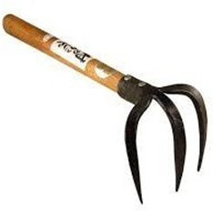
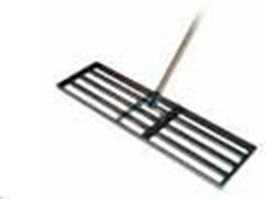
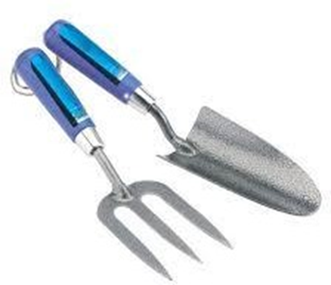
GARDEN TROWEL GRASS SHEAR HAND FORK
HAND CULTIVATOR HAND LAVELLER KHURPI

Slide 5
PRUNING KNIFE PRUNING SHEAR PRUNING SAW
SPADE TREE PRUNER TREE CALIPERS

Slide 6
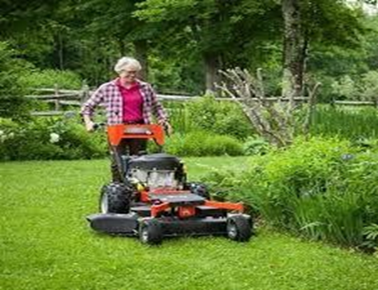
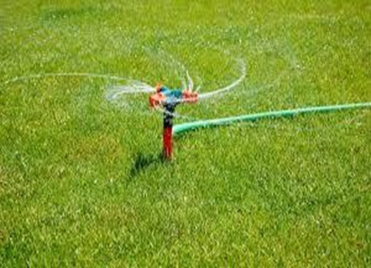
LAWN MOWER LAWN SPRINKLER

Slide 7
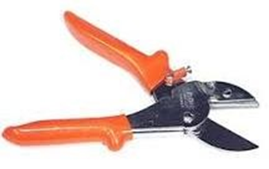
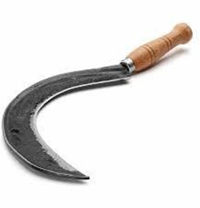
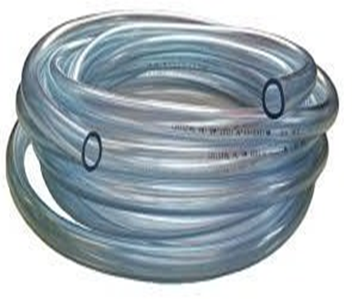
SECATEUR SICKLE HOSE PIPE

