Slide 1
Disease: Deviation from normal physiological functions of the host due to attack
by the pathogen
TERMS AND CONCEPTS USED IN PLANT PATHOLOGY
Disorder: Non-infectious plant diseases due to abiotic causes
Pathogen: Living microorganism which can causes disease
Parasite: An organism survive and draw nutrition from other living organism
Pathogenicity: The ability of an organism to cause disease
Pathogenesis: Chain of events in the disease development
Sign: The physical evidence of the pathogen

Slide 2
Symptom: External or internal changes in the plant as a result of disease
TERMS AND CONCEPTS USED IN PLANT PATHOLOGY
Syndrome: The totality of various symptoms are collectively called
Biotroph: An organism that can derive nutrition only from living organism
Hemibiotroph: An organism that can attack hostl ike biotroph but continue to grow
and derive the nutrition after death of the host
Perthotroph : Pathogen kills the host in advance of penetration
Inoculum: Part of he pathogen which can cause disease
Incubation period: The time interval from penetration till the appearance of
first symptoms

Slide 3
Inoculum potential: The energy of a parasite available for infection to the host
TERMS AND CONCEPTS USED IN PLANT PATHOLOGY
Predisposition: Set of environmental conditions which makes the host vulnerable to
attack by the pathogen
Hypersensitivity: Extreme sensitivity of cells and tissues killed around the infection
Infection : Establishment of host parasite relationship in the host
Systemic infection: Pathogen doesnot produce symptoms from point of infection to varying
extents through it passes

Slide 4
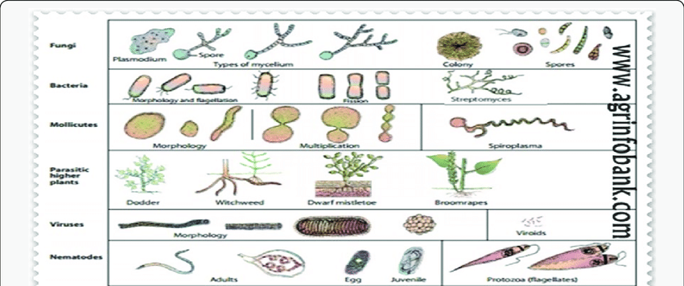
Epidemic disease: Ex: Late blight of potato – Irish famine (1845)
Endemic: Ex: Black wart of potato – Synchytrium endobioticum
Sporadic disease: Ex: Angular leaf spot of cucumber – Pseudomonas lachrymans
Pandemic: Wheat rust- Ug 99 of Puccinia graminis tritici
Various plant pathogens

Slide 5
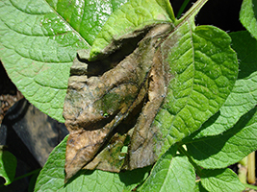
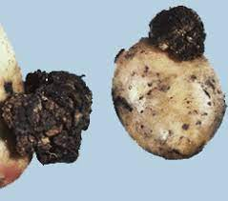
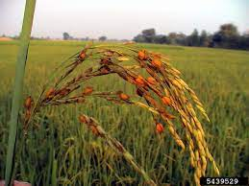
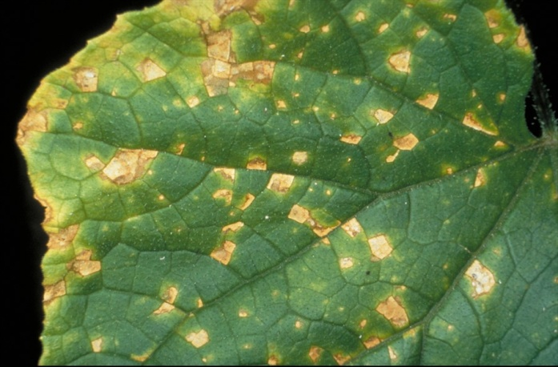
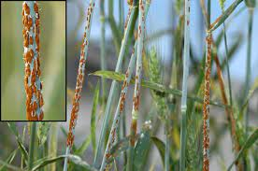
Late blight of potato
Black wart of potato
Cucumber angular leaf spot
Rice false smut
Black stem rust of wheat

