Slide 1
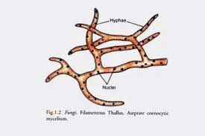
Types of fungal thalli:
1.Plasmodium (plasma = moulded body): It is a naked,multinucleate mass of protoplasm moving and feeding in amoeboid fashion .Eg. Plasmodiophora brassicae.
2.Unicellular thallus: consisting of a single cell. Eg.Chytrids, Synchytrium
3.Multi cellular or filamentous thallus: Majority of fungi i.e., a true fungi are filamentous, consisting of a number of branched, thread like filaments called hyphae.Eg.Many fungi,Alternaria.
Plasmodium
Unicelluar thallus
Filamentous thallus

Slide 2
Fungal tissues: Plectenchyma : Fungal tissues are called plectenchyma i.e., mycelium becomes organized into loosely or compactly woven tissue. This tissue compose various types of vegetative and reproductive structures.
Types of plectenchyma:
1.Prosenchyma: It is a loosely woven tissue. The component hyphae retain their individuality which can be easily distinguishable as hyphae and lie parallel to one another.Eg. Trauma in Agaricus.
2. Pseudoparenchyma:It is compactly woven tissue. It consists of closely packed cells which are isodiametric or oval in shape resembling parenchymatous cells of plants and hence the name. The component hyphae loose their individuality and are not distinguishable as hyphae.
Eg. Sclerotial bodies of Sclerotium and rhizomorph of Armillariella.

Slide 3
1 Prosenchyma
2 Pseudoparenchyma

