Slide 1
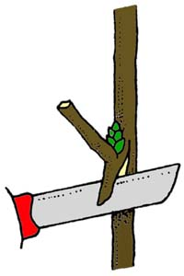
Asexual reproduction
BUDDING

Slide 2
Definition
Budding – the process of connecting scion (bud), and rootstock in a manner such that they may unite and grow successfully as one plant is termed as budding.
Scion – It is a detached portion from parent plant which is added on rootstock to develop new plant.
Rootstock – It is the base and root portion of a grafted/budded plant.

Slide 3
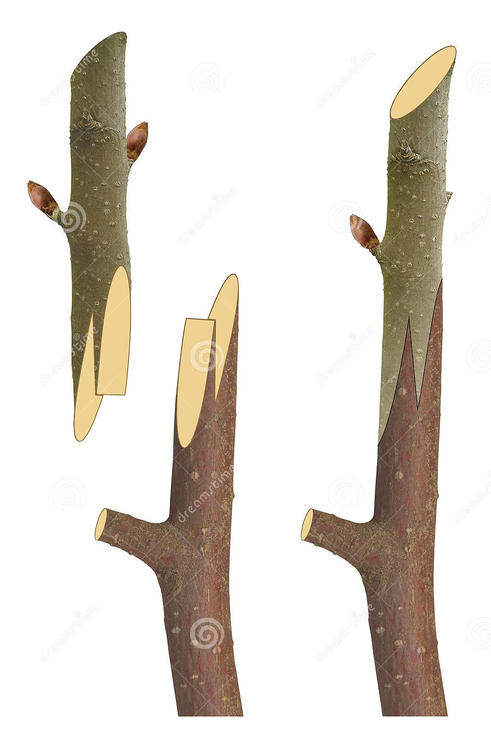
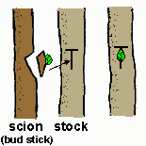
Scion
Rootstock

Slide 4
Types of budding
Shield/T budding
Patch budding
Chip budding
Ring budding
Modified ring budding
Forkert budding
Modified forkert budding

Slide 5
Shield/T budding
Boat shaped bud of 2.5-3cm length is used for budding.
Vertical or T shaped or inverted T shaped insertion is made on the rootstock to insert the bud.
Budding is made at a height of 10-25cm on rootstock and wrapped with a air tight polythene tape leaving the bud exposed.
Ex : Rose, Apple, Peaches, Sweet Oranges etc.

Slide 6
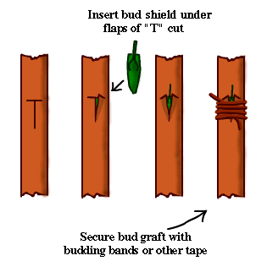

Slide 7
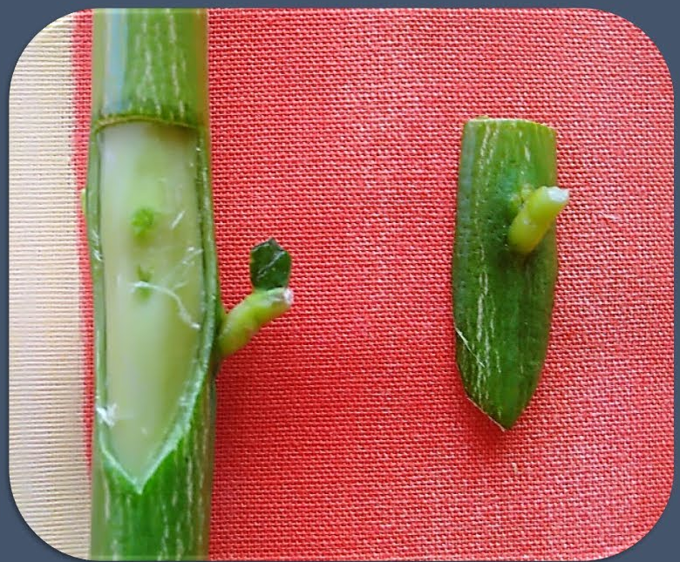
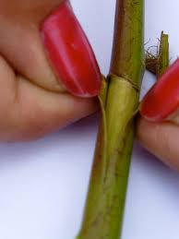
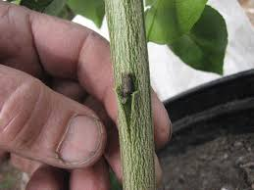
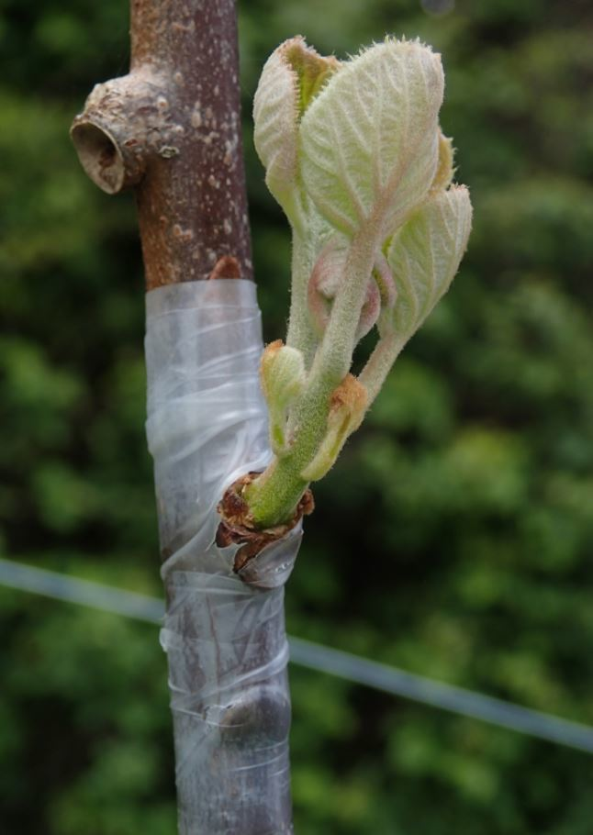

Slide 8
Patch budding
Square or rectangular shape bud is taken out from scion shoot.
Similar incision (2-3cm) is made on the rootstock.
The bud is placed on the root stock.
It is wrapped with a air tight polythene tape leaving the bud exposed.
Ex : Jackfruit, Aonla, Mango, Jamun etc.

Slide 9
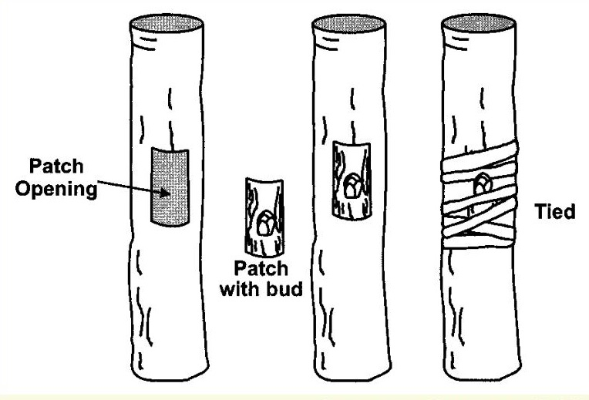

Slide 11
Chip budding
Chip budding is done in early spring, summer or autumn.
The bud is taken out from scion shoot along with the wood.
Similar size incision is made on the rootstock.
The bud is placed on the rootstock and it is wrapped with polythene tape.
Ex: apple, pear and grapes.

Slide 12
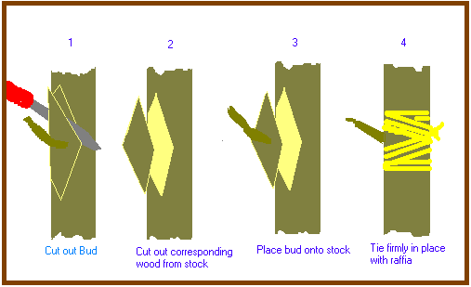

Slide 13
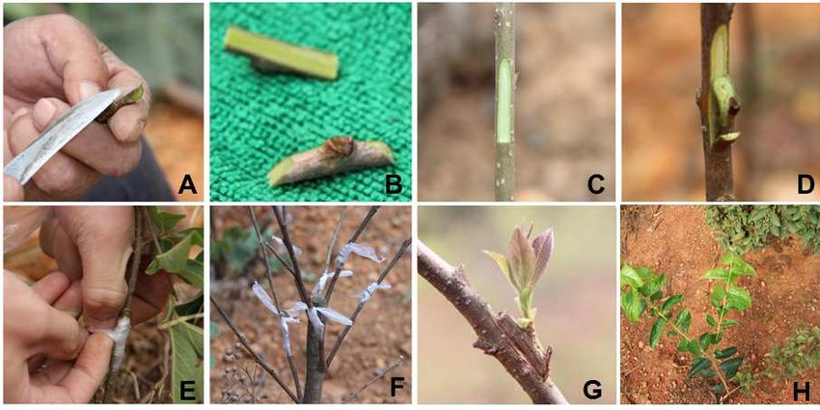

Slide 14
Ring budding
A ring shaped bark of 2.5-3.0cm length containing a bud is taken out from scion shoot.
The thickness of stock and scion should be of same size.
On the terminal end of the stock, incision similar in size of the bud is made.
The ring is made fit on the rootstock.
No wrapping is required in this method.
Ex: Ber, Peach and Mulberry.

Slide 15
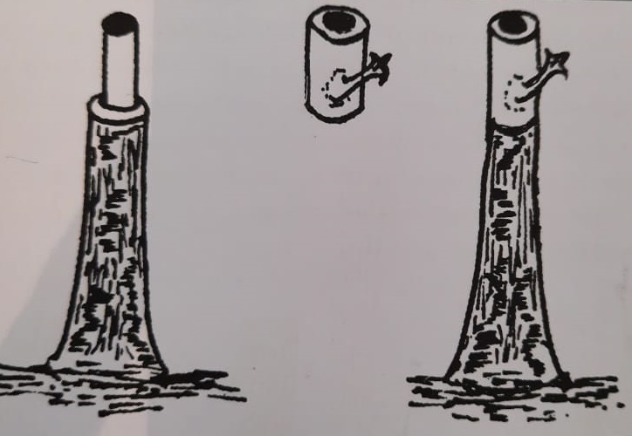

Slide 16
Modified ring budding
The bud wood/bark is taken from the scion with a vertical slit.
Similar size bark is removed from the rootstock.
It is wrapped with a air tight polythene tape/ paraffin wax leaving the bud exposed.
Ex: Guava, Ber, Walnut And Pecanut.

Slide 17
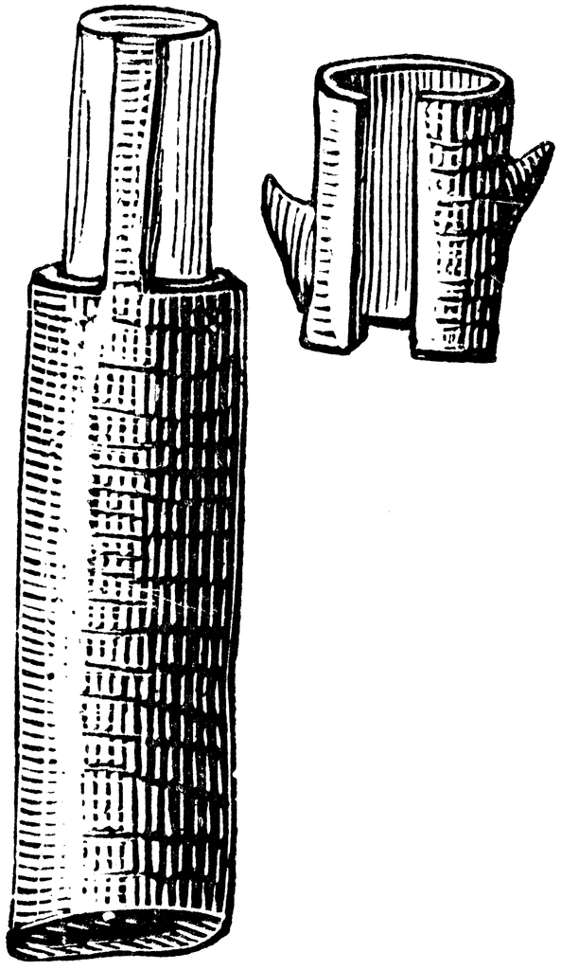

Slide 18
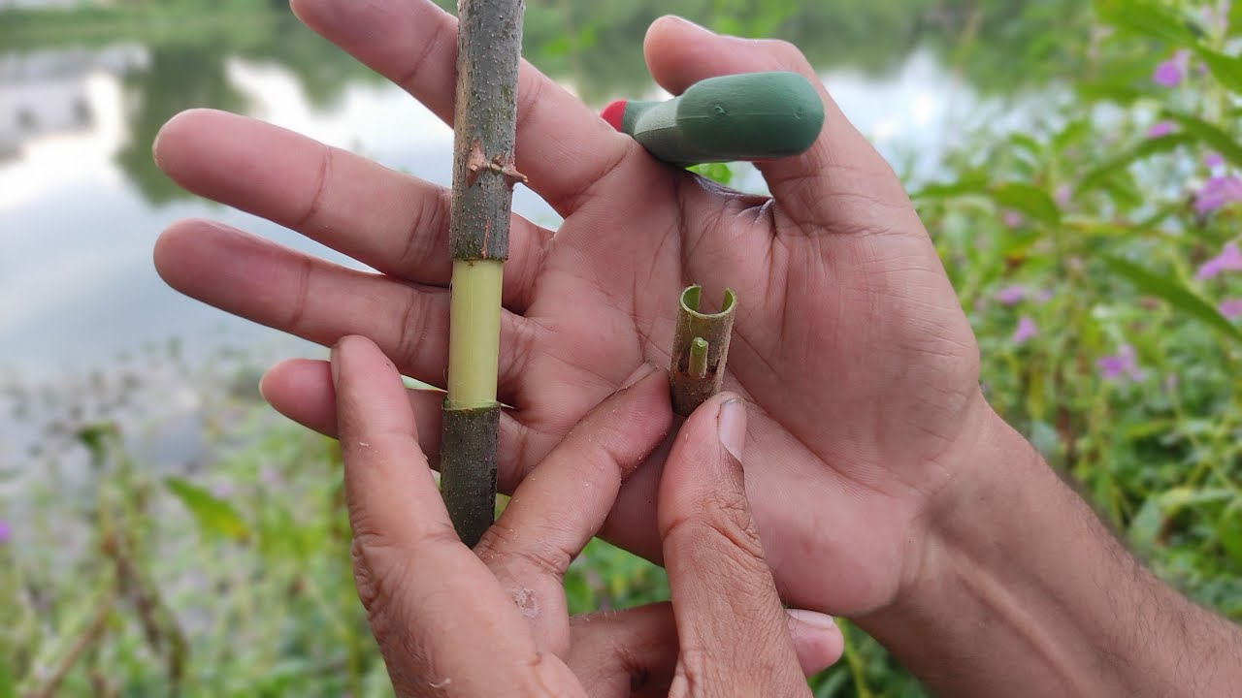

Slide 19
Forkert budding
In forkert budding, the stock is prepared by giving two vertical cuts and a transverse cut above the vertical cuts to join them.
The bark is removed carefully along the cuts, so the flap of bark hangs down.
The scion is prepared in a fashion similar to patch budding, having the size similar to cuts made on the stock.
The scion is then slipped into the exposed portion of the stock and the flap is drawn over the inserted bud patch.
It is then tied with a suitable wrapping material.
After successful growth of bud, the portion of stock above the union is removed carefully.
Ex: Mango, Cashew Nut, Mango etc.

Slide 20
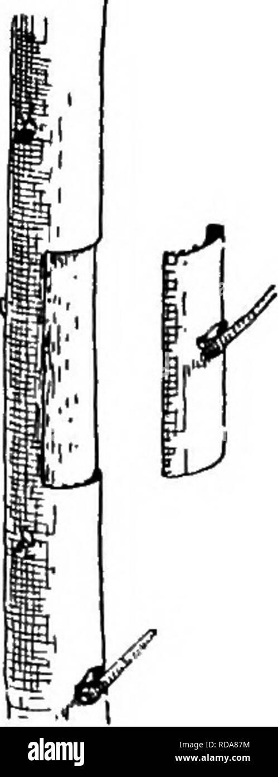

Slide 21
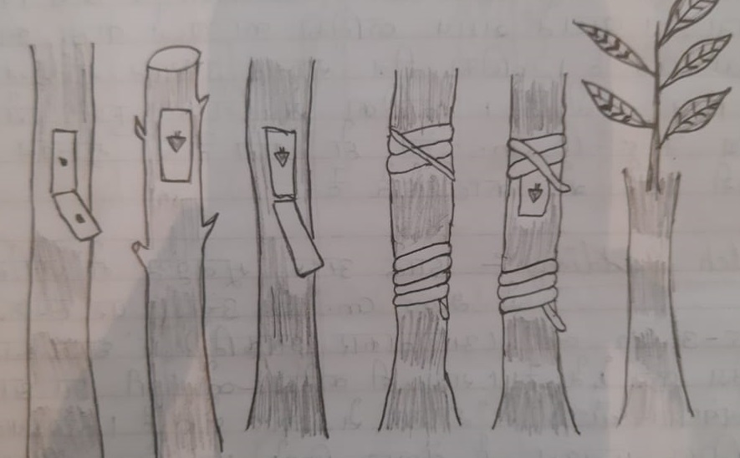

Slide 22
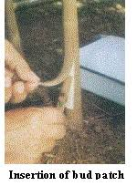

Slide 23
Modified forkert budding
It is similar to forkert budding.
The vertical flap of the bark is covered to base portion of the bud only.
Thus, the need to remove flap as in forkert method is not required.

Slide 24
Thank you

